Slide 1
The Trouble With English
Why is it so difficult to teach kids to read?
Dr. Rosalind R. Gann
Associate Professor of Curriculum and Instruction
East Tennessee State University
Blount County Schools Reading Conference May 27, 2010

Slide 2
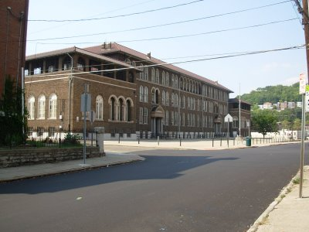
Personal notes …
I have been at ETSU for 8 years. I teach Reading and Language Education at ETSU, and have a small private practice where I work with people with reading difficulties
I grew up in Brooklyn, New York, where I attended P.S. 206.
Before coming to ETSU, I was a reading specialist and English teacher in the Cincinnati Public Schools.
My early career was in clinical social work.

Slide 3
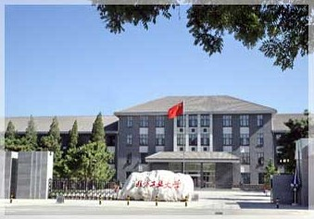
Once more, I am learning to read and write.
明天我要出北京。
This brings us to an important point: reading is a language function. When we claim we can read and write, we are generalizing!
More about this later.

Slide 4
I know your experience is different from mine… so tell me about you!
Where did you go to school?
What grades have you taught and for how long?
What went well this year in the teaching of reading?
What were your frustrations in teaching reading this year?
What do you hope I can help with?

Slide 5
Reading is always done in a particular language. Ours is especially difficult…
Writing systems evolve over millennia.
Pronunciation changes over time. Spelling usually stays the same.
English is a fusion of several languages. In addition, words were absorbed from other languages. We usually keep the foreign spelling, even when we change the pronunciation of the new word.

Slide 6
Because we have read this language all our lives, we underestimate its difficulty.
Consider:
have/cave
comb/bomb
of/love
though/ throw
wound/ bound
cord/ word
stuff/ enough
now/ crow
teen/ been
has/was
We could go on.

Slide 7
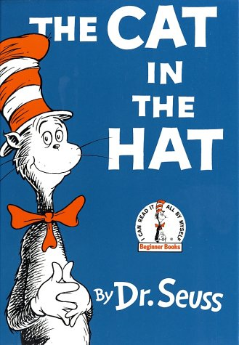
Not all words are all irregular
But children who are first learning the system often experience confusion. This is especially so for the children who have had minimal exposure to print before entering school.
--cat
--hat
--bat

Slide 8
How does anyone read in this language? The four cuing systems in reading
Graphophonic
Semantic
Syntactic
Pragmatic

Slide 9
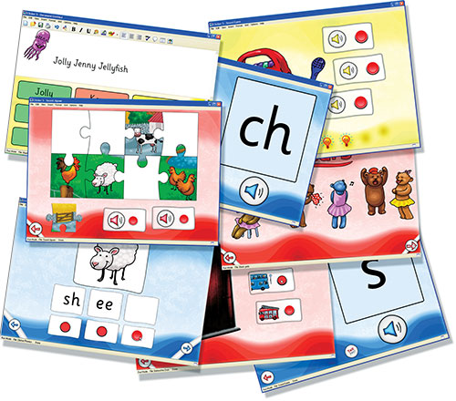
Graphophonic system
Decoding of words
Identify patterns and connect them with spoken code.

Slide 10
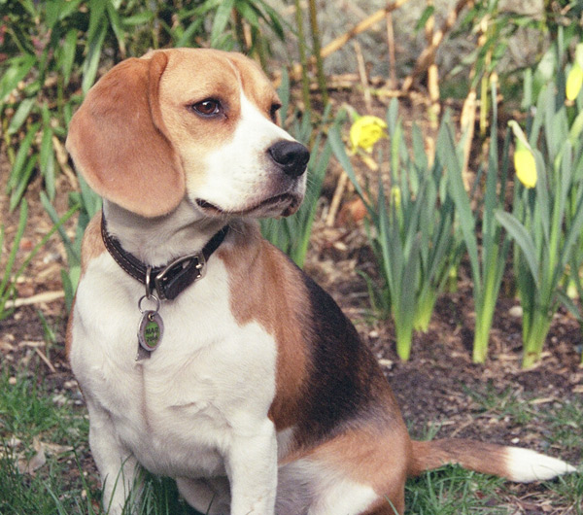
Semantic Cuing system
Use of context clues.
I have a pet …
bog
or maybe it’s dog?

Slide 11
Syntactic cuing system
Utilizes grammatical cues.
He now the prize?
Maybe it’s
He won the prize.

Slide 12
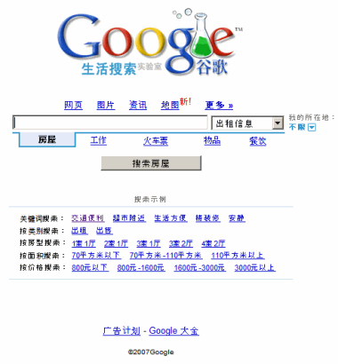
Pragmatic Cuing System
Reading based on experience and practical use.
Is it “really” reading? Depends on your definition of reading.

Slide 13
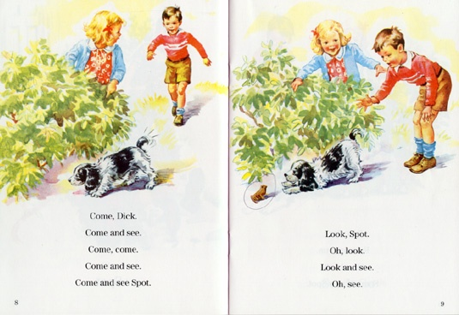
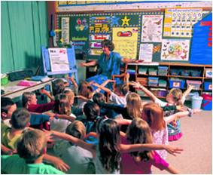
There are three ways you can teach people to read English…
…and they all have problems.
You can emphasis the connection between written symbols and what we say (phonics).
You can build on awareness of context (whole language).
You can emphasize sight memorization.
None of these methods works well. So we change what we do every 20-30 years.

Slide 14
Phonics is based on…
The assumption that we read by sounding out words.
Experienced readers use it to decode and pronounce unfamiliar words.
Try to spell the following words
Notes:
Try to spell:
Cosmogeny
Abjure-- renounce under oath
heteromorphic adj. Deviating from the normal form or standard type
mawkish adj. Sickening or insipid.
peccant adj. Guilty.
syneresis n. The coalescence of two vowels or syllables, as e'er for ever.

Slide 15
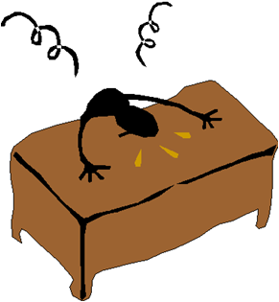
Why phonics is problematic
Phonics presupposes regularity.
There are definite patterns of encoding, but these are not entirely consistent:
Mind/ blind
Tough/ plough
Do
Are/ fare
of

Slide 16
Types of phonics instruction
Sound segmentation:
c-a-t
Onset and rime:
-at
cat
bat
hat

Slide 17
Phonics can become abstract
For some children, it becomes divorced from language.
What does M-i-l-k
Mean?
Somewhat less likely to happen with the onset/rime system.

Slide 18
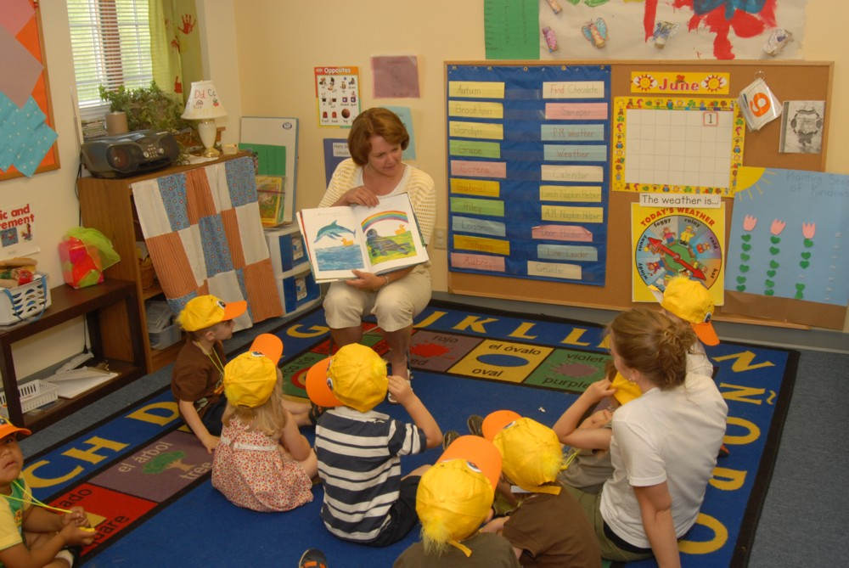
Whole language works sometimes
Some children acquire the written form of the language by experience and observation.
Works best for children from highly literate families.

Slide 19
Sight memorization
Out of favor in these times.
Less emphasized.
All of us use it.
Do you really “sound out” a word such as ‘of’?
What’s the problem with shape charts?

Slide 20
Bottom line
No method works all the time in all cases
Many children learn in whatever way they are taught.
Not all children can learn to read in a class of 25-30.
Instructional packages are not the entire answer.
Teaching is an art: necessary to toggle back and forth between methods for some kids.

Slide 21
Reading is not a political process
What we do is influenced by politics.
To many politicians, phonics sounds better because it appears more disciplined.
Actually, it’s a matter of how people learn.

Slide 22
What's the goal of reading?
Is it about sounding out words?
Or is it about comprehension?
Sometimes methods become ends in themselves.

Slide 23
Why does this happen?
Accountability is another word for checking up.
Standardized tests are imposed on us from the outside.
Reading is fundamentally a mental activity and cannot be measured directly

Slide 24
21st Century jobs
Increasingly require literacy at upper levels.
Not all HS and college graduates are where they ought to be.
These studies looked at textual literacy. There are other types, which younger people are proficient at.
However, text literacy continues to be important.
This is why politicians are so concerned about education in general and literacy in particular.

Slide 25
Let your voice be heard!
Enter the political process.
Seek to influence educational policy
Be active politically.
Run for office

Slide 26
Want a handout?
A copy of this powerpoint is available at:
http://faculty.etsu.edu/gannr/handouts.htm

Slide 27
Keep in Touch
Dr. Rosalind R. Gann
Associate Professor of Reading and Language Education
East Tennessee State University
Box 70684, Johnson City TN 37614
gannr@etsu.edu
Office phone: 423-439-7596
Home phone: 423-434-0105

