Slide 1
Craftsmanship
By Mike Rogers
November 19th, 2014

Slide 2
Introduction
What is not craftsmanship
What craftsmanship is
Why craftsmanship can be rare
Why craftsmanship can be time consuming
Why craftsmanship can be expensive
The benefits of craftsmanship

Slide 3
What is not craftsmanship?
Coding software is not production
Is not an assembly-line manufacturing process
It is not that pesky dialog box asking “Are you sure?”
Is not quite the correct term for making software
Coding software is not always about craftsmanship

Slide 4
What is craftsmanship?
Craftsmanship is mainly about design
Design adds value much faster than it adds cost
The last 1% of the code takes 90% of the time
Only 1% of users ever “sees” this code
A craftsman will take the extra effort in making rare test cases work more than the main code

Slide 5
CityDesk 3.0 Example
Open the file
Read it into a big byte array
Store the byte array into a record

Slide 6
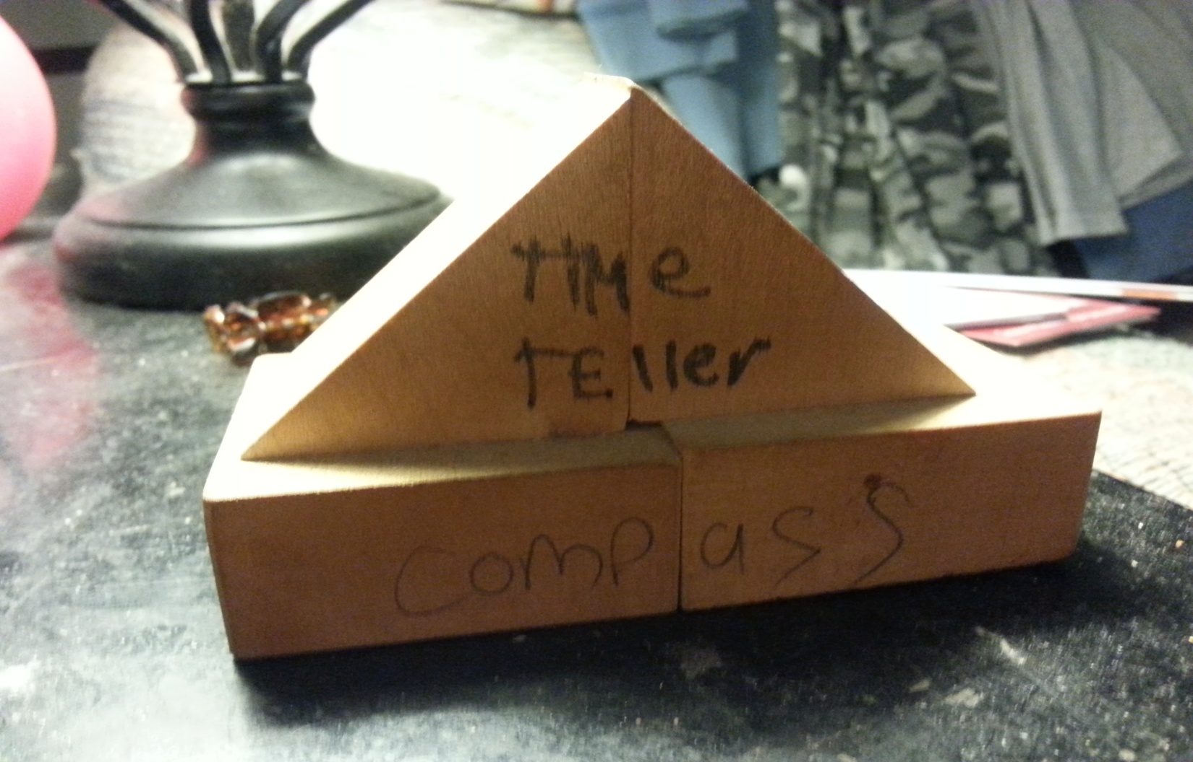
What it is definitely not

Slide 7
What is it really?
Sometimes fixing a 1% defect takes 500% effort
A craftsman will take a lot of time just to get something right
Due to all that effort most software artifacts are only 99% good not 100% good

Slide 8
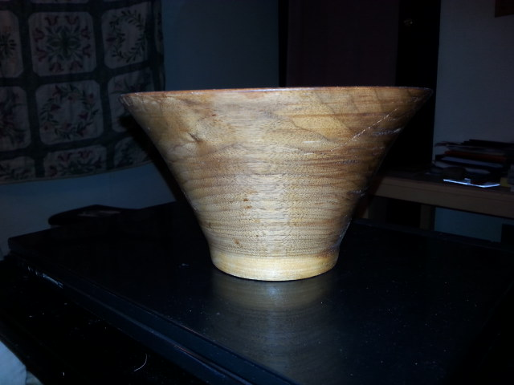
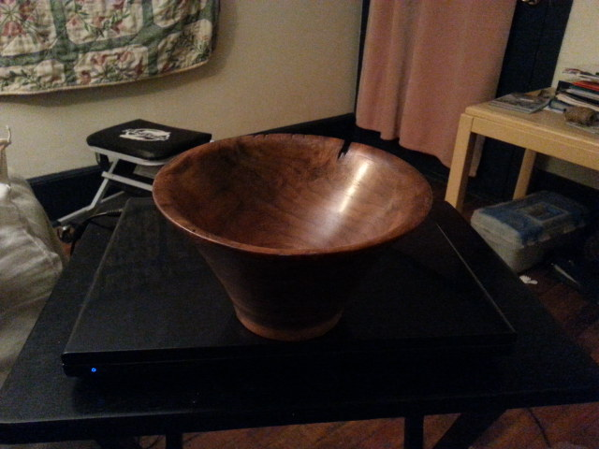
Craftsmanship to me

Slide 9
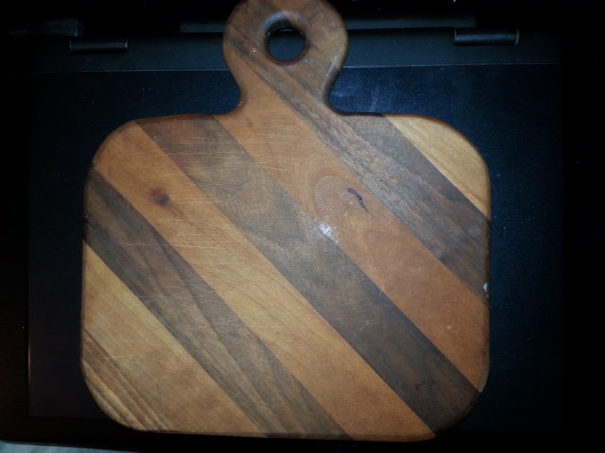
Craftsmanship to me(cont.)

Slide 10
Why it can be rare
Craftsmanship is incredibly expensive
The only way to afford true craftsmanship is to develop for a much larger audience
Internal house applications will never see a high level of craftsmanship because there are not enough users to spread the cost out

Slide 11
Why it can be time consuming
Tracking down and fixing elusive bugs in order to perfect the program takes time
The algorithm for how a program does something specific could take a long time to develop
The solution may not be readily apparent

Slide 12
Why it can be expensive
Craftsmanship means more time trying to get something just right
More time means paying more developers to work on perfecting existing product when it could be spent on new projects, therefore potentially costing new money
More time and more developers means lots of money being spent

Slide 13
Benefits of craftsmanship
“For a shrink-wrapped software company a high level of craftsmanship is precisely what delights users and provides longstanding competitive advantage.”

Slide 14
Summary
What craftsmanship is
What craftsmanship is not
Why craftsmanship can be rare
Why craftsmanship can be time consuming
Why craftsmanship can be expensive
The benefits of craftsmanship

Slide 15
End
Questions?

