Slide 1
The Trouble With Textbooks
Why are textbooks so difficult to read?
Dr. Rosalind R. Gann
Associate Professor of Curriculum and Instruction
East Tennessee State University
Blount County Schools Reading Conference May 27, 2010

Slide 2
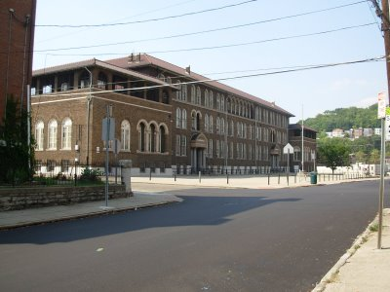
Personal notes …
I have been at ETSU for 8 years. I teach Reading and Language Education at ETSU, and have a small private practice where I work with people with reading difficulties
I grew up in Brooklyn, New York, where I attended P.S. 206.
Before coming to ETSU, I was a reading specialist and English teacher in the Cincinnati Public Schools.
My early career was in clinical social work.

Slide 3
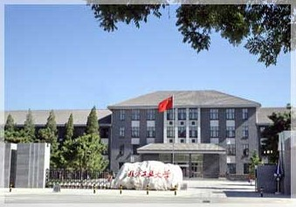
Once more, I am learning to read and write.
明天我要出北京。
This brings us to an important point: reading is a language function. When we claim we can read and write, we are generalizing!
More about this later.

Slide 4
Your experience must be different from mine… so tell me about you!
Where did you go to school?
What grades have you taught and for how long?
What went well this year in the teaching of reading?
What were your frustrations in teaching reading this year?
What do you hope I can help with?

Slide 5
Where is the emphasis in reading instruction?
Content often takes a back seat to decoding.
Textbooks often drive curriculum.
They are often difficult.

Slide 6
The following passage is in English. It should therefore be quite simple to 1)- read it and 2)- provide a brief summary of what you read.
In String Theory, the myriad of particle types is replaced by a single fundamental building block, a `string'. These strings can be closed, like loops, or open, like a hair. As the string moves through time it traces out a tube or a sheet, according to whether it is closed or open. Furthermore, the string is free to vibrate, and different vibrational modes of the string represent the different particle types, since different modes are seen as different masses or spins. One mode of vibration, or `note', makes the string appear as an electron, another as a photon. There is even a mode describing the graviton, the particle carrying the force of gravity, which is an important reason why String Theory has received so much attention. The point is that we can make sense of the interaction of two gravitons in String theory in a way we could not in QFT. There are no infinities! And gravity is not something we put in by hand. It has to be there in a theory of strings. So, the first great achievement of String Theory was to give a consistent theory of quantum gravity, which resembles GR at macroscopic distances. Moreover String Theory also possesses the necessary degrees of freedom to describe the other interactions! At this point a great hope was created that String Theory would be able to unify all the known forces and particles together into a single `Theory of Everything'.

Slide 7
Now, that wasn’t hard…
Provide a summary of the passage you just read.
Answer these questions:
1. In string theory, what replaces the myriad of particle types?
2. What does the string do as it moves through time?
3. What do we call the particle carrying the force of gravity?
4. What was the first great achievement of string theory?

Slide 8
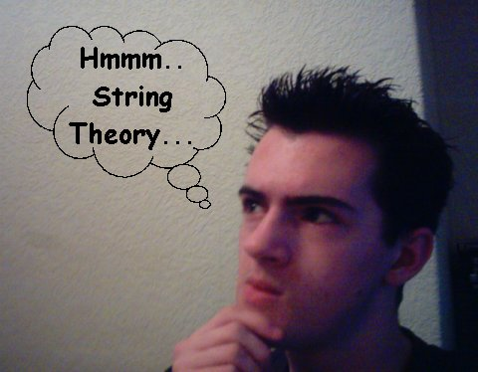
If we have not comprehended a passage, have we actually read it?
It’s a matter of definitions, but comprehension is hard to evaluate.

Slide 9
Whose responsibility?
Reading teachers often believe they should stress the PROCESS of reading.
We usually begin with narratives.
Later on, content teachers may think teaching reading is someone else’s job.
Content area reading falls by the wayside.

Slide 10
Vocabulary
Too often it’s about look up, write down, and memorize.
Definitional knowledge is important, but students must also acquire conceptual and contextual knowledge.
Use of glossaries can be mechanical.

Slide 11
What makes a textbook accessible?
Match between the knowledge the student has and the knowledge the textbook assumes.
Difference in cultural backgrounds may account for part of the mismatch.
Textbooks are not always user friendly.
You don’t have the option of shifting to a different one.

Slide 12
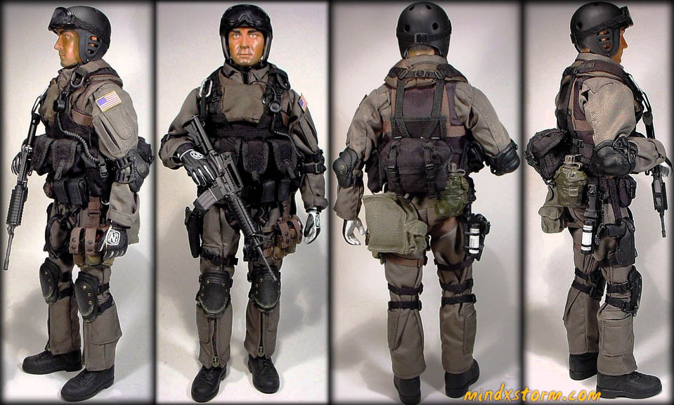
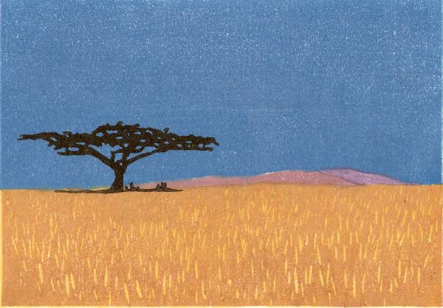
Polysemous words and content reading
What’s a seal?
Plane or plain?

Slide 13
Words and Background knowledge
Words must be related to what we already know.
Teaching of specific morphemes is useful.

Slide 14
What are morphemes?
Roughly speaking, they are word roots. Consider:
Geo- earth
Mis/mit send
Thermo- temperature
Leg- law: legitimate, allege
Nav- boat, sail

Slide 15
Use of dictionary
Does not solve all problems.
Word must be looked up.
Pronunciation guide must be used.
Definition must be fitted to concept.
The spelling problem.

Slide 16
Readability: how do we define it?
Fry method: readability is a function of word length and sentence length
Only an estimate.
Count out 100 words
Count # syllables.
Count sentences, estimating to nearest 10th.
Use graph.

Slide 18
Coping with textbooks
Don’t just assign textbooks as seatwork.
Use informational trade books.
Develop schema.
Contextualize new vocabulary
Consider using multiple sources of information.
Use informational narratives.
Use paired read alouds.

Slide 19
Interdisciplinary model
Learning centers around a common theme.
Hazards.

Slide 20
Electronic texts
Global classrooms.
Information exchanges.
Tele-fieldtrips and electronic field trips.
Problem-solving research tools.

Slide 21
Previewing
Teach skimming and scanning.
Set purpose for reading: details, main ideas.
Activate curiosity.
Develop anticipation guides.
Utilize brainstorming instructionally and diagnostically.

Slide 22
Guide the reading
Utilize study guides– those we develop ourselves are best.
Build affective ties: first person narratives.
Utilize idea circles for discussion of concepts.
Utilize websites– students may review different ones.
Curriculum based reader’s theater.

Slide 23
Internet inquiries
Students need to understand that websites and textbooks are organized differently.
Difference between knowledge information.

Slide 24
Struggling readers and textbooks
Textbooks are particularly difficult for struggling readers.
Teach vocabulary.
Provide simplified material.
DO help them use the textbook.

Slide 25
Vocabulary and comprehension are connected
Words are verbal symbols for concepts. If you don’t understand the concept, you don’t really understand the word.
Words and concepts are linked, so they have to be taught together.

Slide 26
Refining concepts
English is rich in synonyms. These allow for fine shades of meaning.
Useful to do word sorts to develop an understanding of concepts.

Slide 27
Also useful to teach how words change form
verb | Process noun | agentive
create | creation | creator
investigate | investigation | investigator
legislate | legislation | legislator

Slide 28
Vocabulary in content area & literature
In literature, we generally absorb vocabulary for concepts we already possess.
In content areas, we are learning new concepts and associating new vocabulary with it.
Wide reading fosters vocabulary development.
Children may sometimes decide what words should be studied: vocabulary journals.

Slide 29
Bottom line
No method of instruction works all the time with every child.
Many children learn in whatever they are taught.
Teaching is an art.

Slide 30
Reading is not a political process
What we do is influenced by politics.
To many politicians, phonics sounds better because it appears more disciplined.
Actually, it’s a matter of how people learn.

Slide 31
What's the goal of reading?
Is it about sounding out words?
Or is it about comprehension?
Sometimes methods become ends in themselves.

Slide 32
Why does this happen?
Accountability is another word for checking up on us.
Standardized tests are imposed on us from the outside.
Reading is fundamentally a mental activity and cannot be measured directly

Slide 33
21st Century jobs
Increasingly require literacy at upper levels.
Not all HS and college graduates are where they ought to be.
These studies looked at textual literacy. There are other types, which younger people are proficient at.
However, text literacy continues to be important.
This is why politicians are so concerned about education in general and literacy in particular.

Slide 34
Let your voice be heard!
Enter the political process.
Seek to influence educational policy
Be active politically.
Run for office

Slide 35
Want a handout?
A copy of this power point is available at:
http://faculty.etsu.edu/gannr/handouts.htm

Slide 36
Keep in Touch
Dr. Rosalind R. Gann
Associate Professor of Reading and Language Education
East Tennessee State University
Box 70684, Johnson City TN 37614
gannr@etsu.edu
Office phone: 423-439-7596
Home phone: 423-434-0105

