Slide 1
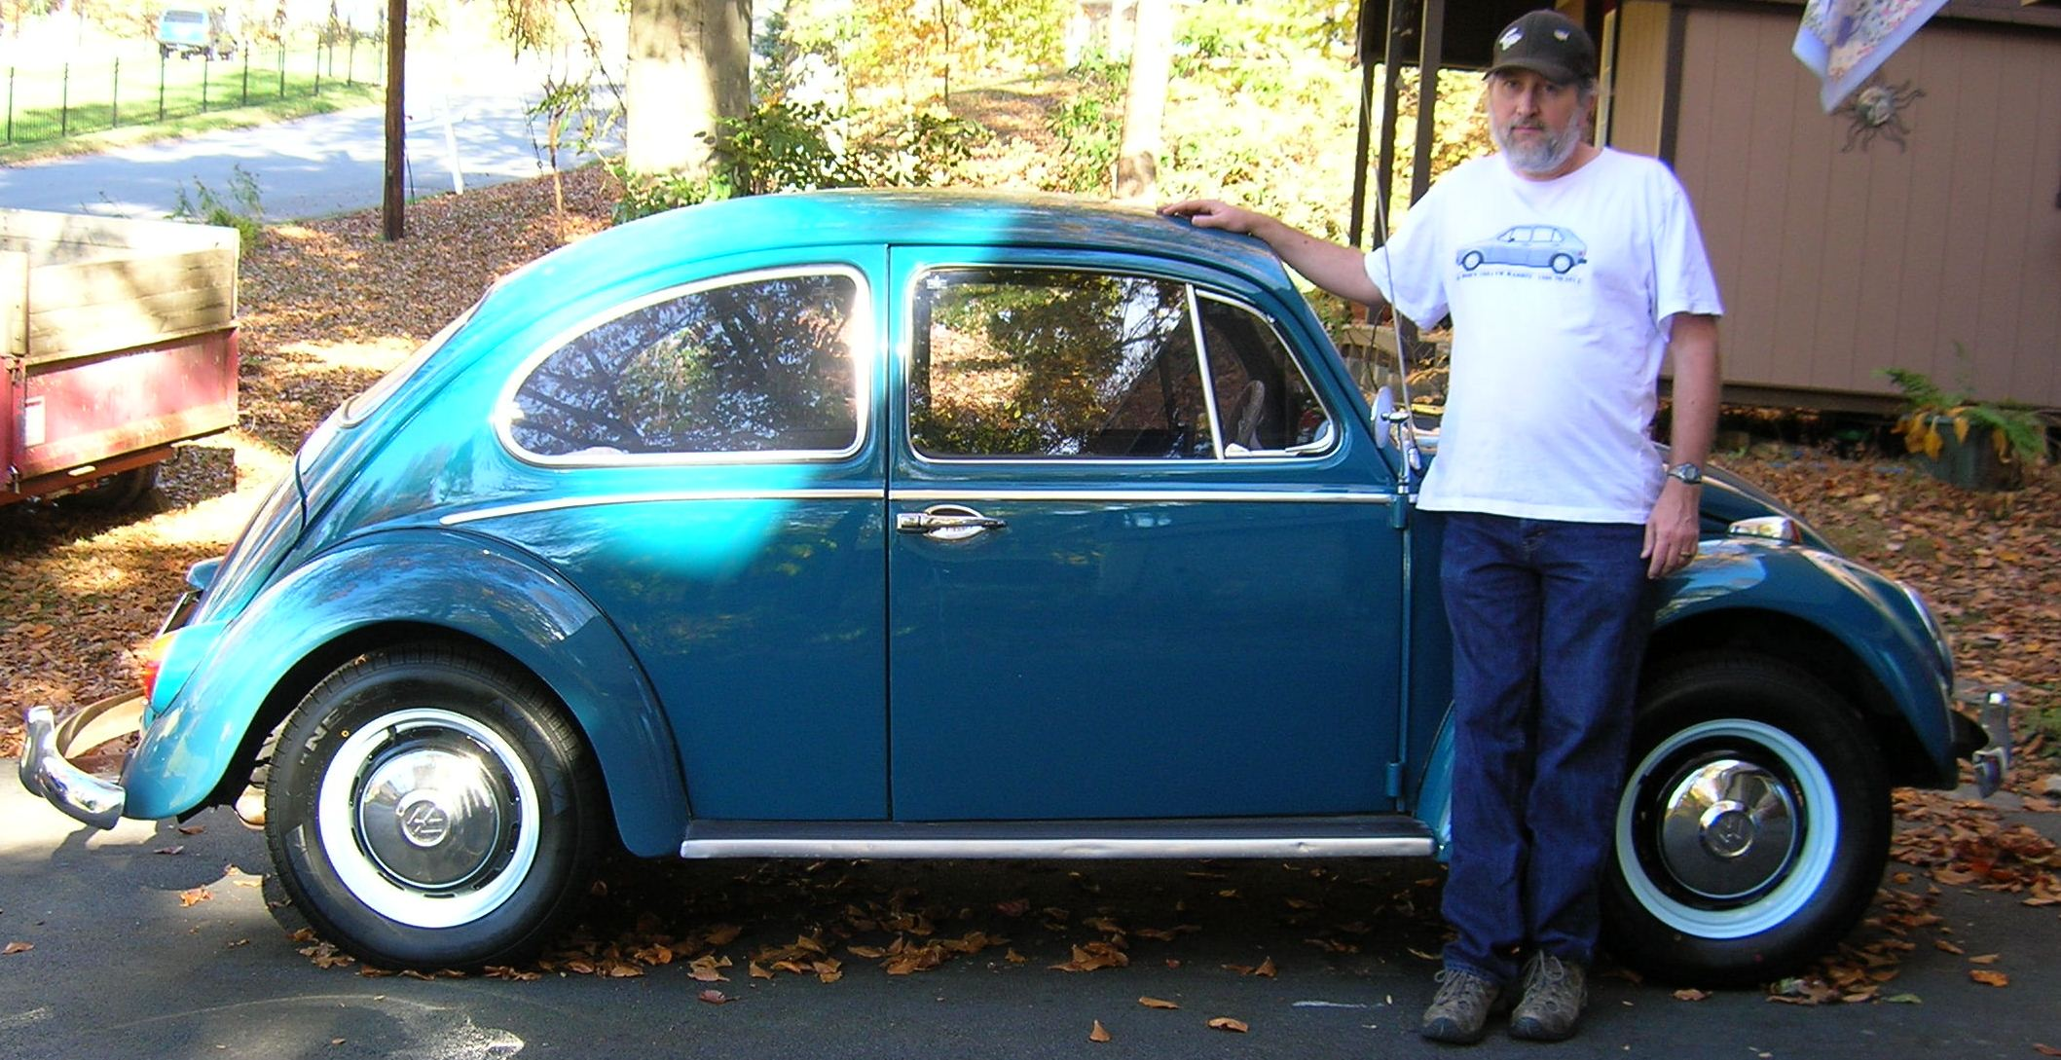
What the Hell do Graph Decompositions have to do with Experimental Designs?
Motivating Graph Packings and Coverings of Non-Complete Graphs
“Old Bob” Gardner Math Department Seminar January 27, 2012

Slide 2
Complete Graphs:
Comparing Samples

Slide 3
Note. Suppose you have a collection of v samples and you wish to compare a property of the samples.
. . .
1
2
3
v
A special thanks to the Institute of Quantitative Biology for the use of several hypothetical mice!

Slide 4
Note. However, the samples are compared by running them in the Motivationtron 3000® three-at-a-time. The machine cannot be calibrated from run to run and so the only way two samples can be compared is to run them together in the machine.
1
1
3
2
3
2
Motivation- tron 3000®

Slide 5
The Question: When (and how) can all of the v samples be optimally compared to each other by running the
machine times?
$${\left(\begin{matrix}v \\ 2\end{matrix}\right)}/3$$
Motivationtron 3000®

Slide 6
Note. The solution to this question is equivalent to finding a K₃–decomposition of K_{v}, where each vertex of K_{v} represents a sample, an edge joining two vertices represents a comparison of the two corresponding samples, and a copy of K₃ represents a run of the machine.
0
0
3
1
3
1
2
2

Slide 7
Definition. A decomposition of a simple graph G with isomorphic copies of graph g is a set
{g₁, g₂, … , g_{n}}
where g_{i} g and V(g_{i}) V(G) for all i, E(g_{i}) ∩ E(g_{j}) = Ø if i ≠ j, and
g_{i} = G.

Slide 8
Example. There is a decomposition of K₅ into 5-cycles:
=
U

Slide 9
Example. There is a decomposition of K₇ into 3-cycles:
1
0
2
(0,1,3)
3
(1,2,4)
6
1
(2,3,5)
(3,4,6)
(4,5,0)
(5,6,1)
2
5
(6,0,2)
4
3

Slide 10
Definition. A Steiner triple system of order v, STS(v), is a decomposition of the complete graph on v vertices, K_{v} , into 3-cycles.

Slide 11
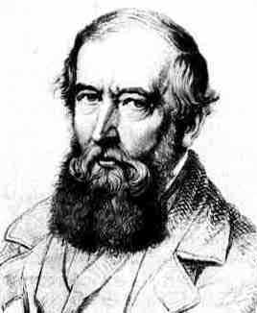
Jakob Steiner
1796-1863
v ≡ 1 or 3 (mod 6) is necessary.
From the Saint Andrews MacTutor History of Mathematics website.
J. Steiner, Combinatorische Aufgabe, Journal für die Reine und angewandte Mathematik (Crelle’s Journal), 45 (1853), 181-182.

Slide 12
Theorem. A STS(v) exists if and only if v ≡ 1 or 3 (mod 6).
Note. Sufficiency follows from Reiss.
M. Reiss, Über eine Steinersche combinatorsche Aufgabe welche in 45sten Bande dieses Journals, Seite 181, gestellt worden ist, Journal für die Reine und angewandte Mathematik (Crelle’s Journal), 56 (1859), 326-344.

Slide 13
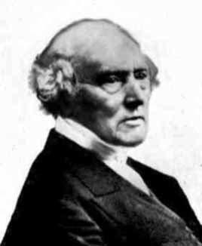
Thomas P. Kirkman
1806-1895
STS(v) iff v ≡ 1 or 3 (mod 6).
From the Saint Andrews MacTutor History of Mathematics website.
T. Kirkman, On a problem in combinations, Cambridge and Dublin Mathematics Journal, 2 (1847), 191-204.

Slide 14
Note. So the Motivationtron 3000® can efficiently compare v samples (without duplication or omission) if and only if the number of samples v satisfies: v ≡ 1 or 3 (mod 6).
THIS IS WHAT DECOMPOSITIONS HAVE TO DO WITH EXPERIMENTAL DESIGNS!!!
1
1
3
2
3
2
Motivation- atron 3000®

Slide 15
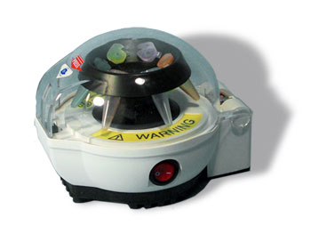
Note. The Gizmotron 5000® runs with 5 samples inserted, but has the curious property that it does not compare each sample to the others, but instead makes comparisons as given schematically here:
Gizmotron 5000®

Slide 16
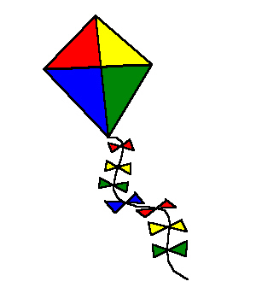
Definition. The 4-cycle with a pendant edge is denoted H and is:
d
(a,b,c,d;e)
= H
c
a
e
b
The graph H is sometimes called a kite.
We call H, for personal reasons, the Hoser graph.

Slide 17
A Cyclic H-Decomposition of K₁₁
0
5
4
10
1
(5, 3, 0, 1; 10)
9
2
2 3 1
8
3
4
7
6
5

Slide 18
Theorem. An H-decomposition of K_{v} exists if and only if v ≡ 0 or 1 (mod 5) and v ≥ 10.
Alex Rosa
Dominique Sotteau
From: http://www.d.umn.edu/~dfroncek/alex/ and http://www-direction.inria.fr/international/DS/page_personnelle.html
J. C. Bermond, C. Huang, A. Rosa, and D. Sotteau, Decompositions of Complete Graphs into Isomorphic Subgraphs with Five Vertices, Ars Combinatoria 10 (1980), 211-254.

Slide 19
Bipartite Graphs:
Two Populations Sampled

Slide 20
Note. Suppose you have a collection of m samples from one population (say white mice) and a collection of n samples from a second population (say brown mice). You are interested in comparing the two populations and hence in comparing each white mouse to each brown mouse.
1₁
2₁
3₁
. . .
m₁
. . .
1₂
2₂
n₂

Slide 21
Example. An H-decomposition of K_{5,2}
1₁
2₁
1₂
(1₂, 1₁, 2₂ , 2₁ ; 3₁)
3₁
(2₂, 4₁, 1₂ , 5₁ ; 3₁)
4₁
2₂
5₁

Slide 22
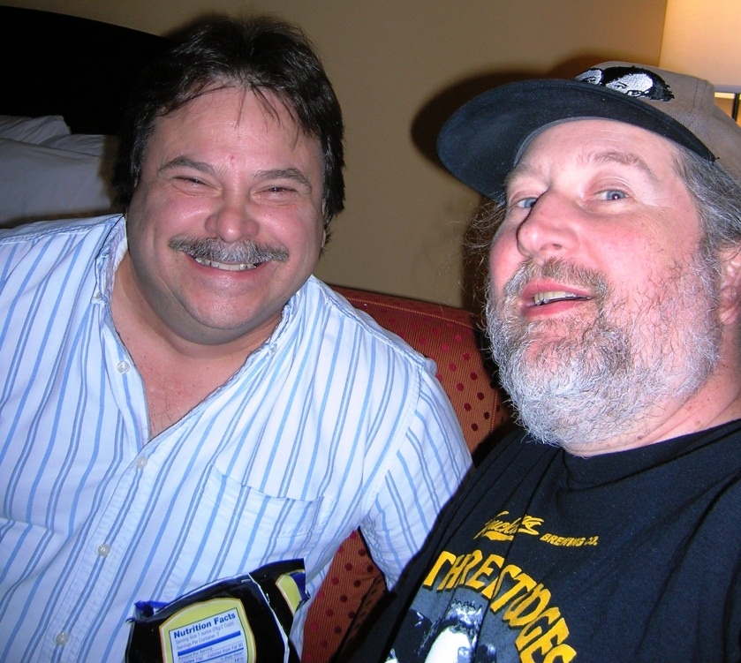
Theorem. An H-decomposition of the complete bipartite graph, K_{m,n}, exists if and only if mn ≡ 0 (mod 5), m ≥ 5, and n ≥ 2.
Brandon Coker, Gary Coker, and Robert Gardner, Decompositions of Various Complete Graphs into Isomorphic Copies of the 4-Cycle with a Pendant Edge, submitted to International Journal of Pure and Applied Mathematics.

Slide 23
Complete Graph with a Hole:
New Samples Added to Old

Slide 24
Note. Suppose you have already performed comparisons on a collection of w samples and then you get additional samples (say, another v – w samples). To analyze the total collection of v samples, you need to compare the new samples to the old and compare the new samples to each other.
1₂
(v-w)₂
2₂
1₁
3₂
2₁
. . .
4₂
w₁

Slide 25
The Complete Graph with a Hole
Definition. The complete graph on v vertices with a hole of size w is the graph with vertex set V(K(v,w))= V_{v-w} U V_{w}, where │ V_{v-w}│= v – w and │V_{w}│ = w, and edge set
E(K(v,w)) = {(a,b) │ a, b ϵ V(K(v,w)), {a,b} V_{w} }.
/
U
V_{v-w}
. . .
V_{w}

Slide 26
Example. An H-decomposition of K(7,2).
1₁
1₂
(5₂, 2₂, 3₂, 4₂; 1₁)
2₂
(1₂, 2₂, 4₂, 1₁; 2₁)
5₂
(3₂, 1₁, 2₂, 2₁; 1₂)
(5₂, 2₁, 4₂, 1₂; 3₂)
4₂
3₂
2₁

Slide 27
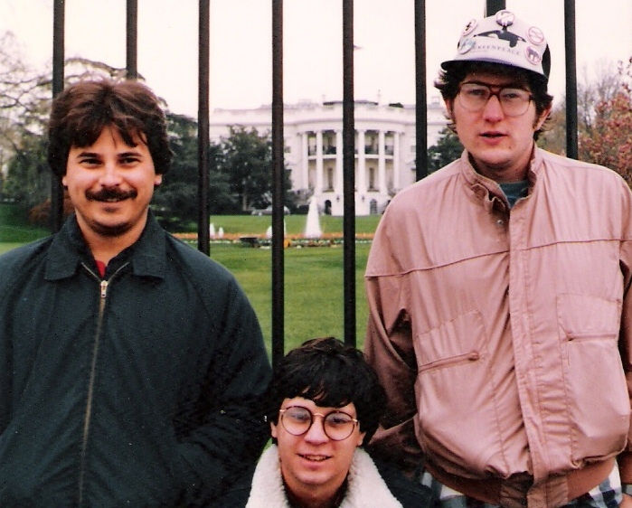
Theorem. There is an H-decomposition of K(v,w) if and only if │E (K(v,w)│ ≡ 0 (mod 5), v – w ≥ 4, and (v,w) ϵ {(5,1),(6,1)}.
/
Ronald Reagan’s house
G.D. Coker
Dr. Bob
Ron Bollschweiler
Brandon Coker, Gary Coker, and Robert Gardner, Decompositions of Various Complete Graphs into Isomorphic Copies of the 4-Cycle with a Pendant Edge, submitted to International Journal of Pure and Applied Mathematics.

Slide 28
What if a Graph Decomposition Does Not Exist?

Slide 29
Note. If a g-decomposition of G does not exist, then we can ask: “How close to a decomposition can we get?”
For example, the Motivationtron 3000® can only be efficiently used to compare v samples if there exists a Steiner triple system of order v – that is, if v ≡ 1 or 3 (mod 6). What should we do with, say, 8 samples?
?

Slide 30
Note. Since we know there is no Steiner triple system of order 8, we know that we will need to either:
Omit some comparisons of samples, or
Repeat some comparisons.
This leads us correspondingly to two ideas related to graph decompositions.

Slide 31
Graph Packing
Note. In our first approach, we can try comparing as many of the samples as possible, without repetition of comparisons (it might be that running the Motivationtron 3000® is expensive). In terms of the associated graph theory problem, this means getting as many copies of K₃ as possible (based on a vertex set of size 8) without repeating edges. This leads to a packing of K₈ with copies of K₃.

Slide 32
Example. A Maximal K₃-packing of K₈.
Notice that each vertex of K₈ is of degree 7 (odd) whereas each vertex of K₃ is of degree 2 (even). So in any union of K₃’s, each vertex will be of even degree:
DEGREE:
0
2
4
6

Slide 33
Therefore, as we pack copies of K₃ into K₈ (in which each vertex is of odd degree 7), we will have at least one edge absent from each vertex in the collection of K₃’s. This collection of “missing” edges form the leave of the packing. Since each vertex must be an element of at least one edge in the leave, then the leave must consist of at least 4 edges. If we are lucky, the leave of this packing will form a perfect matching of K₈. Here is such a packing:

Slide 34
Leave
0
1
(0,4)
(1,5)
(2,6)
(3,7)
7
2
Packing
(0,1,3)
(1,2,4)
(2,3,5)
(3,4,6)
6
3
(4,5,7)
(5,6,0)
(6,7,1)
(7,0,2)
5
4

Slide 35
Definition. A maximal packing of a graph G with isomorphic copies of a graph g is a set {g₁, g₂, …, g_{n}} where g_{i} ≈ g and V(g_{i}) V(G) for all i, E(g_{i}) ∩ E(g_{j}) = Ø for i ≠ j,
g_{i} G,
and
is minimal. The edges of G not in any g_{i} form the leave of the packing.

Slide 36
Theorem. A maximal H-packing of K_{v} , v ≥ 5, has leave L where │E(L)│ = │E (K_{v})│ (mod 5), except when v ϵ {5,6} in which cases │E(L)│ = 5.
Brandon Coker, Gary Coker, and Robert Gardner, Packings and Coverings of Various Complete Graphs with the 4-Cycle with a Pendant Edge, in preparation.

Slide 37
We are also exploring H-packings of complete bipartite graphs and complete graphs with a hole.
Brandon Coker, Gary Coker, and Robert Gardner, Packings and Coverings of Various Complete Graphs with the 4-Cycle with a Pendant Edge, in preparation.

Slide 38
Graph Covering
Note. In our second approach, we insist on comparing every pair of samples. In the event that there is not a decomposition of the corresponding graph, this will require the repetition of some comparisons. We want to minimize the repeated comparisons. In terms of the associated graph theory problem, this means finding a collection of copies of K₃ which include all edges of K_{v} and for which the number of repeated edges is minimized. For example, suppose we want to compare 6 samples on the Motivationtron 3000®. This leads to a K₃ covering of K₆, as follows:

Slide 39
Padding
0
1
(0,3)
(1,4)
(2,5)
Covering
(0,1,3)
5
2
(1,2,4)
(2,3,5)
(3,4,0)
(4,5,1)
(5,0,2)
4
3

Slide 40
Definition. A minimal covering of a simple graph G with isomorphic copies of a graph g is a set {g₁, g₂, … , g_{n}} where g_{i} ≡ g, V(g_{i}) V(G), E(g_{i}) E(G) for all i,
and
is minimal (when considering coverings, the graph
may not be simple and may be a
multiset).

Slide 41
Theorem. A minimal H-covering of K_{v}, v ≥ 5, has padding P where |E(P)|=5 − |E(K_{v})| (mod 5), except when v ϵ {5,6} in which cases |E(P)|=5.
Brandon Coker, Gary Coker, and Robert Gardner, Packings and Coverings of Various Complete Graphs with the 4-Cycle with a Pendant Edge, in preparation.

Slide 42
Can we Cover K_{5,1} with H?
NO! H is not a subgraph of K_{5,1}!
1₁
2₁
3₁
1₂
4₁
5₁

Slide 43
Can we Cover K_{5,1} with H?
1₁
Well… maybe!
2₁
3₁
1₂
4₁
(1₂, 1₁, 4₁, 2₁; 3₁)
5₁
(1₂, 1₁, 2₁, 5₁; 3₁)

Slide 44
Can we Cover K_{5,1} with H?
1₁
Well… maybe!
2₁
3₁
1₂
But these edges are not in the original graph.
4₁
(1₂, 1₁, 4₁, 2₁; 3₁)
5₁
(1₂, 1₁, 2₁, 5₁; 3₁)

Slide 45
Note. Most studies of coverings have involved G = K_{v}, so the condition that the copies of g are subgraphs of G is trivially satisfied. But when G is not a complete graph, there is no obvious reason to impose the subgraph condition. Returning to the testing-of-samples story, we see no reason to disallow, for example, the testing (or re-testing) of two samples in the hole of K(v,w). Therefore, we are motivated to refine the definition of a graph covering into two cases - one case in which edges that are not in G are forbidden from use in the copies of g, and a case in which these edges are not forbidden.

Slide 46
Definition. A minimal unrestricted covering of graph G with isomorphic copies of a graph g is a set {g₁, g₂, …, g_{n}} where g_{i} ≡ g, V(g_{i}) V(G),
and
is minimal. (Notice that we do not make the restriction
E(g_{i}) E(G).)

Slide 47
This is an Unrestricted Covering of K_{5,1} with H
1₁
2₁
3₁
1₂
Padding
{(1₁,4₁), (2₁,4₁), (2₁,4₁), (2₁,5₁), (3₁,1₂)}
4₁
(1₂, 1₁, 4₁, 2₁; 3₁)
5₁
(1₂, 1₁, 2₁, 5₁; 3₁)

Slide 48
Definition. A minimal restricted covering of a simple graph G with isomorphic copies of a graph g is a set {g₁, g₂, … , g_{n}} where g_{i} ≡ g, V(g_{i}) V(G), E(g_{i}) E(G) for all i,
and
is minimal (when considering coverings, the graph
may not be simple and may be a
multiset).

Slide 49
A Restricted K₃ Covering of K_{1,2,3}
Each degree 3
Need 3 more edges from between these sets
Need 3 + 3 =6 edges from between these partite sets (need 4 more)
So padding must consist of at least 7 edges.

Slide 50
A Restricted K₃ Covering of K_{1,2,3}

Slide 51
A Restricted K₃ Covering of K_{1,2,3}
So padding does consist of 7 edges.

Slide 52
An Unrestricted K₃ Covering of K_{1,2,3}
Each degree 3, so must add an edge to each in the padding
●11 edges in K_{1,2,3}
●Need 2 more edges: 11+2=13
Padding has exactly 4 edges!
●Must have a multiple of 3 edges; need 2 more edges. The padding must have at least 4 edges.

Slide 53
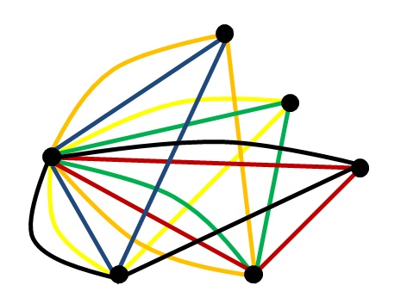
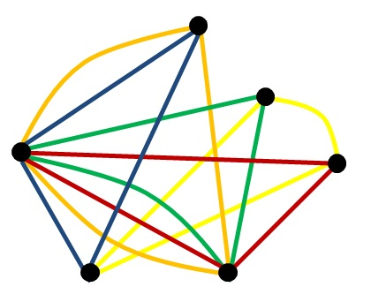
Note. So, there is a difference between minimal restricted and minimal unrestricted coverings, even when graph g is a subgraph of G.
Restricted
Unrestricted
E(P)=7
E(P)=4

Slide 54
We are exploring minimal restricted and minimal unrestricted H-coverings of complete bipartite graphs and complete graphs with a hole.
Brandon Coker, Gary Coker, and Robert Gardner, Packings and Coverings of Various Complete Graphs with the 4-Cycle with a Pendant Edge, in preparation.

Slide 55
Conclusion
Graph decompositions can be used to design experiments
Experiments (i.e., comparisons of samples) can be used to inspire consideration of decompositions of graphs other than complete graphs
When a graph decomposition does not exist, we can explore approximations of decompositions → packings and coverings
Both packing and covering problems are minimization problems (similar to inner and outer measure in real analysis)
When considering non-complete graphs, the possibility of a restricted versus an unrestricted covering arises
One of my current research programs involves packings and coverings of various complete graphs with the 4-cycle with a pendant edge, H

