Slide 1
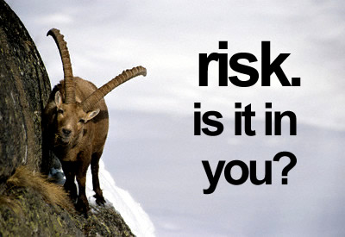

Slide 2
Introduction
The relationship between risk and return is fundamental to finance theory
You can invest very safely in a bank or in Treasury bills. Why would you invest in assets?
  If you want the chance of earning higher returns, it requires that you take on higher risk investments
There is a positive relationship between risk and return

Slide 3
Historical Returns
Computing Returns
Dollar Return = (Capital gain or loss) + Income
= (Ending Value – Beginning Value) + Income
We can convert from dollar returns to percentage returns by dividing by the Beginning Value

Slide 4
Percentage Returns

Slide 5
Example: You held 250 shares of Hilton Hotel’s common stock. The company’s share price was $24.11 at the beginning of the year. During the year, the company paid a dividend of $0.16 per share, and ended the year at a price of $34.90. What is the dollar return, the percentage return, the capital gains yield, and the dividend yield for Hilton?

Slide 6
Dollar return = 250 x ($34.90-$24.11+$0.16)
= $2,737.50
Percent return = ($34.90-$24.11+$0.16)/$24.11
= 45.42%
Capital gains yield = ($34.90 - $24.11)/$24.11
= 44.75%
Dividend yield = $0.16/$24.11
= 0.66%

Slide 7
Returns Using Arithmetic and Geometric Averaging
Arithmetic
r_{a} = (r₁ + r₂ + r₃ + ... r_{n}) / n
r_{a} = (.10 + .25 - .20 + .25) / 4
= .10 or 10%
Geometric
r_{g} = {[(1+r₁) (1+r₂) .... (1+r_{n})]} ^{1/n} - 1
r_{g} = {[(1.1) (1.25) (.8) (1.25)]} ^{1/4} - 1
= (1.5150) ^{1/4} -1 = .0829 = 8.29%

Slide 8
Quoting Conventions
APR = annual percentage rate
(periods in year) X (rate for period)
EAR = effective annual rate
( 1+ rate for period)^{Periods per yr} - 1
Example: monthly return of 1%
APR = 1% X 12 = 12%
EAR = (1.01)¹² - 1 = 12.68%

Slide 9
Rather than looking at past returns, can use a probability matrix as well
State of economy | Probability of state | Stock return in given state | p x Return
Recession | 20% | -15% | -3.0
Normal | 50% | 9% | 4.5
Boom | 30% | 16% | 4.8
Expected Return |  |  | 6.3%

Slide 10
Real vs. Nominal Rates
Fisher effect: Approximation
nominal rate = real rate + inflation premium
  R = r + i or r = R - i
Example r = 3%, i = 6%
  R = 9% = 3% + 6% or 3% = 9% - 6%
Fisher effect: Exact
  r = (R - i) / (1 + i)
  2.83% = (9%-6%) / (1.06)

Slide 11
Historical Risks
When you purchase a U.S. Treasury bill, you know exactly what your returns are going to be, i.e. there is no uncertainty, or risk
On the other hand, when you invest in just about anything else, you do not know what your returns will be.
It is useful to be able to quantify the uncertainty of various asset classes

Slide 12
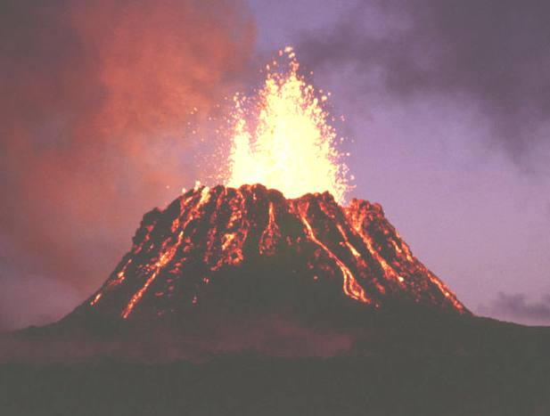
Computing Volatility

Slide 13
Computing Volatility
  High volatility in historical returns are an indication that future returns will be volatile
  One popular way of quantifying volatility is to compute the standard deviation of percentage returns
    Standard deviation is the square root of the variance
    Standard deviation is a measure of total risk

Slide 14
Skewed Distribution: Large Negative Returns Possible
Median
Negative
r
Positive

Slide 15
Skewed Distribution: Large Positive Returns Possible
Median
Negative
r
Positive

Slide 16
Characteristics of Probability Distributions
1) Mean: most likely value
2) Variance or standard deviation
3) Skewness
* If a distribution is approximately normal, the distribution is described by characteristics 1 and 2

Slide 17
Example: Using the following returns, calculate the average return, the variance, and the standard deviation for Acme stock.
Year Acme
1 10%
2 4
3 - 8
4 13
5 5

Slide 18
Average Return = (10 + 4 - 8 + 13 + 5 ) / 5 = 4.80%
σ²_{Acme} = [(10 – 4.8)² + (4 – 4.8)² (- 8 – 4.8)²
+ (13 – 4.8)² + (5 – 4.8)² ] / (5 - 1)
σ²_{Acme} = 258.8 / 4 = 64.70
σ_{Acme} = (64.70)^{1/2} = 8.04%

Slide 19
Can also find standard deviation using probability framework
State of economy | p | R | E(R) | R-E(R) | (R-E(R))² | p x (R-E(R))²
Recession | 20% | -15% | 6.3% | -21.3 | 453.69 | 90.74
Normal | 50% | 9% | 6.3% | 2.7 | 7.29 | 3.65
Boom | 30% | 16% | 6.3% | 9.7 | 94.09 | 28.23
 |  |  |  |  | Variance | 122.61
 |  |  |  |  | Std Dev | 11.07%

Slide 20
E(R) +/- 1 standard deviation: 68% of observations
E(R) +/- 2 standard deviation: 95% of observations
E(R) +/- 3 standard deviation: 99% of observations

Slide 21
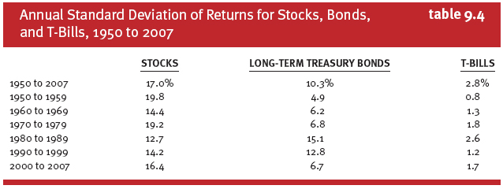
Risk of Asset Classes

Slide 22
Risk versus Return
  There is a tradeoff between risk and return
  One way to measure this risk-vs.-reward relationship is the coefficient of variation
  A smaller CoV indicates a better risk-reward relationship

Slide 23
Risk versus Return
  A very popular measure of risk is called Value at Risk or VAR. It is generally the amount you can lose at a particular confidence interval. It is only concerned with loss.
  At the 95% level, E(R) – 1.65(standard dev)
  At the 99% level, E(R) – 2.33(standard dev)

Slide 24
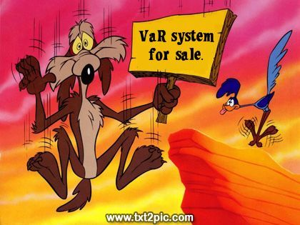
  VAR Example
  Invest $100 at 10% with S.D. of 15%. What is the 95% Var over the year?
  10% - 1.65(15%) = -14.75%
  Var = 100 * -.1475 = $14.75

Slide 25
Now that we can measure some expected return and risk, how do we use it?
Risk Premiums
  An investment in a risk-free Treasury bill offers a low return with no risk
  Investors who take on risk expect a higher return
  An investor’s required return is expressed in two parts:
    Required Return = Risk-free Rate + Risk Premium
  The risk-free rate equals the real interest rate and expected inflation
    Typically considered the return on U.S. government bonds and bills

Slide 26
Allocating Capital Between Risky & Risk-Free Assets
Possible to split investment funds between safe and risky assets
Risk free asset: proxy; T-bills
Risky asset: stock (or a portfolio)

Slide 27
Example
r_{f} = 7%
σ_{rf} = 0%
E(r_{p}) = 15%
σ_{p} = 22%
y = % in p
(1-y) = % in r_{f}

Slide 28
Expected Returns for Combinations
E(r_{c}) = yE(r_{p}) + (1 - y)r_{f}
r_{c} = complete or combined portfolio
For example, y = .75
E(r_{c}) = .75(.15) + .25(.07)
= .13 or 13%

Slide 29
Possible Combinations
E(r)
E(r_{p}) = 15%
P
r_{f} = 7%
F
0
22%
σ

Slide 30
Variance on the Possible Combined Portfolios
Since
σ
= 0, then
r_{f}
σ
=
y
σ
c
p

Slide 31
Combinations Without Leverage
If y = .75, then
σ
= .75(.22) = .165 or 16.5%
c
If y = 1
σ
= 1(.22) = .22 or 22%
c
If y = 0
σ
= 0(.22) = .00 or 0%
c

Slide 32
Using Leverage with Capital Allocation Line
Borrow at the Risk-Free Rate and invest in stock
Using 50% Leverage
r_{c} = (-.5) (.07) + (1.5) (.15) = .19
σ_{c} = (1.5) (.22) = .33

Slide 33
E(r)
CAL
(Capital
Allocation
Line)
P
E(r_{p}) = 15%
E(r_{p}) -
r_{f} = 8%
) S = 8/22
r_{f} = 7%
F
0
P
= 22%
σ

Slide 34
What was the beginning price of a stock if its ending price was $23, its cash dividend was $1, and the holding period return on a stock was 20%?
A) $20
B) $24
C) $21
D) $18

Slide 35
You purchased 100 shares of stock for $25. One year later you received $2 cash dividend and sold the shares for $22 each. Your holding-period return was ____.
A) 4%
B) 8.33%
C) 8%
D) -4%

Slide 36
The geometric average of 10%, -20% and 10% is __________.
A) 0%
B) 1.08%
C) -1.08%
D) -2%

Slide 37
An investor invests 80% of her funds in a risky asset with an expected rate of return of 12% and a standard deviation of 20% and 20% in a treasury bill that pays 3%. Her portfolio's expected rate of return and standard deviation are __________ and __________ respectively.
A) 12%, 20%
B) 7.5%, 10%
C) 9.6%, 10%
D) 10.2%, 16%

Slide 38
Suppose stock ABC has an average return of 12% and a standard deviation of 20%. Determine the range of returns that ABC's actual returns will fall within 95% of the time.
A) Between -28% and 52%
B) Between -8% and 32%
C) Between 12% and 20%
D) None of the above

Slide 39
What is the expected real rate of return on an investment that has expected nominal return of 20%, assuming the expected rate of inflation to be 6%?
A) 14%
B) 13.2%
C) 20%
D) 18.4%

Slide 40
What is the ending price of a stock if its beginning price was $30, its cash dividend was $2, and the holding period return on a stock was 20%?
A) $32
B) $34
C) $36
D) $28

Slide 41
Historical returns have generally been __________ for stocks than for bonds.
A) the same
B) lower
C) higher
D) none of the above

Slide 42
Geometric average returns are generally __________ arithmetic average returns.
A) the same as
B) lower than
C) higher than
D) none of the above

Slide 43
Two-Security Portfolio: Return
r_{p} = W₁r₁ + W₂r₂
W₁ = Proportion of funds in Security 1
W₂ = Proportion of funds in Security 2
r₁ = Expected return on Security 1
r₂ = Expected return on Security 2
n
Σ
W
=
1
i
i
=1

Slide 44
Two-Security Portfolio: Risk
σ_{p}² = w₁²σ₁² + w₂²σ₂² + 2W₁W₂ Cov(r₁r₂)
σ₁² = Variance of Security 1
σ₂² = Variance of Security 2
Cov(r₁r₂) = Covariance of returns for
Security 1 and Security 2

Slide 45
Covariance
Cov(r₁r₂) = ρ_{1,2}σ₁σ₂
ρ_{1,2} = Correlation coefficient of
returns
σ₁ = Standard deviation of
returns for Security 1
σ₂ = Standard deviation of
returns for Security 2

Slide 46
Correlation Coefficients: Possible Values
Range of values for ρ _{1,2}
-1.0 < ρ < 1.0
If ρ = 1.0, the securities would be perfectly positively correlated
If ρ = - 1.0, the securities would be perfectly negatively correlated

Slide 47
In General, For an n-Security Portfolio:
r_{p} = Weighted average of the
n securities
σ_{p}² = (Consider all pair-wise
covariance measures)

Slide 48
Two-Security Portfolio
E(r_{p}) = W₁r₁ + W₂r₂
σ_{p}² = w₁²σ₁² + w₂²σ₂² + 2W₁W₂ Cov(r₁r₂)
σ_{p} = [w₁²σ₁² + w₂²σ₂² + 2W₁W₂ Cov(r₁r₂)]^{1/2}

Slide 49
E(r)
TWO-SECURITY PORTFOLIOS WITH DIFFERENT CORRELATIONS
13%
ρ = -1
ρ = 0
ρ = .3
ρ = -1
8%
ρ = 1
12%
20%
St. Dev

Slide 50
Portfolio Risk/Return Two Securities: Correlation Effects
Relationship depends on correlation coefficient
-1.0 < ρ < +1.0
The smaller the correlation, the greater the risk reduction potential
If ρ = +1.0, no risk reduction is possible

Slide 51
Extending Concepts to All Securities
The optimal combinations result in lowest level of risk for a given return
The optimal trade-off is described as the efficient frontier
These portfolios are dominant

Slide 52
The minimum-variance frontier of risky assets
E(r)
Efficient
frontier
Individual
assets
Global
minimum
variance
portfolio
Minimum
variance
frontier
St. Dev.

Slide 53
Extending to Include Riskless Asset
The optimal combination becomes linear
A single combination of risky and riskless assets will dominate

Slide 54
ALTERNATIVE CALS
CAL (P)
E(r)
CAL (A)
M
M
P
P
CAL (Global
minimum variance)
A
A
G
F
σ
P
P&F
M
A&F

Slide 55
Dominant CAL with a Risk-Free Investment (F)
CAL(P) dominates other lines -- it has the best risk/return or the largest slope
Slope = (E(R) - Rf) / σ
[ E(R_{P}) - R_{f}) / σ _{P} ] > [E(R_{A}) - R_{f}) / σ_{Α}]
Regardless of risk preferences combinations of P & F dominate

Slide 56
Some diversification benefits can be achieved by combining securities in a portfolio as long as the correlation coefficient between the securities is ________________.
A) 1
B) less than or equal to 0
C) between 0 and 1
D) less than 1
Some diversification benefits can be achieved by combining securities in a portfolio as long as the correlation coefficient between the securities is ________________.
Some diversification benefits can be achieved by combining securities in a portfolio as long as the correlation coefficient between the securities is ________________.
Some diversification benefits can be achieved by combining securities in a portfolio as long as the correlation coefficient between the securities is ________________.
Some diversification benefits can be achieved by combining securities in a portfolio as long as the correlation coefficient between the securities is ________________.
A)
A)
A)
A)
1
1
1
B)
1
B)
B)
B)
less than or equal to 0
less than or equal to 0
less than or equal to 0
less than or equal to 0
C)
C)
C)
C)
between 0 and 1
between 0 and 1
between 0 and 1
between 0 and 1
D)
D)
D)
D)
less than 1
less than 1
less than 1
less than 1

Slide 57
Which of the following is correct concerning efficient portfolios?
A) They have zero risk.
B) They have the lowest risk.
C) They have the highest risk/return tradeoff.
D) They have the highest expected return.

Slide 58
The standard deviation of return on stock A is 0.25 while the standard deviation of return on stock B is 0.30. If the covariance of returns on A and B is 0.06, the correlation coefficient between the returns on A and B is __________.
A) 0.2
B) 0.6
C) 0.7
D) 0.8

Slide 59
Which one of the following statements is correct concerning a two-stock portfolio?
A) Portfolio return is a weighted average of the two stocks’ returns if the stocks have a positive correlation coefficient.
B) Portfolio standard deviation can be a weighted average of the two stocks’ standard deviations in theory.
C) Portfolio standard deviation is zero if the two stocks have a correlation coefficient of 0.
D) None of the above is correct.

Slide 60
The standard deviation of return on investment A is 0.2 while the standard deviation of return on investment B is 0.3. If the correlation coefficient between the returns on A and B is -0.8, the covariance of returns on A and B is ________.
A) -0.048
B) -0.06
C) 0.06
D) 0.048

Slide 61
A portfolio is composed of two stocks, A and B. Stock A has an expected return of 10% while stock B has an expected return of 18%. What is the proportion of stock A in the portfolio so that the expected return of the portfolio is 16.4%?
A) 0.2
B) 0.8
C) 0.4
D) 0.6

Slide 62
Expected Return Std Deviation
X10% 15%
Y12% 20%
Z15% 20%
Which of the following portfolios cannot lie on the efficient frontier?
A) Portfolio Z
B) Portfolio X
C) Portfolio Y
D) All portfolios should lie on the efficient frontier

