Slide 1
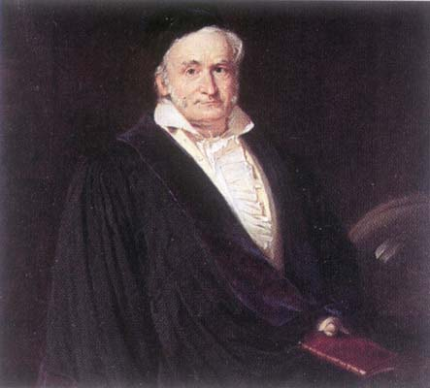
The Fundamental Theorem of Algebra - A History
If $P(z)∈ℂ[z]$ is a polynomial of degree $n$, then $P$ has $n$ roots in $ℂ$.
Robert “Dr. Bob” Gardner
East Tennessee State University
Department of Mathematics and Statistics

Slide 2
Statement
Note. There a number of ways to state the Fundamental Theorem of Algebra:
Every polynomial with complex coefficients has a complex root.
Every polynomial of degree n with complex coefficients has n complex roots counting multiplicity.
Every polynomial of degree n with complex coefficients can be written as a product of linear terms (using complex roots).
The complex field is algebraically closed.
Historically, finding the roots of a polynomial has been the motivation for both classical and modern algebra.

Slide 3
The Babylonians
Note. The Babylonians (1900 to 1600 BCE) had some knowledge of the quadratic equation and could solve the equation
$$x^{2}+\left(2/3\right)x={35}/{60}$$
(see page 1 Israel Kleiner's A History of Abstract Algebra, Birkhäuser: 2007). We would then expect that they could solve $x^{2}+ax=b$ for $a>0$ and $b>0$. The technique would be to “complete the square” (suggestive geometric terminology, eh!). Of course, the Babylonians had no concept of what we call the quadratic equation:
$$ax^{2}+bx+c=0 ⟹x=\frac{−b±\sqrt{b^{2}−4ac}}{2a} .$$

Slide 4
Completing the Square
Note. Consider the monic polynomial $x^{2}+qx$. Algebraically completing the square requires us to add $q^{2}/4$, in which case we notice that: $x^{2}+qx+\frac{q^{2}}{4}={\left(x+\frac{q}{2}\right)}^{2}$. This has a geometric interpretation as:
$$x^{2}+qx=x^{2}+2\left(\frac{q}{2}\right)\left(x\right)$$
$$\frac{q}{2}$$
$$x^{2}+2\left(\frac{q}{2}\right)\left(x\right)+{\left(\frac{q}{2}\right)}^{2}={\left(x+\frac{q}{2}\right)}^{2}$$
$$x$$
$$q$$
$$x$$
$$\frac{q}{2}$$

Slide 5
The Quadratic Equation
Note. The quadratic equation is now easily derived by completing the square. You might see this in a high school algebra class. We have that each of the following equations is equivalent:
$$ax^{2}+bx+c=0$$
$$x+\frac{b}{2a}=±\sqrt{\frac{b^{2}}{4a^{2}}−\frac{c}{a}}=±\sqrt{\frac{b^{2}}{4a^{2}}−\frac{4ac}{4a^{2}}}$$
$$ax^{2}+bx=−c$$
$$a\left(x^{2}+\frac{b}{a}x\right)=−c$$
$$x=−\frac{b}{2a}±\sqrt{\frac{b^{2}−4ac}{4a^{2}}}$$
$$x^{2}+\frac{b}{a}x=−\frac{c}{a}$$
$$x=−\frac{b}{2a}±\frac{1}{2a}\sqrt{b^{2}−4ac}$$
$$x^{2}+\frac{b}{a}x+\frac{b^{2}}{4a^{2}}=−\frac{c}{a}+\frac{b^{2}}{4a^{2}}$$
$$x=\frac{−b±\sqrt{b^{2}−4ac}}{2a}$$
$${\left(x+\frac{b}{2a}\right)}^{2}=−\frac{c}{a}+\frac{b^{2}}{4a^{2}}=\frac{b^{2}}{4a^{2}}−\frac{c}{a}$$

Slide 6
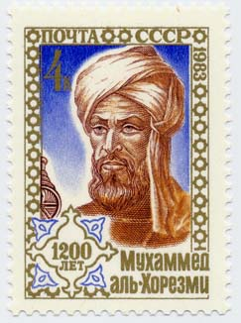
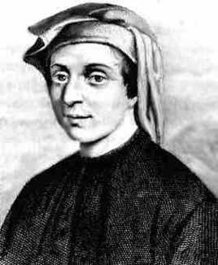
Al-Khwarizmi (790-850) and Fibonacci (1170-1250)
Note. The numerical symbols we are used to, 0, 1, 2, 3, 4, 5, 6, 7, 8, and 9, are known as the Arabic numerals. However, they are in fact of Indian origin. They were carried through the Arabic world to Europe and this explains the fact that we know them as the “Arabic numerals.” The Indian numerals were used in al-Khwarizmi's ab al-jabr w'al-muqabala (circa 800 CE), which “can be considered as the first book written on algebra.” [MacTutor] In fact, it is from the title of this book that we get our word “algebra.”
Note. The “Arabic numerals” were used in Fibonacci's book Liber abbaci (published in 1202), and it is this book that spread the numerals through Europe. The first seven chapters of the book introduce the numerals and give examples on their use. The last eight chapters of the book include problems from arithmetic, algebra, and geometry. There are also problems relating to commerce. The use of a standardized numerical system by merchants further helped spread the numerals. [Derbyshire, page 68]

Slide 7
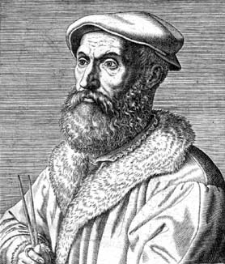
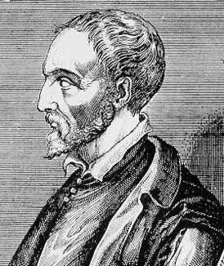
Tartaglia (1500-1557) and Cardano (1501-1576)
Note. Around 1530, Niccolò Tartaglia discovered a formula for the roots of a third degree polynomial. Gerolamo Cardano published the formula in Ars Magna in 1545 (leading to a “battle” between Tartaglia and Cardano). In 1540, Ludovico Ferrari found a formula for the roots of a fourth degree polynomial. The cubic equation gives the roots of $ax^{3}+bx^{2}+cx+d=0$ as:

Slide 8
$$x_{1}=−\frac{b}{3a}−\frac{1}{3a}\sqrt[3]{\frac{1}{2}\left(2b^{3}−9abc+27a^{2}d+\sqrt{{\left(\left(2b^{3}−9abc+27a^{2}d^{2}\right)\right)}^{2}−4{\left(b^{2}−3ac\right)}^{3}}\right)}$$
$$−\frac{1}{3a}\sqrt[3]{\frac{1}{2}\left(2b^{3}−9abc+27a^{2}d−\sqrt{{\left(\left(2b^{3}−9abc+27a^{2}d^{2}\right)\right)}^{2}−4{\left(b^{2}−3ac\right)}^{3}}\right)}$$
$$x_{2}=−\frac{b}{3a}+\frac{1+\sqrt{−3}}{6a}\sqrt[3]{\frac{1}{2}\left(2b^{3}−9abc+27a^{2}d+\sqrt{{\left(\left(2b^{3}−9abc+27a^{2}d^{2}\right)\right)}^{2}−4{\left(b^{2}−3ac\right)}^{3}}\right)}$$
$$+\frac{1−\sqrt{−3}}{6a}\sqrt[3]{\frac{1}{2}\left(2b^{3}−9abc+27a^{2}d−\sqrt{{\left(\left(2b^{3}−9abc+27a^{2}d^{2}\right)\right)}^{2}−4{\left(b^{2}−3ac\right)}^{3}}\right)}$$
$$x_{3}=−\frac{b}{3a}+\frac{1−\sqrt{−3}}{6a}\sqrt[3]{\frac{1}{2}\left(2b^{3}−9abc+27a^{2}d+\sqrt{{\left(\left(2b^{3}−9abc+27a^{2}d^{2}\right)\right)}^{2}−4{\left(b^{2}−3ac\right)}^{3}}\right)}$$
$$+\frac{1+\sqrt{−3}}{6a}\sqrt[3]{\frac{1}{2}\left(2b^{3}−9abc+27a^{2}d−\sqrt{{\left(\left(2b^{3}−9abc+27a^{2}d^{2}\right)\right)}^{2}−4{\left(b^{2}−3ac\right)}^{3}}\right)}$$

Slide 9
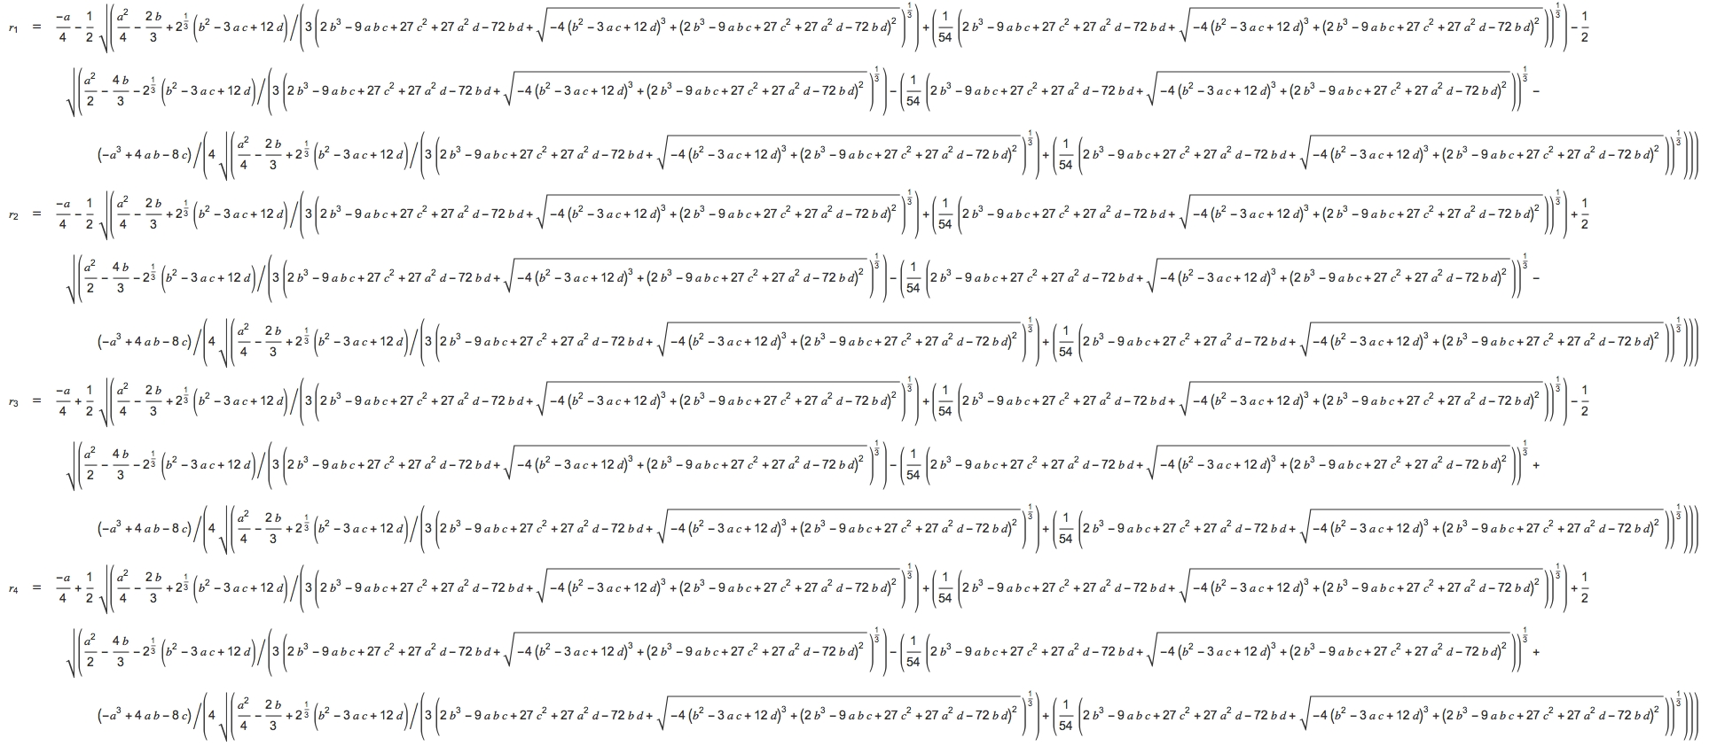
The quartic equation gives the roots of $x^{4}+ax^{3}+bx^{2}+cx+d=0$ as:

Slide 10
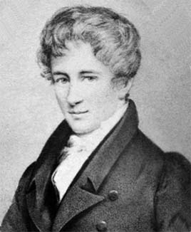
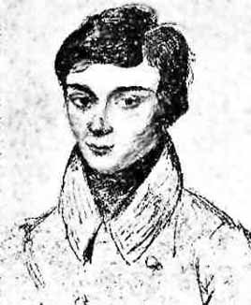
Abel (1802-1829) and Galois (1811-1832)
Note. The rapid succession of the discovery of the cubic and quartic equations lead many to think that a general (algebraic) formula for the roots of an n^{th} degree polynomial was on the horizon. However, Niels Henrik Abel's 1824 proof of the unsolvability of the quintic and later work of Evaristé Galois, we now know that there is no such algebraic formula.

Slide 11
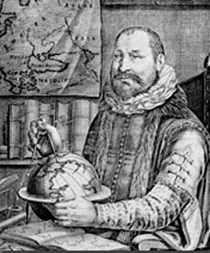
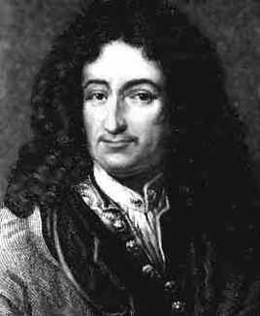
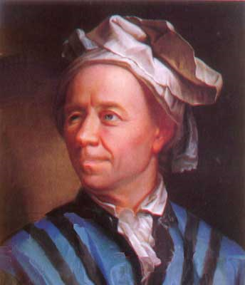
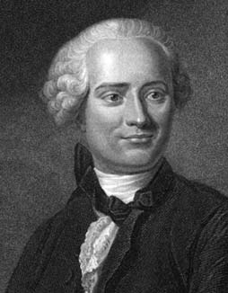
F.T.A. – Early Attempts
Albert Girard Gottfried Leibniz Leonhard Euler Jean d'Alembert
(1595-1632) (1646-1716) (1707-1783) (1717-1783)
Note. The first person to clearly claim that an n degree polynomial equation has n solutions was Albert Girard (1595-1632) in 1629 in his L'invention Nouvelle en l'Algèbre. However, he did not understand the nature of complex numbers and this was to have implications for future explorations of the problem. In fact, Gottfried Wilhelm von Leibniz (1646-1716) claimed to prove that the Fundamental Theorem of Algebra was false, as shown by considering $x^{4}+t^{4}$ which he claimed could not be written as a product of two real quadratic factors. His error was based, again, on a misunderstanding of complex numbers. In 1742, Leonhard Euler (1707-1783) showed that Leibniz's example was not correct. In 1746, Jean Le Rond D'Almbert (1717-1783) made the first serious attempt at a proof of the Fundamental Theorem of Algebra, but his proof had several weaknesses.

Slide 12
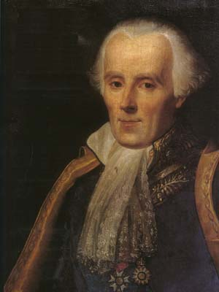
Leonhard Euler (1707-1783)
Pierre-Simon Laplace (1749-1827)
Note. Leonhard Euler proved that every real polynomial of degree n, where n $≤6$, has exactly n complex roots. In 1749, Euler attempted a proof for a general n^{th} degree polynomial, but his proof was a bit sketchy. In 1772, Joseph-Louis Lagrange raised objections to Euler's proof. Pierre-Simon Laplace (1749-1827), in 1795, tried to prove the FTA using a completely different approach based on the discriminant of a polynomial. His proof was very elegant and its only `problem’ was that the existence of roots was assumed.

Slide 13
Carl Friederich Gauss (1777-1855)
Note. Quoting from Morris Kline's Mathematical Thought from Ancient to Modern Times, Oxford University Press (1972), Volume 2 (page 598): “The first substantial proof of the fundamental theorem, though not rigorous by modern standards, was given by Gauss in his doctoral thesis of 1799 at Hemlstädt” (see Werke, Königliche Gellschaft der Wissenscheften zu Göttingen, 1876, 3 (1-30)). “He criticized the work of d'Alembert, Euler, and Lagrange and then gave his own proof. Gauss's method was not to calculate a root but to demonstrate its existence. … Gauss gave three more proofs of the theorem.”

Slide 14
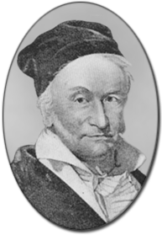
Note. Gauss's first proof, given in his dissertation, was a geometric proof which depended on the intersection of two curves which were based on the polynomial. In his second proof, he abandoned the geometric argument, but gave an argument still not rigorous based on the ideas of the time [Werke, 3, 33-56]. The third proof was based on Cauchy's Theorem and, hence, on the then-developing theory of complex functions (see “Gauss's Third Proof of the Fundamental Theorem of Algebra,” American Mathematical Society, Bulletin, 1 (1895), 205-209). This was originally published in 1816 in Comm. Soc. Gott, 3 (also in Werkes, 3, 59-64). The fourth proof is similar to his first proof and appears in Werke, 3, 73-102 (originally published in Abhand. der Ges. der Wiss. zu Gött., 4, 1848/50). Gauss's proofs were not entirely general, in that the first three proofs assumed that the coefficients of the polynomial were real. Gauss's fourth proof covered polynomials with complex coefficients. Gauss's work was ground-breaking in that he demonstrated the existence of the roots of a polynomial without actually calculating the roots [Kline, pages 598 and 599].
I should try again…

Slide 15
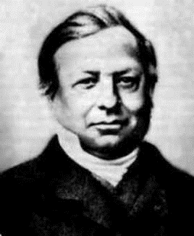
Joseph Liouville (1809-1882)
Note. To date, the easiest proof is based on Louisville's Theorem (which, like Gauss's third proof is, in turn, based on Cauchy's Theorem). Louisville's Theorem appears in 1847 in “Leҫons sur les fonctions doublement périodiques,” Journal für Mathematik Bb., 88(4), 277-310.

Slide 16
Theorem. Liouville’s Theorem.
If $f$ is a function analytic in the entire complex plane ( $f$ is called an entire function) which is bounded in modulus, then $f$ is a constant function.
Joseph Liouville (1809-1882)

Slide 17
Theorem. Fundamental Theorem of Algebra. Any polynomial
of degree $n$ ($n≥1$) has at least one zero. That is, there exists at least one point $z_{0}$ such that $P\left(z_{0}\right)=0$.
Note. It follows that $P$ can be factored into $n$ (not necessarily distinct) linear terms:
Where the zeros of $P$ are $z_{1}, z_{2},…, z_{n}$.

Slide 18
Proof. Suppose not.
Suppose P is never zero. Define
the function
Then $f$ is an entire function. Now
Therefore
So for some $R$,

Slide 19
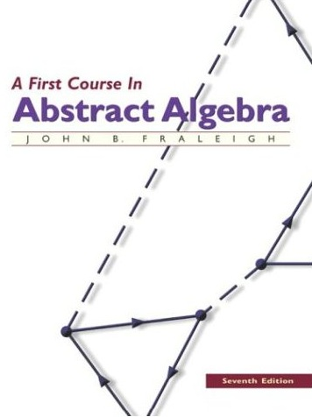
Next, by the Extreme Value Theorem, for some $M$,
But then, $P$ is bounded for all $z$ by max{1, $M$}. So by Louisville’s Theorem, $P$ is a constant, contradicting the fact that it is a polynomial.
Note. This is the proof given by John Fraleigh in Section 31 (Algebraic Extensions) in the 7th edition of his A First Course In Abstract Algebra.

Slide 20
Note. In your math career, you have several opportunities to see a proof of the Fundamental Theorem of Algebra. Here are some of them:
In Complex Analysis [MATH 5510/5520] where Liouville's Theorem is used to give a very brief proof. See http://faculty.etsu.edu/gardnerr/5510/notes/IV-3.pdf (Theorems IV.3.4 and IV.3.5). You will see the same proof in our Complex Variables class [MATH 4337/5337]: http://faculty.etsu.edu/gardnerr/5337/ notes/Chapter4-53.pdf. In fact, this is the proof you see in Introduction to Modern Algebra 2 [MATH 4227/5227] which Fraleigh presents in his A First Course In Abstract Algebra, 7th Edition: http://faculty.etsu.edu/gardnerr/4127/notes/VI-31.pdf (see Theorem 31.18).
In Complex Analysis [MATH 5510/5520] again where Rouche's Theorem (based on the argument principle) is used: http://faculty.etsu.edu/gardnerr/5510/notes/V-3.pdf (see Theorem V.3.8 and page 4).
In Introduction to Topology [MATH 4357/5357] where path homotopies and fundamental groups of a surface are used: http://faculty.etsu.edu/gardnerr/5210/notes/Munkres-56.pdf.
In Modern Algebra 2 [MATH 5420] where a mostly algebraic proof is given, but two assumptions based on analysis are made: (A) every positive real number has a real positive square root, and (B) every polynomial in $ℝ[x]$ of odd degree has a root in $ℝ$. Both of these assumptions are based on the definition of $ℝ$ and the Axiom of Completeness. See: http://faculty.etsu.edu/gardnerr/5410/notes/V-3-A.pdf.

Slide 21
Note. There are no purely algebraic proofs of the Fundamental Theorem of Algebra [A History of Abstract Algebra, Israel Kleiner, Birkhäuser (2007), page 12]. There are proofs which are mostly algebraic, but which borrow result(s) from analysis (such as the proof presented by Hungerford). However, if we are going to use a result from analysis, the easiest approach is to use Liouville's Theorem from complex analysis. This leads us to a philosophical question concerning the legitimacy of the title “Fundamental Theorem of Algebra” for this result! If seems more appropriate to refer to it as “Liouville's Corollary”! Polynomials with complex coefficients are best considered as special analytic functions (an analytic function is one with a power series representation) and are best treated in the realm of complex analysis. Your humble presenter therefore argues that the Fundamental Theorem of Algebra is actually a result of some moderate interest in the theory of analytic complex functions. After all, algebra in the modern sense does not deal so much with polynomials (though this is a component of modern algebra), but instead deals with the theory of groups, rings, and fields!
I like the sound of that: “Liouville’s Corollary”!

Slide 22
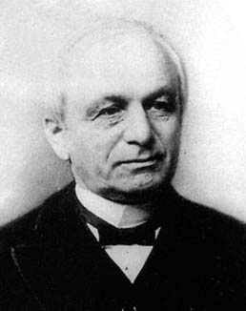
Leopold Kronecker (1823-1891)
Note. Part of the issue here is that pure “algebra” deals only with a finite number of operations. For example, in a field it does not make sense to talk about an infinite sum (a series), since this requires a concept of a limit and hence of distance (or at least, a topology). This is reflected in the famous quote of Kronecker below. In algebra, “Kronecker’s Theorem” refers to the result which states that a polynomial over a field $F$ has a root in some extension field of $F$. Inductively, Kronecker can find all the roots of a given polynomial, but he cannot show that the roots of all polynomials over $F$ lie in some field (a field $F$ which contains all roots of polynomials over $F$ is algebraically closed; Zorn’s Lemma is required to show that every field has an algebraic closure).
“God made the integers, all else is the work of man.”

Slide 23
Note. As mentioned above, the Fundamental Theorem of Algebra can be proved algebraically, expect for two results borrowed from analysis (both based on the Axiom of Completeness of the real numbers). In the humble opinion of your speaker, it is somewhat impressive that algebra can even get this close to an “independent proof”! It seems that the real(!) stumbling block for algebra, is that there is no clean algebraic definition of the real numbers. Some concept of the continuum and completeness is required, and these are analytic ideas. This is first axiomatically accomplished by Richard Dedekind in 1858 (published in 1872).
Note. So why is the Fundamental Theorem of Algebra true? How do we come to an intuitive understanding of why it is true? To motivate this, we must explore the realm of the complex numbers…

Slide 24
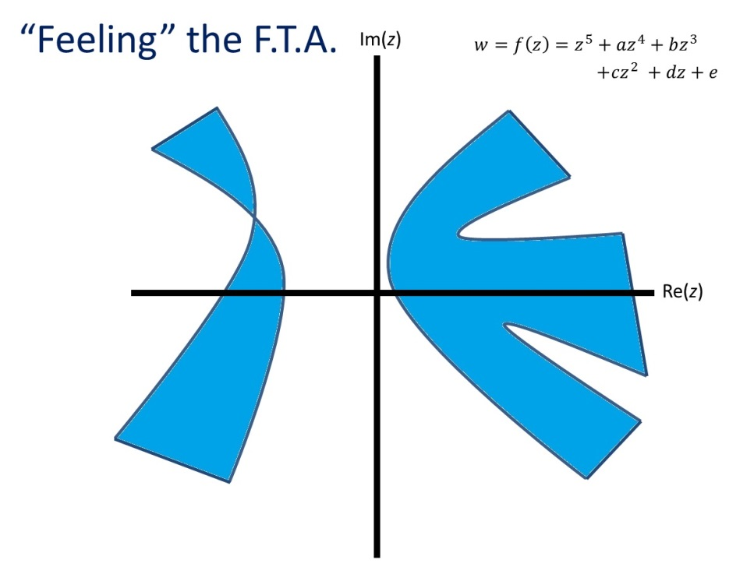
“Feeling” the Fundamental Theorem of Algebra – An Intuitive Argument

Slide 25
A Weird Example
Note. We mention in passing that there are exotic settings where a polynomial of degree $n$ may have more than $n$ roots. This happens in the division ring of the real “quaternions.” The quaternions are of the form $a+bi+cj+dk$ where $a, b, c, d$ are real numbers and $i, j, k$ satisfy the following multiplication rules:
$$∙$$ | $$1$$ | $$i$$ | $$j$$ | $$k$$ | $$−1$$ | $$−i$$ | $$−j$$ | $$−k$$
$$1$$ | $$1$$ | $$i$$ | $$j$$ | $$k$$ | $$−1$$ | $$−i$$ | $$−j$$ | $$−k$$
$$i$$ | $$i$$ | $$−1$$ | $$k$$ | $$−j$$ | $$−i$$ | $$1$$ | $$−k$$ | $$j$$
$$j$$ | $$j$$ | $$−k$$ | $$−1$$ | $$i$$ | $$−j$$ | $$k$$ | $$1$$ | $$−i$$
$$k$$ | $$k$$ | $$j$$ | $$−i$$ | $$−1$$ | $$−k$$ | $$−j$$ | $$i$$ | $$1$$
$$−1$$ | $$−1$$ | $$−i$$ | $$−j$$ | $$−k$$ | $$1$$ | $$i$$ | $$j$$ | $$k$$
$$−i$$ | $$−i$$ | $$1$$ | $$−k$$ | $$j$$ | $$i$$ | $$−1$$ | $$k$$ | $$−j$$
$$−j$$ | $$−j$$ | $$k$$ | $$1$$ | $$−i$$ | $$j$$ | $$−k$$ | $$−1$$ | $$i$$
$$−k$$ | $$−k$$ | $$−j$$ | $$i$$ | $$1$$ | $$k$$ | $$j$$ | $$−i$$ | $$−1$$
If we consider the degree 2 polynomial $x^{2}+1$, we find that it has at least 6 roots, namely $±i$, $±j$, and $±k$. In fact, it has an infinite number of roots! See page 160 of Hungerford’s Algebra (Springer-Verlag, 1974).
Note. It is the absence of commutivity that allows the weirdness of this example. If we have an integral domain, then a degree $n$ polynomial will have at most $n$ roots (see Theorem III.6.7 of Hungerford).

Slide 26
Complex Numbers and the Complex Plane
Im(z)
$$z=r\left(\cos{θ}+i\sin{θ}\right)$$
$$r$$
$$θ$$
Re(z)

Slide 27
Multiplication of complex numbers results in addition of arguments
Im(z)
$$z^{2}=0+i, \text{arg}\left(z^{2}\right)=π/2$$
$$z=\frac{\sqrt{2}}{2}+i\frac{\sqrt{2}}{2},$$
$$\text{arg}\left(z\right)=π/4$$
$$z=−1+i0, \text{arg}\left(z\right)=π$$
Re(z)
$$z^{2}=1+i0, \text{arg}\left(z^{2}\right)=2π$$

Slide 28
Mappings of $f\left(z\right)=z^{5}$
Im(z)
$$\text{|}\text{arg}\left(z^{5}\right)|≤π/2$$
$$π\text{/10}≤\text{arg}\left(z\right)≤3π/10$$
$$\text{|}\text{arg}\left(z\right)|≤π/10$$
Re(z)
$$π\text{/}2≤\text{|}\text{arg}\left(z^{5}\right)|≤3π/2$$

Slide 29
Sectors Mapped to $\text{Re}\text{(}\text{w}\text{)}≥0$
Under $w=f\left(z\right)=z^{5}$
Im(z)
Re(z)

Slide 30
More Mappings of $w=f\left(z\right)=z^{5}$
Im(z)
Im(w)
$$w=z^{5}$$
Re(w)
Re(z)
$$\text{Im}\text{(}\text{w}\text{)}<0$$
$$\text{Re}\text{(}\text{w}\text{)}≥0$$

Slide 31
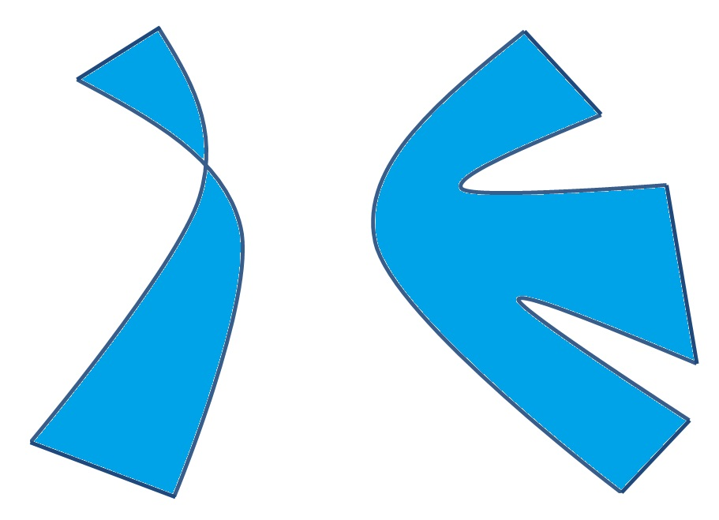
“Feeling” the F.T.A.
Im(z)
$$w=f\left(z\right)=z^{5}+az^{4}+bz^{3}$$
$$+cz^{2} +dz+e$$
*
*
Mapped to positive imaginary axis
*
Re(z)
*
*
*Mapped to $\text{Re}\text{(}\text{w}\text{)}≥0$
Mapped to the imaginary axis, $\text{Im}\left(w\right)=0$
Mapped to negative imaginary axis

Slide 32
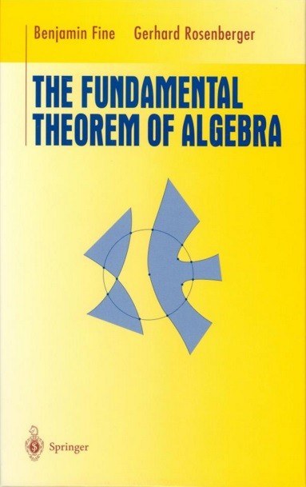
Note. The mathematical details of this are explained in Appendix A of Fine and Rosenberger’s The Fundamental Theorem of Algebra, Springer-Verlag (1997).

Slide 33
REFERENCES
MacTutor FTA website: http://www-history.mcs.st-and.ac.uk/HistTopics/Fund_theorem_of_algebra.html
J. Derbyshire, Unknown Quantity: A Real and Imaginary History of Algebra, Plume (2007).
B. Fine and G. Rosenberger, The Fundamental Theorem of Algebra, Springer-Verlag (1997).
T. Hungerford, Algebra, Springer-Verlag (1974).
I. Kleiner, A History of Abstract Algebra, Birkhäuser (2007).
M. Kline's Mathematical Thought from Ancient to Modern Times, Oxford University Press (1972).
P. Pesic, Abel’s Proof: An Essay on the Sources and Meaning of Mathematical Unsolvability, MIT Press (2004).
QUESTIONS?

