Slide 1
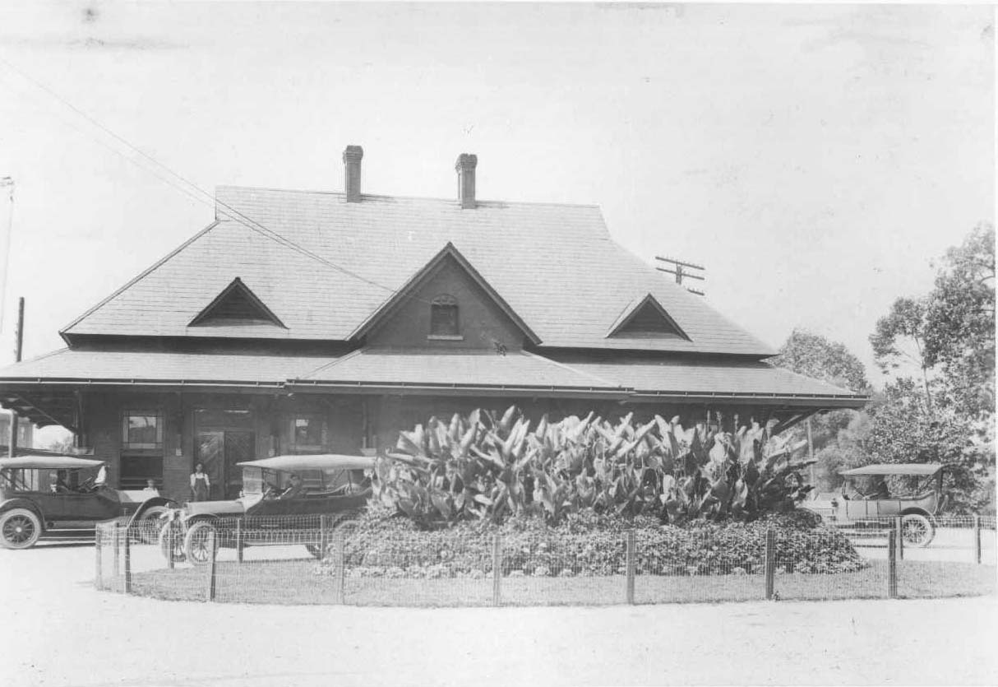
Johnson City History: Some of the Downtown Buildings
Presented at Yee Haw Brewing Company
Robert “Dr. Bob” Gardner
July 30, 2017

Slide 2
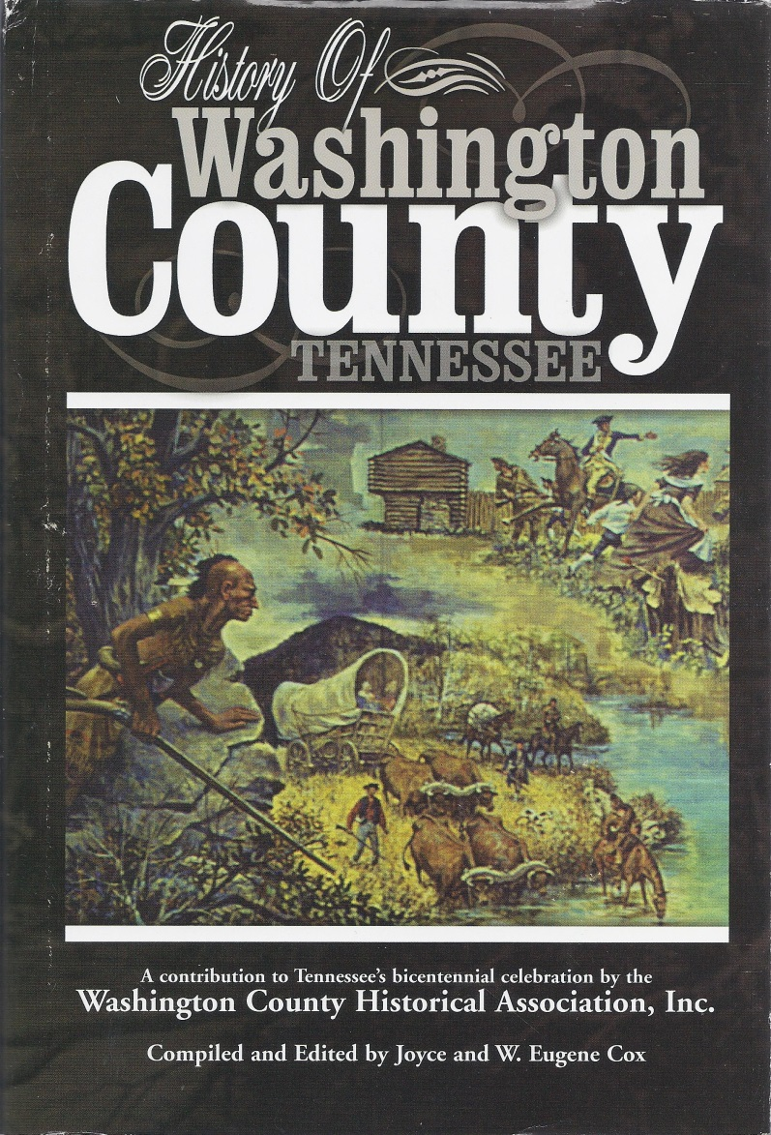
The Cherokee
Overmountain Press (2001)

Slide 3
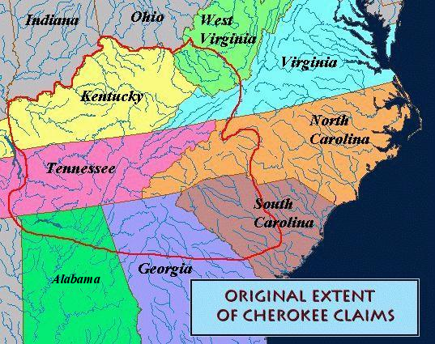
Cherokee Lands
https://chenocetah.wordpress.com/tag/map-of-cherokee-indian-lands/

Slide 4
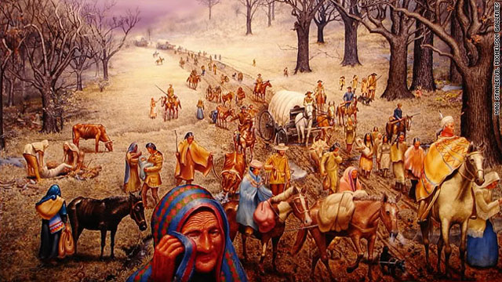
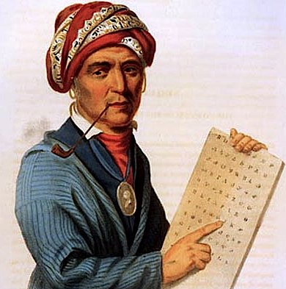
Cherokee Native Americans
https://www.americanhistoryusa.com/the-cherokee-acculturation/
http://www.cnn.com/2010/OPINION/11/15/langguth.trail.of.tears/

Slide 5
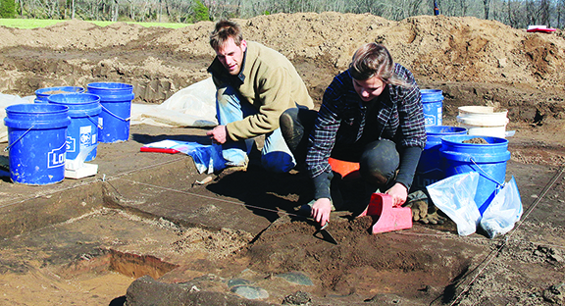
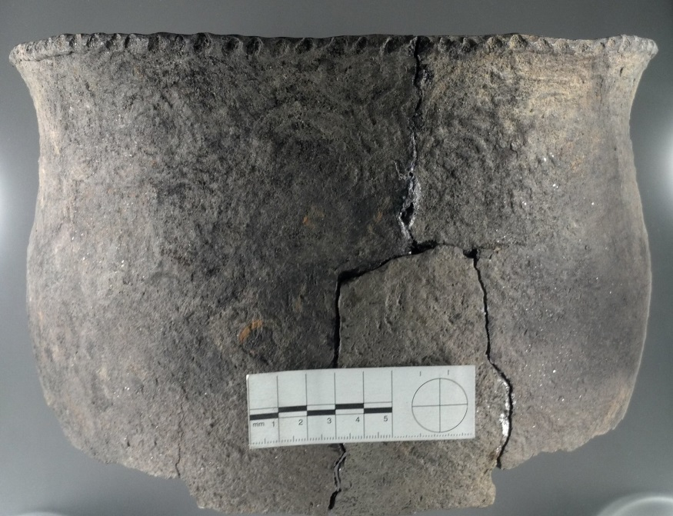
Protohistoric Cherokee Town Cane Notch
ETSU archaeology students excavating at Cane Notch on the Nolichucky River .
From: http://jcnewsandneighbor.com/peeling-back-the-cherokee-past/#prettyPhoto
http://faculty.etsu.edu/franklij/etsu_archaeological_field_school_10.htm

Slide 6
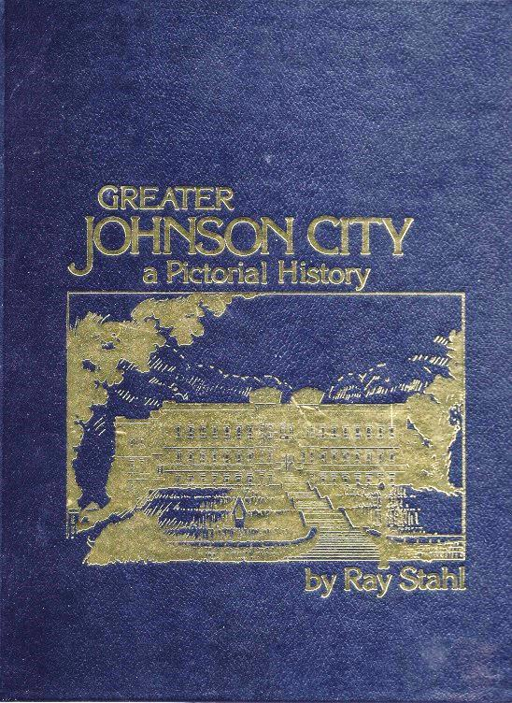
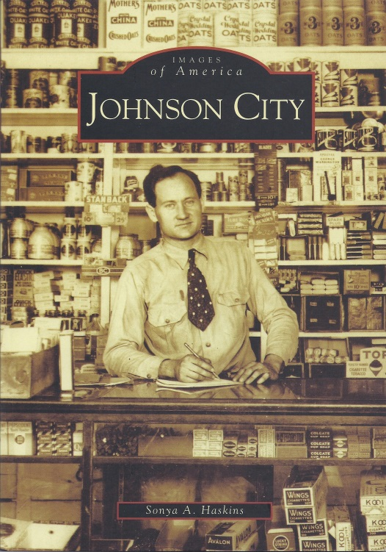
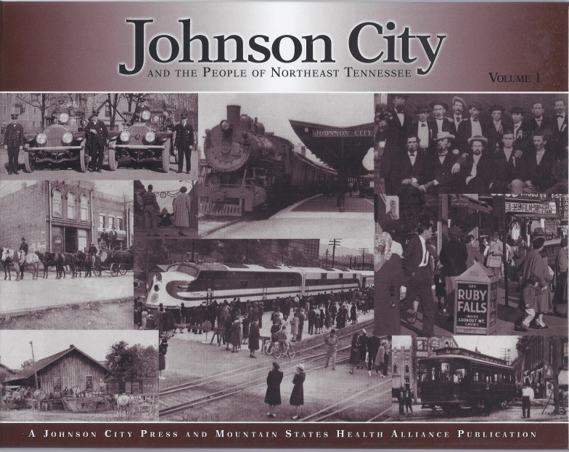
Henry Johnson and Johnson’s Depot
Johnson City Press (2006)
(1983, 1986, 1992)
(2005)

Slide 7
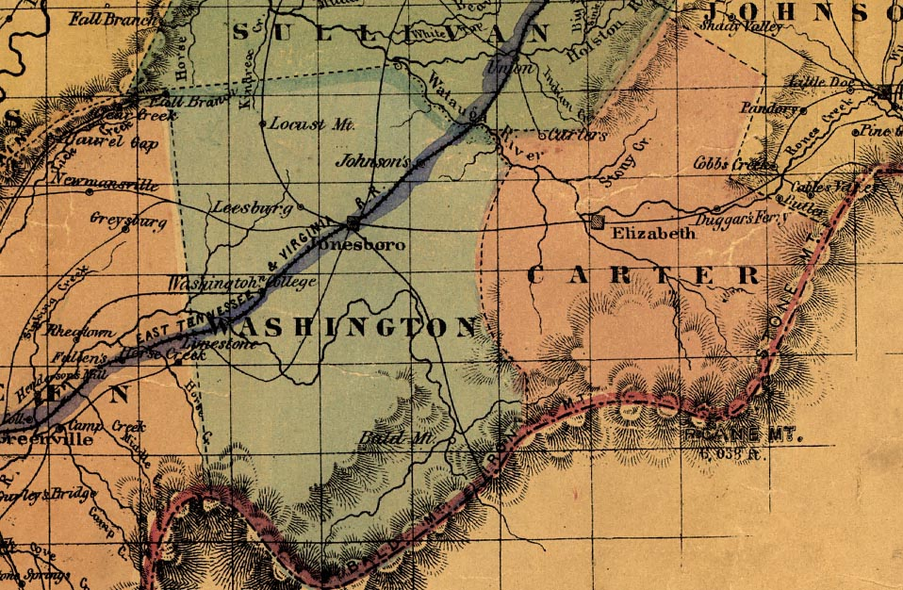
Railroads Make Johnson City
http://www.stateoffranklin.net/johnsons/maps/tennmap1861.jpg

Slide 8
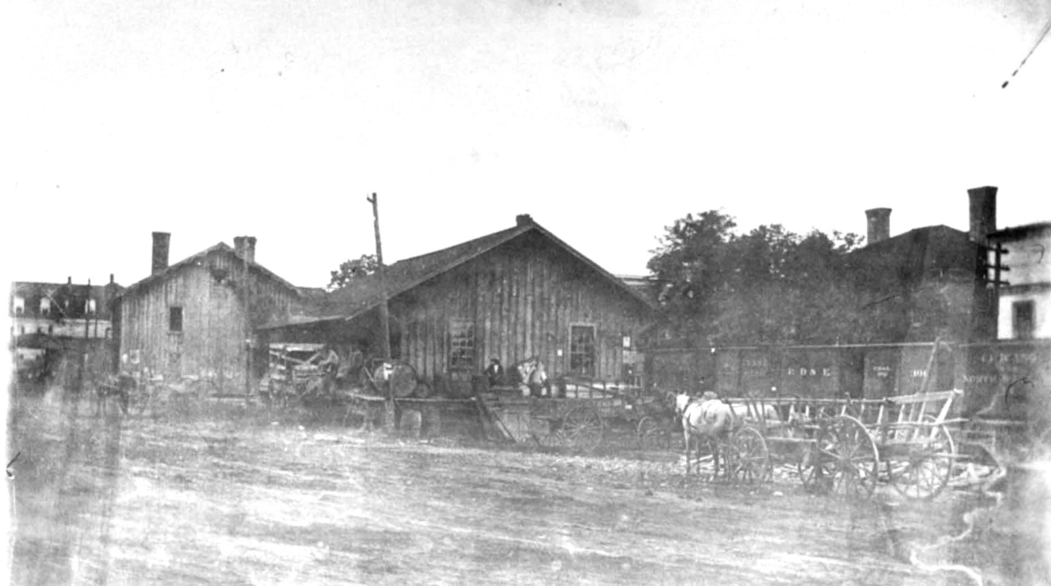
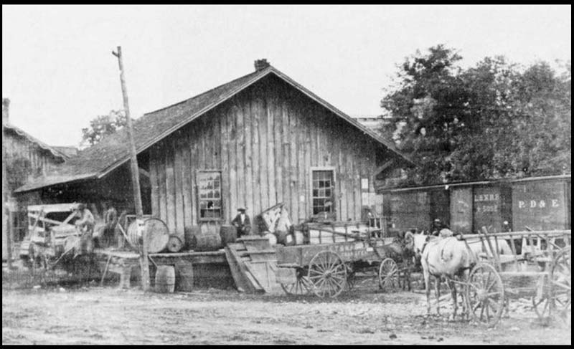
Johnson’s Depot
http://www.stateoffranklin.net/johnsons/images/photos/photos1/hendepot1.jpg

Slide 9
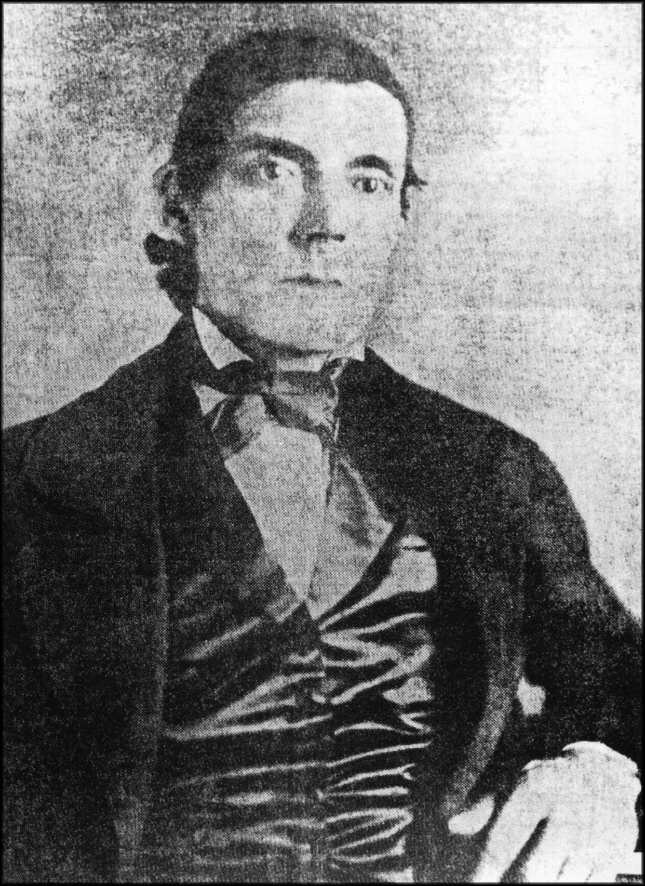
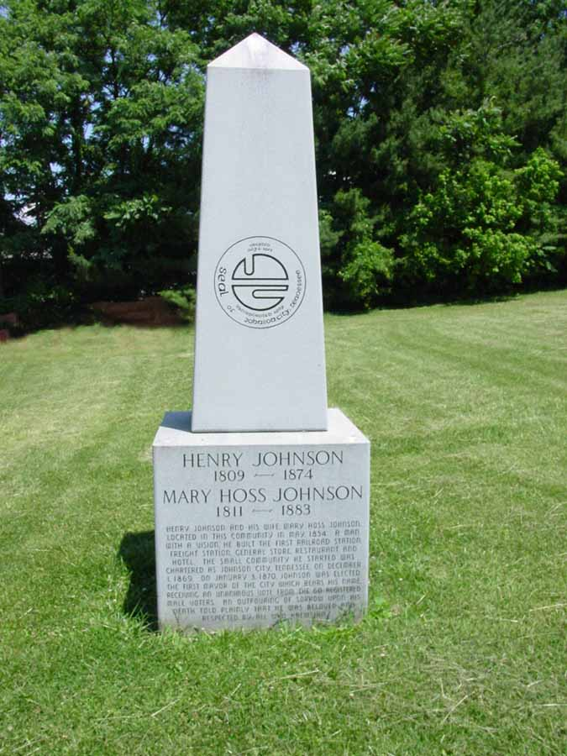
Henry Johnson
http://www.stateoffranklin.net/johnsons/cemeteries/oakhill/hjmarker1.jpg
http://www.bcyesteryear.com/node/688

Slide 10
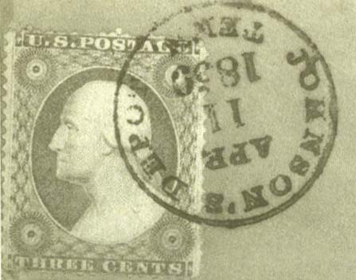

Slide 11
Where Was It?
Johnson’s Store and Residence
East TN, VA and GA Railroad Station
Hoss House

Slide 12
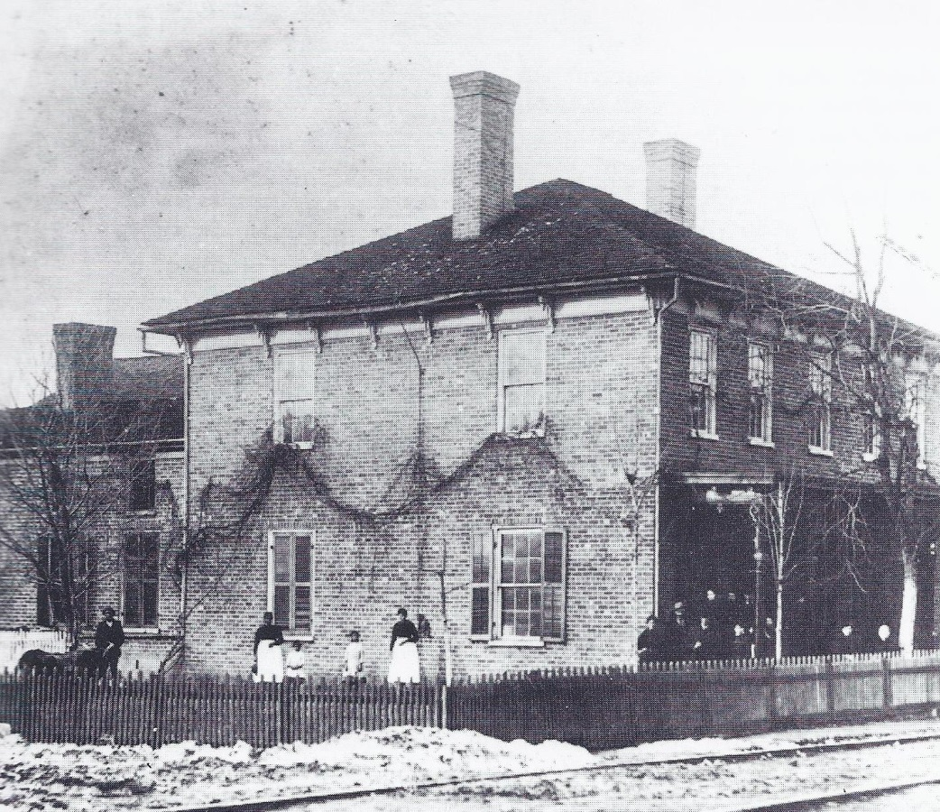
Hoss House
From page 51 of Ray Stahl’s Greater Johnson City, A Pictorial History.

Slide 13
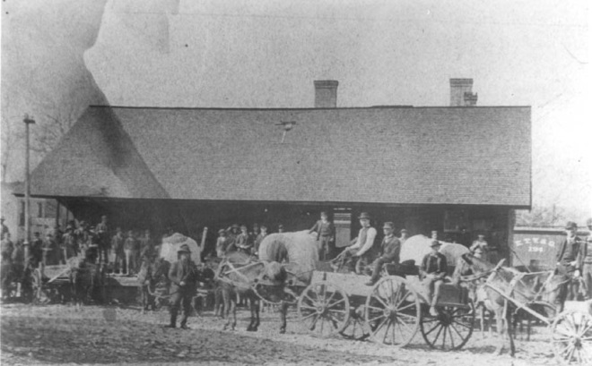
East Tennessee, Virginia, and Georgia Railroad Station (1886)
Hoss House

Slide 14
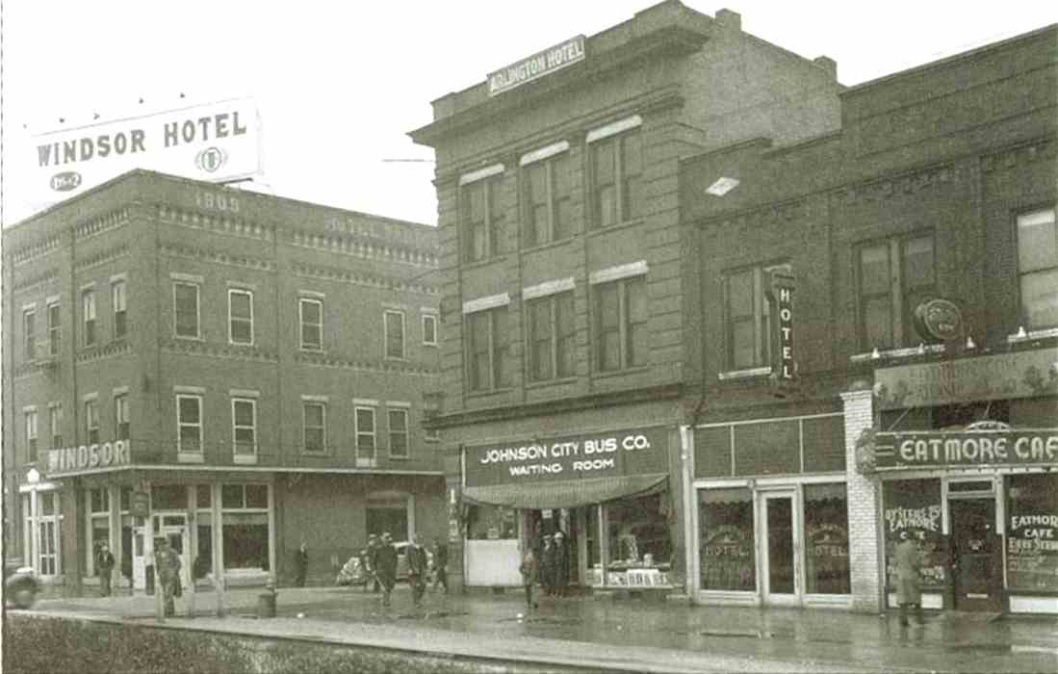
Pardue/Windsor Hotel, Arlington Hotel
From: http://www.johnsoncitypress.com/gallery/A-look-at-Downtown-Johnson-City-then-and-now-COPY-0

Slide 15
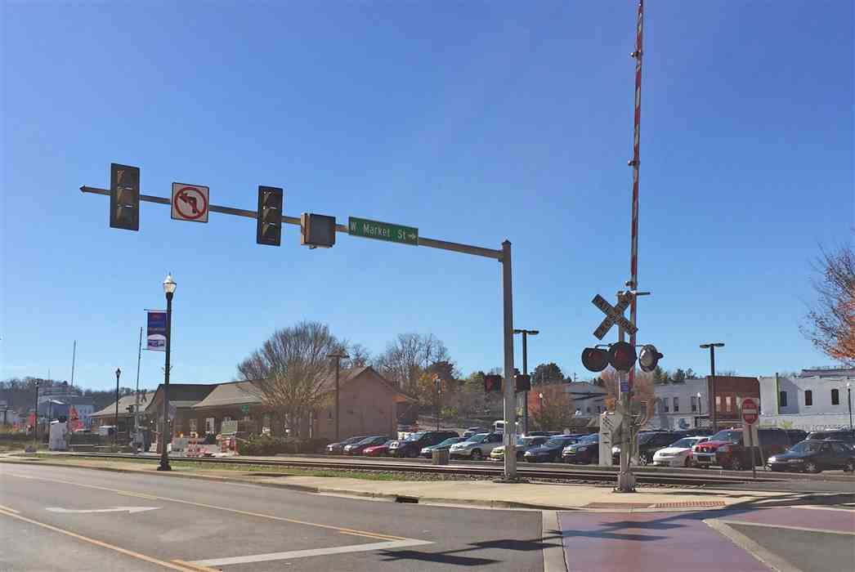
http://www.johnsoncitypress.com/gallery/A-look-at-Downtown-Johnson-City-then-and-now-COPY-0

Slide 16
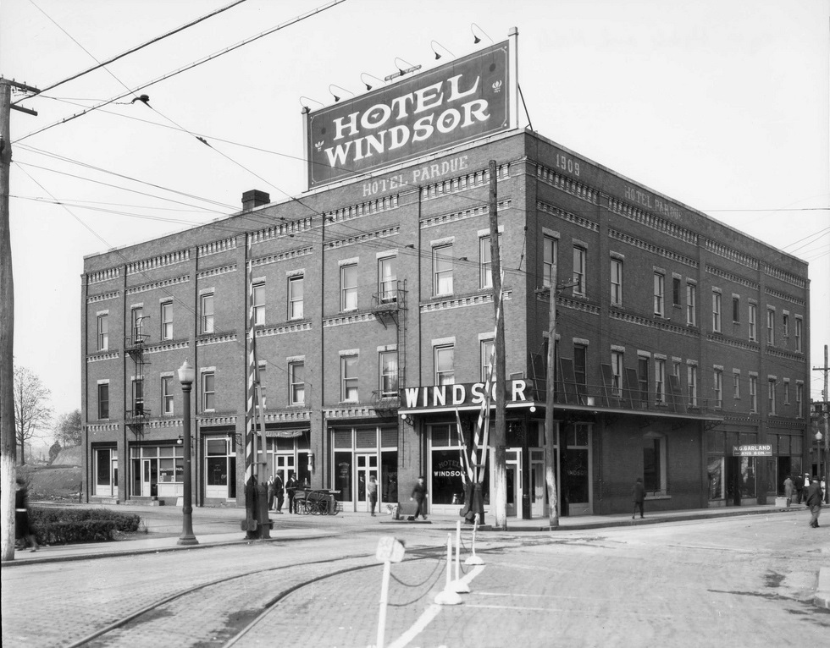
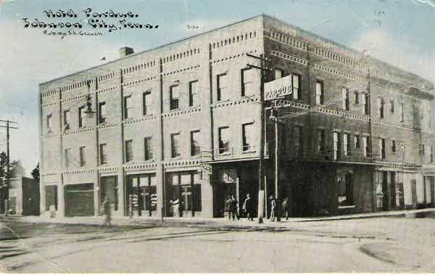

Slide 17
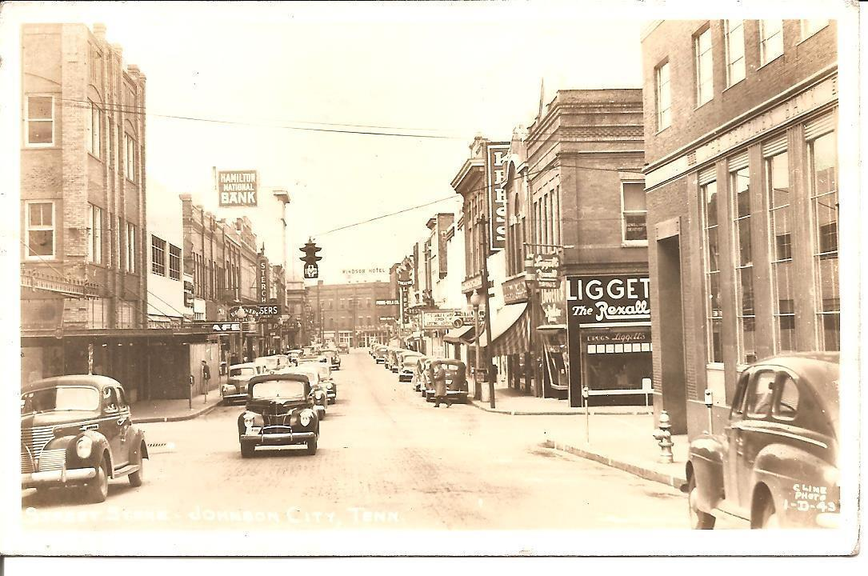
View Down Main Street, 1943

Slide 18
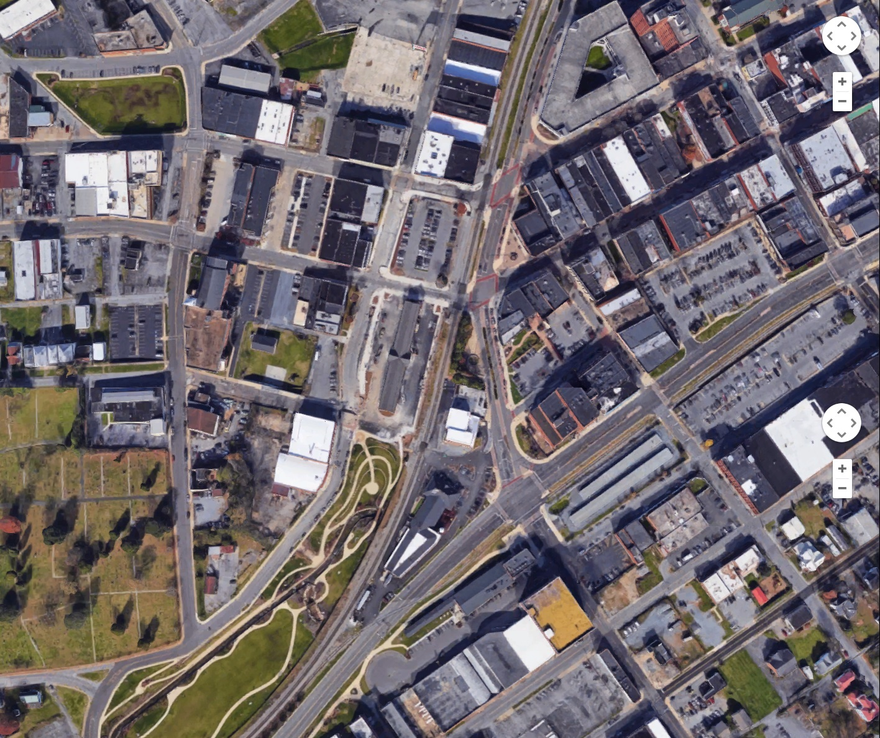

Slide 19
Hoss House
x Site of Johnson’s Depot
x
Johnson’s Store
E TN, VA, GA Station

Slide 20
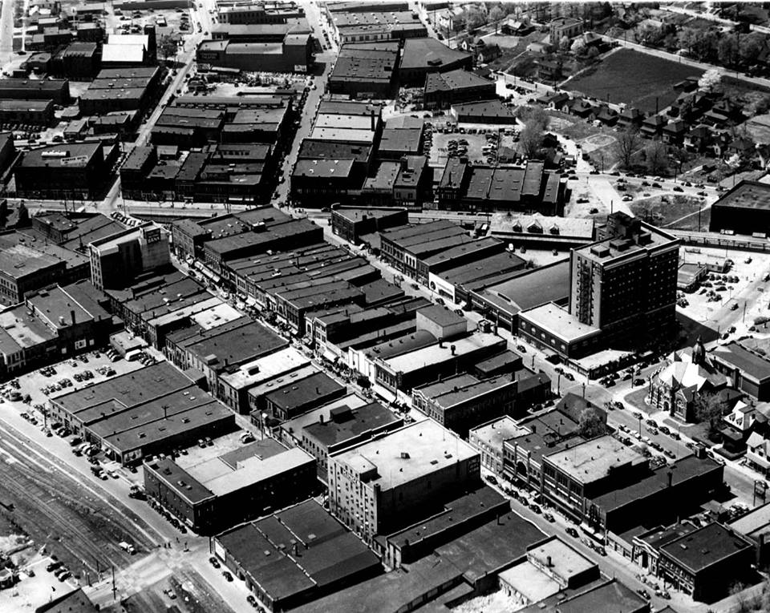
1940
From Johnson’s Depot

Slide 21
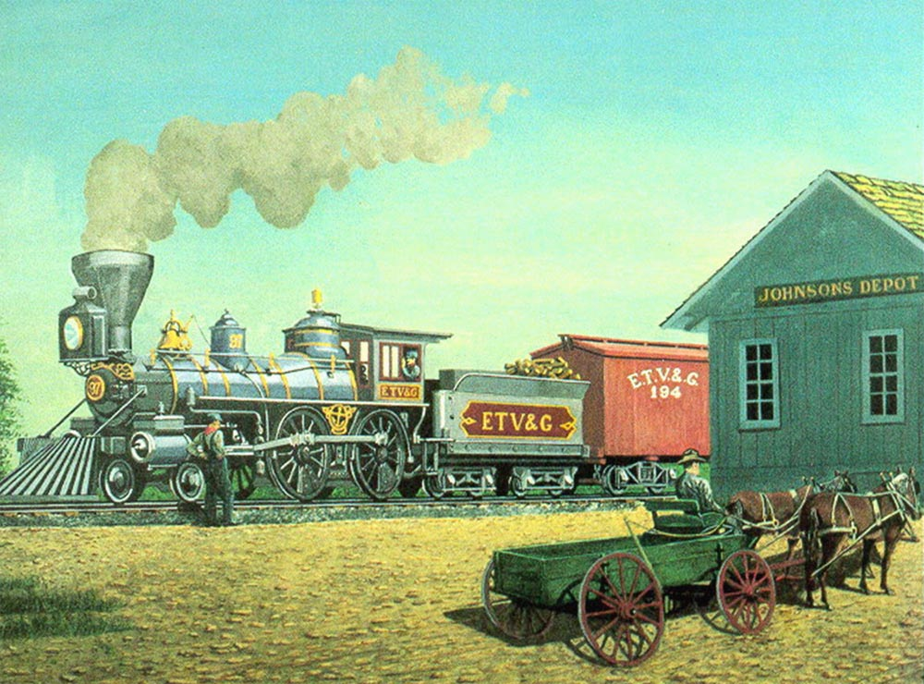
There seems to be no photo of Johnson’s Depot building, but…

Slide 22
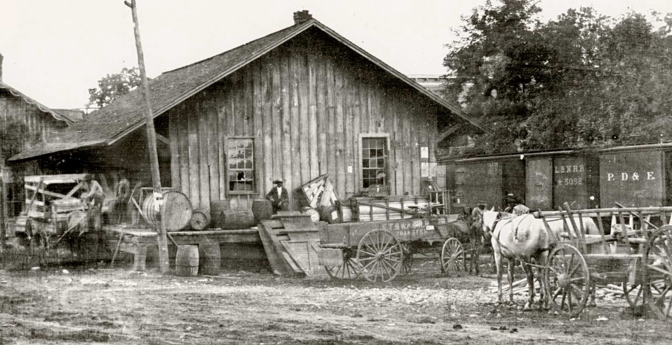
What’s This?
?

Slide 23
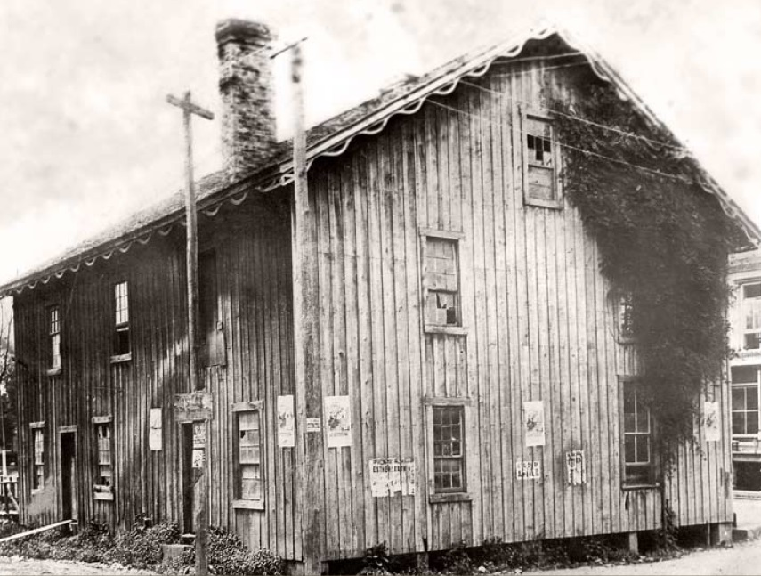
…and that?
?

Slide 24
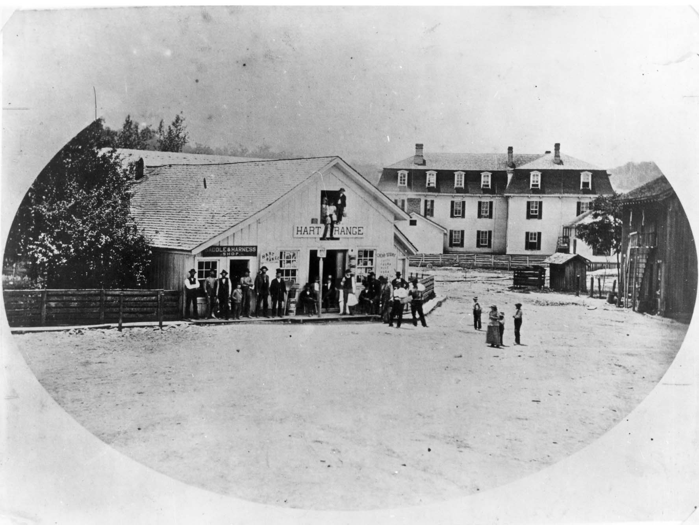
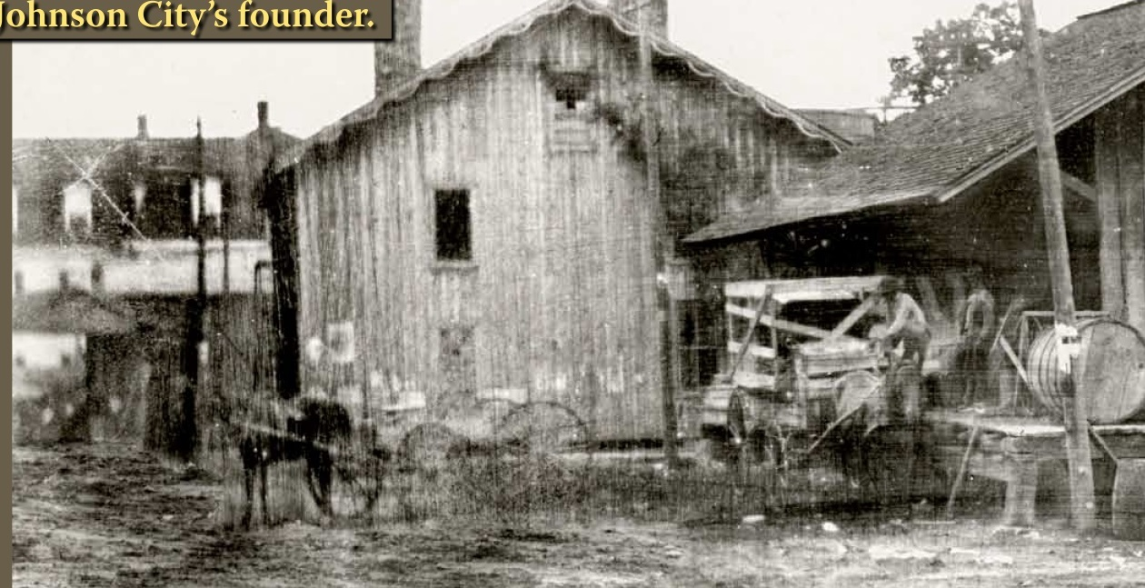
City Hotel

Slide 25
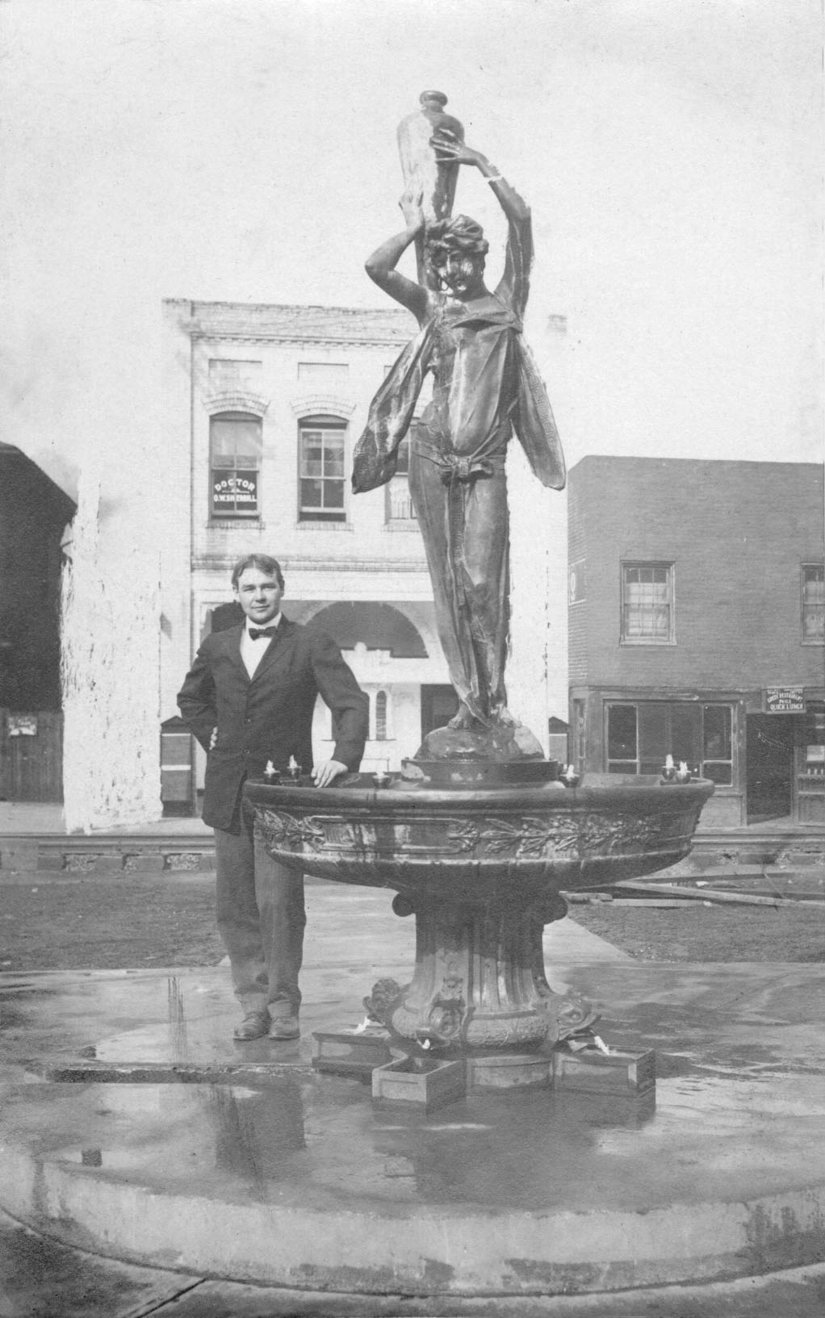
Fountain Square

Slide 26
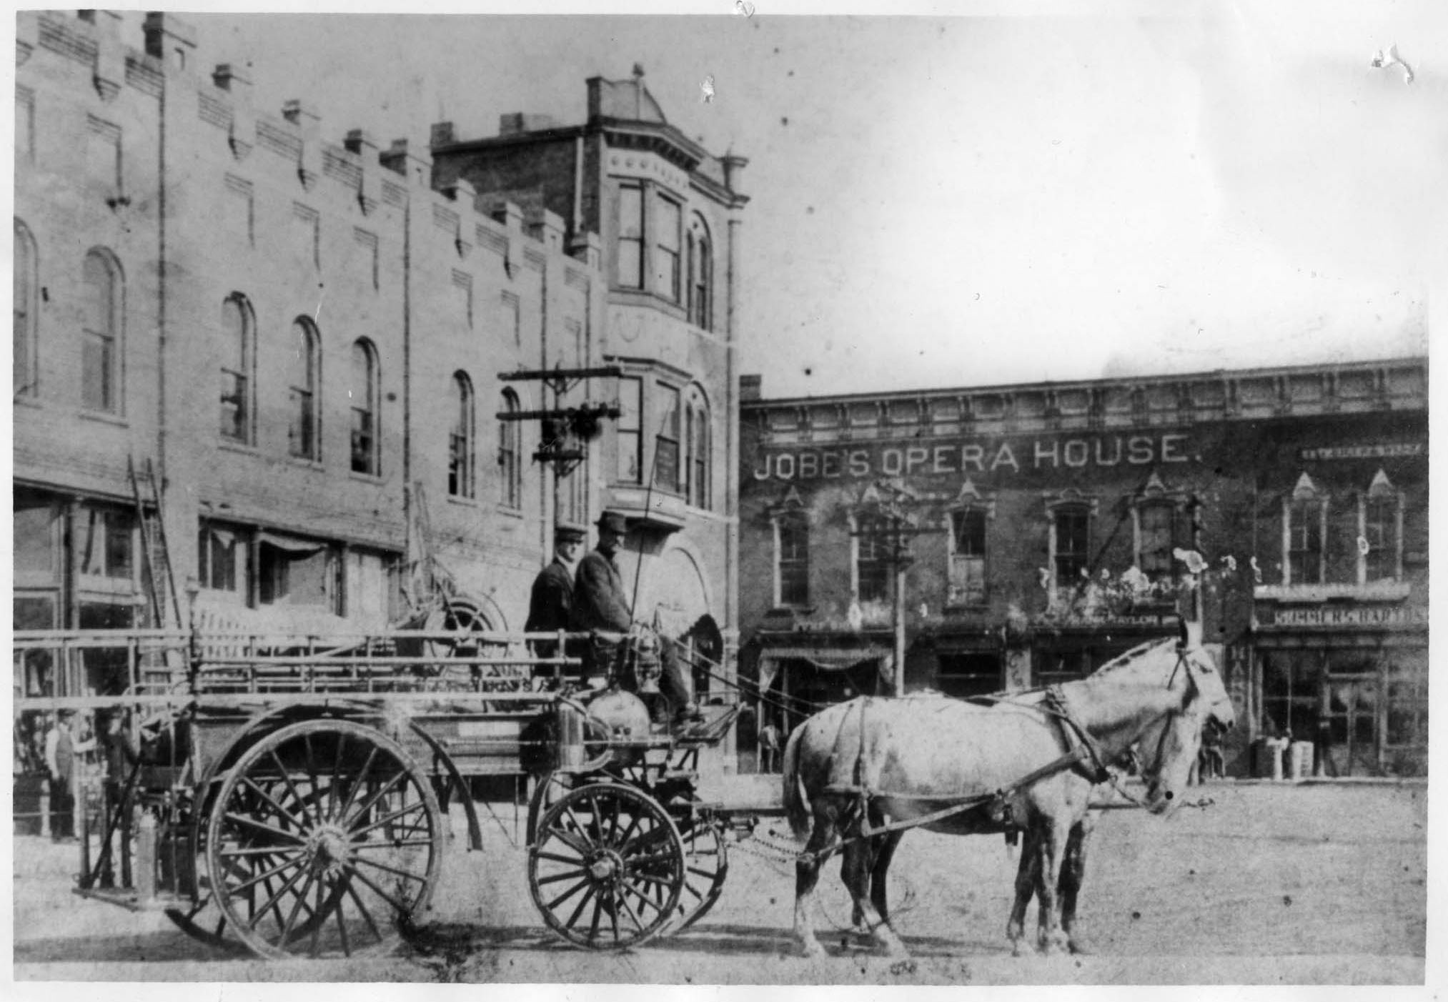
Fountain Square 1
http://www.stateoffranklin.net/johnsons/images/photos/photos1/jobeopera.jpg

Slide 27
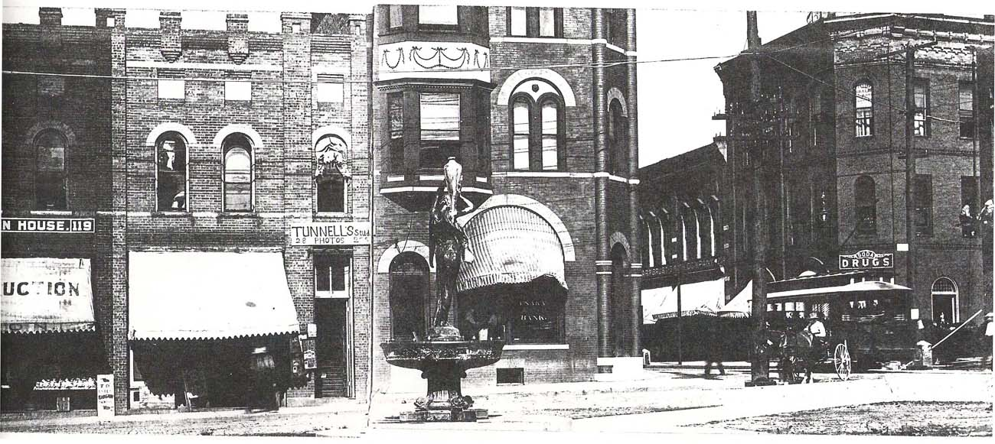
Fountain Square 2
http://www.stateoffranklin.net/johnsons/images/photos/photos1/ftnsquare2a.jpg

Slide 29
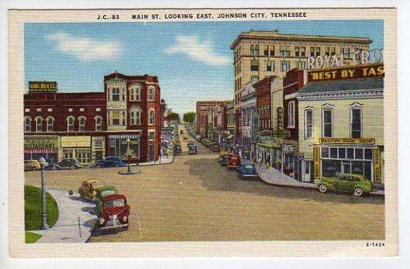
Fountain Square, Looking East

Slide 30
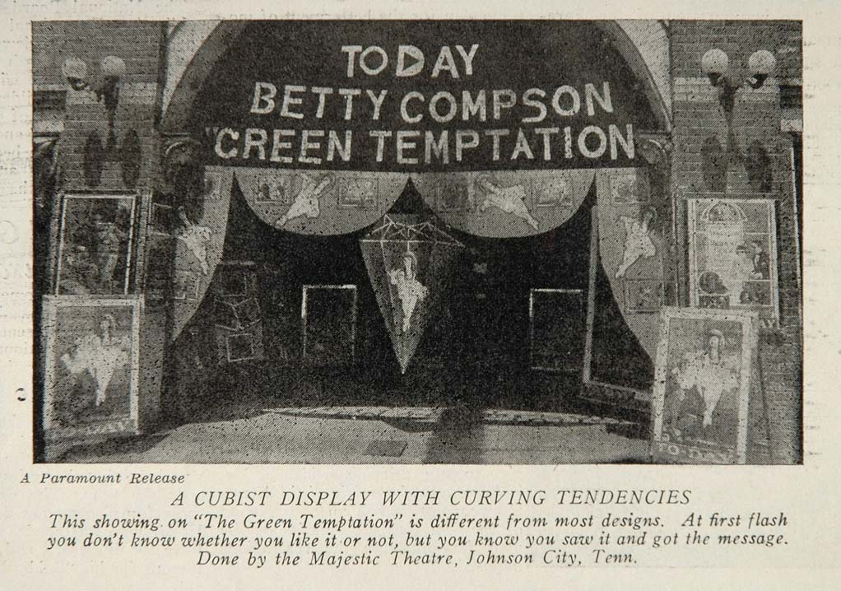
Theaters

Slide 31
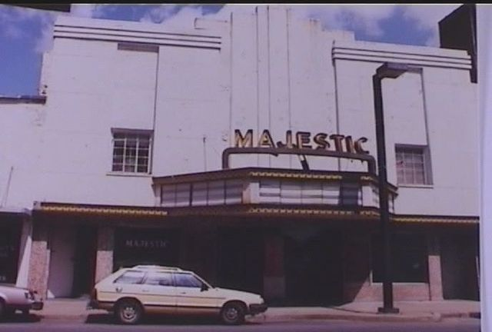
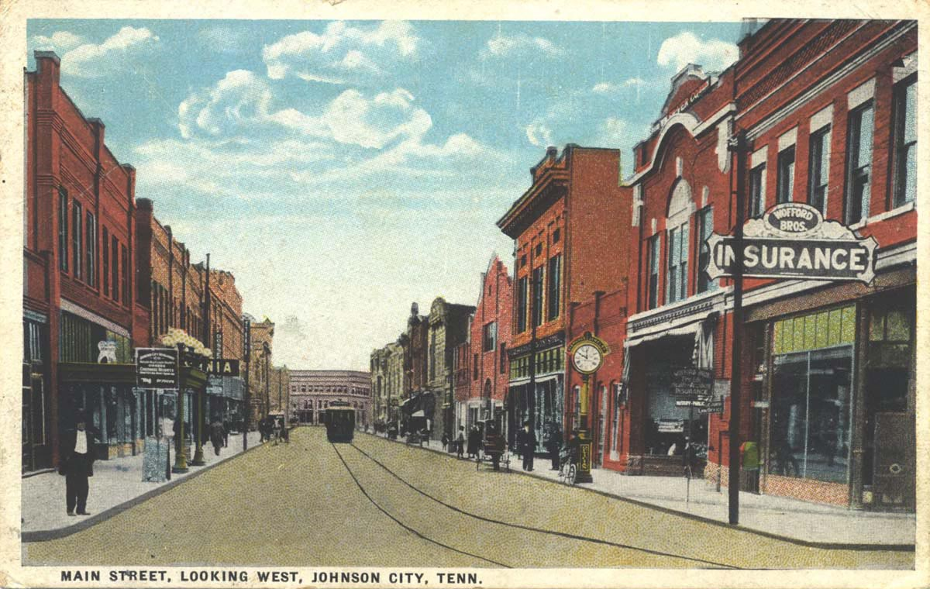
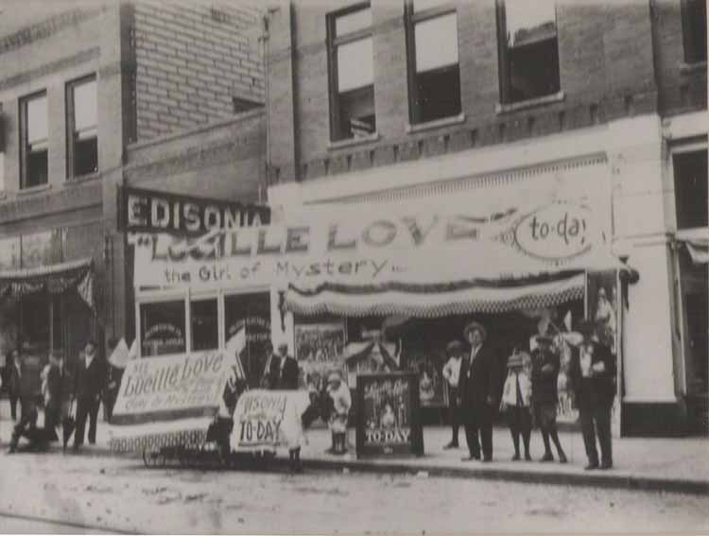
Main Street Looking West

Slide 32
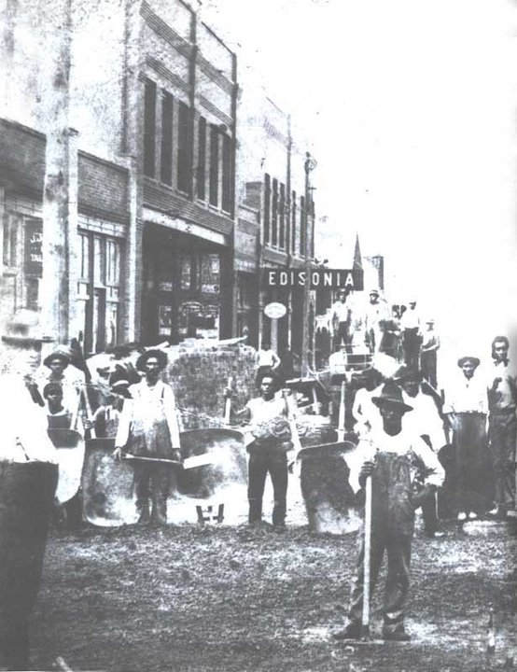
Edisonia 1
Lucille Love, the Girl of Mystery
Laying Brick on Main Street

Slide 33
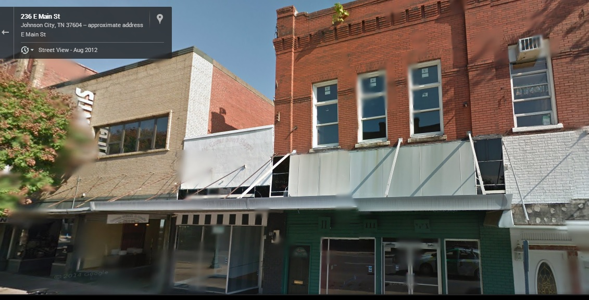
Edisonia 2

Slide 34
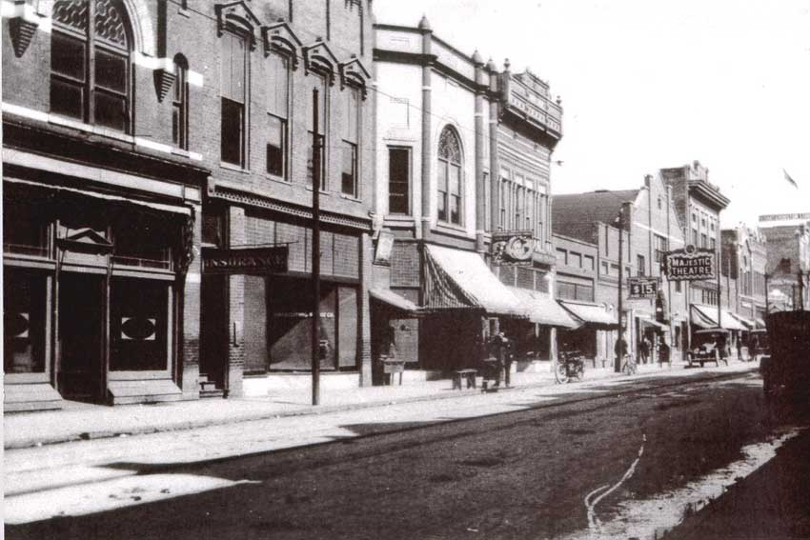
Majestic Theater 1

Slide 35
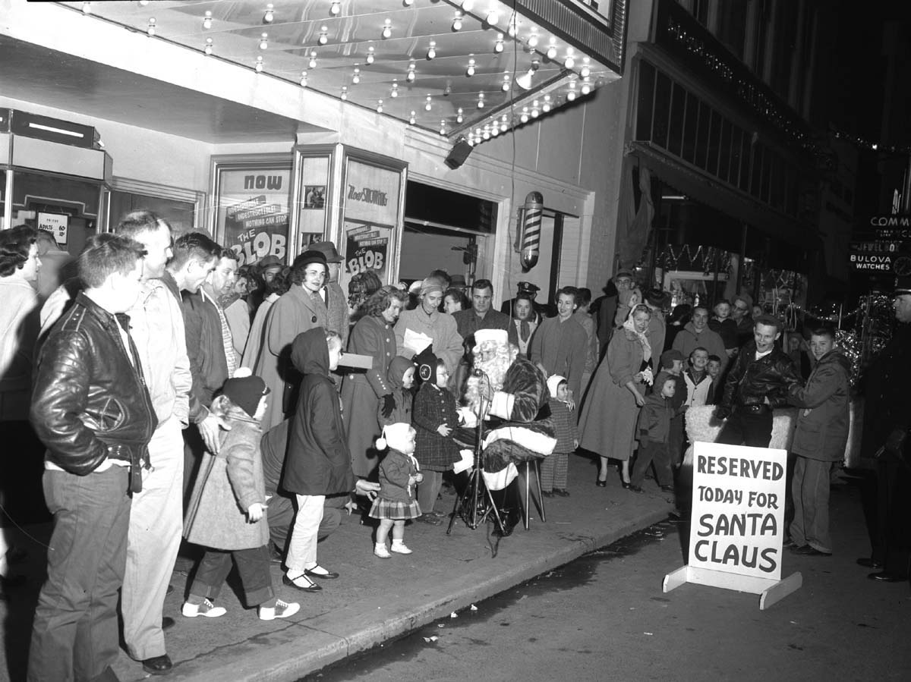
Majestic Theater 2

Slide 37
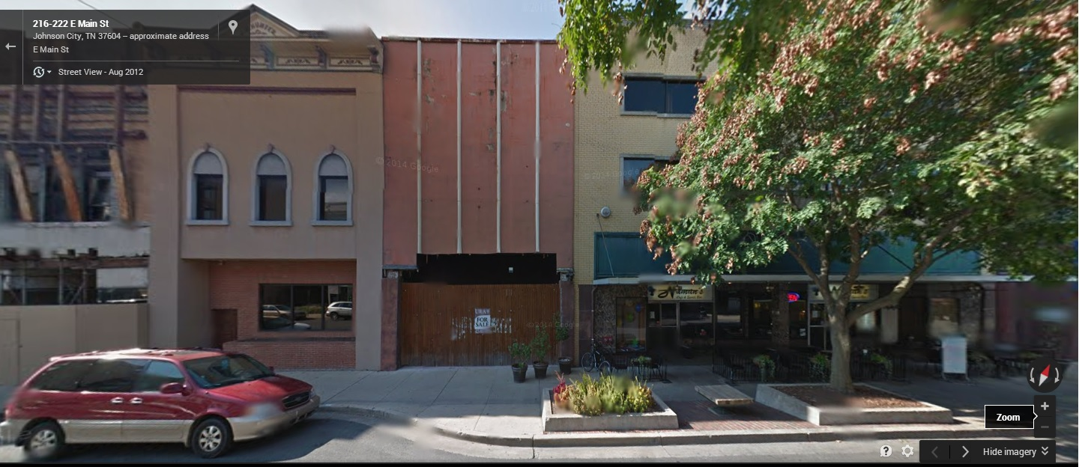
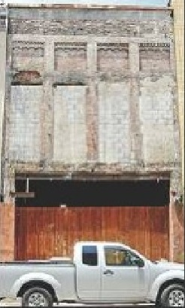
Liberty Theater

Slide 38
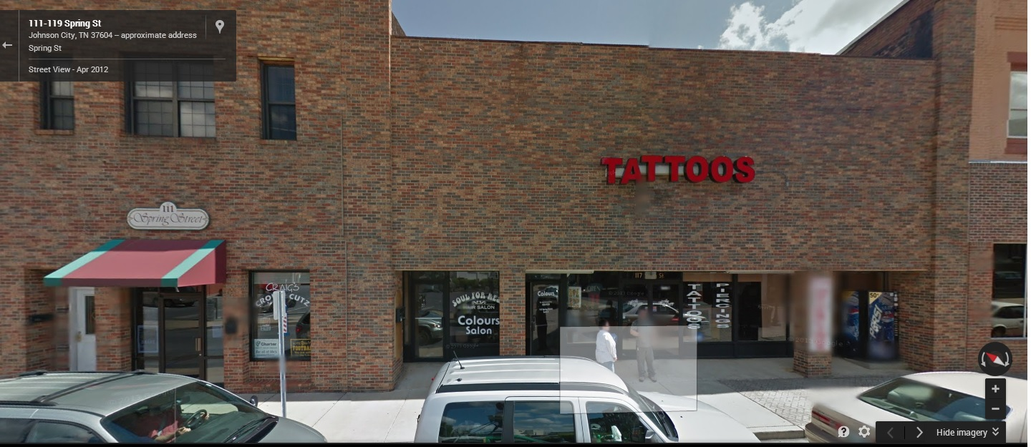
Sevier Theater

Slide 39
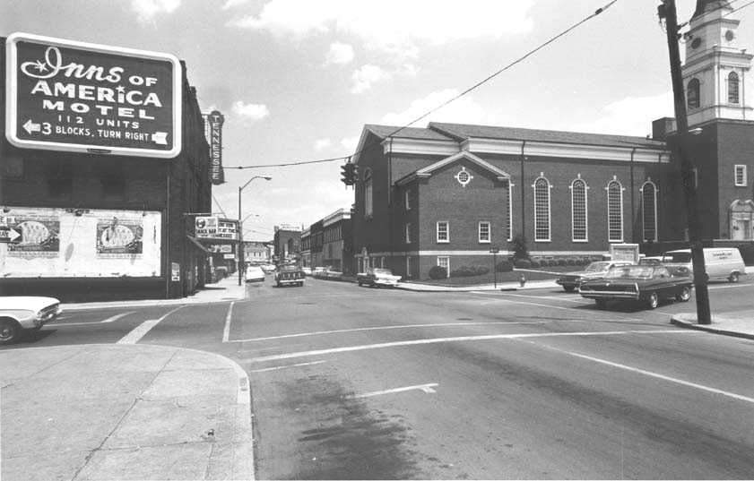
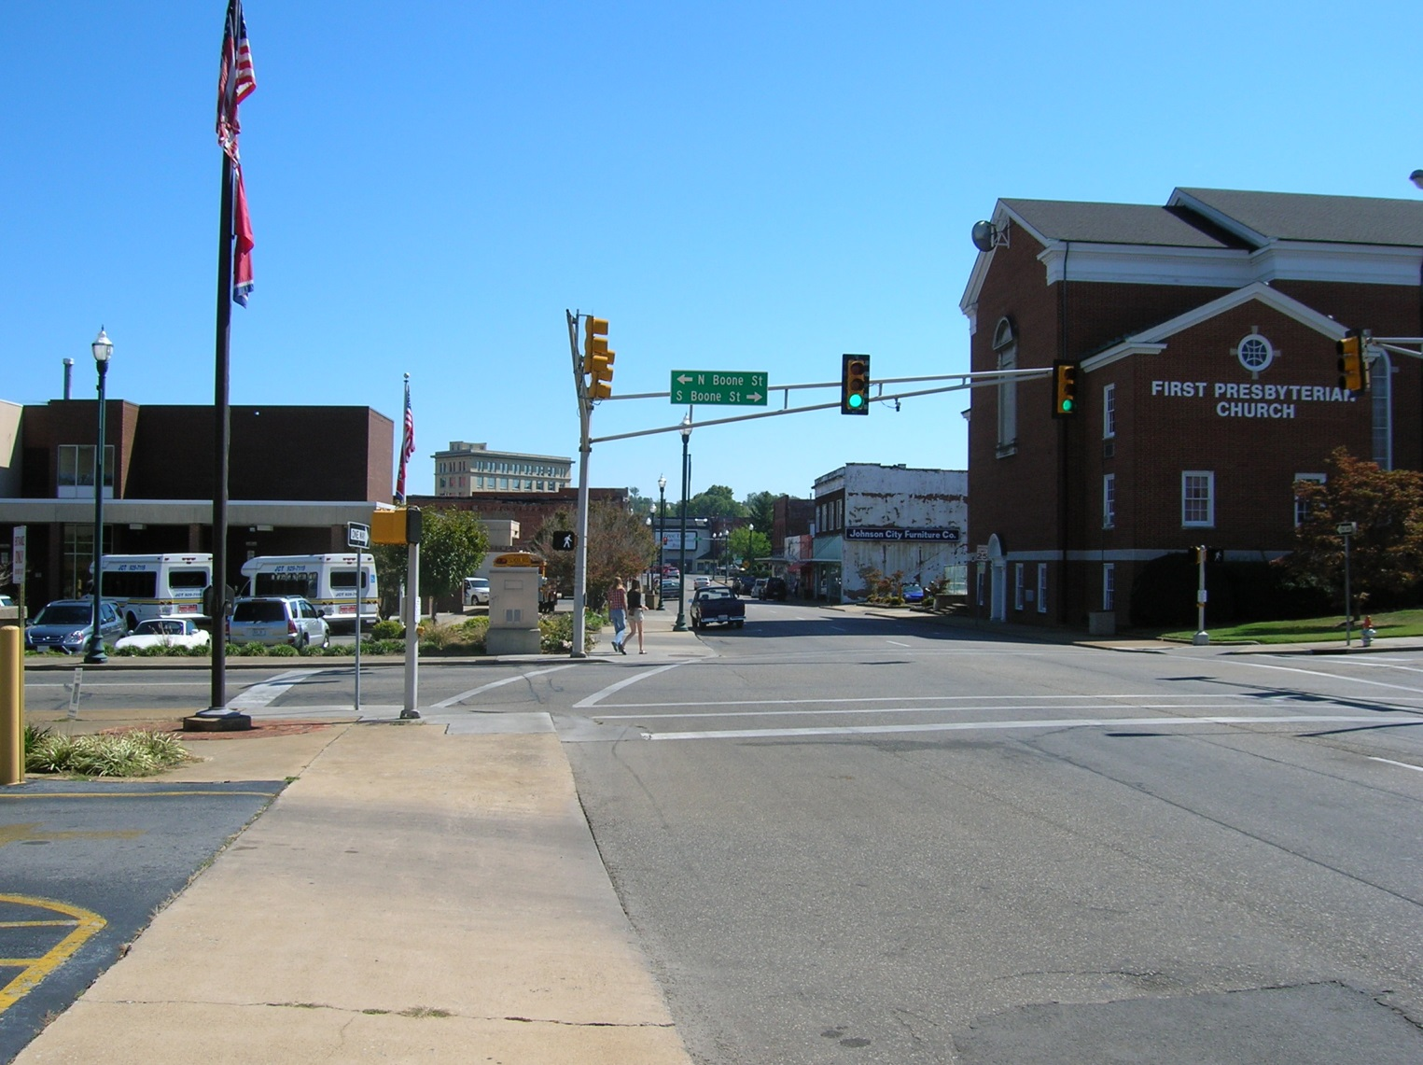
Tennessee Theater 1

Slide 40
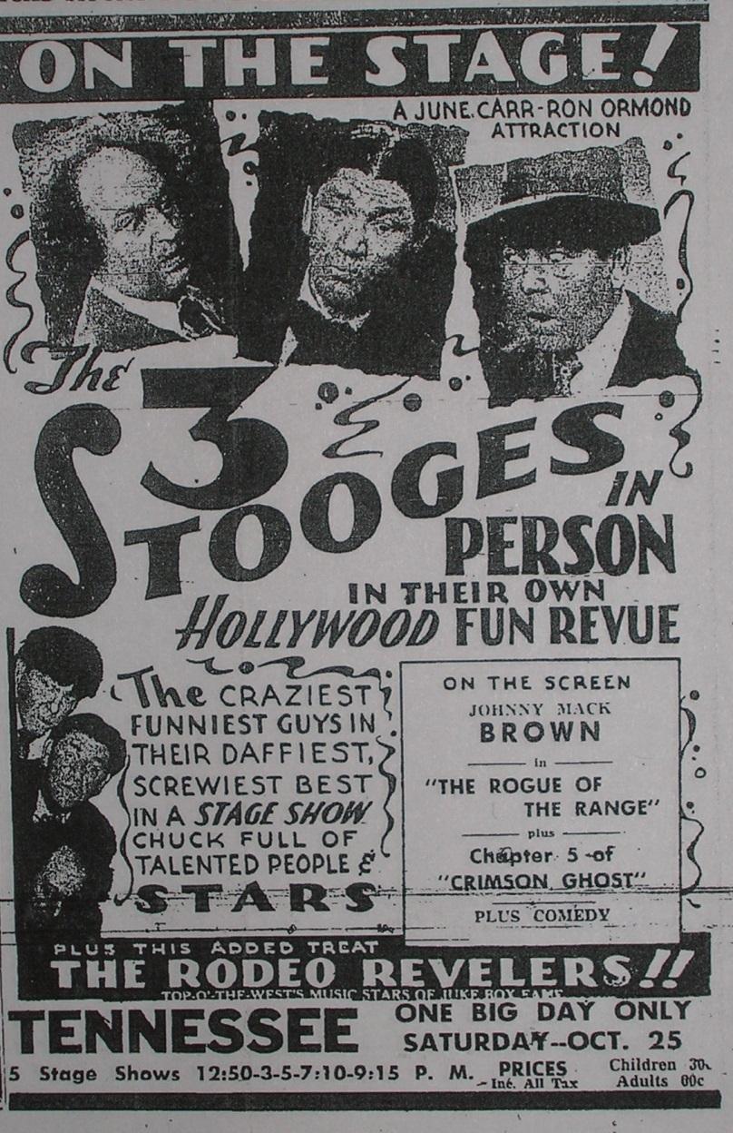
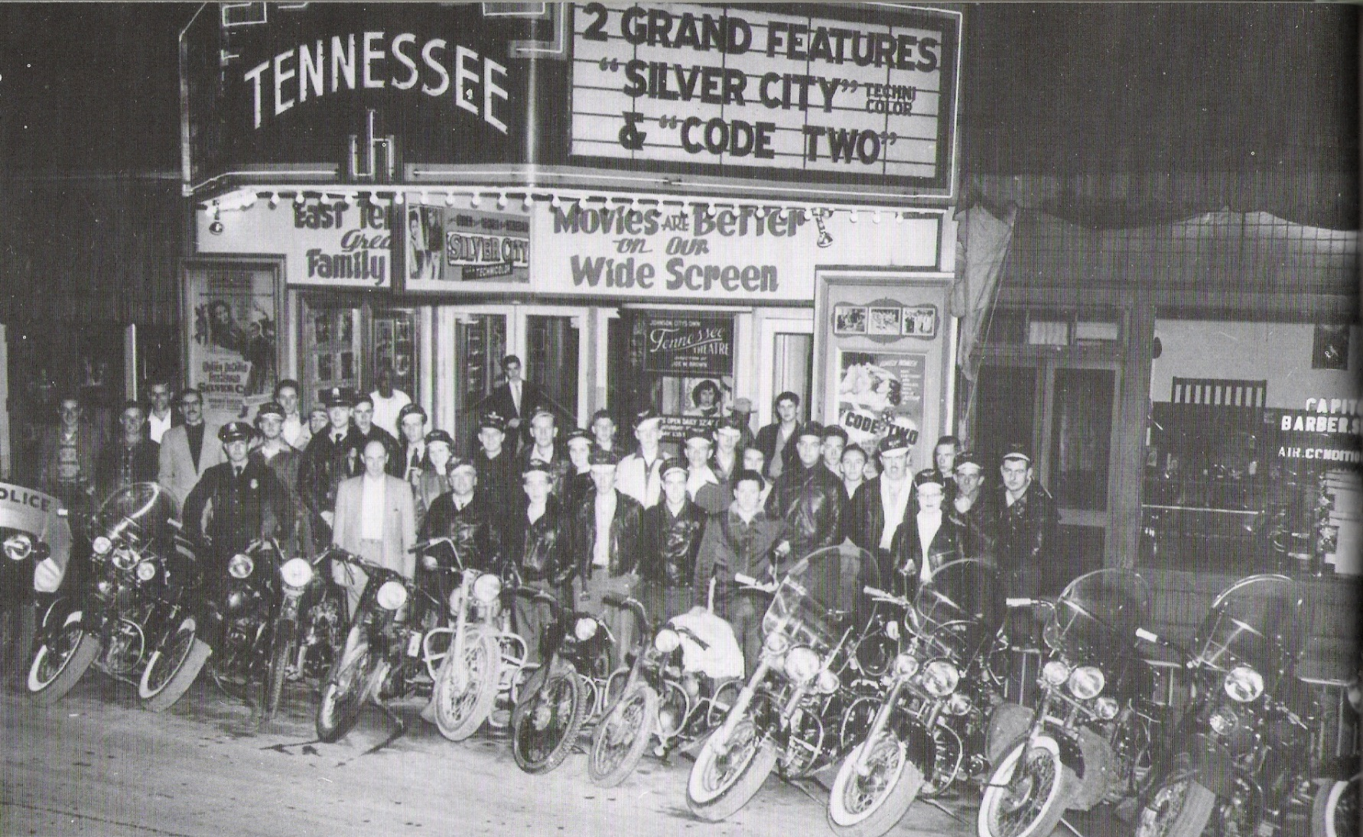
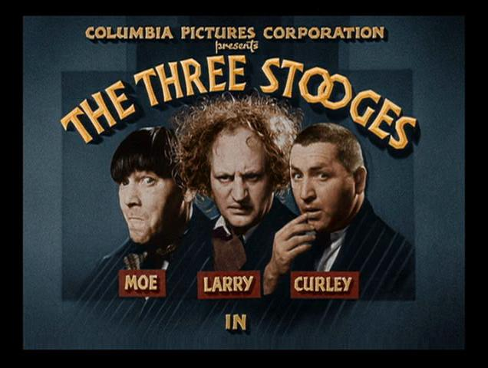
Tennessee Theater 2
See Bob Cox article, Johnson City Press, April 6, 2009.
Three Stooges appear at Tennessee Theater on October 25, 1947

Slide 41
Railroad Stations

Slide 42
1940
Fountain Square
Southern Depot
Sevier Hotel
King Center
From Johnson’s Depot

Slide 43
Southern Railroad Station, 1912-1973

Slide 44
Southern Railroad Station
See for more details: http://www.stateoffranklin.net/johnsons/southern/index_so.htm

Slide 45
CC&O Depot

Slide 46
CC&O Depot Before Renovation

Slide 47
CC&O Depot
as Tupelo Honey
From: Trip Advisor
http://jetsliketaxis.com/johnson-city/

Slide 48
ET&WNC Depot
The ET&WNC railroad depot building in the 1890s. http://www.johnsoncitypress.com/gallery/A-look-at-Downtown-Johnson-City-then-and-now-COPY-0

Slide 49
ET&WNC Depot, 1930
http://www.stateoffranklin.net/johnsons/images/photos/photos3/etwnc.jpg

Slide 51
Free Service Tire, circa 1960
http://www.stateoffranklin.net/johnsons/images/photos/photos3/etwnc.jpg

Slide 52
ET&WNC Depot Today
http://www.johnsoncitypress.com/gallery/A-look-at-Downtown-Johnson-City-then-and-now-COPY-0

Slide 53
The Giant Sign
From: Johnson City Press, February 3, 2017

Slide 54
The Giant Food Market Sign
From: http://downtownjc.com/wp-content/uploads/2017/02/Achieving-Landmark-Status-Brochure-final.pdf

Slide 55
King Creek Basin Project
From: Johnson City Press, March 12, 2017

Slide 58
Tipton Street

Slide 59
Tipton Street 1924
http://www.johnsoncitypress.com/gallery/A-look-at-Downtown-Johnson-City-then-and-now-COPY-0

Slide 60
Tipton Street Today
http://www.johnsoncitypress.com/gallery/A-look-at-Downtown-Johnson-City-then-and-now-COPY-0

Slide 61
Tipton Street Coca-Cola Sign
http://jetsliketaxis.com/johnson-city/

Slide 62
State Flag

Slide 63
The Tennessee State Flag
LeRoy Reeves
Oak Hill Cemetery
http://tngenweb.org/washington/files/2012/10/stateflagmkr.jpg
http://www.stateoffranklin.net/johnsons/cemeteries/oakhill/reeves.jpg
http://www.findagrave.com/cgi-bin/fg.cgi?page=gr&GRid=7716822

Slide 64
ETSU and the History of the Tennessee State Flag

Slide 65
Some of Reeves original of drawings are on display at:

Slide 66
ETSU
(1970s view)

Slide 67
From East Tennessee State Normal School to East Tennessee State University
(1947)
ETSU Press (1991)
(2010)

Slide 68
George L. Carter
1857-1936
A bust of George L. Carter sits outside of Mayetta Carter Hall (named for his wife), an original building on campus which has served as a women’s residence since the university opened in 1911.

Slide 69
The Carter House
http://www.stateoffranklin.net/johnsons/normal/normal.htm
Later a dorm; Cooper Hall (page 16 of Good)

Slide 70
ETSNS to ETSU
1911 East Tennessee State Normal School
1925 East Tennessee State Teachers College
1930 State Teachers College, Johnson City
1943 East Tennessee State College
1963 East Tennessee State University
http://www.johnsoncitypress.com/image/2015/02/24/640x/76a732fa70913ee47cd297517b517078-jpg-13.jpg

Slide 71
The Administrative Building
https://www.flickr.com/photos/etsuarchives/4331998149/in/photostream/

Slide 72
The First Football Team
Record: 3-2, beating Greeneville High, Washington College, and Johnson City High; loosing to Carson-Newman (0-55) and Milligan (0-30).

Slide 73
Memorial Stadium

Slide 74
Trolley Service
https://www.flickr.com/photos/etsuarchives/4332746840/in/photostream/

Slide 75
Administrative Building Named “Gilbreath Hall” in 1957

Slide 76
Desegregation in 1956 and 1958

Slide 77
East Tennessee State
College
University
Governor Frank Clement signing the bill renaming “ETSC” as “ETSU” on March 5, 1963. The name change took effect July 1, 1963.

Slide 78
Graduate Certificate in Mathematical Modeling in Biosciences, 2013
The first and, to date, only student to complete the graduate certificate program…

Slide 79
For the Future…

Slide 80
2019 Anniversaries
Apollo 11 (50 years)
Sidney Gilbreath (150 years)

Slide 81
Johnson City’s Sesquicentennial

Slide 82
Armchair Historian Sources

Slide 83
Website References
Johnson’s Depot: http://www.stateoffranklin.net/johnsons/index.htm
Sam Watson ‘s “A Look at Downtown Johnson City Then and Now” on the Johnson City Press website: http://www.johnsoncitypress.com/gallery/A-look-at-Downtown-Johnson-City-then-and-now-COPY-0
Bob Cox’s Yesteryear archives: http://www.bcyesteryear.com/
Library of Congress digital copies of The Comet (1884-1916)
http://chroniclingamerica.loc.gov/lccn/sn89058128/
Celebrating Our Centennial (a site with ETSU history): https://www.etsu.edu/100years/default.aspx
Youtube video of George L. Cater: https://www.youtube.com/watch?v=zTipwNGNRbI
Youtube video of Clinchfield Depot: https://www.youtube.com/watch?v=hcjvEViPDUo&feature=youtube_gdata

Slide 84
References
David Sinclair Burlseson, History of the East Tennessee State College, ETSC Press? (1947).
J. And W. E. Cox (eds.), A History of Washington County, Tennessee: a Contribution to the Bicentennial Celebration of Tennessee Statehood, Overmountain Press, Johnson City (2001).
Don Good, East Tennessee State University, The Campus History Series, Arcadia Publishing, Charleston/Chicago/Portsmouth/San Francisco (2010).
Sonya A. Haskins, Images of America, Johnson City, Arcadia Publishing, Charleston/Chicago/Portsmouth/San Francisco (2005).
Johnson City Press and Mountain States Health Alliance, Johnson City and the People of Northeast Tennessee, Volume 1, Jostens Books (2006) .
Ray Stahl, Greater Johnson City, a Pictorial History, Dinning Company/Publishers, Virginia Beach, VA (1983, 1986, 1992).
Frank B. Williams, East Tennessee State University - A University’s Story, 1911-1980, ETSU Press, Johnson City, TN (1991).

Slide 85
THANK YOU!!!

