Slide 1
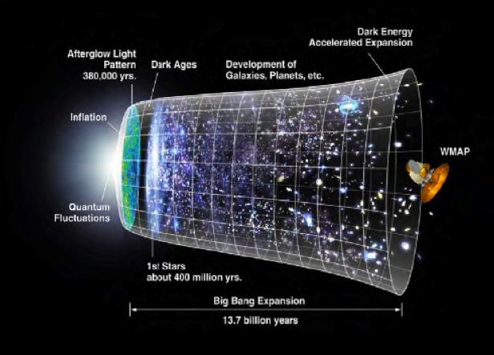
The Big Bang and the Shape of Space
http://kipac.stanford.edu/kipac/research/primordial_inflation
Robert “Dr. Bob” Gardner
East Tennessee State University
Department of Mathematics and Statistics

Slide 2
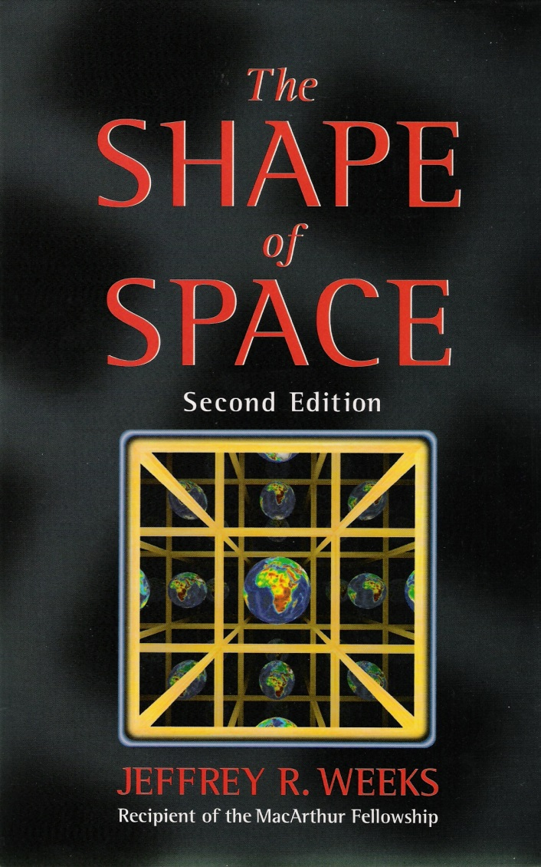
Jeffrey R. Weeks' The Shape of Space, 2nd edition, CRC Press (2001).
Line drawings of solid objects in this presentation are either due to the speaker or are from Weeks’ book.

Slide 3
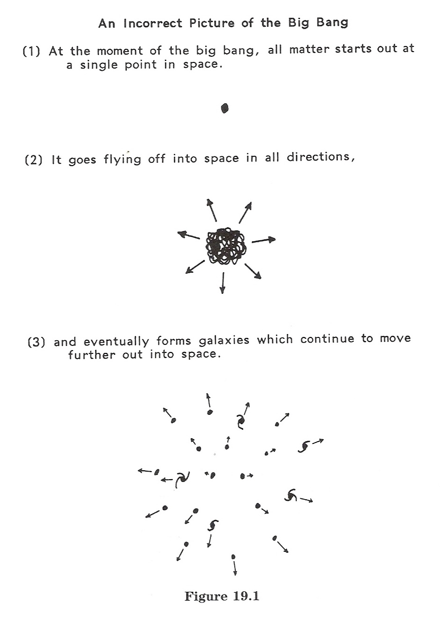
An incorrect way to visualize the Big Bang:
(from The Shape of Space, page 266)
Now a video from: http://yourtubetheme.com/2014/09/after-effects-big-bang-explosion-video-download/

Slide 5
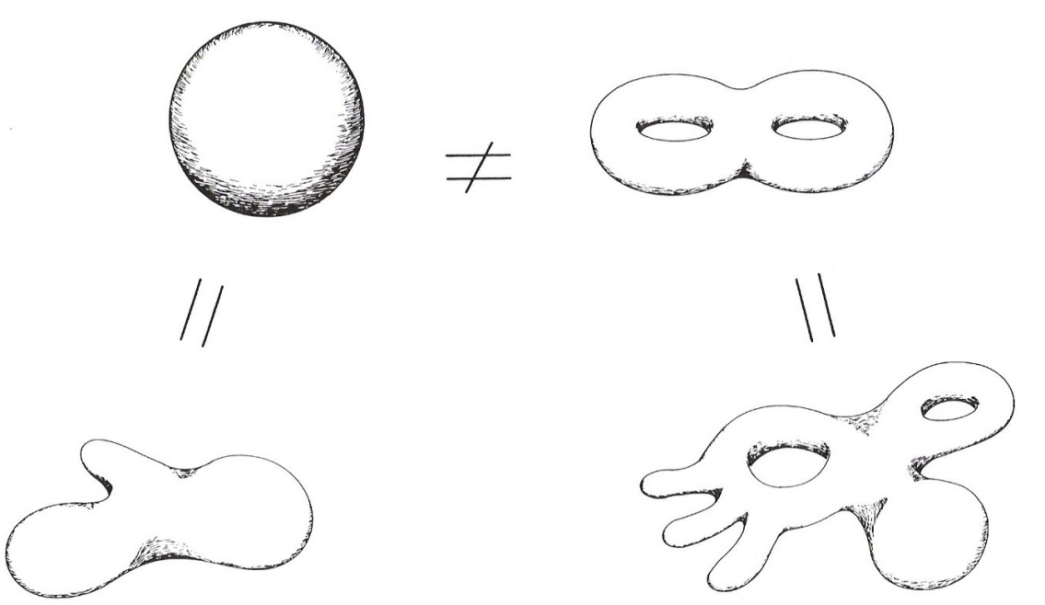
Geometry versus Topology
Definition. The aspects of a surface’s (or any geometric object's) nature which are unaffected by deformation make up the topology of the surface (or object). For example, connectedness and simple-connectedness are topological properties:
Definition. A surface's geometry consists of those properties which do change when the surface is deformed. For example, curvature, area, distances, and angles are geometric properties.

Slide 6
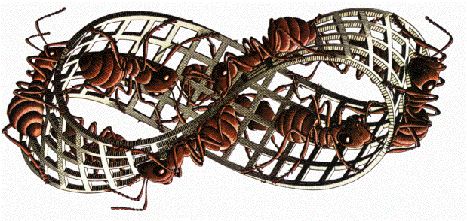
Local versus Global Properties
Definition. Local properties of a manifold are those which are observable within a small region of the manifold. Global properties require consideration of the manifold as a whole.
Note. A surface is “locally 2-dimensional.” We live in a universe that is locally 3-dimensional. That is, our universe is a 3-manifold.
Note. When discussing properties of surfaces, we often take the perspective of a 2-dimensional creature living within the surface (a “Flatlander”).

Slide 7
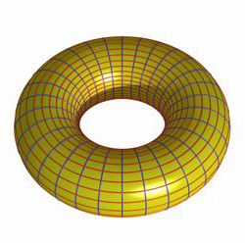
The 2-Torus
Note. The 2-torus is a 2-dimensional manifold which can be described as a “quotient space” involving the fundamental domain which is the unit square in the plane.
http://koc.wikia.com/wiki/File:Torus.jpg

Slide 8
Equivalence Relation for a 2-Torus
Define an equivalence relation on $X=ℝ×ℝ$ as $\left(x_{1},y_{1}\right)\sim \left(x_{2},y_{2}\right)$ if and only if $x_{1}−x_{2}∈ℤ$ and $y_{1}−y_{2}∈ℤ$. We partition $X$ as:
$$y$$
$$\left(i+1,j+1\right)$$
$$x$$
$$\left(i,j\right)$$

Slide 9
The Fundamental Domain
Note. Suppose the unit square (called the fundamental domain of the 2-torus) is occupied by a certain geometric shape…

Slide 10
Movement in the Fundamental Domain
The 2-Torus

Slide 11
Movement in the Fundamental Domain
The 2-Torus

Slide 13
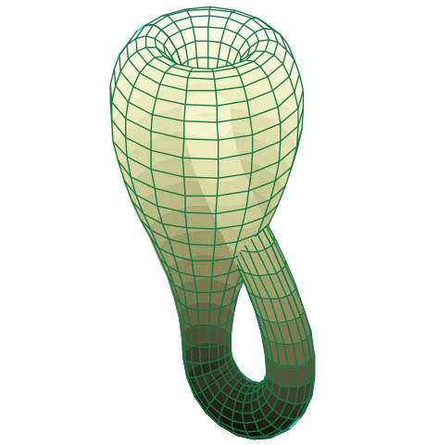
The Klein Bottle
Note. The Klein Bottle is a 2-dimensional manifold which, like the 2-torus, can be described as a “quotient space” involving the fundamental domain which is the unit square in the plane.
http://www.ediblegeography.com/wp-content/uploads/2013/03/Klein-bottle-460.jpg

Slide 14
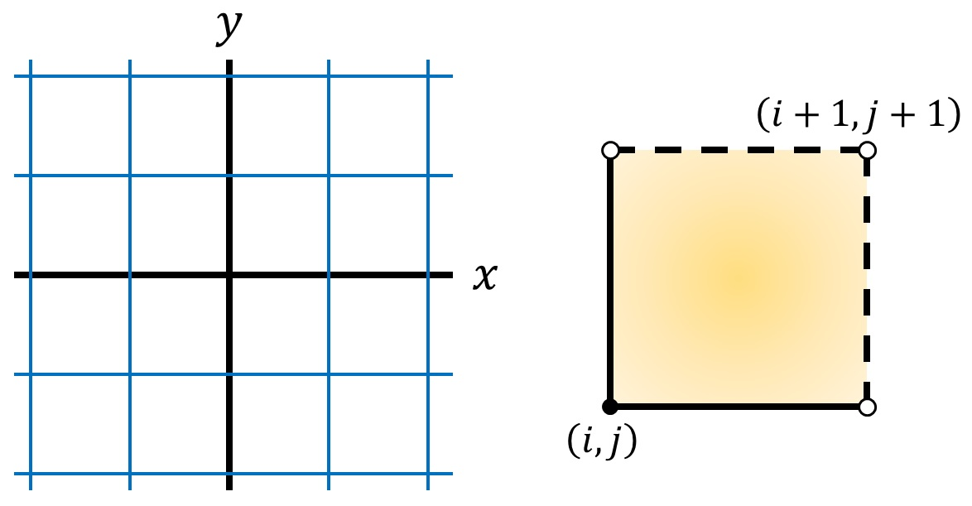
Equivalence Relation for a Klein Bottle
Define an equivalence relation on $X=ℝ×ℝ$ as $\left(x_{1},y_{1}\right)\sim \left(x_{2},y_{2}\right)$ if and only if
$y_{1}−y_{2}∈ℤ$ and $x_{1}−x_{2}∈2ℤ$, or
$y_{1}+y_{2}∈ℤ$ and $x_{1}−x_{2}∈ℤ∖2ℤ$.
We partition $X$ as:

Slide 15
The Fundamental Domain
Note. Again we introduce a non-symmetric geometric shape in the fundamental domain …

Slide 16
Movement in the Fundamental Domain
The Klein Bottle

Slide 17
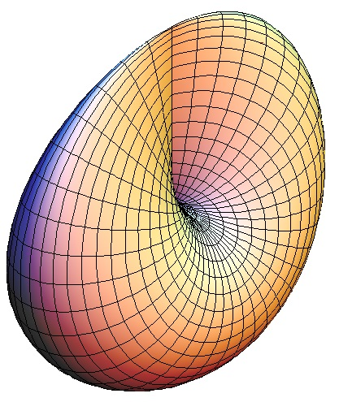
The Projective Plane
http://xahlee.info/surface/cross-cap/cross-cap.html

Slide 18
Equivalence Relation for a Projective Plane
Define an equivalence relation on $X=ℝ×ℝ$ as $\left(x_{1},y_{1}\right)\sim \left(x_{2},y_{2}\right)$ if and only if
$x_{1}−x_{2}∈2ℤ$ and $y_{1}−y_{2}∈2ℤ$, or
$y_{1}+y_{2}∈ℤ$, $\left\lfloor y_{1}\right\rfloor −\left\lfloor y_{2}\right\rfloor ∈2ℤ$, and $x_{1}−x_{2}∈ℤ∖2ℤ$, or
$x_{1}+x_{2}∈ℤ$, $\left\lfloor x_{1}\right\rfloor −\left\lfloor x_{2}\right\rfloor ∈2ℤ$, and $y_{1}−y_{2}∈ℤ∖2ℤ$, or
$y_{1}+y_{2}∈ℤ$, $\left\lfloor y_{1}\right\rfloor −\left\lfloor y_{2}\right\rfloor ∈ℤ∖2ℤ$, $x_{1}+x_{2}∈ℤ$ and $\left\lfloor x_{1}\right\rfloor −\left\lfloor x_{2}\right\rfloor ∈ℤ∖2ℤ$.
We partition $X$ as:

Slide 19
The Fundamental Domain
Note. As usual, we start with our winking smiley face friend…

Slide 20
Movement in the Fundamental Domain
The Projective Plane

Slide 21
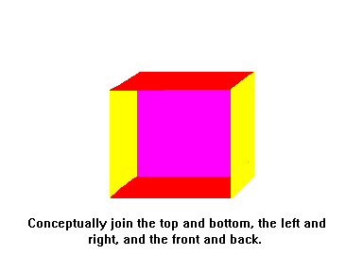
The 3-Torus and a 3-D Klein Bottle
Note. Now let's construct a flat 3-torus. We start with a cube. Conceptually join the front and back of the cube, the left and the right sides of the cube, and the top and the bottom of the cube. In this room, that corresponds to joining the front wall and the back wall, the left wall and the right wall, and the floor and the ceiling. Again, the connections are conceptual. This means that if we throw a ball out the back of the room, it will reappear at the front of the room. This reflects the path that a photon would follow. Therefore, if you look straight out the back of the room, you see the back of your own head!
Note. We can similarly construct a “nonorientable” 3-manifold by conceptually connecting the left wall to the right wall, but by connecting the front left wall to the rear right wall.

Slide 22
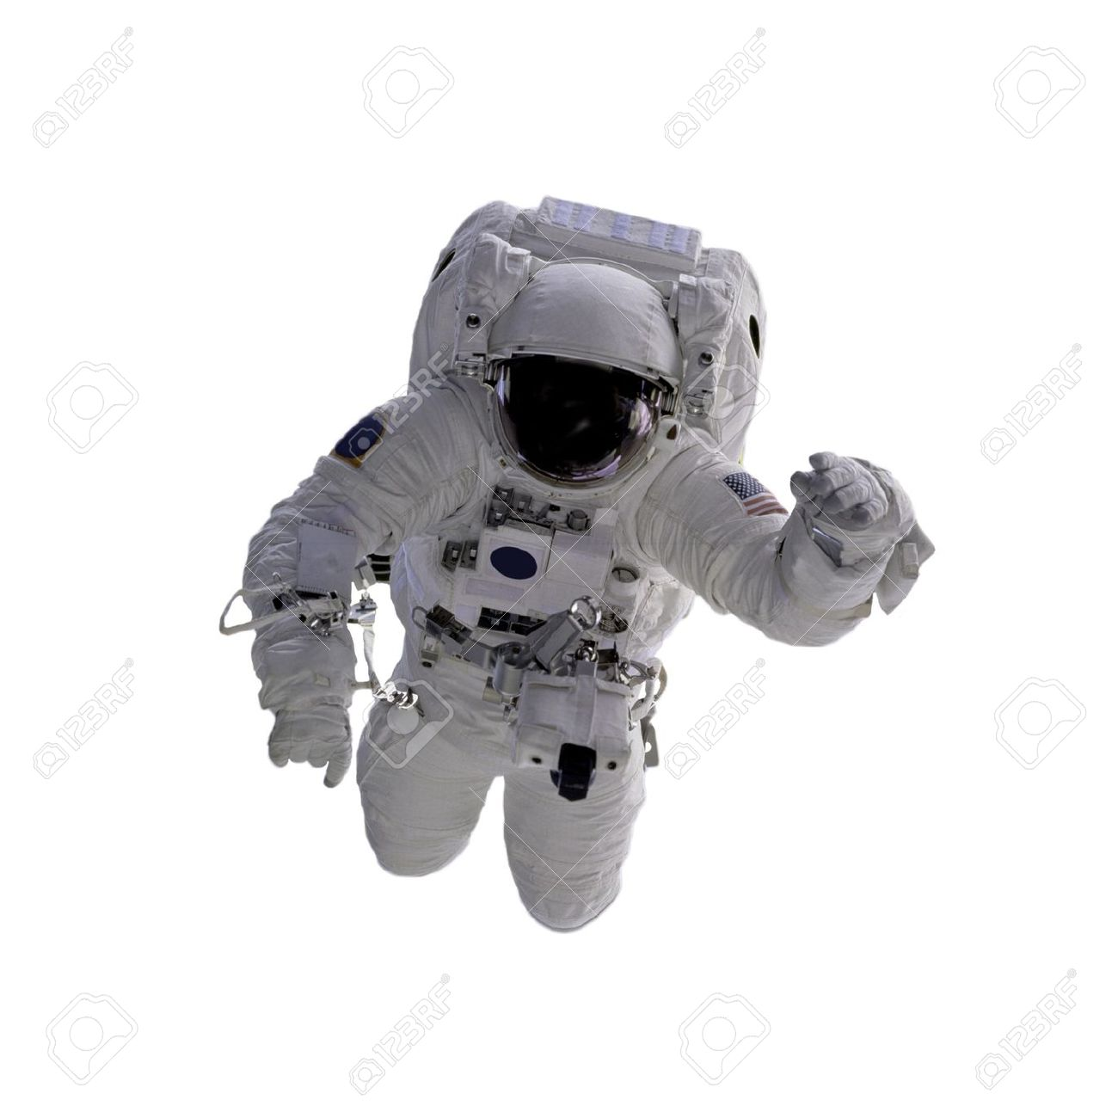
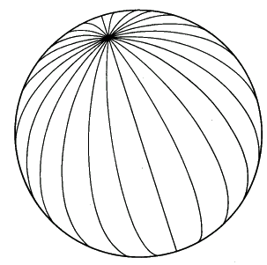
The 3-Sphere
Note. Another interesting 3-manifold is the 3-sphere. It is best thought of by making analogies with the 2-sphere. Here's the story of what we would see in a 3-sphere. If you are the sole inhabitant of such a space, then you would see yourself in every direction you look. Suppose the circumference of this 3-sphere is C and suppose I am in this space with you. If I start to fly away from you, then you see my image get smaller and smaller until I am a distance of C/4 from you. Then my image starts to get larger. When I am only 3 feet from the point antipodal to you (which lies a distance of C/2 from you), then I appear the same as I would when I am only 3 feet from you. When I arrive at the antipodal point, you see my image fill the entire sky!
http://facweb.bhc.edu/academics/science/harwoodr/geog101/study/longlat.htm

Slide 23
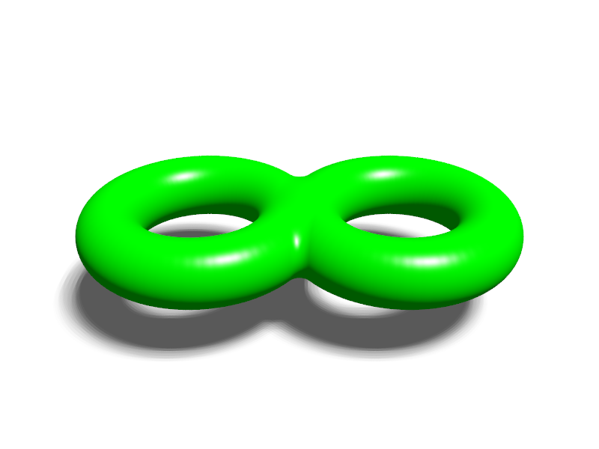
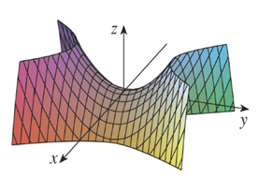
Closed versus Open Manifolds
Definition. A manifold is closed if it is finite (or more accurately, if it is bounded). A manifold is open if it is infinite (or unbounded).
Note. When we use the term “manifold,” we refer to objects without boundaries. For example, a circle is a manifold (locally 1-dimensional) but a disk (which is locally 2-dimensional) is not.

Slide 24
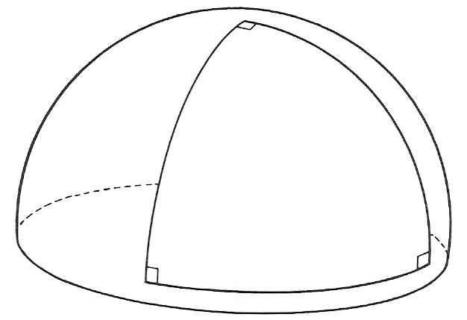
Curvature
Note. We illustrate curvature very informally with three examples (each a 2-manifold).
1. A sphere has positive curvature:
2(a). A plane and a cylinder have zero curvature:

Slide 25
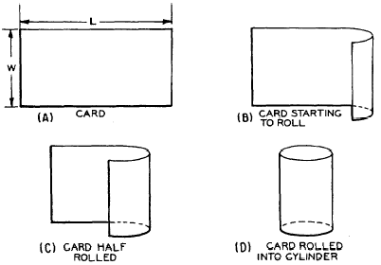
Curvature (cont.)
2(b). In fact, a cylinder also has zero curvature:
http://qa.pwnthesat.com/post/60458023231/hey-mike-if-a-right-circular-cylinder-is-made-of

Slide 26
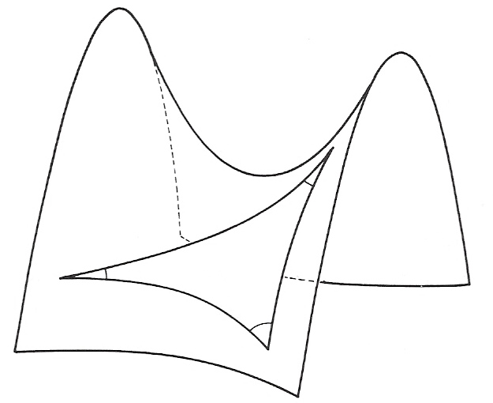
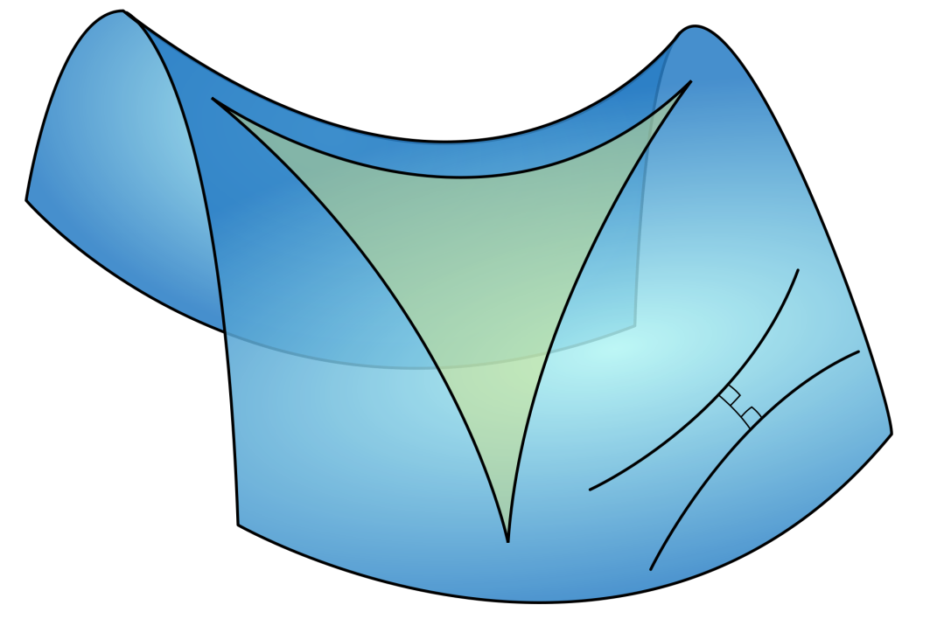
Curvature (cont.)
3. A “saddle” (i.e., hyperbolic paraboloid) has negative curvature:
https://en.wikipedia.org/wiki/Hyperbolic_geometry

Slide 27
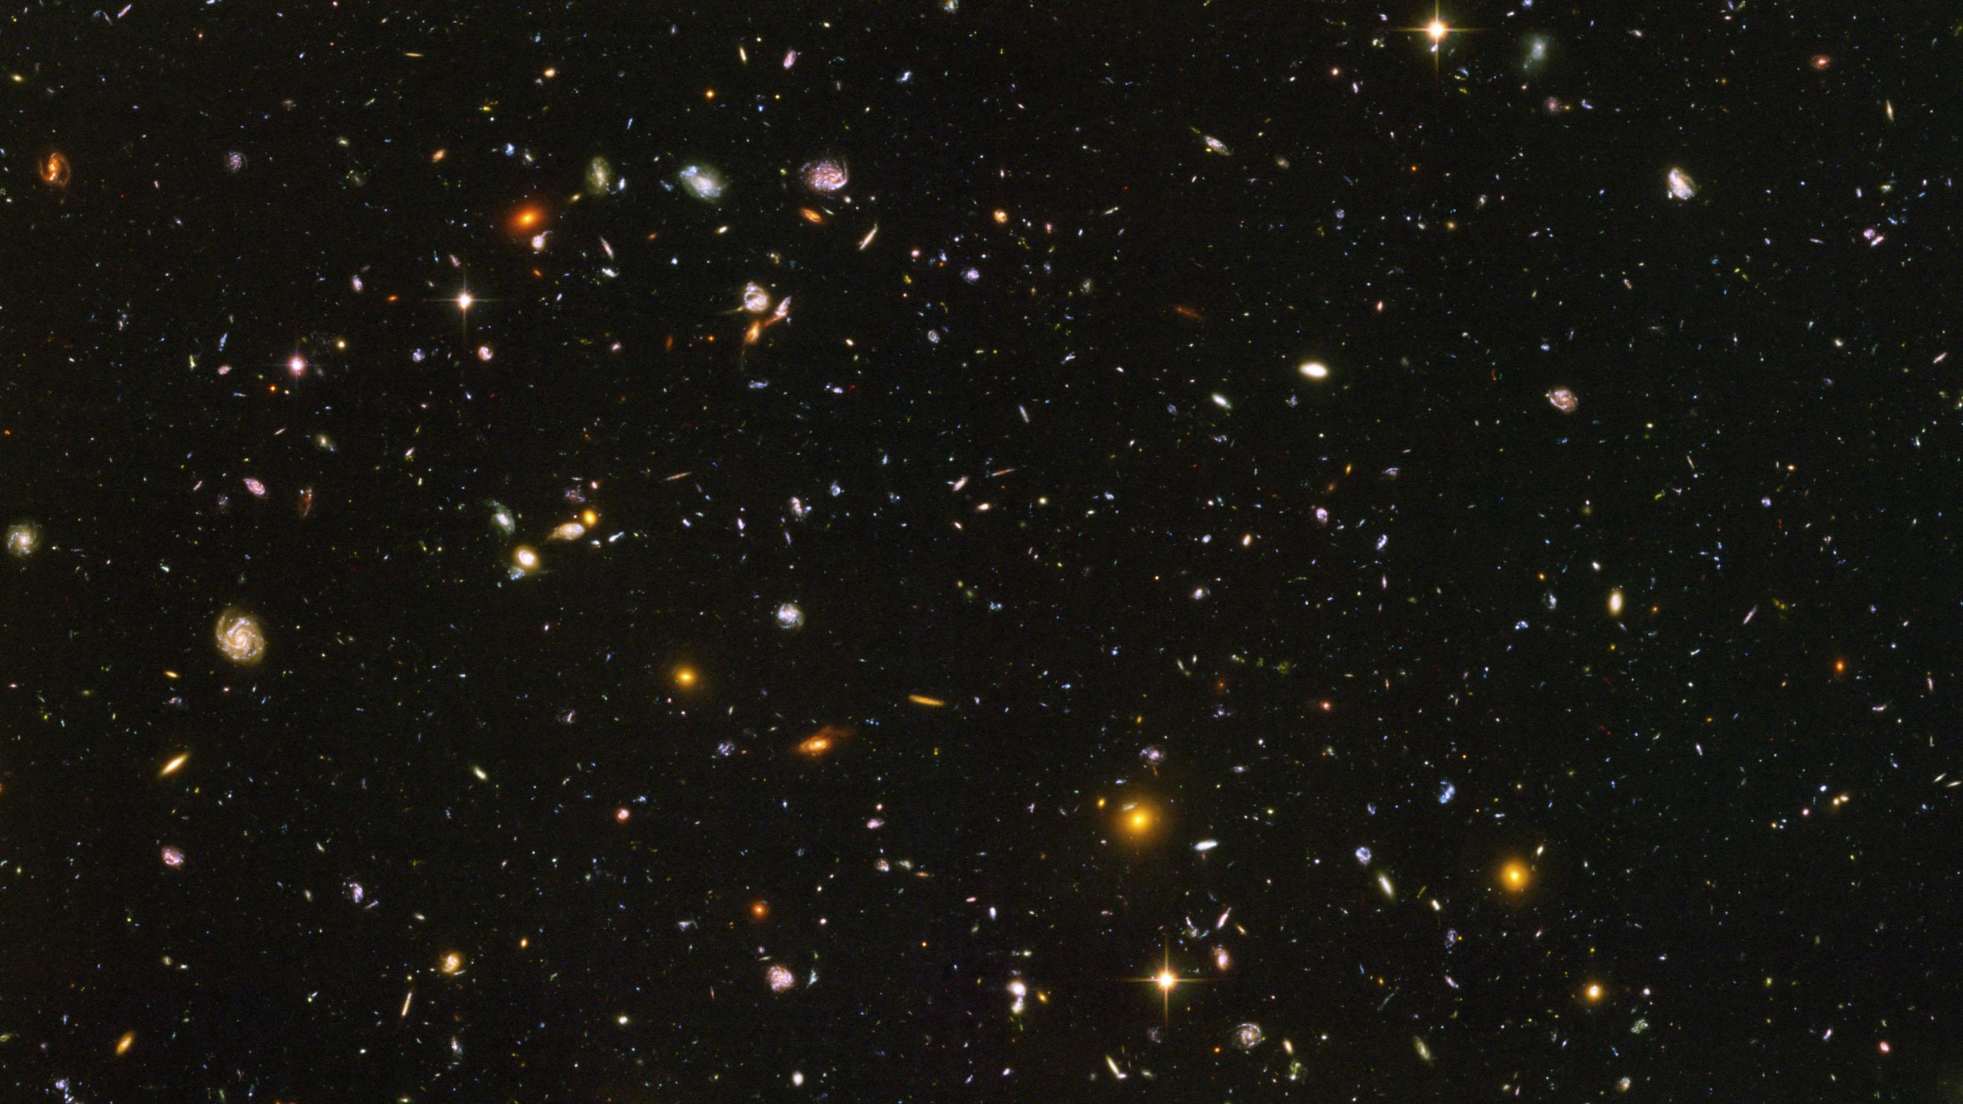
Applications to the Universe
Definition. A surface with positive curvature is said to have elliptic geometry. A surface with zero curvature is said to have Euclidean geometry. A surface with negative curvature is said to have hyperbolic geometry. (However, the term “geometry” implies a certain homogeneity of a surface - namely, that the surface must be of constant curvature. The sphere, plane, and cylinder are of constant curvature, but the saddle surface is not.)
Note. So we are now faced with two parameters for a manifold:
the global topology, and
the local geometry.

Slide 28
Local Geometry of the Universe
Note. The universe may have any of the three above geometries, depending on its density:
Geometry/Curvature | Fate | Density
Elliptic/+ | Recollapse | $$ρ>3H/(8πG)$$
Euclidean/0 | Eternal Expansion (barely) | $$ρ=3H/(8πG)$$
Hyperbolic/$−$ | Eternal Expansion | $$ρ<3H/(8πG)$$
Note. An elliptic universe must have finite volume and therefore deserves the term “closed.” However, a common misconception is to describe a Euclidean or hyperbolic universe as necessarily “open” (i.e., infinite). This is NOT THE CASE! The proper terms to use are (geometrically): elliptic, Euclidean, hyperbolic, OR (curvature): positive, zero, negative (respectively). As we shall see, there are possible (even, in a sense, probable) Euclidean and hyperbolic geometries on closed 3-manifolds. This leads us to questions of global topology for the 3-manifold which is our universe.

Slide 29
Global Topology of the Universe
Note. We can best visualize certain 3-manifolds by throwing out a dimension and imagining ourselves as flatlanders. An example of a closed 2-manifold with positive curvature is then a sphere (denoted $S^{2}$). An example of an open 2-manifold with hyperbolic geometry is the saddle (denoted $H^{2}$). Just add a dimension and you have two possible models for the universe (denoted $S^{3}$ and $H^{3}$, respectively).
Note. The flat 3-torus is constructed by conceptually joining opposite faces of a cube. This is denoted $T^{3}$ and is an example of a closed Euclidean 3-manifold.
Note. $S^{3}$, $H^{3}$, and $E^{3}=ℝ^{3}$ are the only homogeneous and isotropic 3-manifolds.

Slide 30
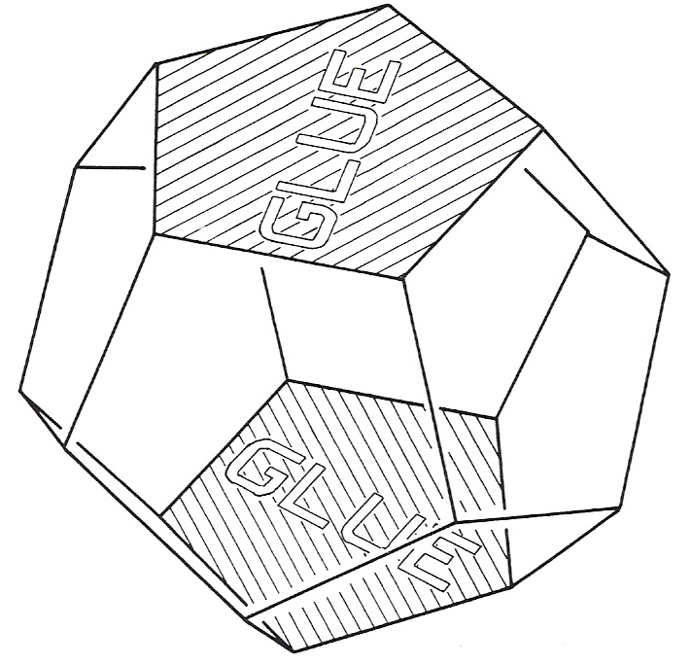
The Seifert-Weber Space
Note. The Seifert-Weber space is constructed by conceptually adhering opposite faces of a dodecahedron, after giving them a 3/10 clockwise turn. To make the angles “fit together,” the dodecahedron must be embedded in $H^{3}$. This space is an example of a closed hyperbolic 3-manifold.
http://www.math.univ-toulouse.fr/~cheritat/GalIII/SW-dod.png

Slide 31
Global Topology of the Universe
Note. Five of the six combinations of open/closed and geometry are possible. A manifold with elliptic geometry (and, as a consequence, positive curvature) must “curve back on itself” and be closed.
 | Elliptic/+ | Euclidean/0 | Hyperbolic/$−$
Closed | $$S^{3}$$ | $$T^{3}$$ | Seifert-Weber space
Open | none | Euclidean 3-space, $E^{3}$ | $$H^{3}$$
Note. William Thurston has shown (1970s-80s) that “most” 3-manifolds admit a hyperbolic geometry.

Slide 32
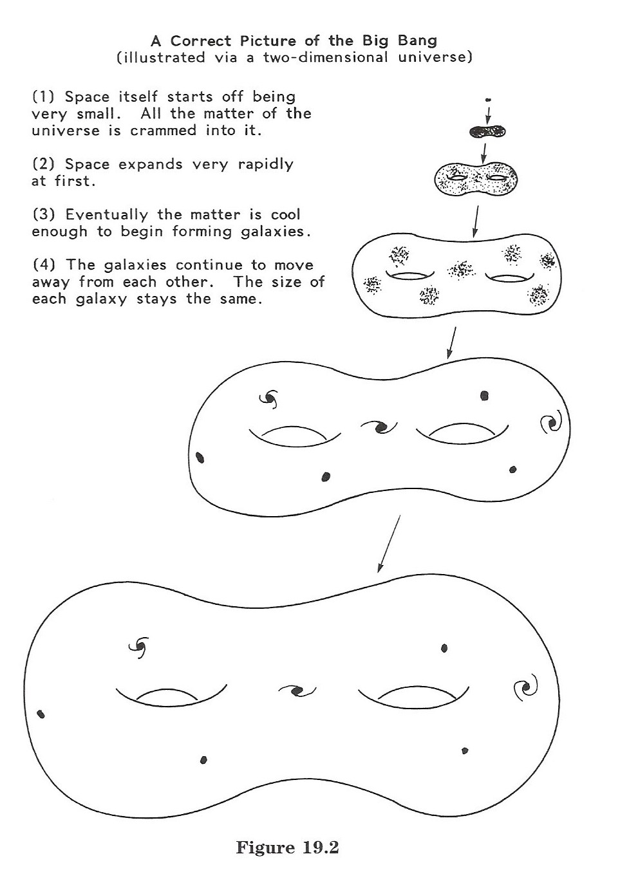
A correct way to visualize the Big Bang:
(from The Shape of Space, page 267)
So what is the 3-manifold for the spatial part of our universe?

Slide 33
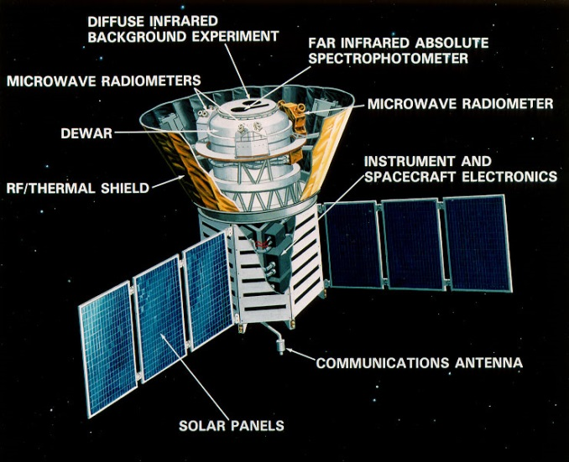
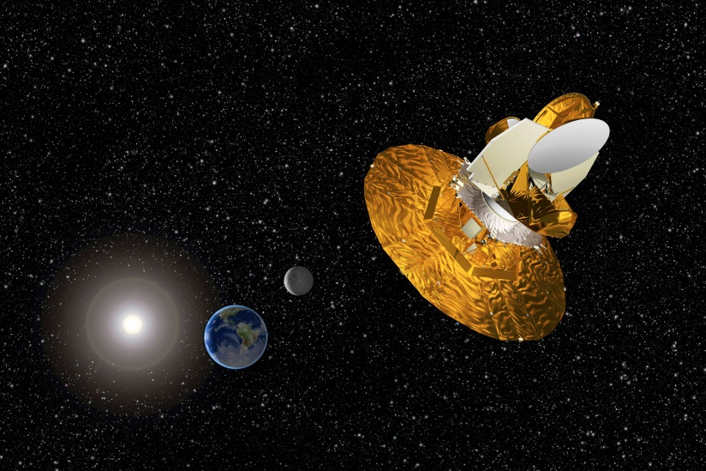
Empirical Evidence
Note. Einstein's general theory of relativity tells us how matter and space interact. This theory only deals with the universe's local geometry (and it is the field equations which lead us to the “fate of the universe” under the different local geometries given above). If we can calculate the universe's density, then we can determine its curvature, local geometry, and ultimate fate. However, this still leaves the question of the universe's global topology.
Note. One could detect that he lives in a closed (i.e., finite) universe by looking for images of himself! That is, we could look for, say, an image of the Virgo cluster appearing far off in the universe. Or, we could look for two images of a given quasar in opposite directions of the sky. However, given the distance scale, these objects simply evolve too quickly for us to recognize them as they were billions of years ago.
https://en.wikipedia.org/wiki/Cosmic_Background_Explorer
http://wmap.gsfc.nasa.gov/media/990387/index.html

Slide 34
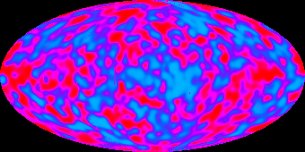
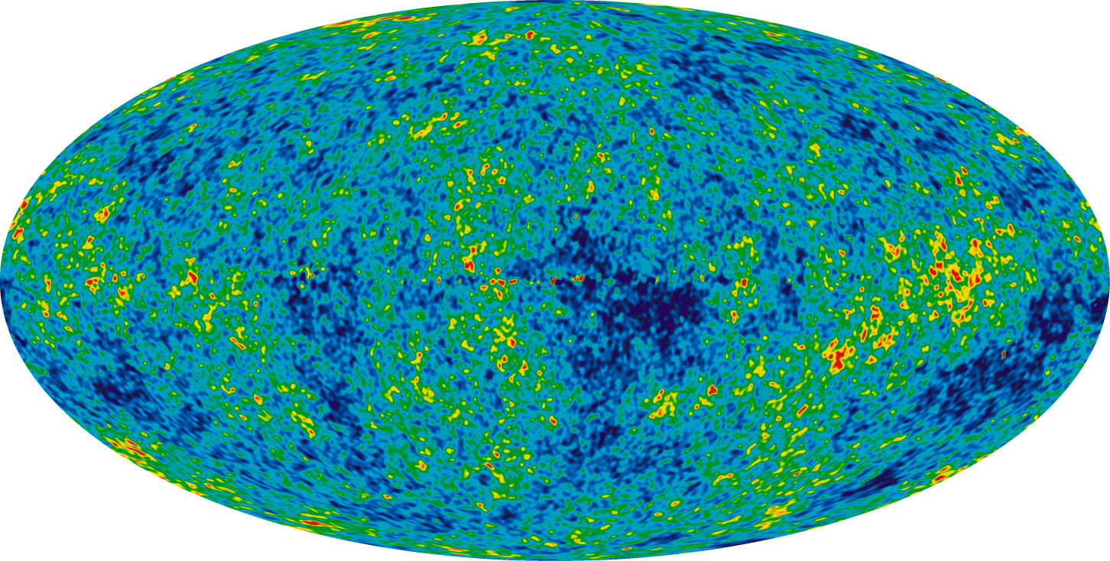
CMB
Note. Consider the cosmic microwave background (CMB). As we see it, it represents a sphere of radiation (called the “surface of last scattering”) with us at the center. In a closed universe, this sphere could intersect itself ad the intersection would result in a circle. It might be possible, then, to see the same circles of intersection in two different areas of the sky. There are tiny fluctuations in the CMB, and these circles could be detected by looking for similar patterns in the fluctuations. With the circles in hand, a precise model of the universe could be EMPIRICALLY constructed which reflects not only the local geometry, but also the global topology.
WMAP
COBE

Slide 35
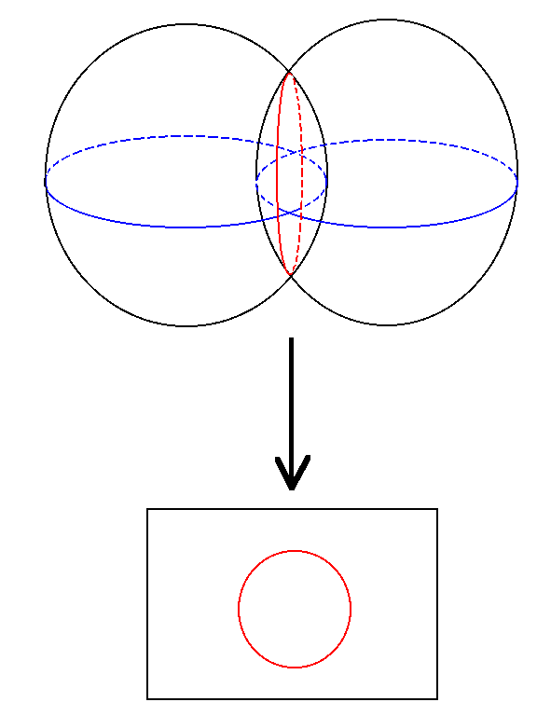
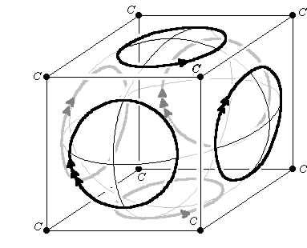
Circles in the Sky
Note. If our universe is a 3-torus, then we would see the CMB intersect itself in certain directions in the sky, producing circles of hot and dark patterns which are the same.
http://www.math.cornell.edu/~dwh/books/eg99/Ch20/Ch20.html

Slide 36
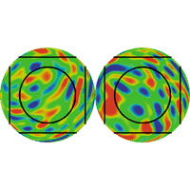
Circles in the Sky (cont.)
Note. The hot and cold patterns do not look the same, but if we trace around the two circles, one clockwise and the other counterclockwise, then we see the same patterns of colors.

Slide 37
Conclusion
Note. “After a difficult start, the overall topology of the universe has become an important concern in astronomy and cosmology. Even if particularly simple and elegant models such as the PDS [Poincare Dodecahedral Space] and the hypertorus seem now to be ruled out at a subhorizon scale, many more complex models of multi-connected space cannot be eliminated as such. In addition, even if the size of a multi-connected space is larger (but not too much) than that of the observable universe, we could still discover an imprint in the fossil radiation, even while no pair of circles, much less ghost galaxy images, would remain. The topology of the universe could therefore provide information on what happens outside of the cosmological horizon.” [http://www.scholarpedia.org/article/Cosmic_Topology]
Note. A recent paper on this is “Nine-Year Wilkinson Microwave Anisotropy Probe (WMAP) Observations: Cosmological Parameter Results,” G. Hinshaw, D. Larson, E. Komatsu, D. N. Spergel, et al., The Astrophysical Journal Supplement Series, 208:19 (25pp), 2013 October. This is available online at:
http://iopscience.iop.org/article/10.1088/0067-0049/208/2/19/meta;jsessionid=2E44D864CB06ABA0F62A0CF4B7B55BAD.c6.iopscience.cld.iop.org

Slide 38
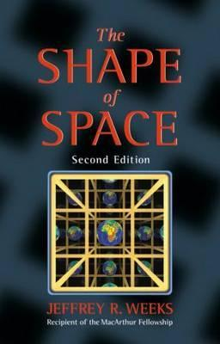
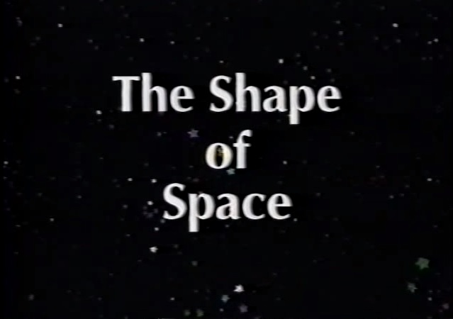
“Read More About It”
The video is online on YouTube at:
www.youtube.com/watch?v=-gLNlC_hQ3M
For software related to The Shape of Space, see: www.geometrygames.org/SoS/

Slide 39
Questions
?

