Slide 1
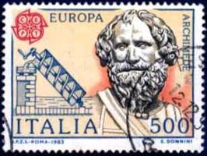
Archimedes
2000 Years Ahead of His Time
“Dr. Bob” Gardner ETSU, Department of Mathematics and Statistics Fall, 2014
(an updated version of a spring 2011 presentation)

Slide 2
Primary reference:
The Archimedes Codex – How a Medieval Prayer Book is Revealing the True Genius of Antiquities Greatest Scientist
by Reviel Netz & William Noel, 2007.

Slide 3
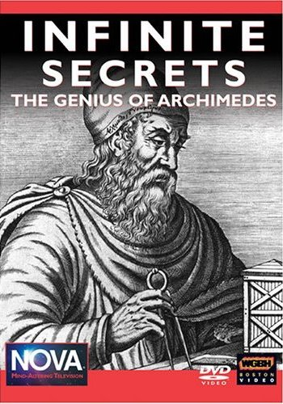
Primary reference:
Infinite Secrets: The Genius of Archimedes
NOVA, WGBH Boston (September 30, 2003).

Slide 4
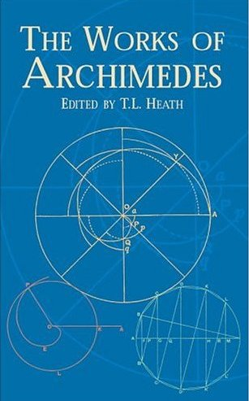
Primary reference:
The Works of Archimedes
Edited by Sir Thomas Heath, Dover Publications, 2002 (Unabridged reprint of the classic 1897 edition, with supplement of 1912).

Slide 5
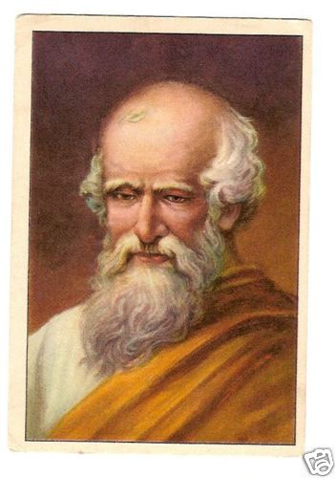
Archimedes – A Biography
287 BCE – 212 BCE

Slide 6
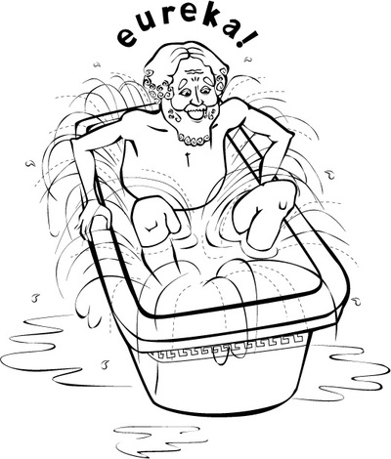
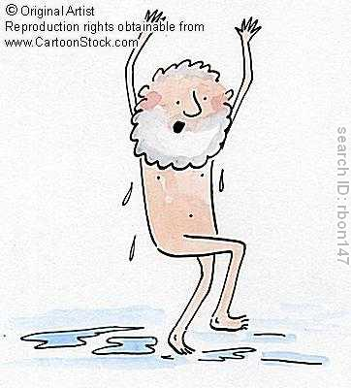
Ενρηκα! Ενρηκα!
http://twistedphysics.typepad.com/cocktail_party_physics/2007/07/index.html
http://www.cartoonstock.com/directory/a/archimedes.asp

Slide 7
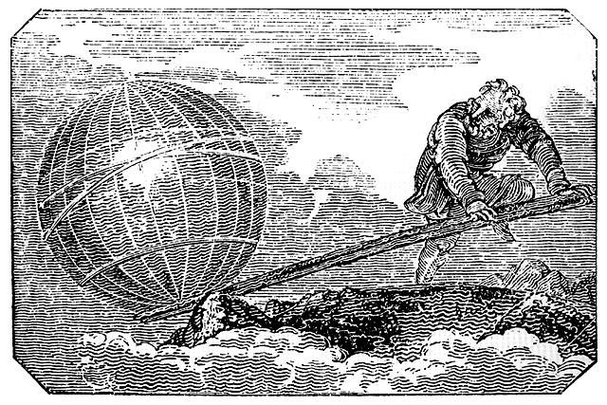
Give me a place to stand and I will move the world!
From greggshake.com

Slide 8
Another Archimedes
“Archimedes” costarred in Disney’s The Sword in the Stone

Slide 9
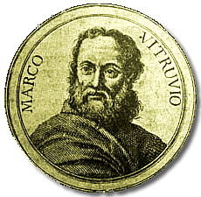
Vitruvius (75 BCE to 25 BCE)
He cried EUREKA!!!
www.bookyards.com

Slide 10
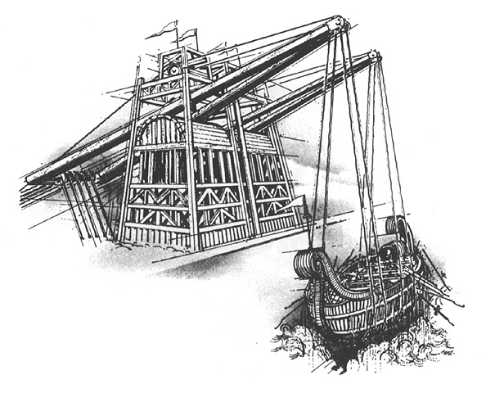
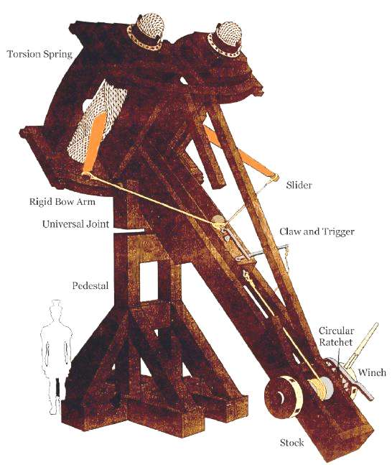
The Archimedean Claw, The Catapult
http://www.math.nyu.edu/~crorres/Archimedes/Claw/illustrations.html
http://www.mlahanas.de/Greeks/war/Catapults.htm

Slide 11
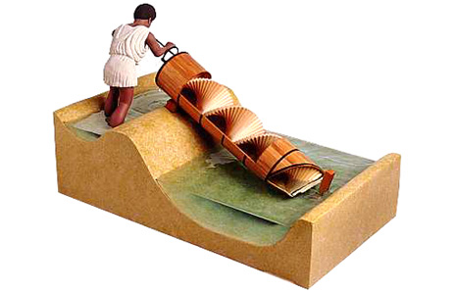
The Archimedean Screw
http://www.dorlingkindersley-uk.co.uk/nf/ClipArt/Image/0,,_1583231,00.html

Slide 12
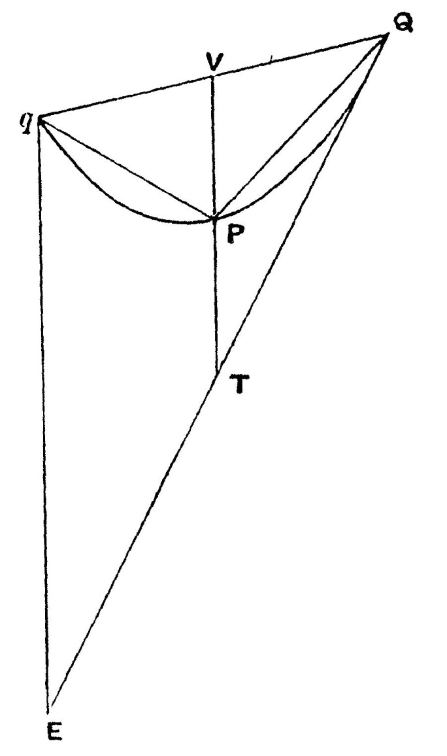
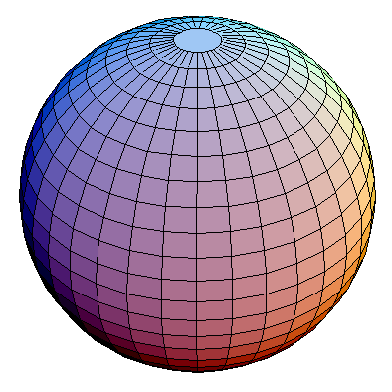
Quadrature and “Cubature”
http://virtualmathmuseum.org/Surface/sphere/sphere.html
(Page 246 of The Works of Archimedes by T. Heath, 1897.)

Slide 13
Extant Works
On Plane Equilibriums, Book I.
Quadrature of the Parabola.
On Plane Equilibriums, Book II
The Method.
On the Sphere and Cylinder: Two Books.
On Spirals.
On Conoids and Spheroids.
On Floating Bodies: Two Books.
Measurement of a Circle.
The Sand-Reckoner (Psammites).
Stomachion (a fragment).

Slide 14
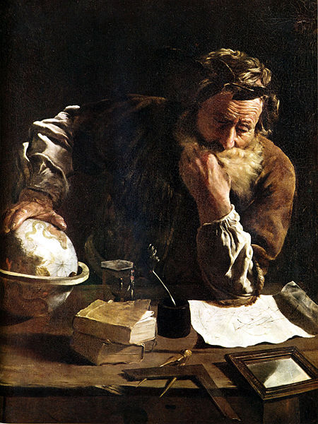
The Method
Domenico-Fetti
Painting of Archimedes, 1620
From Wikipedia

Slide 15
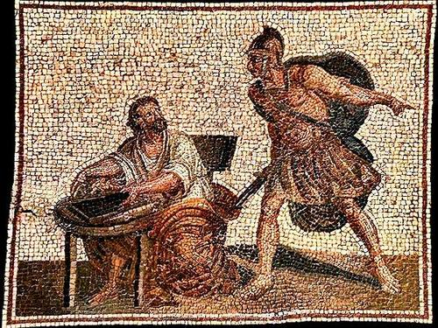
The death of Archimedes (Sixteenth century copy of an ancient mosaic).
From: http://www.livius.org/sh-si/sicily/sicily_t17.html

Slide 16
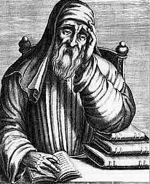
Archimedes refused to go until he had worked out his problem and established its demonstration, whereupon the soldier flew into a passion, drew his sword, and killed him.
Plutarch (c. 46 – 120 CE)
http://hootingyard.org/archives/1668

Slide 17
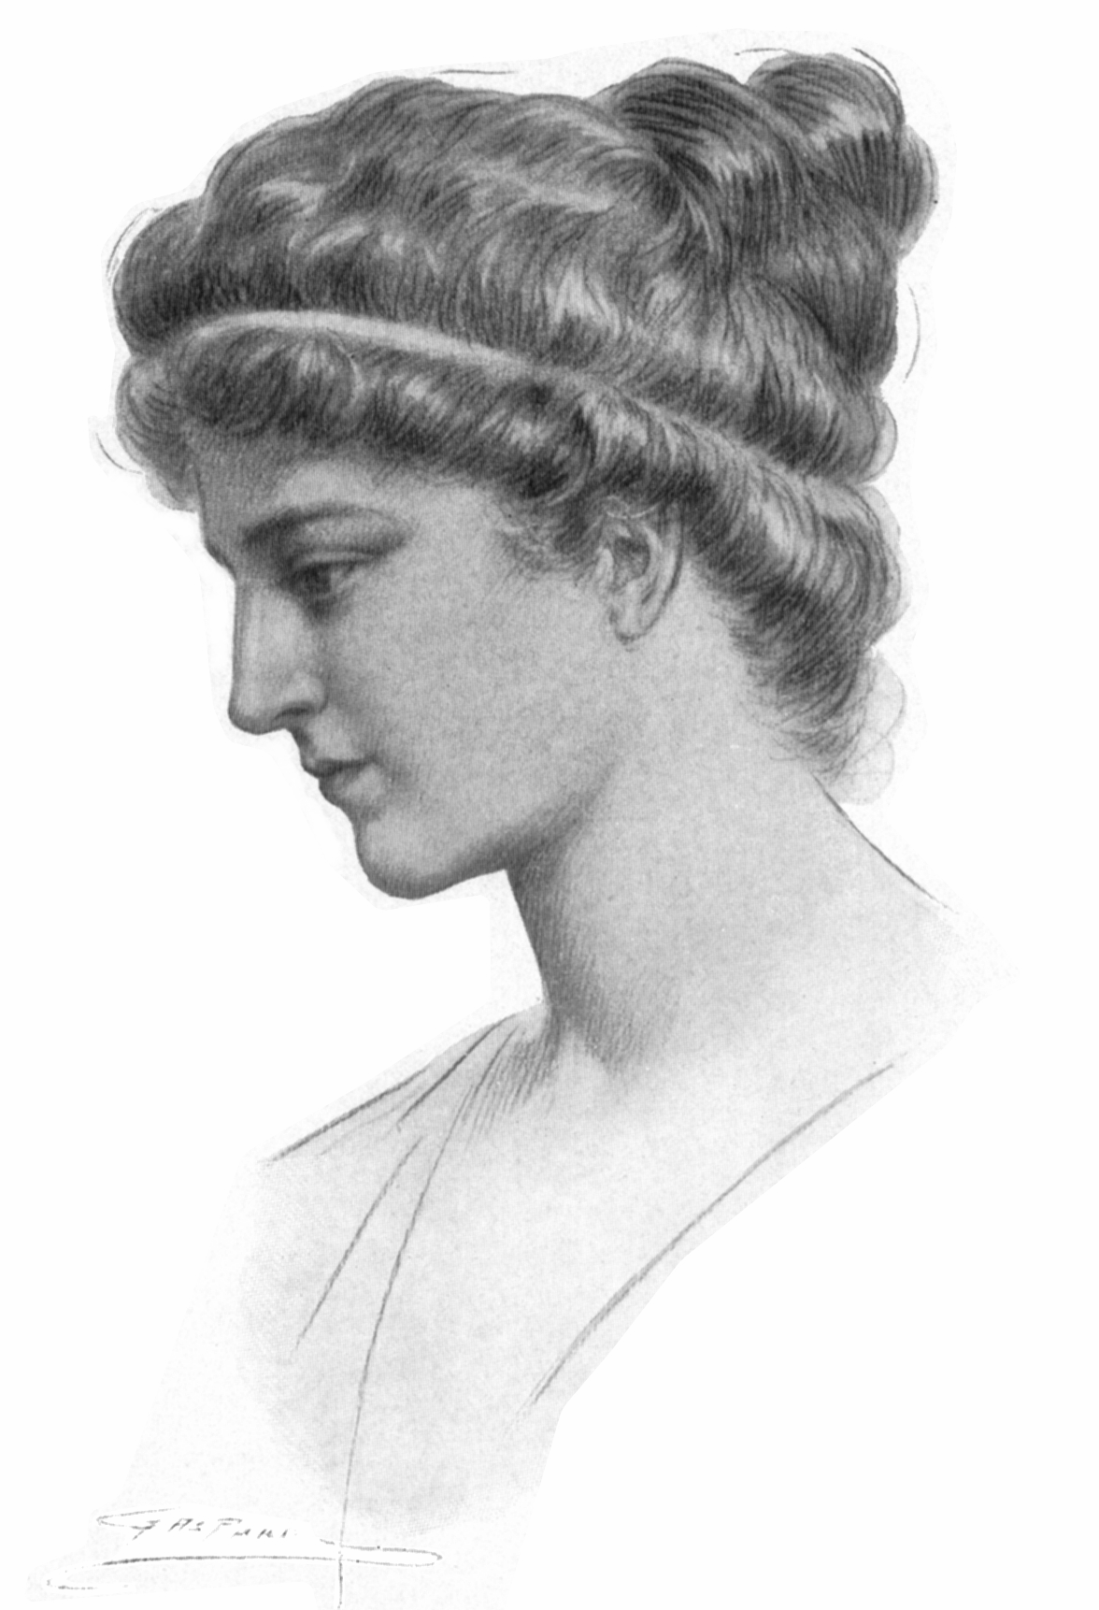
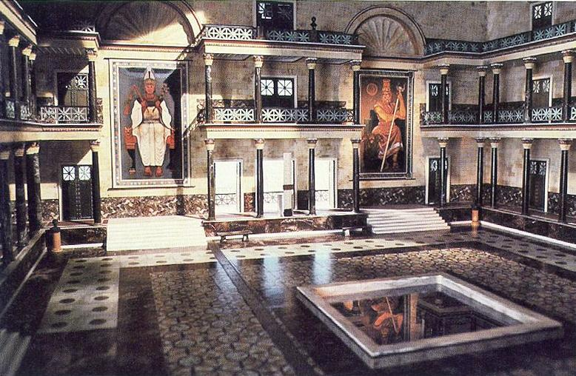
The Alexandrian Library and Hypatia
The Alexandrian Library as portrayed in the PBS series COSMOS
From: http://www.sacred-destinations.com/egypt/alexandria-library-bibliotheca-alexandrina
Hypatia (370 CE to 415 CE) Image from: http://resilienteducation.com/IMAGES/

Slide 18
The Archimedes Palimpsest

Slide 19
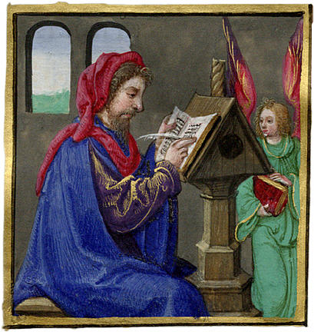
A 10th Century Scribe
On Plane Equilibriums
On the Sphere and Cylinder
Measurement of a Circle
On Spiral
On Floating Bodies
The Method
Stomachion
http://www.fromoldbooks.org/Rosenwald-BookOfHours/pages/016-detail-miniature-scribe/

Slide 20
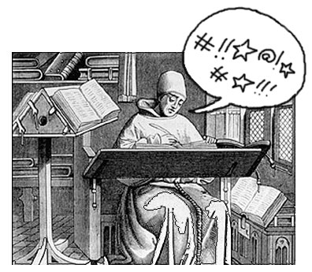
Archimedes is “Recycled”
http://www.archimedespalimpsest.org/palimpsest_making1.html
http://storms.typepad.com/booklust/2004/10/if_you_havent_n.html
http://www.archimedespalimpsest.org/palimpsest_making1.html

Slide 21
“Palimpsest”
Greek: palin (again) and
psan (to rub).

Slide 22
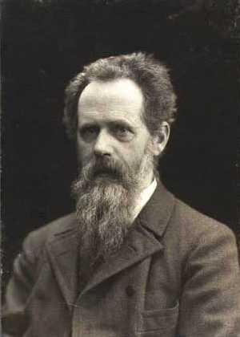
Johan Ludwig Heiberg
1854-1928
From Wikipedia

Slide 23
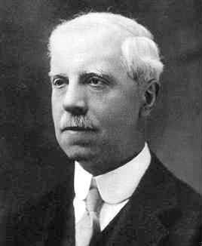
Thomas Little Heath
1861-1940
http://www.gap-system.org/~history/Mathematicians/Heath.html

Slide 24
?

Slide 25
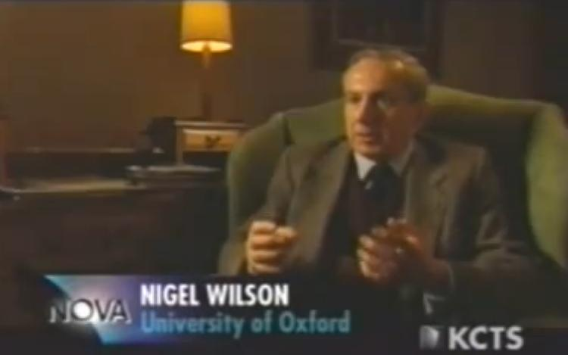
Nigel Wilson
From NOVA’s Infinite Secrets

Slide 26
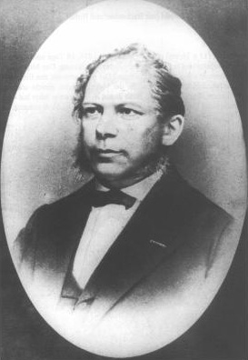
Constantine Titchendorf
1815-1874
From Wikipedia

Slide 27
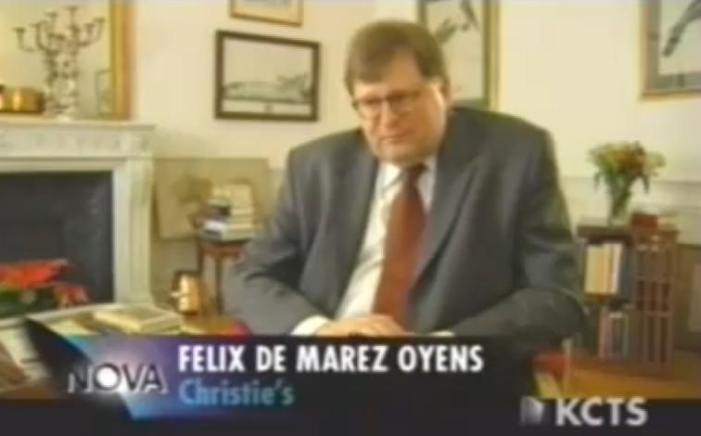
Felix de Marez Oyens
From NOVA’s Infinite Secrets

Slide 28
Thumbing through the Palimpsest
http://www.archimedespalimpsest.org/palimpsest_making1.html

Slide 29
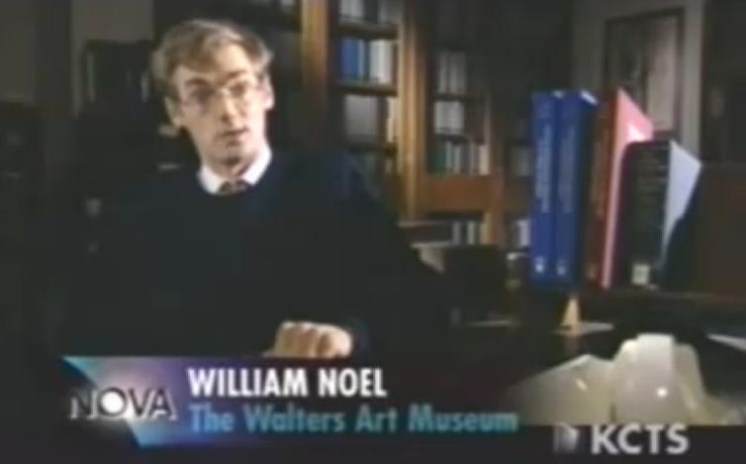
William Noel
From NOVA’s Infinite Secrets

Slide 30
Infinite Secrets: The Genius of Archimedes
NOVA, WGBH Boston (originally aired: September 30, 2003).
Also available online at:
https://www.youtube.com/watch?v=wxe-Z3Bk808
The NOVA resources website is at:
http://www.pbs.org/wgbh/nova/archimedes/

Slide 31
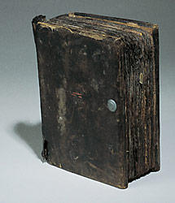
The Archimedes Palimpsest Project Online
http://www.archimedespalimpsest.org
http://www.archimedespalimpsest.org/index.html

Slide 32
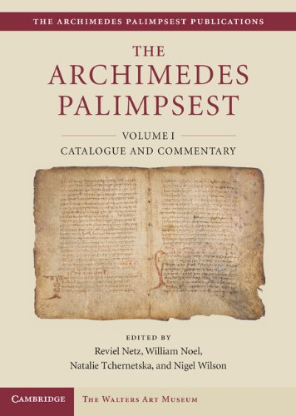
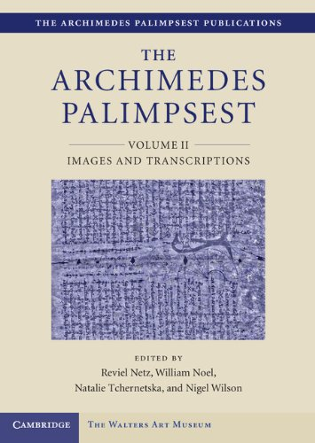
Cambridge University Press, December 2011
“This is the iceberg in full view, a massive tome that took more than a decade to produce, recovering - perhaps as fully as can ever be hoped - texts that miraculously escaped the oblivion of decay and destruction.” Washington Post (this statement and these images are from Amazon.com; accessed 9/22/2014)

Slide 33
Archimedes and

Slide 34
Euclid’s Elements, Book XII, Proposition 2
Circles are to one another as the squares on the diameters.
That is, the area of a circle is proportional to the square of its diameter, or equivalently, “the area of a circle is proportional to the square of its radius.”

Slide 35
Archimedes’ Measurement of a Circle
Proposition 1. “The area of any circle is equal to a right-angled triangle in which one of the sides about the right angle is equal to the radius, and the other to the circumference of the circle.” [That is, a circle of radius r, and hence circumference 2πr, has area πr².]
r
r
2πr

Slide 36
Let K the triangle described.
r
K
2πr
If the area of the circle is not equal to the area of K, then it must be either greater or less in area.

Slide 37
Part I.
If possible, let the area of the circle be greater than the area of triangle K.

Slide 38
Part I.
A
D
Inscribe a square ABCD in circle ABCD.
B
C

Slide 39
Part I.
A
D
Bisect the arcs AB, BC, CD, and DA
and create a regular octagon inscribed in the circle.
B
C

Slide 40
Part I.
P
Continue this process until the area of the resulting polygon P is greater than the area of K.

Slide 41
P
Part I.
A
Let AE be a side of polygon P.
N
E
Let N be the midpoint of AE.

Slide 42
P
Part I.
A
Let O be the center of the circle.
N
O
E
Introduce line segment ON.

Slide 43
Line segment ON is shorter than the radius of the circle r.
P
A
N
O
Perimeter of polygon P is less than the circumference of the circle, 2πr.
E
r
K
2πr

Slide 44
( ) = ( )
P
Area of Polygon P
Area of Triangle T
2n
A
= ( )
12
N
2n
NE x ON
=
T
12
O
(2n x NE) x ON
E
= ( )( )
12
Perimeter of P
ON
< ( )( ) = ( )
12
Area of Triangle K
2πr
r
r
K
2πr

Slide 45
Part I.
Assumption: If possible, let the area of the circle be greater than the area of triangle K.
Intermediate Step: Inscribed Polygon P has area greater than triangle K.
Conclusion: Inscribed polygon P has area less than triangle K.

Slide 46
Part I.
So the area of the circle is not greater than the area of triangle K:
( )
Area of a circle with radius r
πr².

Slide 47
Part II.
If possible, let the area of the circle be less than the area of triangle K.

Slide 48
Part II.
Assumption: If possible, let the area of the circle be less than the area of triangle K.
Intermediate Step: Circumscribed polygon P has area less than triangle K.
Conclusion: Circumscribed polygon P has area greater than triangle K.

Slide 49
Part II.
So the area of the circle is not less than the area of triangle K:
( )
Area of a circle with radius r
πr².

Slide 50
Measurement of a Circle
Proposition 1. “The area of any circle is equal to a right-angled triangle in which one of the sides about the right angle is equal to the radius, and the other to the circumference of the circle.”
( )
Area of a circle with radius r
πr².

Slide 51
Archimedes and the Approximation of π

Slide 52
Also in Measurement of a Circle
Proposition 3. “The ratio of the circumference of any circle to its diameter is less than 3 but greater than 3 .”

Slide 53
In the proof of Proposition 3, Archimedes uses two approximations of the square root of 3:

Slide 54
Let AB be the diameter of a circle, O its center, AC the tangent at A; and let the angle AOC be one-third of a right angle (i.e., 30º).
C
30º
A
B
O

Slide 55
Then and
C
30º
A
B
O

Slide 56
First, draw OD bisecting the angle AOC and meeting AC in D.
C
D
A
15º
O

Slide 57
By Euclid’s Book VI Proposition 3,
C
D
A
15º
O

Slide 58
implies that
C
or
D
A
15º
O

Slide 59
implies that
C
D
A
15º
O

Slide 60
C
D
A
15º
O

Slide 61
C
D
A
15º
O

Slide 62
C
since
D
A
15º
O

Slide 63
Second, let OE bisect angle AOD, meeting AD in E.
C
D
(Poor Scale!)
E
A
O
7.5º

Slide 64
By Euclid’s Book VI Proposition 3,
C
D
E
A
O
7.5º

Slide 65
C
implies that
or
D
E
A
O
7.5º

Slide 66
C
implies that
D
E
A
O
7.5º

Slide 67
C
D
since
E
A
O
7.5º

Slide 68
C
D
E
A
O
7.5º

Slide 69
C
since
D
E
A
O
7.5º

Slide 70
Thirdly, let OF bisect angle AOE, meeting AE in F.
C
D
E
(Poorer Scale!)
F
A
O
3.75º

Slide 71
By Euclid’s Book VI Proposition 3,
C
D
E
F
A
O
3.75º

Slide 72
C
implies that
D
or
E
F
A
O
3.75º

Slide 73
C
D
implies that
E
F
A
O
3.75º

Slide 74
C
D
E
since
F
A
O
3.75º

Slide 75
C
D
E
F
A
O
3.75º

Slide 76
C
D
since
E
F
A
O
3.75º

Slide 77
Fourthly, let OG bisect angle AOF, meeting AF in G.
C
D
E
F
(Poorest Scale!)
G
A
O
1.875º

Slide 78
By Euclid’s Book VI Proposition 3,
C
D
E
F
G
A
O
1.875º

Slide 79
C
implies that
D
or
E
F
G
A
O
1.875º

Slide 80
C
D
implies that
E
F
G
A
O
1.875º

Slide 81
C
D
E
F
since
G
A
O
1.875º

Slide 82
E
Make the angle AOH on the other side if OA equal to the angle AOG, and let GA produced meet OH in H.
F
G
A
O
1.875º
1.875º
H

Slide 83
E
The central angle associated with line segment GH is 3.75º = 360º/96. Thus GH is one side of a regular polygon of 96 sides circumscribed on the given circle.
F
G
A
O
1.875º
1.875º
H

Slide 84
Since and
it follows that
G
A
B
O
H
AB
Since
( )
Perimeter of P

Slide 85
AND SO…
( )
Perimeter of P
Circumference of the Circle
Diameter of the Circle
AB

Slide 86
Using a 96 sided inscribed polygon (again, starting with a 30º), Archimedes similarly shows that:
Therefore:

Slide 87
Archimedes and Integration

Slide 88
The Method, Proposition 1
Let ABC be a segment of a parabola bounded by the straight line AC and the parabola ABC, and let D be the middle point of AC. Draw the straight line DBE parallel to the axis of the parabola and join AB, BC. Then shall the segment ABC be 4/3 of the triangle ABC.
(Page 29 of A History of Greek Mathematics, Volume 2, by T. Heath, 1921.)

Slide 89
Archimedes says: “The area under a parabola (in green) is 4/3 the area of the triangle under the parabola (in blue).”
B
A
C
B
A
C

Slide 90
Introduce Coordinate Axes
y
B
=(0,b)
x
A
C
=(-a,0)
=(a,0)
y
Area of triangle is ½ base times height:
½(2a)(b)=ab
B
=(0,b)
x
A
C
=(-a,0)
=(a,0)

Slide 91
Area Under the Parabola
y
B
=(0,b)
x
A
C
=(-a,0)
=(a,0)
Equation of the parabola is:
Area under the parabola is:

Slide 92
Consider A Segment of a Parabola, ABC
B
A
C

Slide 93
Add a Tangent Line, CZ,
Add line AB.
and a line perpendicular to line AC, labeled AZ.
Z
Add the axis through point B and extend to lines AC and CZ, labeling the points of intersection D and E, respectively.
K
E
B
Add line CB and extend to line AZ and label the point of intersection K.
A
D
C

Slide 94
Z
Let X be an arbitrary point between A and C.
M
Add a line perpendicular to AC and through point X.
K
E
N
B
O
Introduce points M, N, and O, as labeled.
A
X
D
C

Slide 95
S
Z
T
M
H
K
E
Extend line segment CK so that the distance from C to K equals the distance from K to T.
N
B
O
Add line segment SH where the length of SH equals the length of OX.
A
X
D
C

Slide 96
S
Z
T
M
H
K
E
By Apollonius’ Proposition 33 of Book I in Conics:
N
B
B is the midpoint of ED
O
N is the midpoint of MX
K is the midpoint of AZ
A
X
D
C
(Also from Elements [of Conics] by Aristaeus and Euclid)

Slide 97
Quadrature of the Parabola, Proposition 5
Z
M
Since MX is parallel to ZA:
K
E
N
B
O
so
A
X
D
C

Slide 98
S
Z
T
M
H
Since TK = KC:
K
E
N
B
O
Since SH = OX:
A
X
D
C

Slide 99
S
Z
T
M
H
K
E
Cross multiplying:
N
B
O
A
X
D
C

Slide 100
S
Z
T
M
H
K
E
Cross multiplying:
N
B
O
A
X
D
C

Slide 101
Archimedes Integrates!!!
S
Z
T
M
H
K
E
N
B
O
A
X
D
C

Slide 102
Archimedes Integrates!!!
Z
T
K
E
B
A
D
C
C

Slide 103
Archimedes Integrates!!!
Z
T
K
E
B
A
D
C

Slide 104
centroid of parabolic region
T
K
centroid of triangle
Y
fulcrum
A
C

Slide 105
T
K
Y
Z
B
A
C
A
B
(area of ABC) = 1/3 (area of AZB)

Slide 106
Triangle AZC ~ Triangle DEC
Z
So AZ = 2 DE.
(area of parabolic segment ABC)
= 1/3 (area of AZC)
= 1/3 (4 X area of triangle ABC)
=4/3 (area of triangle ABC).
K
E
B
A
D
C

Slide 107
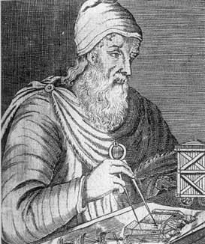
(area of parabolic segment ABC)
=4/3 (area of triangle ABC)!
From MacTutor

Slide 108
Additional Work on Spheres
http://schools-wikipedia.org/images/1729/172985.png
(accessed 9/22/2014)

Slide 109
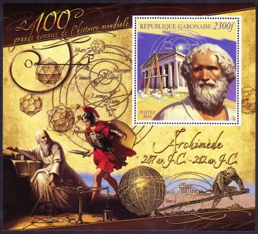
Archimedes (287 BCE - 212 BCE)
http://web.olivet.edu/~hathaway/Archimedes_s.html (accessed 9/22/2014)

Slide 110
References
Heath, T.L., The Works of Archimedes, Edited in Modern Notation with Introductory Chapters, Cambridge: University Press (1897). Reprinted in Encyclopedia Britannica's Great Books of the Western World, Volume 11 (1952).
Heath, T.L., A History of Greek Mathematics, Volume II: From Aristarchus to Diophantus, Clarendon Press, Oxford (1921). Reprinted by Dover Publications (1981).
Noel, W. and R. Netz, Archimedes Codex, How a Medieval Prayer Book is Revealing the True Genius of Antiquity's Greatest Scientist, Da Capo Press (2007).
NOVA, “Infinite Secrets: The Genius of Archimedes,” WGBH Boston (originally aired September 30, 2003).
Unless otherwise noted, websites were accessed in spring 2011.

Slide 111
The next slide is part of the nice integration animation.
The slide following it is the desire, smooth animation to replace slides 102 and 103.

Slide 112
Archimedes Integrates!!!
Z
T
K
E
B
A
D
C

