Slide 1
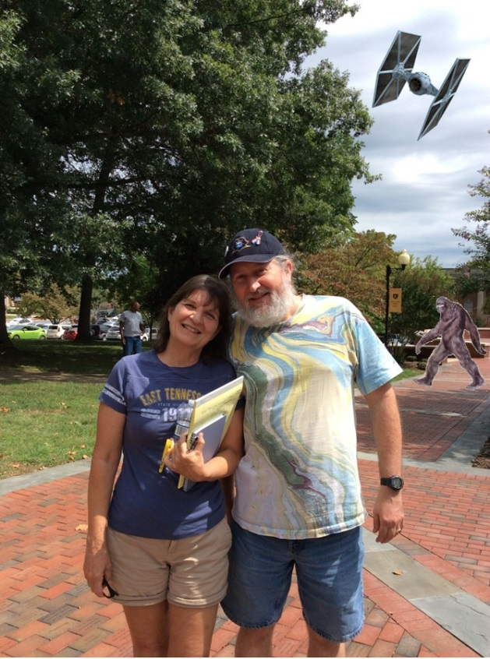
The ETSU Mathematics and Statistics Graduate Program: A Brief History
With a Healthy Side Order of Local History
Robert “Dr. Bob” Gardner
March 4, 2016

Slide 2
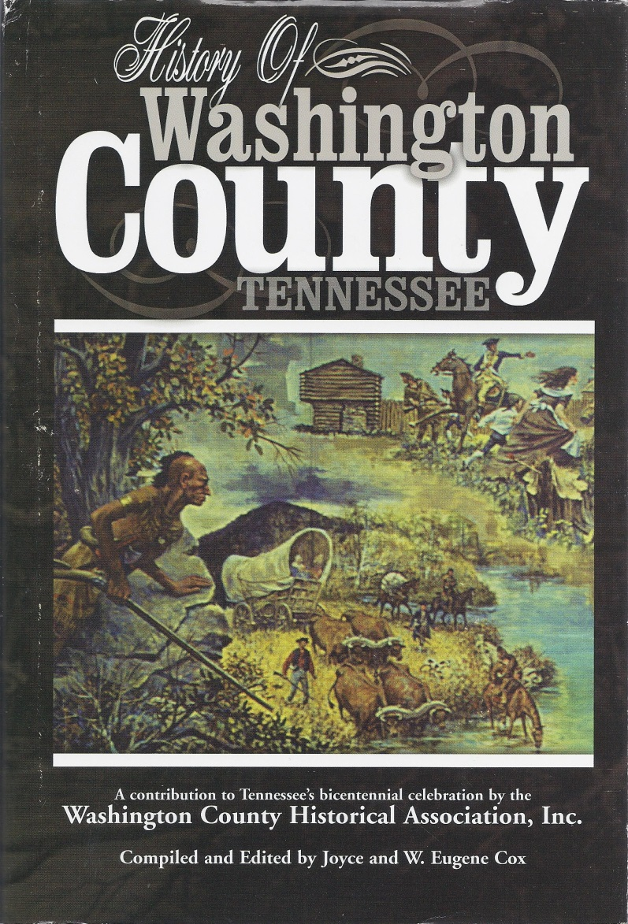
The Cherokee
Overmountain Press (2001)

Slide 3
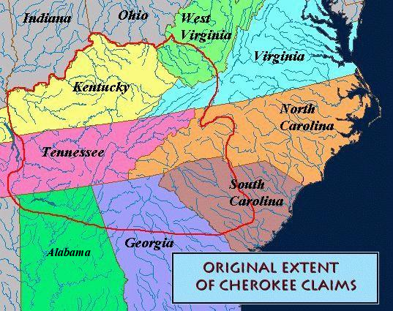
Cherokee Lands
https://chenocetah.wordpress.com/tag/map-of-cherokee-indian-lands/

Slide 4
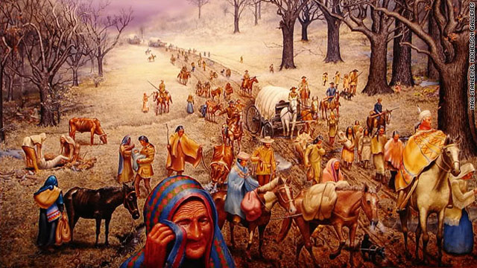
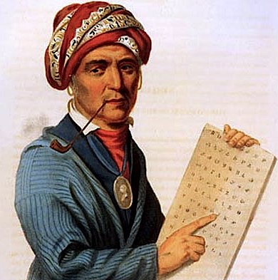
Cherokee Native Americans
https://www.americanhistoryusa.com/the-cherokee-acculturation/
http://www.cnn.com/2010/OPINION/11/15/langguth.trail.of.tears/

Slide 5
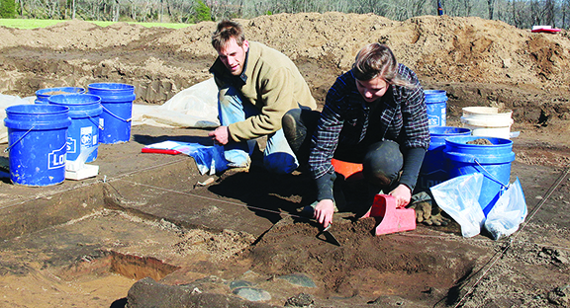
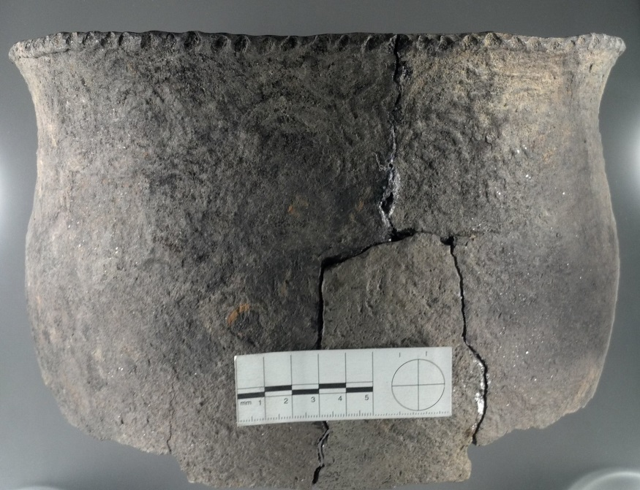
Protohistoric Cherokee Town Cane Notch
ETSU archaeology students excavating at Cane Notch on the Nolichucky River .
From: http://jcnewsandneighbor.com/peeling-back-the-cherokee-past/#prettyPhoto
http://faculty.etsu.edu/franklij/etsu_archaeological_field_school_10.htm

Slide 6
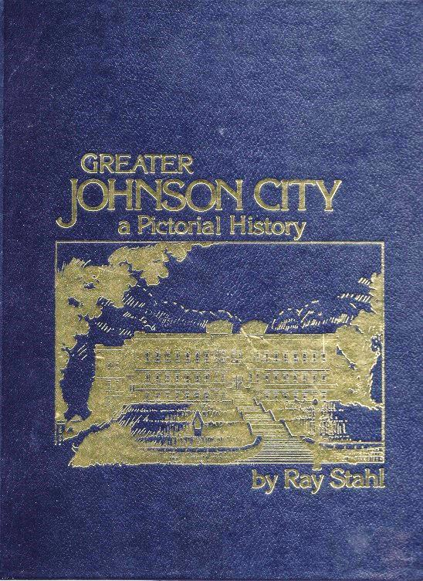
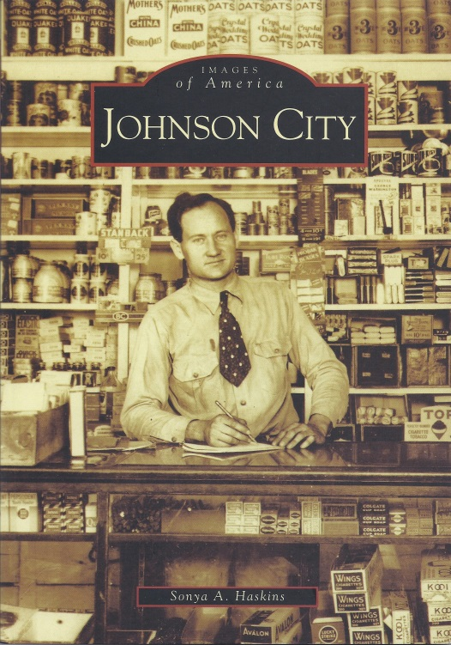
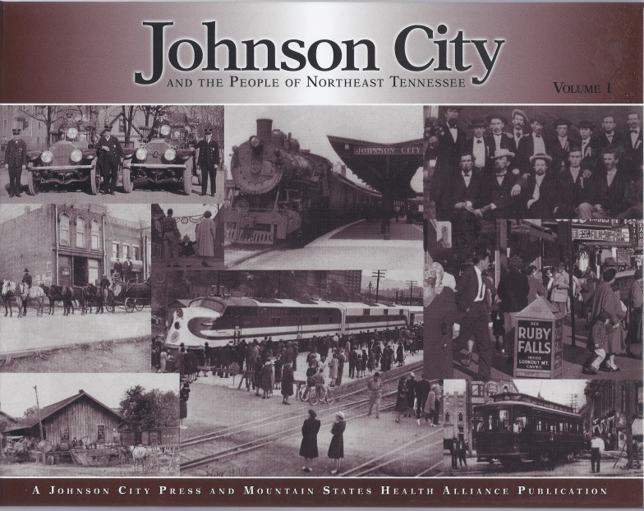
Henry Johnson, Johnson’s Depot, and Johnson City
Johnson City Press (2006)
(1983, 1986, 1992)
(2005)

Slide 7
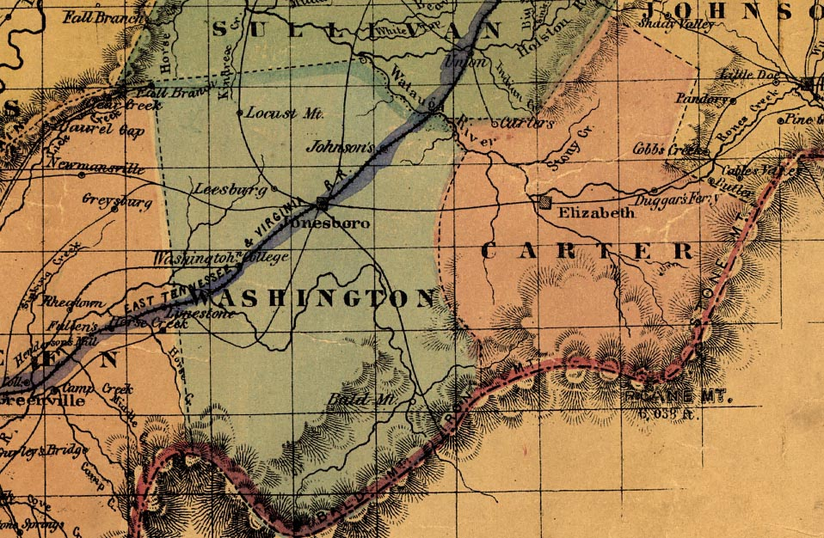
Railroads Make Johnson City
http://www.stateoffranklin.net/johnsons/maps/tennmap1861.jpg

Slide 8
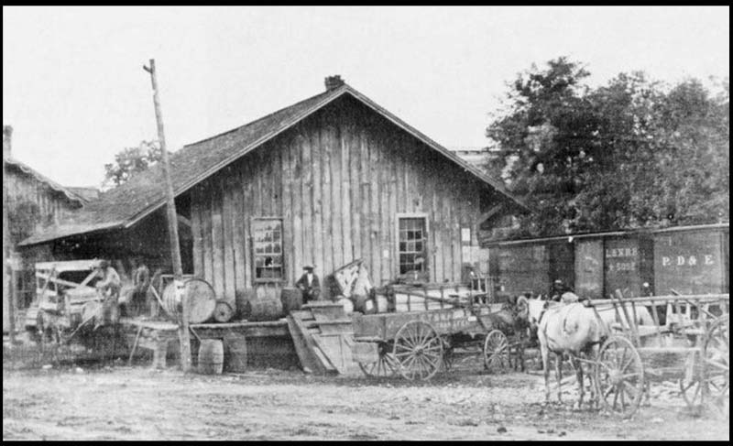
Johnson’s Depot
http://www.stateoffranklin.net/johnsons/images/photos/photos1/hendepot.jpg

Slide 9
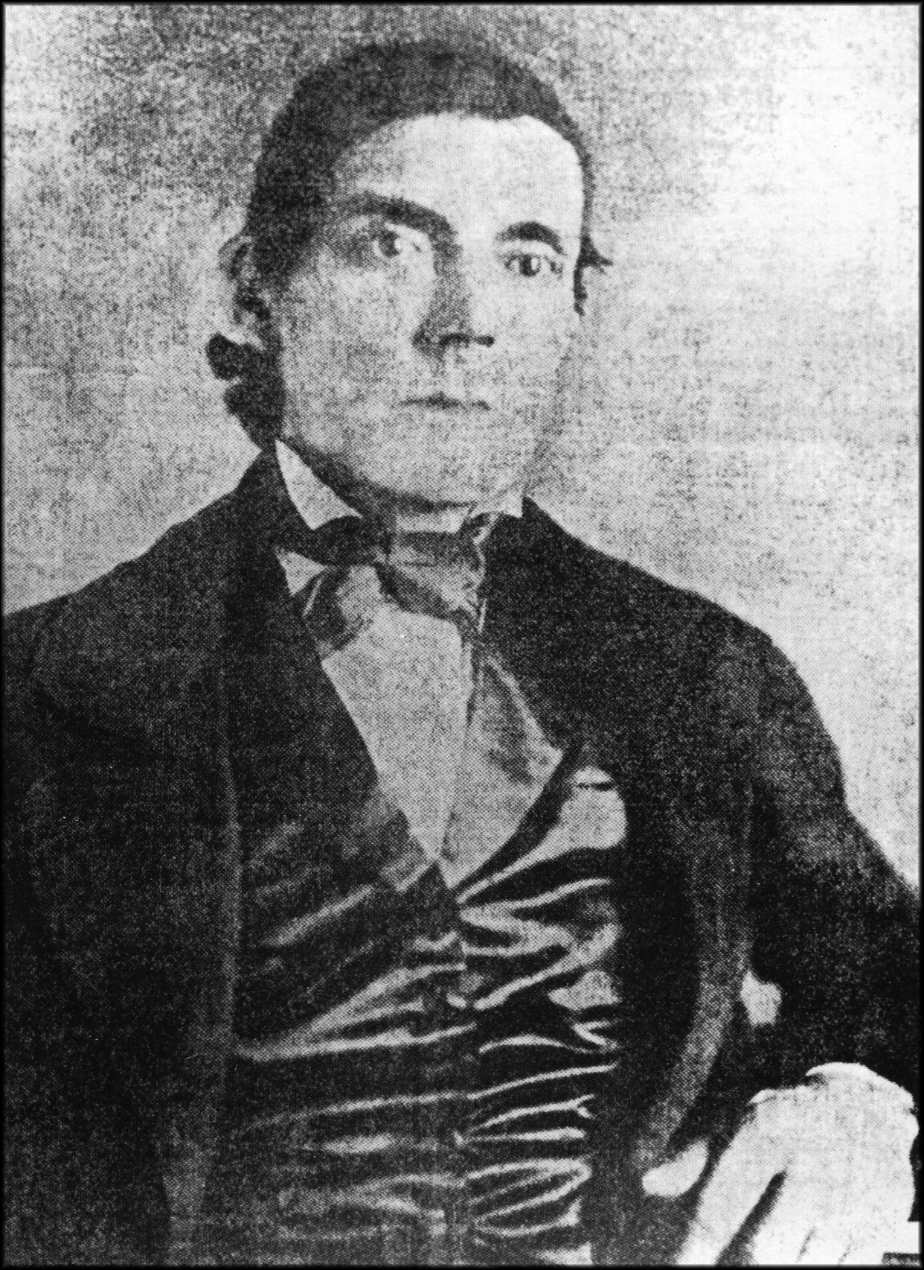
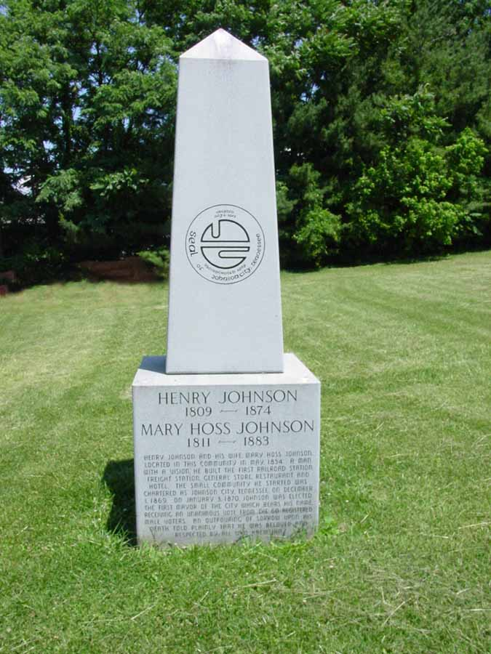
Henry Johnson
http://www.stateoffranklin.net/johnsons/cemeteries/oakhill/hjmarker1.jpg
http://www.bcyesteryear.com/node/688

Slide 10
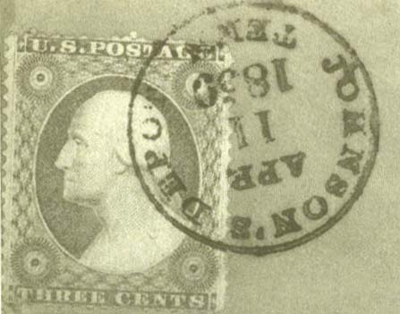

Slide 11
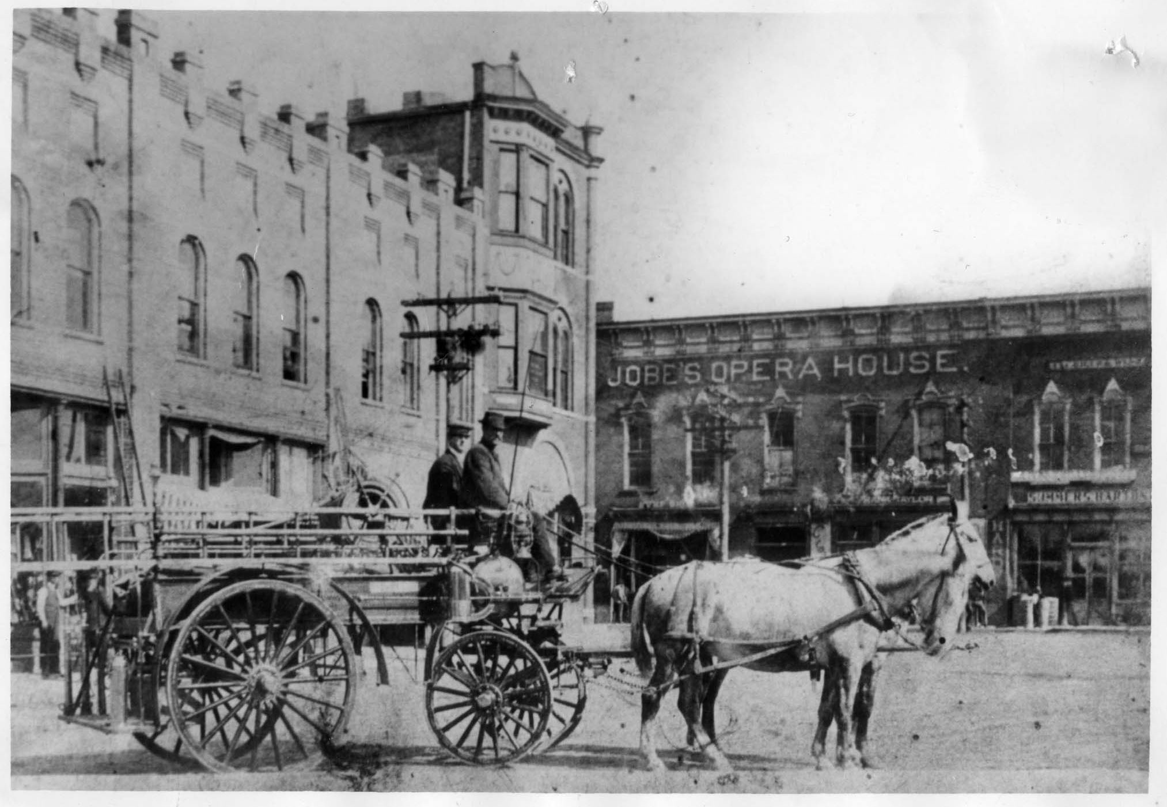
Fountain Square 1
http://www.stateoffranklin.net/johnsons/images/photos/photos1/jobeopera.jpg

Slide 12
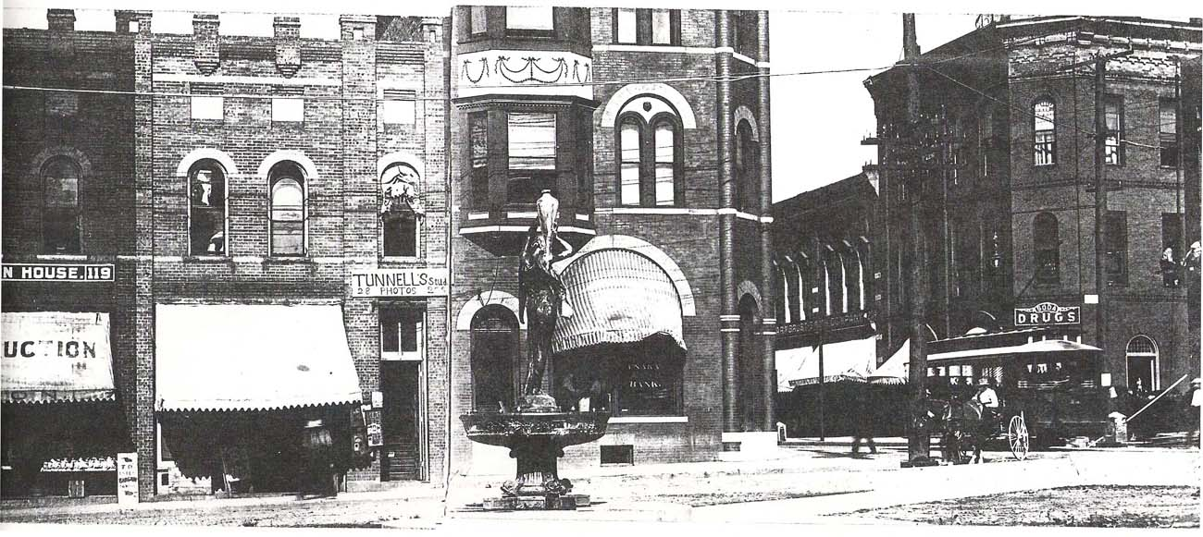
Fountain Square 2
http://www.stateoffranklin.net/johnsons/images/photos/photos1/ftnsquare2a.jpg

Slide 14
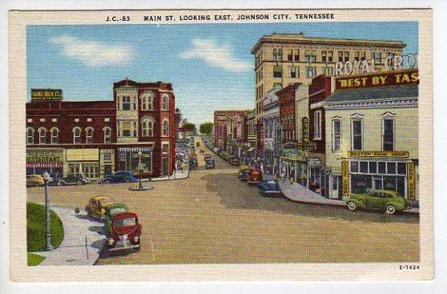
Fountain Square, Looking East

Slide 15
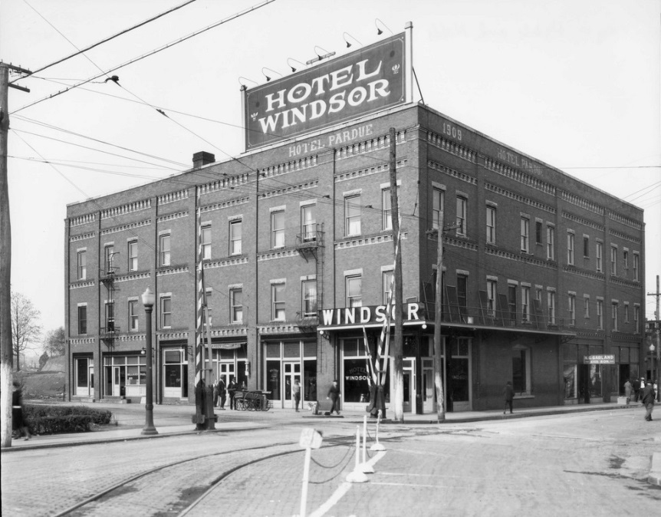
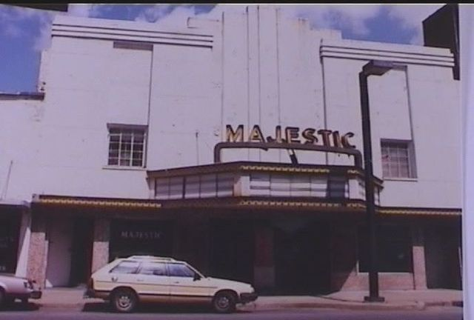
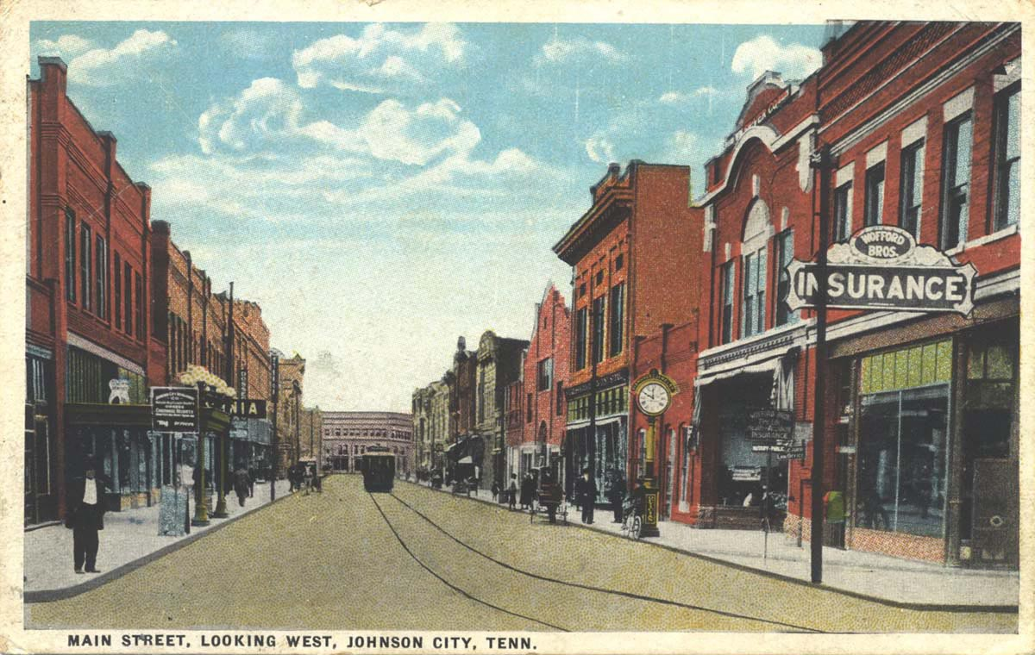
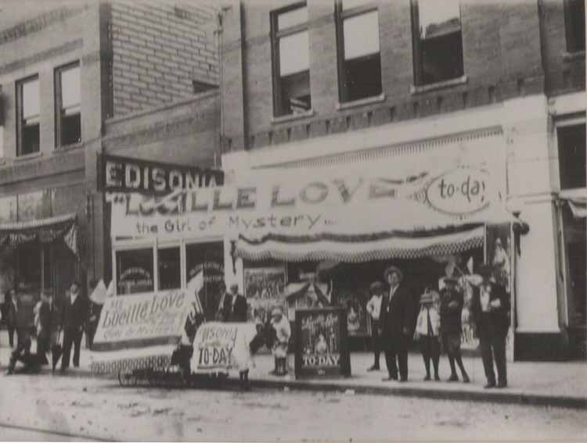
Main Street From the Other End

Slide 16
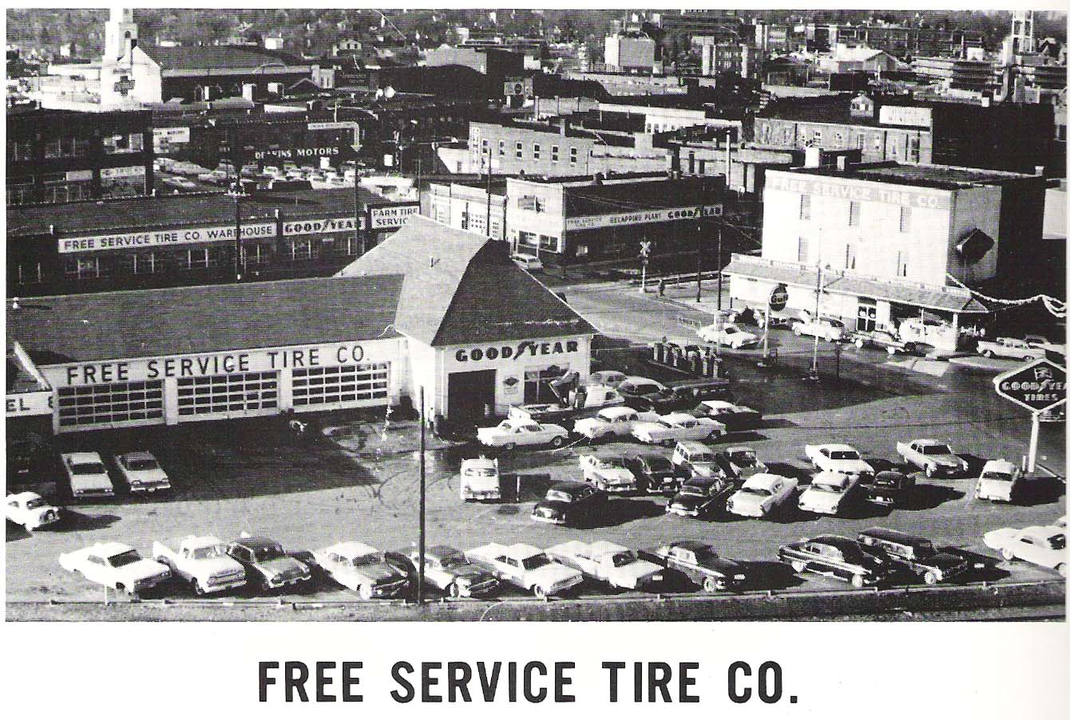
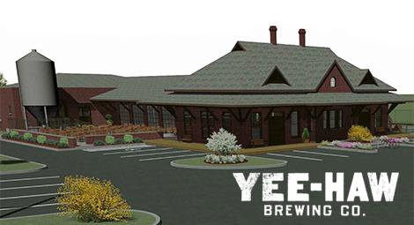
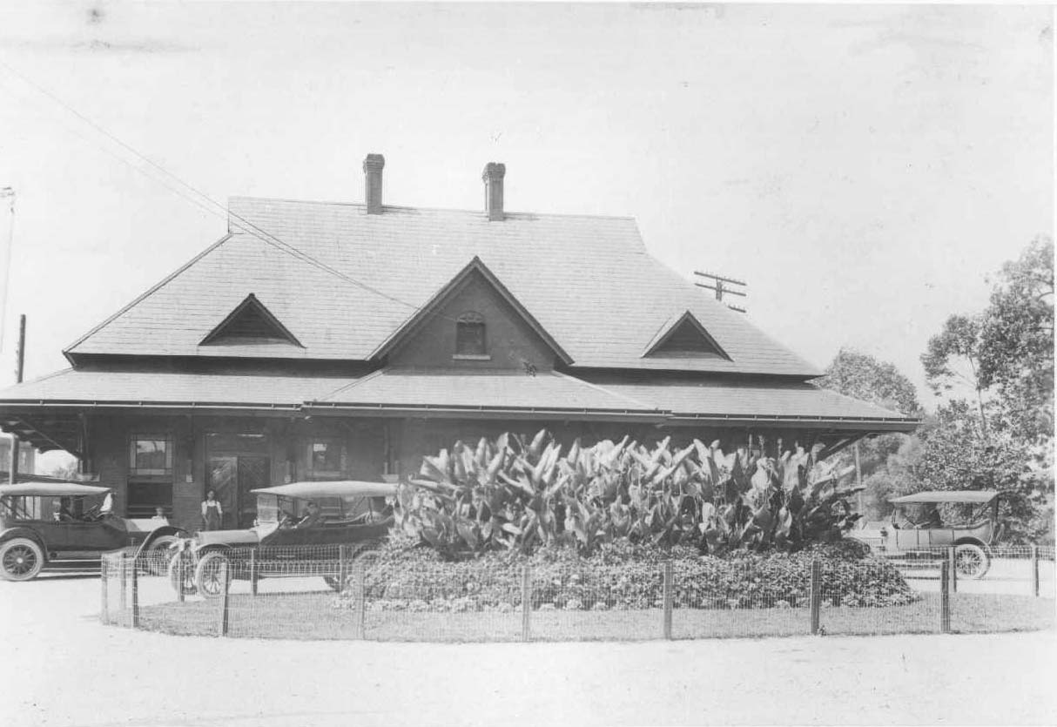
Yee-Haw Brewing, 2015
Free Service Tire, circa 1960
ET&WNC Depot, 1930
http://www.stateoffranklin.net/johnsons/images/photos/photos3/etwnc.jpg

Slide 17
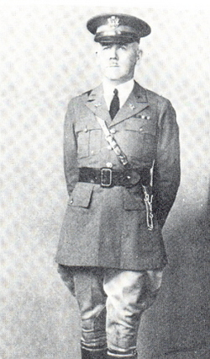
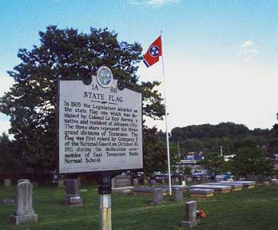
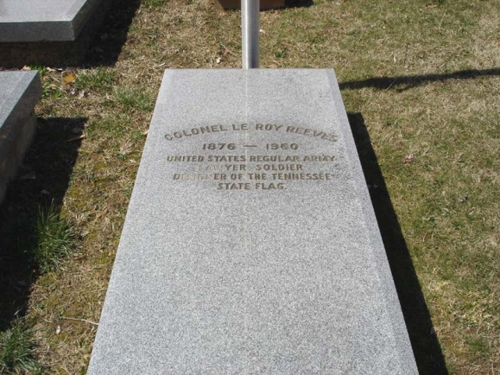
The Tennessee State Flag
LeRoy Reeves
Oak Hill Cemetery
http://tngenweb.org/washington/files/2012/10/stateflagmkr.jpg
http://www.stateoffranklin.net/johnsons/cemeteries/oakhill/reeves.jpg
http://www.findagrave.com/cgi-bin/fg.cgi?page=gr&GRid=7716822

Slide 18
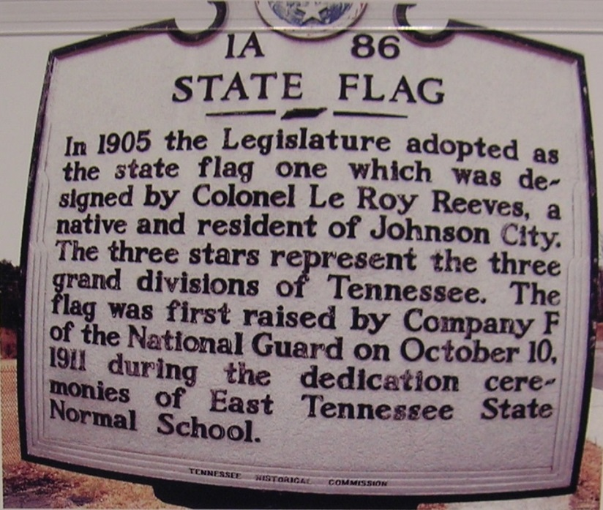
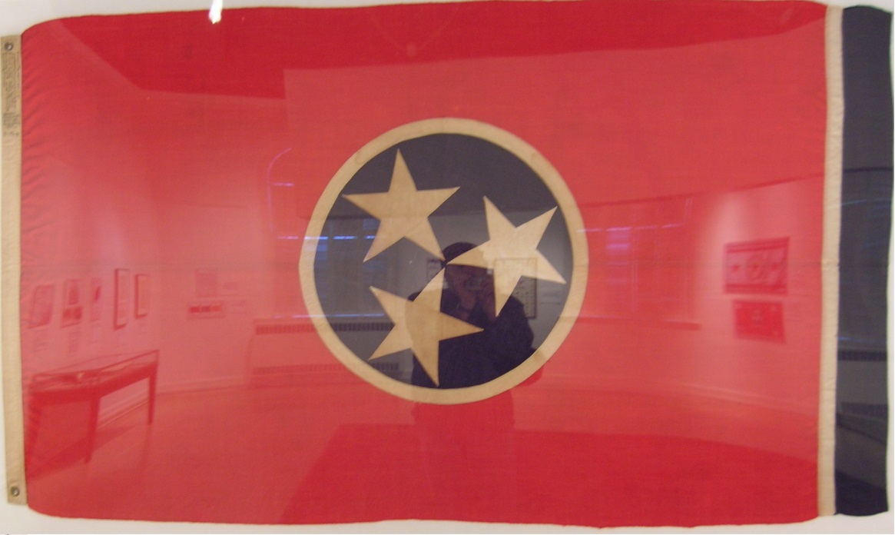
ETSU and the History of the Tennessee State Flag

Slide 19
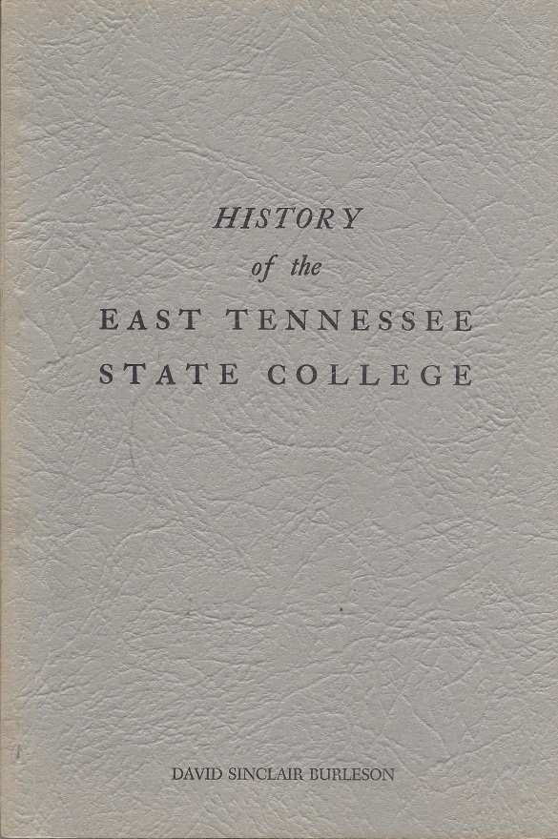
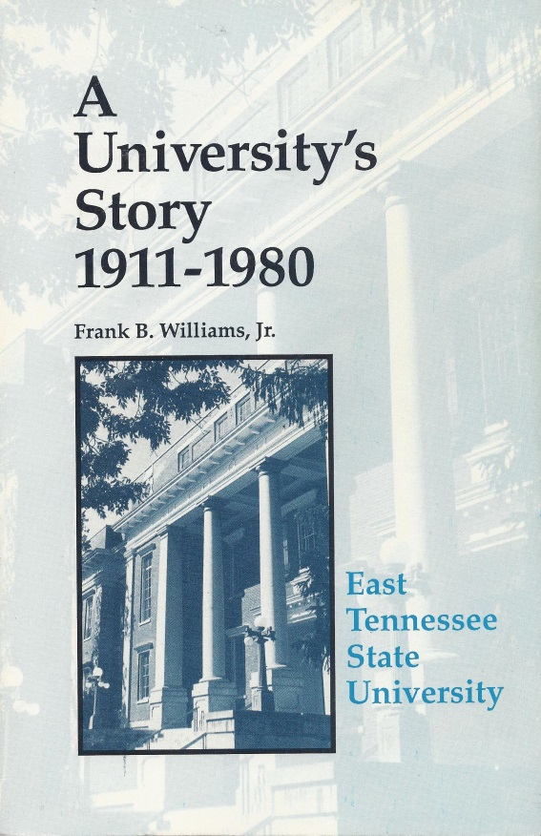
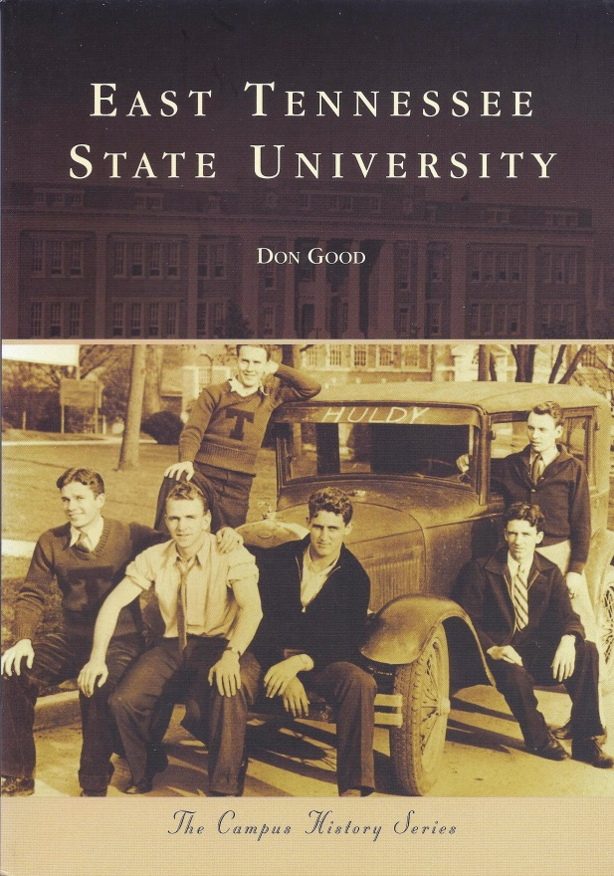
From East Tennessee State Normal School to East Tennessee State University
(1947)
ETSU Press (1991)
(2010)

Slide 20
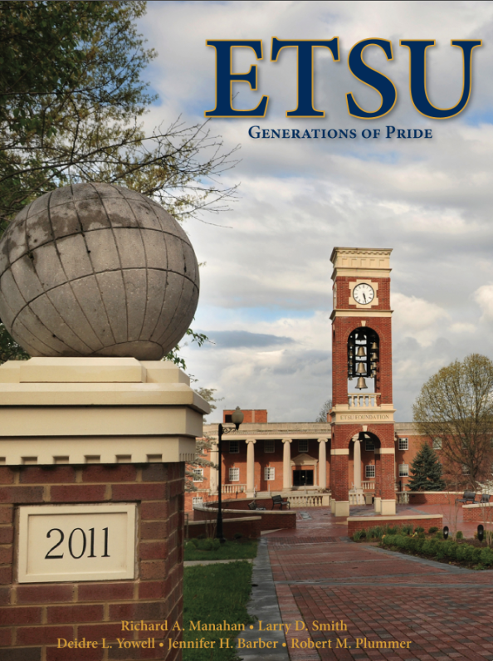
“Carved from the mountains of America’s first frontier, East Tennessee has been a unique fulcrum of change as our nation grew west, as transportation change[d] and waves of people moved with an eye toward a better future. Generations have come to the mountains, seduced by their peace and strength. People continue to seek benefit of their treasured resources, the time-tested way of life and to enjoy the strong, abiding Appalachian culture and heritage. … As a `Normal School,’ education’s early 20th century revolution made its beginning on [this] campus with 17 students and the dreams of many. Through time, change and modernization have brought new subjects, added departments, which emerged as schools and colleges, each broadening the mission, impact, and scope to become – East Tennessee State University.”
ETSU: Generations of Pride, Overmountain Press (2010)

Slide 21
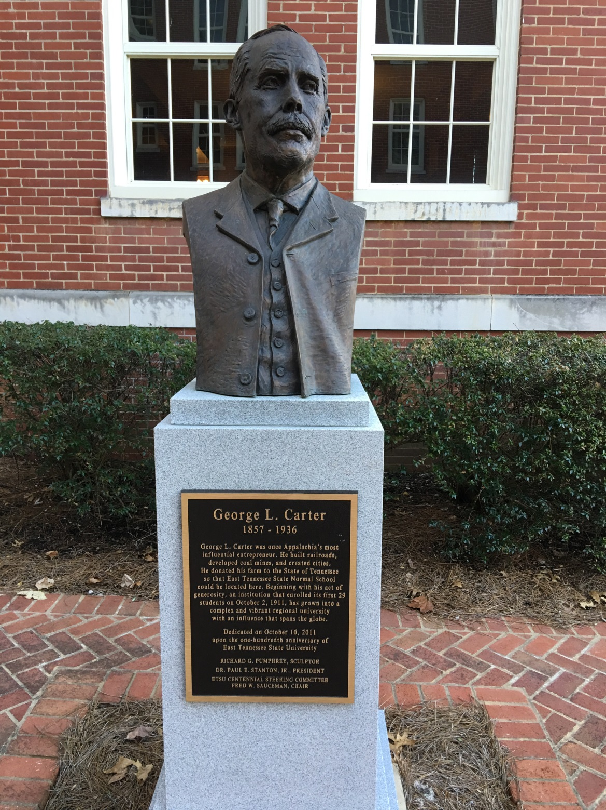
George L. Carter
1857-1936
A bust of George L. Carter sits outside of Mayetta Carter Hall (named for his wife), an original building on campus which has served as a women’s residence since the university opened in 1911.

Slide 22
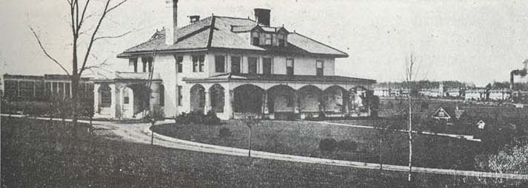
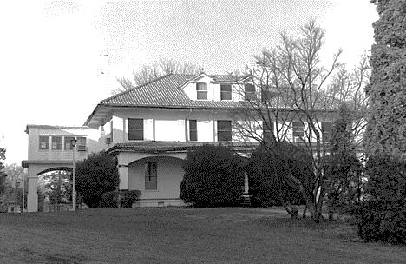
The Carter House
http://www.stateoffranklin.net/johnsons/normal/normal.htm
Later a dorm; Cooper Hall (page 16 of Good)

Slide 23
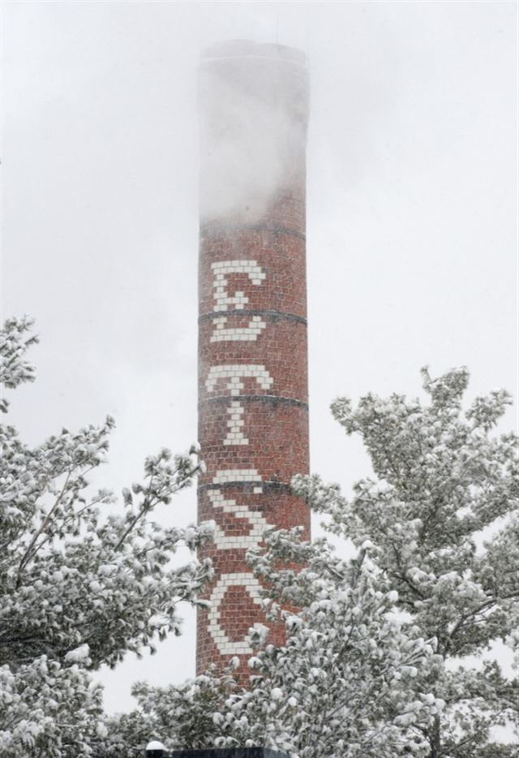
ETSNS to ETSU
1911 East Tennessee State Normal School
1925 East Tennessee State Teachers College
1930 State Teachers College, Johnson City
1943 East Tennessee State College
1963 East Tennessee State University
http://www.johnsoncitypress.com/image/2015/02/24/640x/76a732fa70913ee47cd297517b517078-jpg-13.jpg

Slide 24
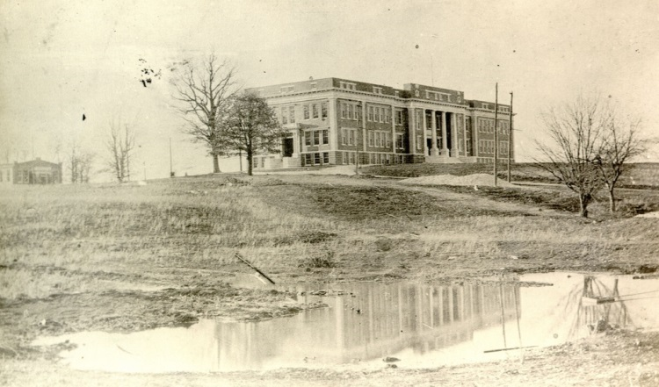
The Administrative Building
https://www.flickr.com/photos/etsuarchives/4331998149/in/photostream/

Slide 25
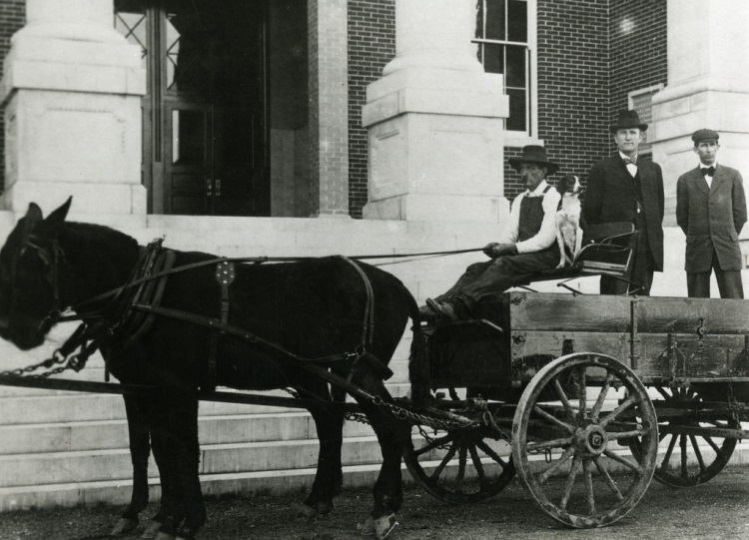
Front Steps of the Administration Building
C. Hodge Mathes
Sidney Gilbreath
East Tennessee Normal School, circa 1911.

Slide 26
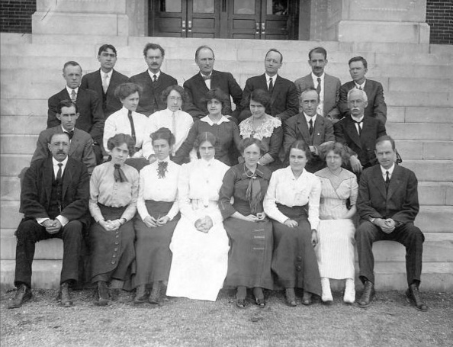
The Charter Faculty, 1911-12
Christian Rogers
Sidney Gilbreath
David Burleson

Slide 27
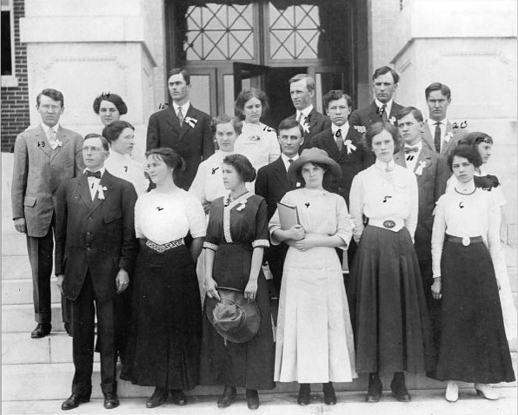
The First Graduating Class
This photo of 20 students (from page 15 of Good’s book) is purported to be “the first graduating class.”

Slide 28
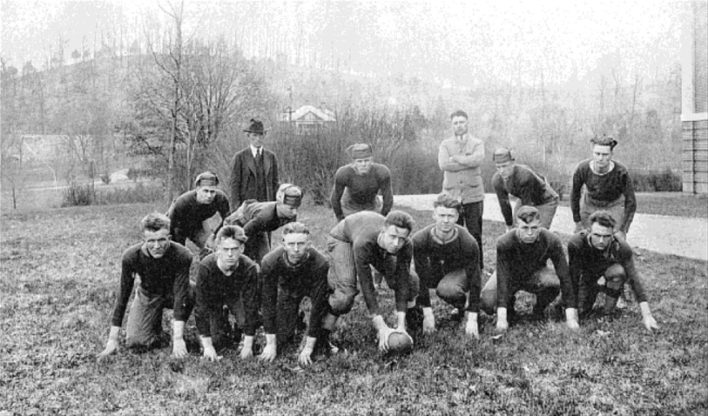
The First Football Team
Record: 3-2, beating Greeneville High, Washington College, and Johnson City High; loosing to Carson-Newman (0-55) and Milligan (0-30).

Slide 29
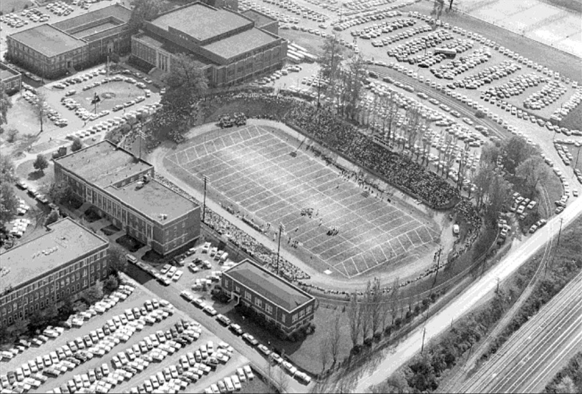
Memorial Stadium

Slide 30
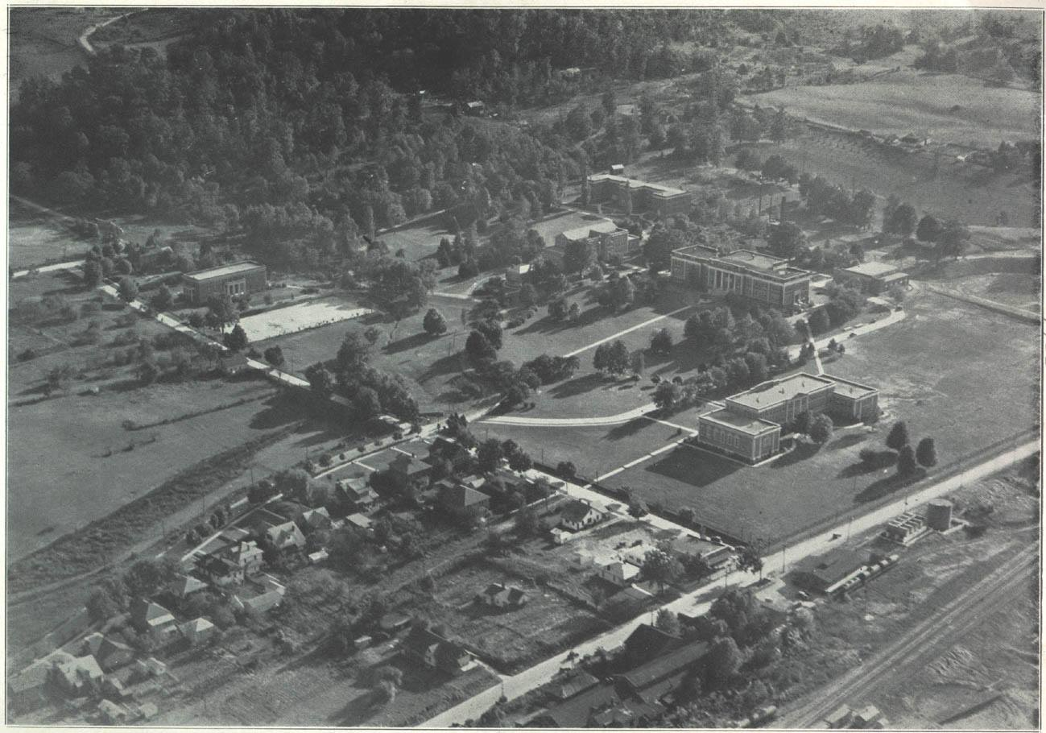
State Teachers College, 1935

Slide 31
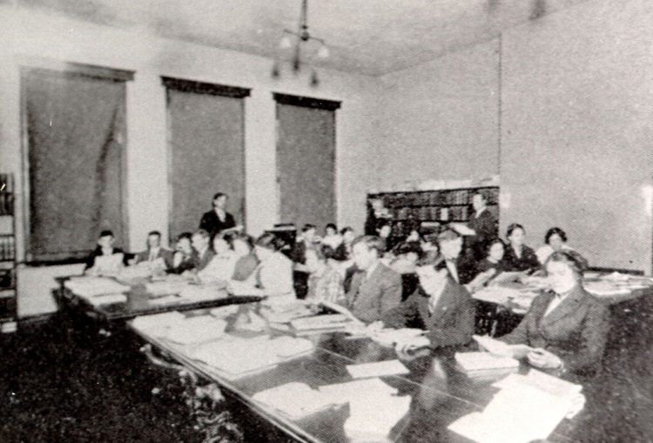
The First Library
https://www.flickr.com/photos/etsuarchives/4332457145/in/photostream/

Slide 32
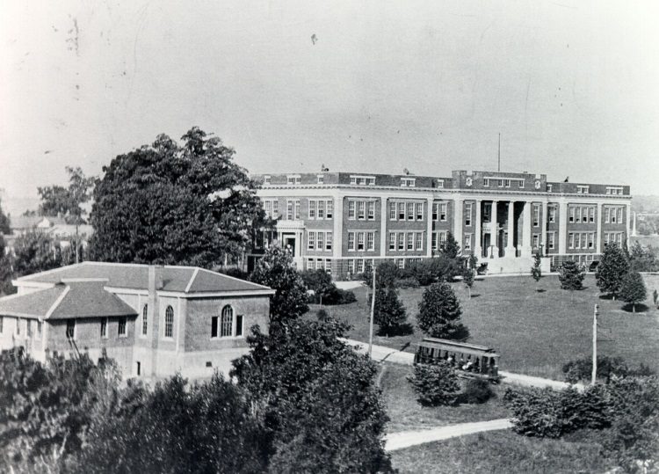
Trolley Service
https://www.flickr.com/photos/etsuarchives/4332746840/in/photostream/

Slide 33
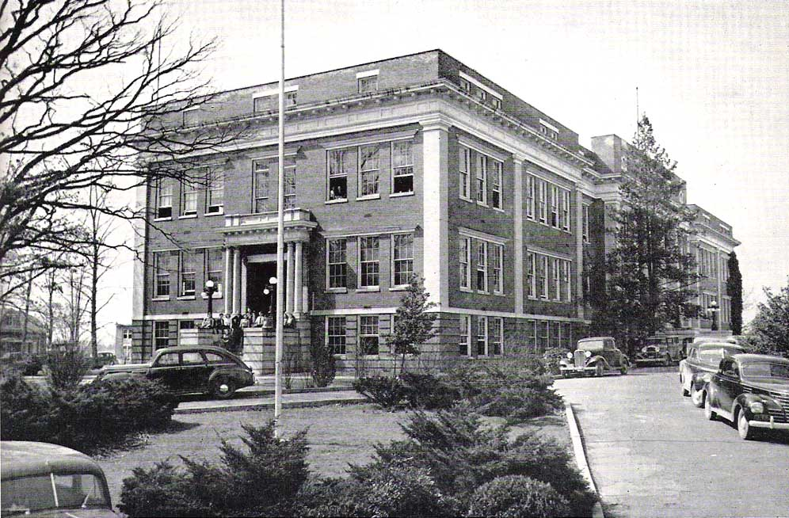
The Administrative Building, 1941
http://www.stateoffranklin.net/johnsons/normal/etsc1941a.jpg

Slide 34
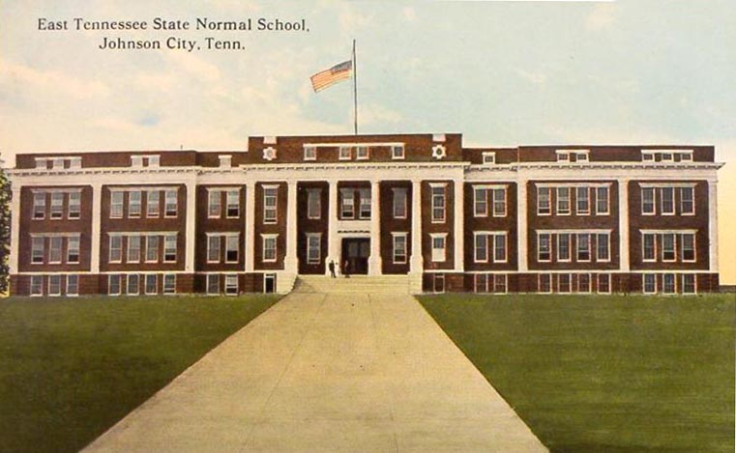
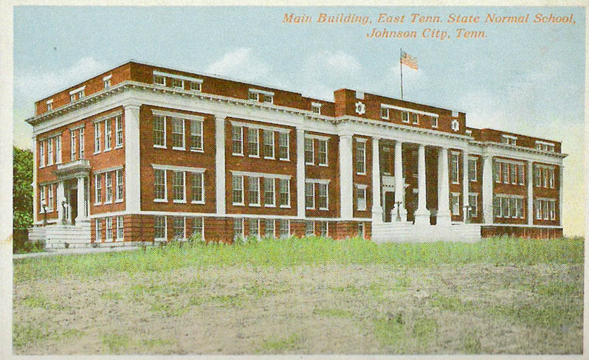
Administrative Building Named “Gilbreath Hall” in 1957

Slide 35
Spheres of the World
http://www.etsualumni.org/s/974/interior-template.aspx?sid=974&gid=1&pgid=1221

Slide 36
Spheres of the World

Slide 37
Desegregation in 1956 and 1958

Slide 38
East Tennessee State
College
University
Governor Frank Clement signing the bill renaming “ETSC” as “ETSU” on March 5, 1963. The name change took effect July 1, 1963.

Slide 39
Other Landmark Events
Approved in 1974, first students in 1978
Gray Natural History Museum opened in 2007
Engineering degree, Fall 2016
Kingsport Center opened in 1959

Slide 40
The Department of Mathematics
…and Statistics

Slide 41
Departmental Chairs
Chair | Dates | # Years
David S. Burleson | 1911-1913 | 2
Christian E. Rogers | 1913-1924 | 11
Thomas C. Carson | 1924-1959 | 35
Lester C. Hartsell | 1959-1980 | 21
William N. Anderson, Jr. | 1980-1984 | 4
Charles W. Wilson | 1984-1986 | 2
George D. Poole | 1986-1999 | 13
Janice Huang | 1999-2000 | 1
Anant Godbole | 2000-2011 | 11
Robert “Young Bob” Price | 2011-present | 5+
Dates based on Faculty Handbook, Mathematics Department, ETSU, 1997.
NOTE: The website http://www.etsu.edu/facts/history.aspx states that the Mathematics Department was first part of the school in 1926.

Slide 42
David Burleson
Christian Rogers
https://www.etsu.edu/100years/highlights.aspx
https://www.flickr.com/photos/etsuarchives/4435407407

Slide 43
Thomas Carson
M.A. degree from Duke University (1928) with thesis titled “Some Historical Investigations into the Parallel Postulate.” A copy of his thesis is available in the ETSU Archives of Appalachia (QA681.C37).
https://www.flickr.com/photos/etsuarchives/4426967783

Slide 44
Carson Hall 1
https://www.flickr.com/photos/etsuarchives/4615513834

Slide 45
Carson Hall 2
https://www.flickr.com/photos/etsuarchives/4331024682

Slide 46
The Math Club, March 1955
Department Chair (and building namesake) Thomas Carson.

Slide 47
Dr. Lester C. Hartsell (1921-2016)
https://www.pinterest.com/pin/386254105519956027/

Slide 48
Velma Cloyd and Marjorie Midyett
Math faculty member: 1928-1972. https://www.flickr.com/photos/etsuarchives/4427736410
Math faculty member: 1966-1990. https://www.flickr.com/photos/etsuarchives/4435585654

Slide 49
The Department’s First Website (circa 1996)
https://web.archive.org/web/19980214230636/http://www3.etsu.edu/MATH/MATH.HTM

Slide 50
First Female Chair of Math
Janice Huang, 1999-2000
Janice Huang, seen here with her husband Tom (chair of the ETSU Department of Chemistry for several years) . Her Ph.D. is in algebra from the University of Illinois (1994).
From ETSU Today, Fall 2001, page 14.

Slide 51
The Era of Chairperson
Robert
“Young Bob”
Price
Dr. Price celebrates 2 years as chair, July 1, 2013.

Slide 52
The Graduate Program
(the biased view of a pure mathematician)
Supervised Teaching (MATH 5019) Class, Fall 2014

Slide 53
The Beginning of our Graduate Program
The 1951-52 East Tennessee State College Bulletin introduced the “Graduate Division” and reports the following (pages 140-141):
The program involves a Master of Arts in education. “Minor Fields” listed by name are English, social studies, biology, and chemistry.

Slide 54
The First “Math Thesis”
According to the Listing of Master’s Theses, East Tennessee State University, 1951-1976 (which lists 89 departmental theses), the first thesis to fall under the heading of math was:
Florence Bogart, “Making First-Year Algebra More Meaningful” (1951).

Slide 55
A Historical Thesis
A Study of the Organization and Function of the Mathematics Club of East Tennessee State College
Lora DeVault McCormick
August 1955
Thomas Carson
Francis L. Celauro
S. W. Grise (?)
Lora McCormick went on to work in the Department of Mathematics from 1953-1975!

Slide 56
1952-53
The 1952-53 East Tennessee State College Bulletin lists math as a “Minor Field” in the Master or Arts in education degree and gives the first post-calculus analysis-type class (as well as the first appearance of a modern algebra-type class):
502. Infinite Series. (3 hours)
A Study will be made of theory and application of infinite series, convergence, divergence, ratio and comparison tests power series, expansion of functions in series. Prerequisite: Math. 303 [Calculus 3]
503. Introduction to Modern Algebra. (3 hours)
This is a study of polynomials and fundamental properties, linear dependents, matrices, invariants, bilinear forms, and selected topics from the theory of numbers and finite groups. Prerequisite: Math. 303.
The faculty listed for the Math Department are: “Mr. Carson, Miss Cloyd, Mr. Jasper, Miss Smith, and Mr. Stollard.”

Slide 57
1953-57
The 1953-54 East Tennessee State College Bulletin has the addition of Advanced Calculus:
511S, 512S. Advanced Calculus . (3 hours)
Supplementary study of calculus, including partial derivatives with applications to surfaces and space curves, Taylor’s Theorem and relative extremes of functions of several variables, line and surface integrals, improper integrals, indeterminate forms.
The 1955-56 East Tennessee State College Bulletin has the addition of:
551, 552. Functions of a Complex Variable . (3 hours)
595. Methods of Research.
The 1956-57 East Tennessee State College Bulletin has the addition of:
521S. Elementary Math from an Advanced Standpoint . (3 hours)
An ‘S’ means that the class can be taken by qualified seniors.

Slide 58
1960-61: The BIG BANG
The 1960-61 East Tennessee State College Bulletin includes:
http://www.universetoday.com/102783/kapow-keck-confirms-puzzling-element-of-big-bang-theory/
412G-413G. Introduction to Modern Algebra. (3 hours each quarter)
Construction of the number systems in algebra; groups, rings, and fields; polynomials.
541-542-543. Modern Algebra. (3 hours each quarter)
Prerequisite: Math 412G [Introduction to Modern Algebra 1].
Theory of groups, rings, integral domains, and fields; polynomials; vector spaces, and theory of ideals.
An ‘G’ denotes an undergraduate class which graduates can take for credit.

Slide 59
The 1960-61 East Tennessee State College Bulletin (continued – Real and Complex):
521-522-523. Foundations of Analysis. (3 hours each quarter)
Prerequisite: Math. 422G [Advanced Calculus 2].
A rigorous study of the real and complex number systems, elements of set theory, numerical sequences and series, continuity, differentiation, the Riemann-Stieltjes Integral, sequences and series of functions, further topics in the theory of series, functions of several variables, and the Lebesque Theory.
551-552-553. Functions of a Complex Variable. (3 hours each quarter)
Prerequisite: Math 423G [Advanced Calculus 3].
Complex numbers, analytic and elementary functions, integrals, power series, residues and poles, conformal mapping and applications.
555-556-557. Functions of a Real Variables. (3 hours each quarter)
Prerequisite: Math. 423 G [Advanced Calculus 3].
The real number system, theory of point sets, rigorous investigation of many questions arising in calculus, Lebesque integrals and infinite series.

Slide 60
The 1960-61 East Tennessee State College Bulletin (continued – Topology and Research):
411G. Introduction to Topology . (3 hours)
A basic course in the properties of a space which are invariant under continuous transformations. Set topology, homology, homotopy, fixed point theorems, and manifolds.
575-576-577. Topology. (3 hours each quarter)
Prerequisite: Math. 411G [Intro to Topology] and Math. 523 [Foundations of Analysis 2].
An Introduction to the study of geometric properties that depend only on continuous structure and not on size or shape. Topics will be selected from the following: point sets, cardinal numbers, neighborhood spaces, continuous mappings, connectivity, network, polyhedra.
595. Introduction to Mathematical Research. (1 hour)
596. The Thesis. (4-6 hours)

Slide 61
Modern Algebra at ETSU

Slide 62
The Evolution of our
Modern Algebra Sequences
412G-413G.
Introduction to Modern Algebra
541-542-543. Modern Algebra.
Change ‘5’ to ‘4/5’ and add a ‘7’
Add a ‘0’, drop third class
4127/5127, 4137/5137.
Introduction to Modern Algebra 1 and 2.
5410, 5420.
Modern Algebra 1 and 2.

Slide 63
Undergraduate/Graduate and Graduate Algebra Classes
Introduction to Modern Algebra (MATH 4127/5127): Introduction to the basic algebraic systems, including groups, rings, integral domains, and fields.
Introduction to Modern Algebra II (MATH 4137/5137): The study of rings is continued to include topics of factor rings, ideals and factorization. The study of field theory is expanded to include extension fields and splitting fields, time permitting; Sylow theory is included.
Modern Algebra I (MATH 5410) Monoids, group theory, ring theory, modules over a principal ideal domain.
Modern Algebra II (MATH 5420): Field theory, Galois theory, algebra over a field, ring theory.
Descriptions from the 2015-16 Graduate Catalog.

Slide 64
ETSU Abstract Algebra Club
An unofficial, unrecognized organization created in 2014 to promote abstract (or modern) algebra and the classes which ETSU offers in this area.

Slide 65
Analysis at ETSU

Slide 66
The Evolution of our
Analysis Sequences
521-522-523.
Foundations of Analysis.
555-556-557.
Functions of a Real Variable.
Add a ‘0’, drop third class
Change ‘5’ to ‘4/5’ and add a ‘7’
4217/5217, 4227/5227.
Analysis 1 and 2.
5210, 5220.
Real Analysis 1 and 2.

Slide 67
The Evolution of our
Complex Analysis Classes
551-552-553. Functions of a Complex Variable.
?
Add a ‘0’, drop third class
4337/5337.
Complex Variables.
5510, 5520.
Complex Analysis 1 and 2.

Slide 68
The Evolution of our
Topology Class
411G. Introduction to Topology.
575-576-577. Topology.
5350. Topology.
4357/5357. Introduction to Topology.

Slide 69
Undergraduate/Graduate Analysis Classes
Analysis 1 (MATH 4217/5217): In a setting of the real numbers, a study of sets, functions on sets, algebra and order properties of the real numbers, sequences, sequences of functions, continuous functions, limits of functions, function approximation.*
Analysis 2 (MATH 4227/5227): A study of the derivative and integral of functions of one variable, the Riemann- Stieltjes integral, series, series of functions, Fourier series*
Complex Variables (MATH 4337/5337): Complex numbers and their algebra, complex differentiation and integration, analytic and elementary functions, residues and power series.
Introduction to Topology (MATH 4357/5357): Open and closed sets, continuous functions, metric spaces, connectedness, continuous functions, metric spaces, connectedness, compactness, the real line, and the fundamental group.
Descriptions from the 2015-16 Graduate Catalog.
*The description of Analysis 1 and Analysis 2 are different in the Undergraduate
Catalog.

Slide 70
Analysis Instructor for 2016-17
Dr. Rodney Keaton
B.S., University of North Carolina at Asheville (2007)
M.S., Clemson University (2010)
Ph.D., Clemson University (2014)

Slide 71
Graduate Analysis Classes
Real Analysis 1 (MATH 5210): The real number system, sequences, functions, Lebesgue measure, measurable functions, the Lebesgue integral, differentiation.
Real Analysis 2 (MATH 5220): Classical Banach spaces, metric spaces, topological spaces, Riesz Representation theory, Hilbert spaces, general measure and integration.
Complex Analysis 1 (MATH 5510): Complex numbers, continuity and derivatives of functions, power series, Laurent series, transcendental functions, line and contour integrals, Cauchy integral formula, Maximum Principle, applications.
Complex Analysis 2 (MATH 5520): Residues and integration, harmonic functions, conformal mapping and applications, Laplace transform, Riemann surfaces.
Introduction to Functional Analysis (MATH 5740): An introduction to the standard topics of functional analysis are given. Properties of normed linear spaces, Banach spaces, and Hilbert spaces are studied. The Hahn-Banach Theorem is addressed. Spectral theory and compact operators are introduced. A knowledge of measure theory is not assumed and any needed measure theoretic results are presented in the course.*
Descriptions from the 2015-16 Graduate Catalog.
*Proposed description for this experimental course.

Slide 72
Math Modeling in Biosciences Certificate
First Certificate Graduates…?

Slide 73
Samuel Green
Expected completion of certificate program: Fall 2016 or Spring 2017

Slide 74
Walter Witt
Expected completion of certificate program: Fall 2016 or Spring 2017

Slide 75
The New M.S. Core
The current (2015-16) Graduate Catalog lists the following requirements:
Every candidate must complete Real Analysis I (MATH 5210) and Modern Algebra I (MATH 5410), plus at least two (2) of the following:
Complex Analysis I (MATH 5510)
Applied Mathematics I (MATH 5610)
Statistical Methods I (STAT 5710)
Graph Theory I (MATH 5340)
Introduction to Topology (MATH 5357)
Plus one two-course sequence.
A proposal is in the works (to better accommodate our students with an interest in statistics) to change these requirements to:
Every Candidate must complete Real Analysis I (MATH 5210) and either Modern Algebra I (MATH 5410) or Statistical Methods I (STAT 5710), plus a two-course sequence.

Slide 76
Some Questions
Who was the first regular faculty member (i.e., nonchair) with a Ph.D.?
Who from the department published the first research paper?
Where has the department been housed after being in Carson Hall? When was the department moved to Gilbreath Hall room 312?
Why does the stairwell landings in the front of Gilbreath intersect the windows?
Was there a 4th floor in Gilbreath Hall?
When were all those classes introduced in 1960 first taught and by whom?
What’s the story behind our applied and statistics classes?

Slide 77
The Current Faculty
Faculty Member | Year | Faculty Member | Year
Robert Beeler | 2007 | Debra Knisley | 1989
Ariel Cintron-Arias | 2009 | Jeff Knisley | 1990
Robert Davidson | 1985* | Nicole Lewis | 2013
Robert Gardner | 1993 | Michael Marks | 2000
Anant Godbole | 2000 | Jamie McGill | 1993*
Sherri Hardin | 1989* | Rick Norwood | 1988
Teresa Haynes | 1988 (1993) | Robert Price | 1997
Michel Helfgott | 2004 | George Poole | 1986
Jean Marie Hendrickson | 2016 | Edith Seier | 1998
Michele Joyner | 2010 | D. C. Smith | 2001*
Rodney Keaton | 2016 | Daryl Stephens | 1994*
*These faculty members transferred into the Department of Mathematics from Developmental Studies in 2003.
Total faculty spring 2016: 20 Total faculty fall 2016: 20

Slide 78
The Most Recent Group Photo
Spring 2012 (Not pictured: Joyner, D. Knisley, J. Knisley, Lewis, Marks, Norwood, Poole, and Smith)

Slide 79
References
David Sinclair Burlseson, History of the East Tennessee State College, ETSC Press? (1947).
J. And W. E. Cox (eds.), A History of Washington County, Tennessee: a Contribution to the Bicentennial Celebration of Tennessee Statehood, Overmountain Press, Johnson City (2001).
Don Good, East Tennessee State University, The Campus History Series, Arcadia Publishing, Charleston/Chicago/Portsmouth/San Francisco (2010).
Sonya A. Haskins, Images of America, Johnson City, Arcadia Publishing, Charleston/Chicago/Portsmouth/San Francisco (2005).
Johnson City Press and Mountain States Health Alliance, Johnson City and the People of Northeast Tennessee, Volume 1, Jostens Books (2006) .
Ray Stahl, Greater Johnson City, a Pictorial History, Dinning Company/Publishers, Virginia Beach, VA (1983, 1986, 1992).
Frank B. Williams, East Tennessee State University - A University’s Story, 1911-1980, ETSU Press, Johnson City, TN (1991).

Slide 80
Website References
Celebrating Our Centennial (in commemoration of ETSU’s 100th year): https://www.etsu.edu/100years/default.aspx
Department of Mathematics and Statistics: http://www.etsu.edu/cas/math/
ETSU Abstract Algebra Club: http://faculty.etsu.edu/gardnerr/4127/algebra-club/ETSU-Abstract-Algebra-Club.htm
ETSU National Alumni Association website (includes ETSU history and timeline information): http://www.etsualumni.org/s/974/interior-template.aspx?sid=974&gid=1&pgid=1210
ETSU Football History: http://cdn.streamlinetechnologies.com/etsubucs/4475FE80-D02E-4CC4-AB99-C00529BA3225/FootballRecordBook2013.pdf
Johnson’s Depot (a website concerning the history of Johnson City): http://www.stateoffranklin.net/johnsons/index.htm
Obituary for Lester Hartsell in Johnson City Press: http://www.johnsoncitypress.com/Obituary/2016/01/23/Dr-Lester-Hartsell

