Slide 1
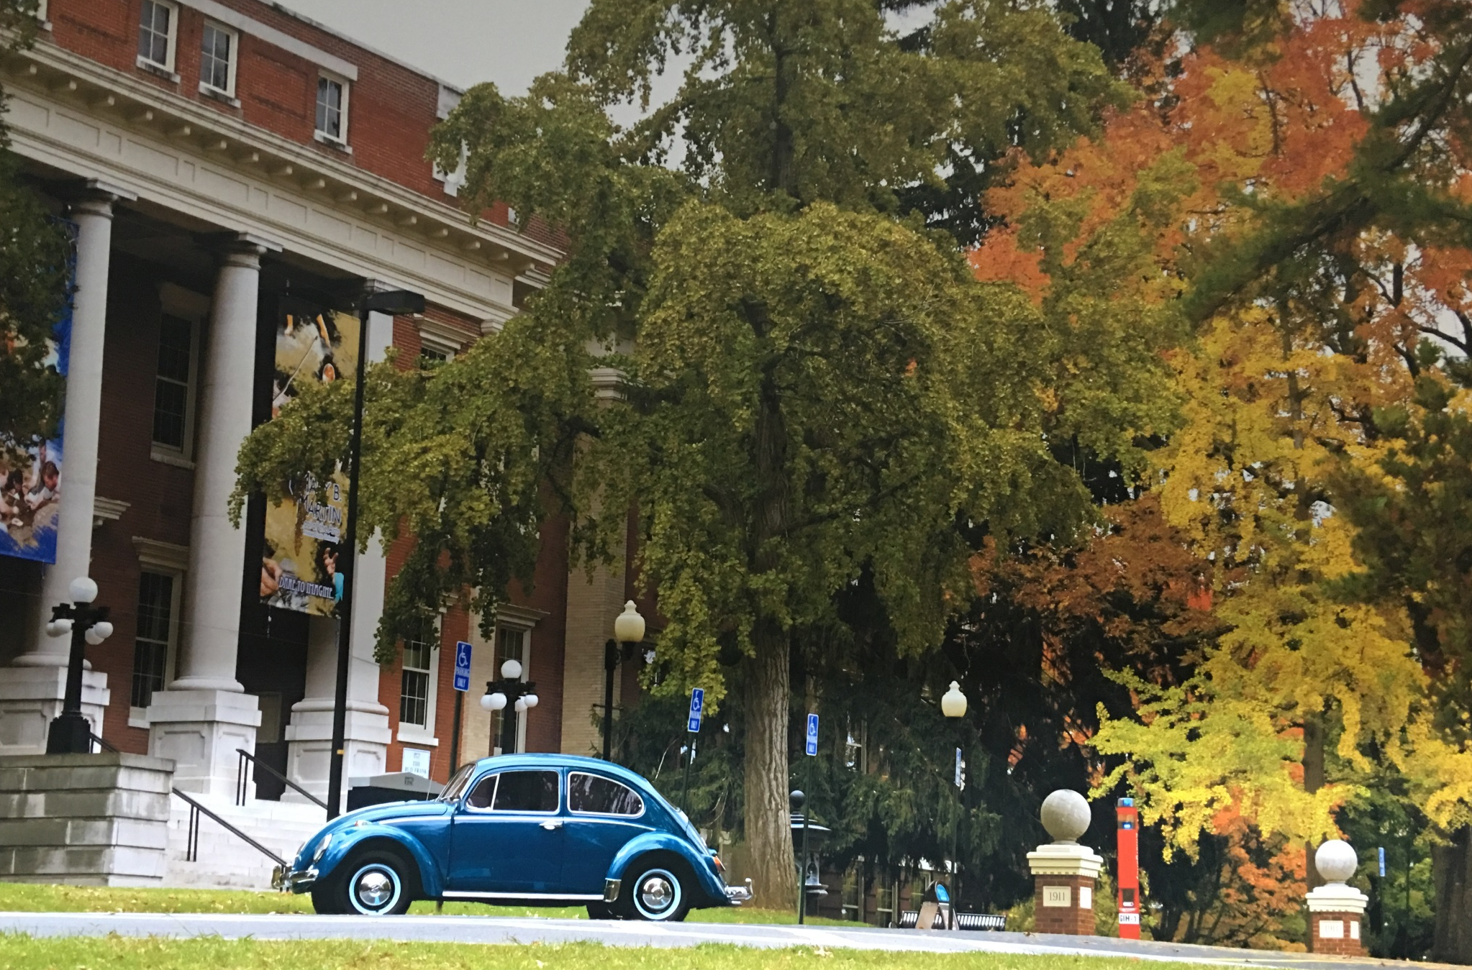
A Brief History of ETSU, Gilbreath Hall, and the Department of Mathematics and Statistics
(in commemoration of the 90th anniversary of the department)
A rambling seminar presented by
Robert “Dr. Bob” Gardner
October 28, 2016
Photo in the Johnson City Power Board lobby
(as of 5/3/2016)

Slide 2
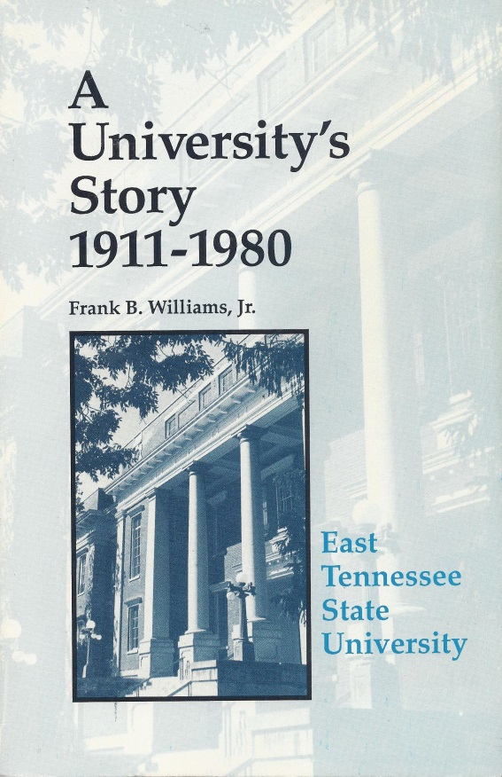
References
Bulletins of the school/college/university
Phone Directories
The Comet (newspaper)
University Websites
The Buccaneer (yearbook)
Personal photographs
Old Hickory
Special Thanks to: Selena Harmon, Archive Assistant

Slide 3
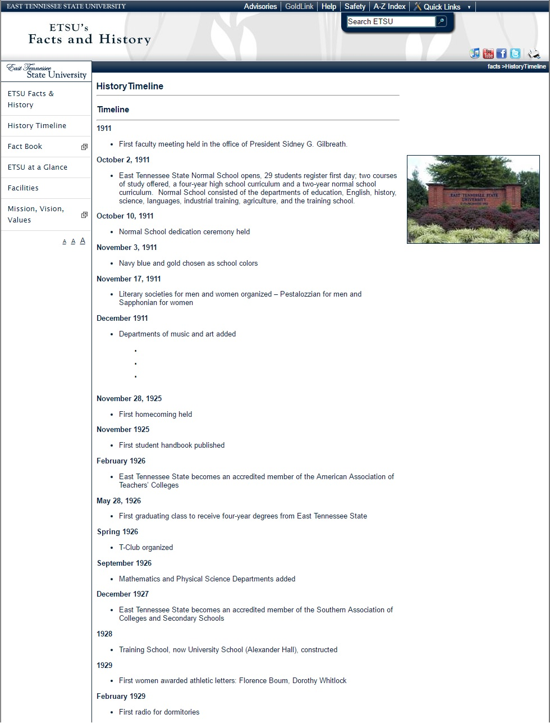
The Department of Mathematics (and Statistics)
Celebrates 90 Years
The website http://www.etsu.edu/facts/history.aspx states that the Mathematics Department was first part of the school in 1926.

Slide 4
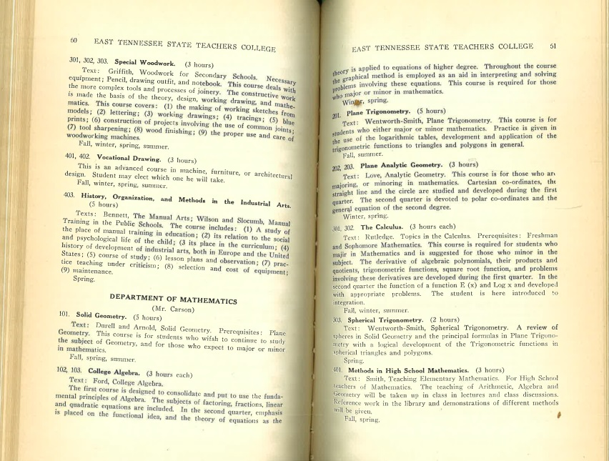
Disclaimer
Our department is likely older than 90 years! We’ll see a reference to another bit of information indicating that there are incorrect dates on the “Facts and History” webpage.
CLASSES
Solid Geometry
College Algebra
Plane Trigonometry
Plane Analytic Geometry
The Calculus
Spherical Trigonometry
Methods in High School
Mathematics
History of Mathematics
Solid Analytic Geometry
ETSC Bulletin (July, 1926) XVI #1

Slide 5
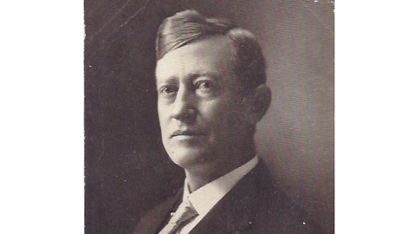
The Genesis of East Tennessee State Normal School
Tennessee Education Bill of 1909
$⟹$ Four Normal Schools (“three white, one black”)
Malcolm R. Patterson (1861-1935)
TN Governor 1907-1911

Slide 6
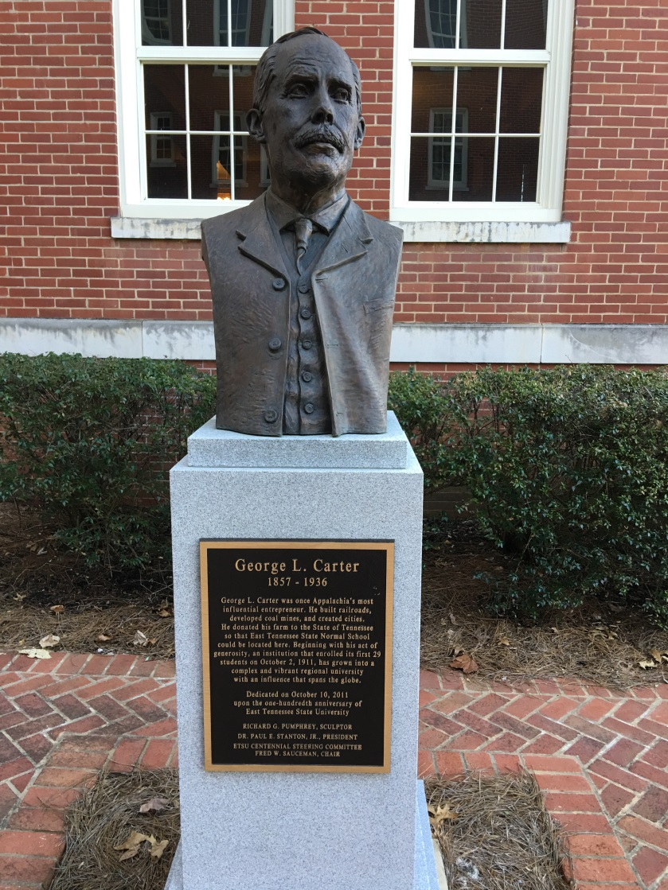
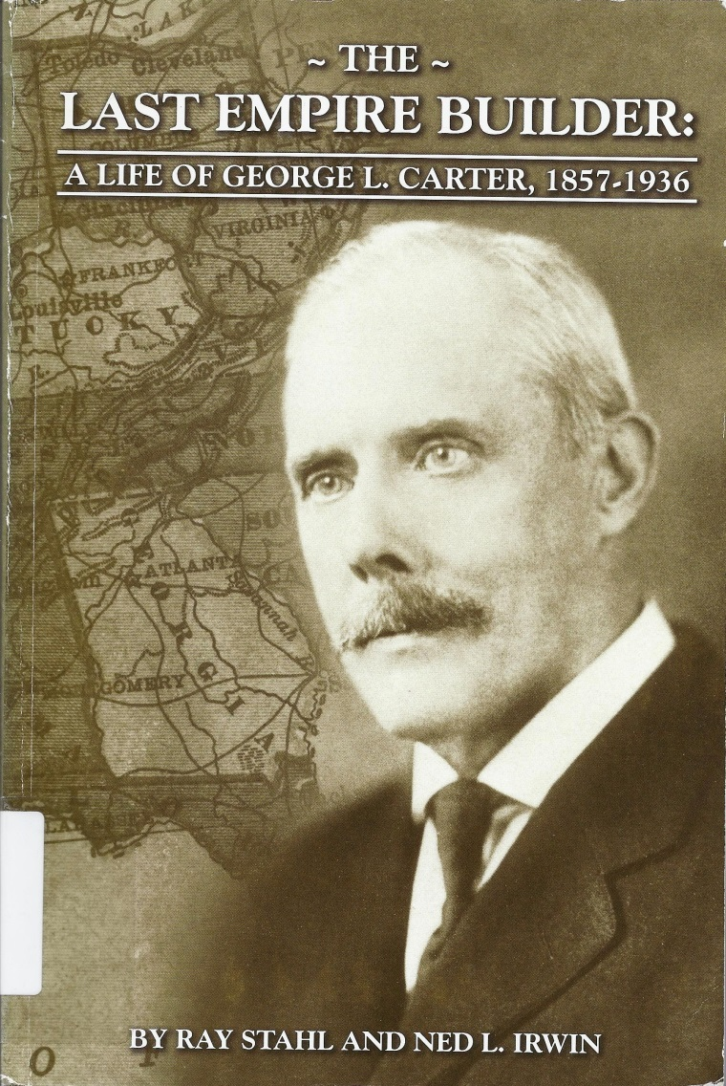
The Land for East Tennessee State Normal School
George L. Carter (1957-1936)
Bust outside Mayetta Carter Hall
Published by ETSU in 2012
(HC102.5.C365 S7 2012 in ETSU Library)

Slide 7
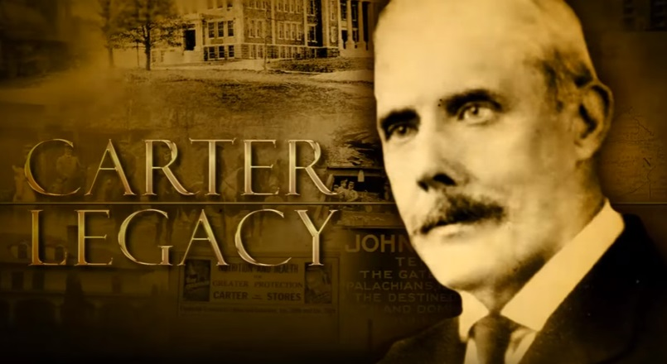
YouTube Video: The Carter Legacy
https://www.youtube.com/watch?v=zTipwNGNRbI

Slide 8
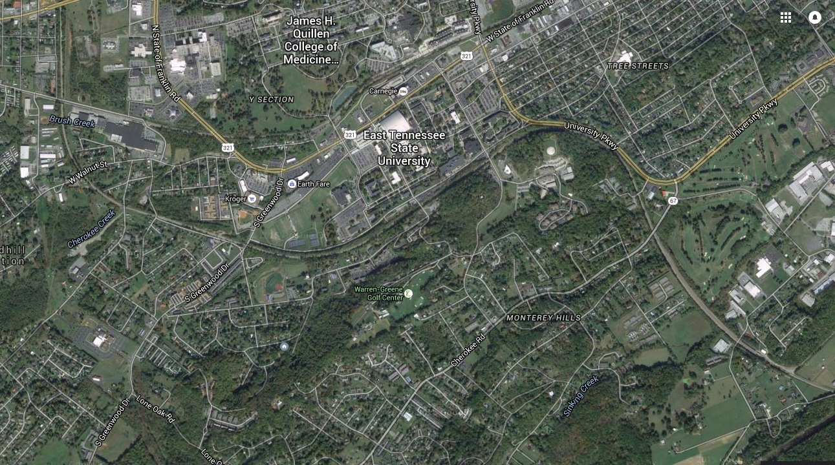
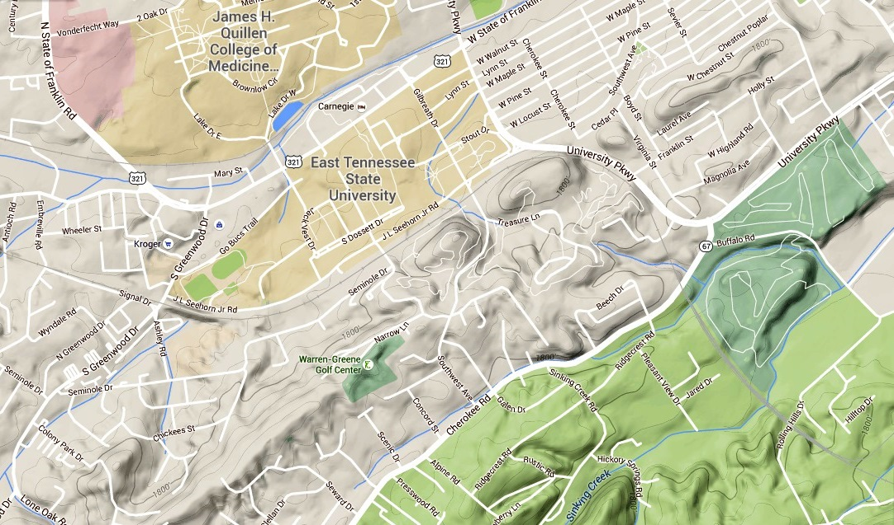
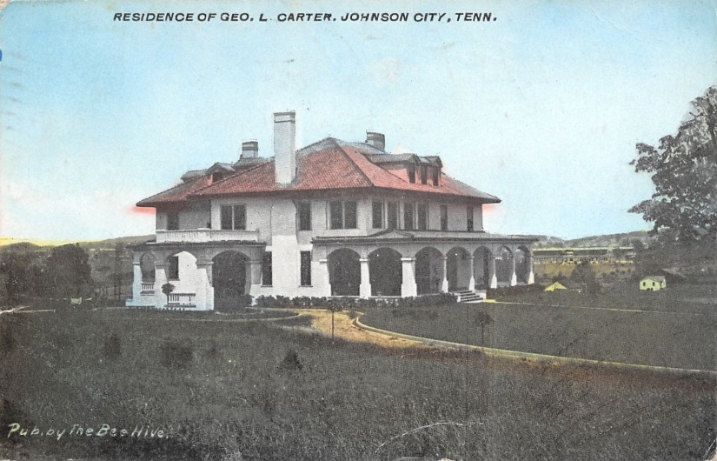
1910 Postcard

Slide 9
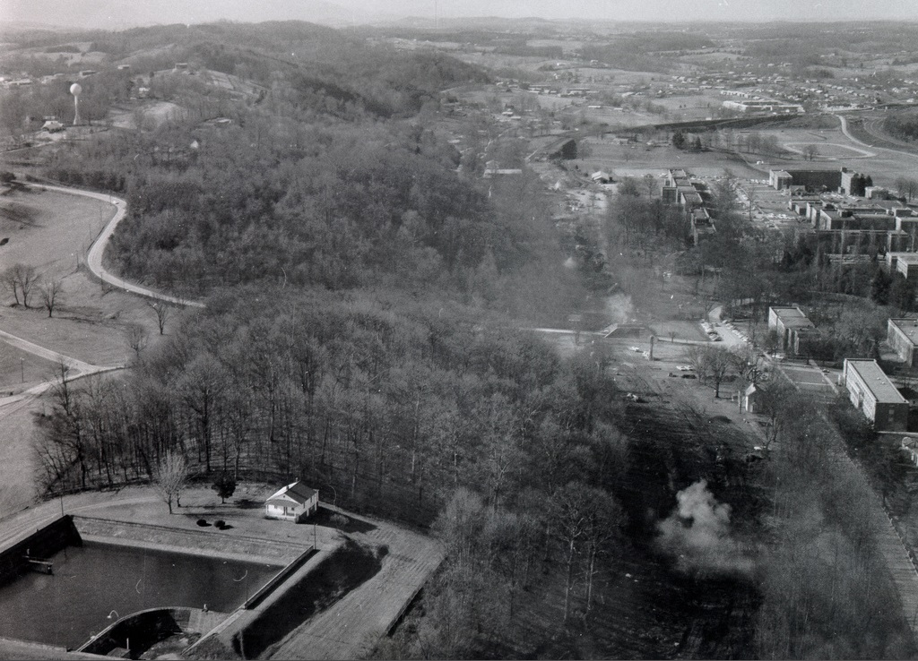
The Hills South of Campus (1969)

Slide 10
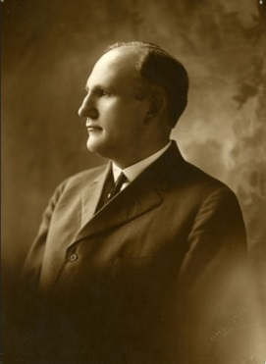
First President: Sidney Gilbreath

Slide 11
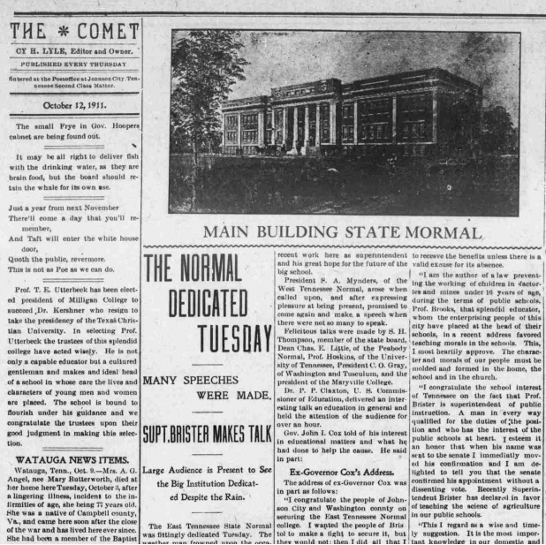
Johnson City newspaper The Comet reported on the October 10, 1911 opening ceremony of East Tennessee State Normal School

Slide 12
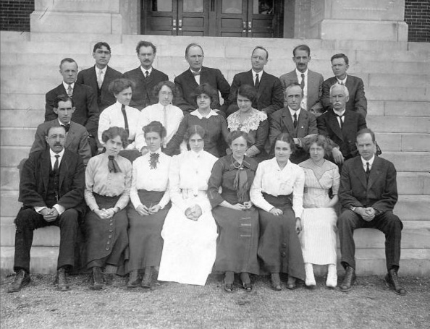
The Front Steps Have Hosted Many Events…
The Charter Faculty

Slide 13
The First Five Buildings

Slide 14
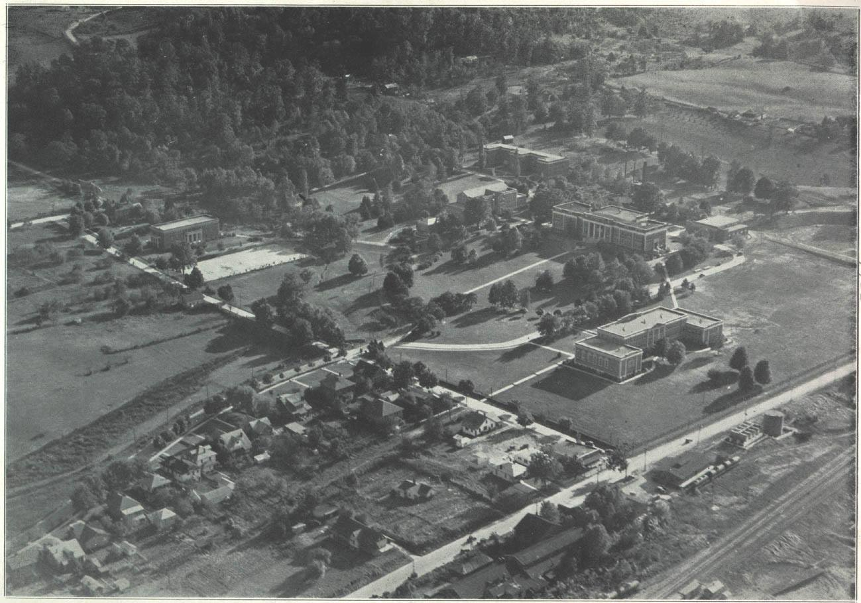
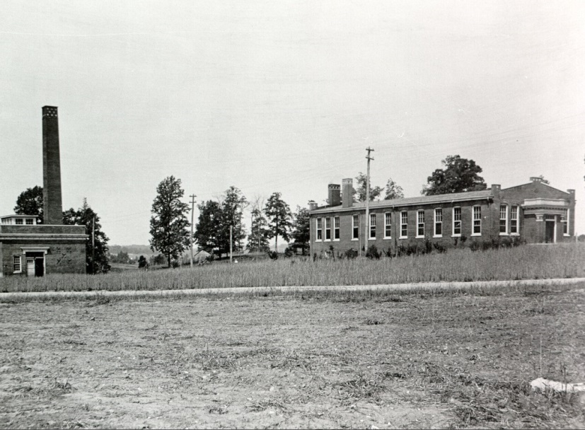
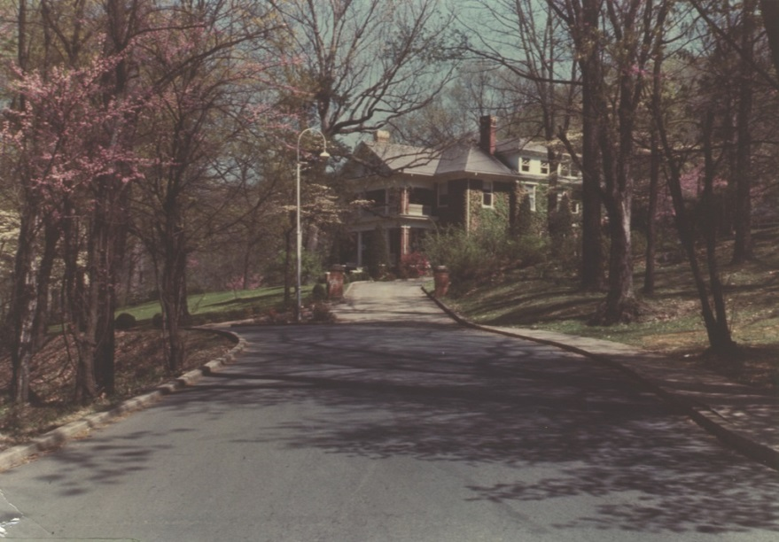
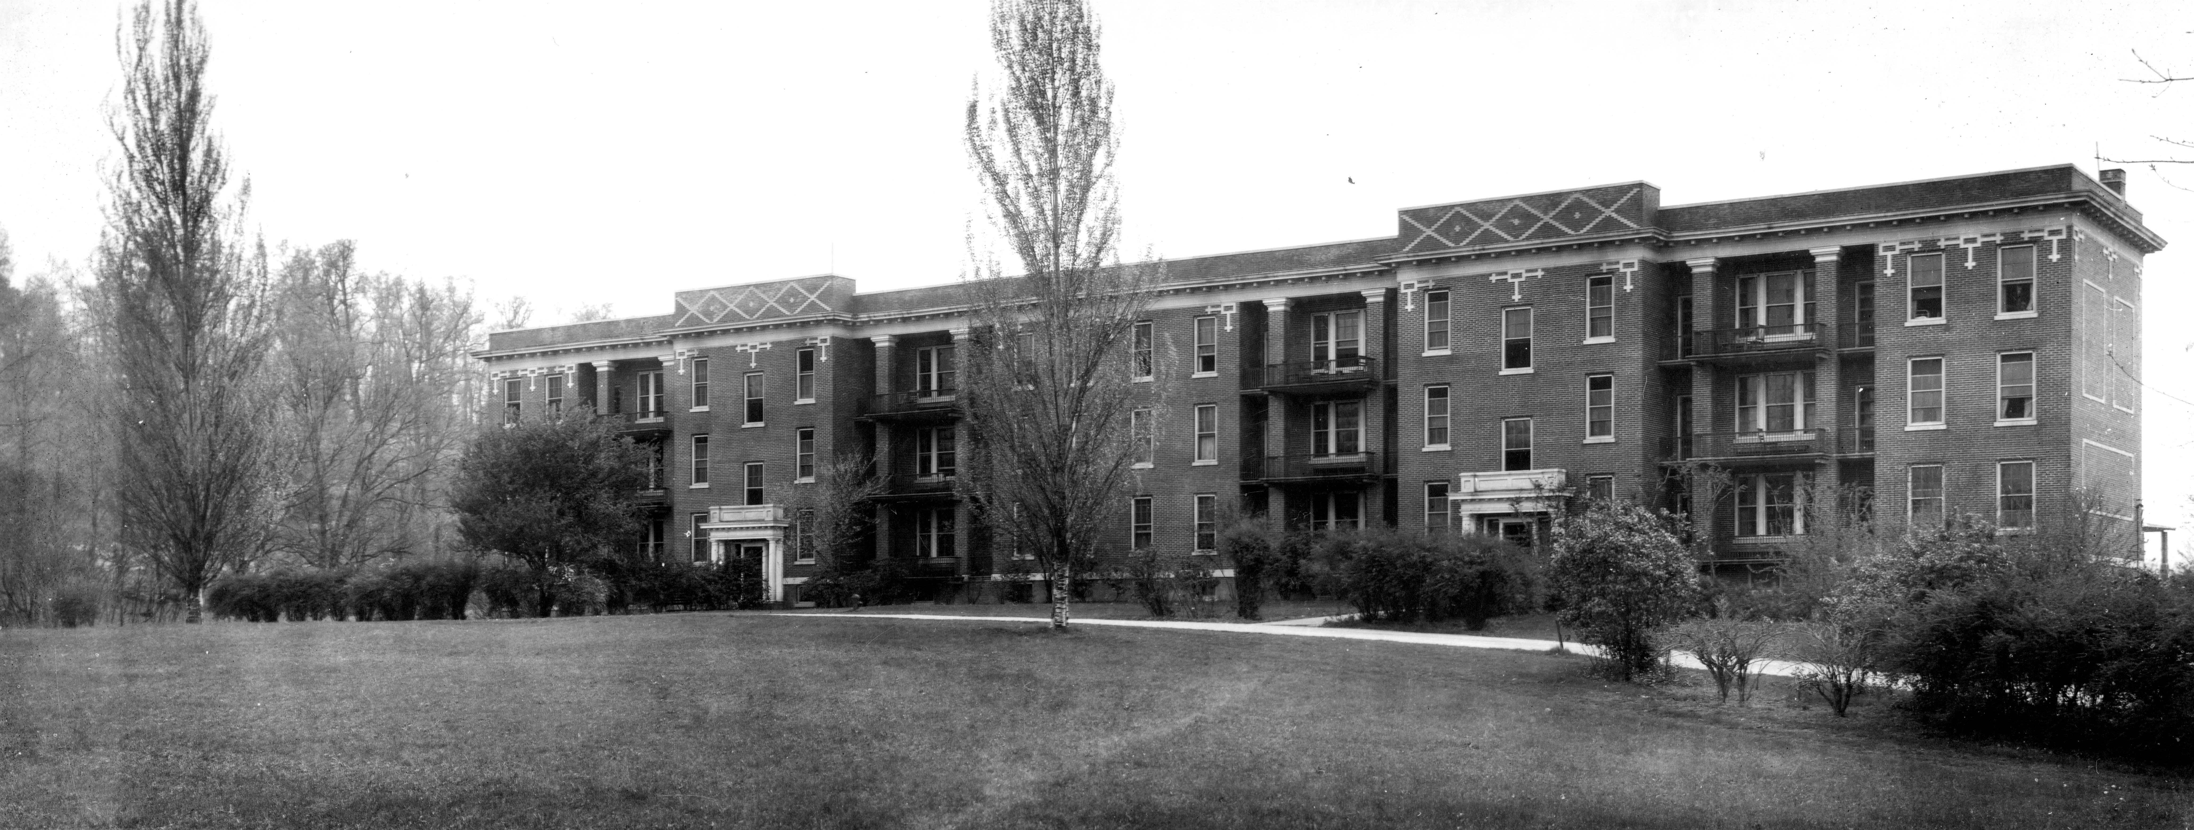
Women’s Dorm (Carter Hall, 1911)
President’s House (1911)
Heating Plant, Dining Hall, 1911
East Tennessee State Normal School
(1911)
State Teachers College, Johnson City (1935)

Slide 15
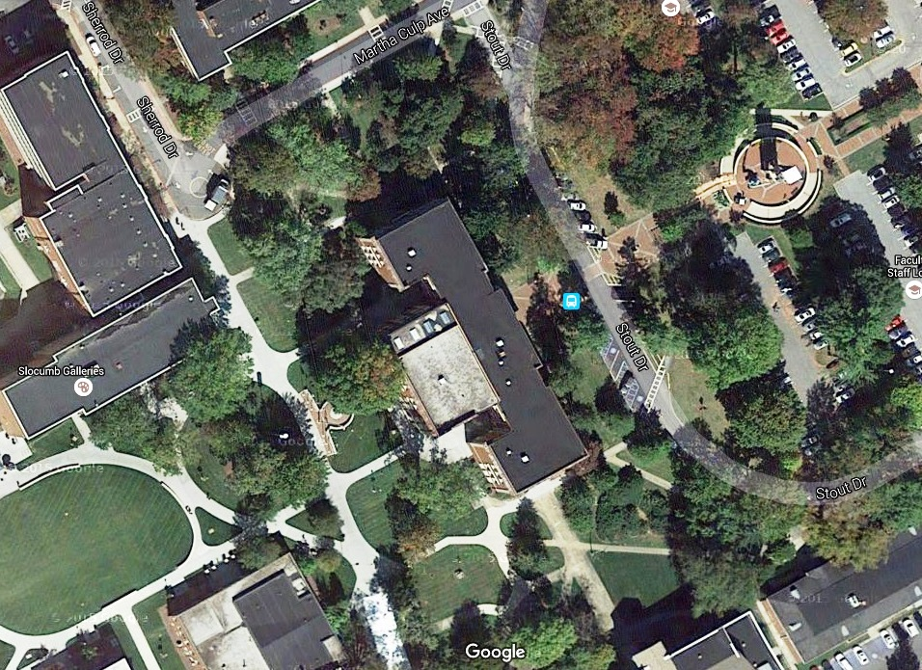
Our home: Gilbreath Hall (the “Administrative Building”)
Northern End
Front
(East)
Back
(West)
Southern End

Slide 16
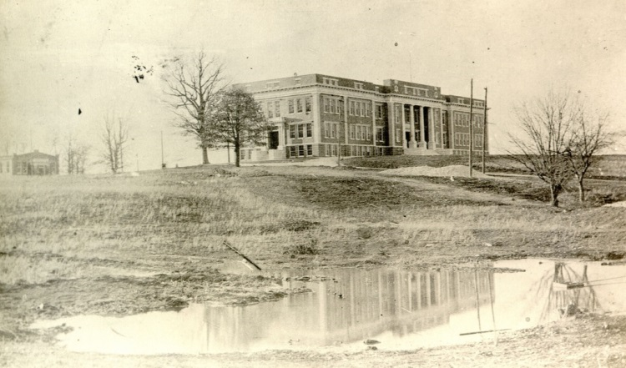
Gilbreath Hall Shortly after Construction (circa 1911)
This is the oldest photo I can find. Notice the absence of the lights near the entrances.

Slide 17
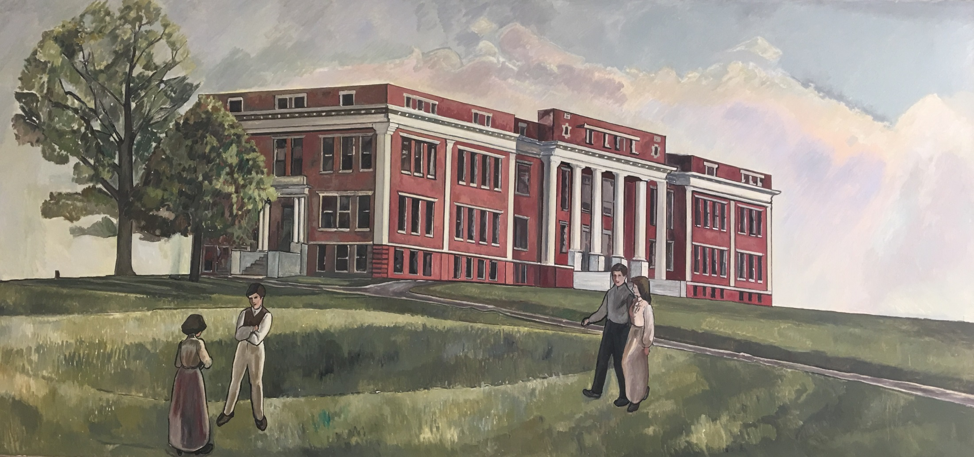
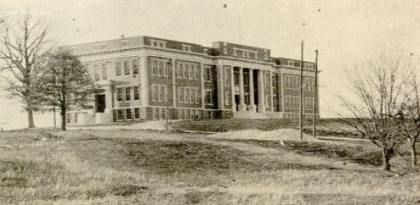
Large Painting on 2nd Floor

Slide 18
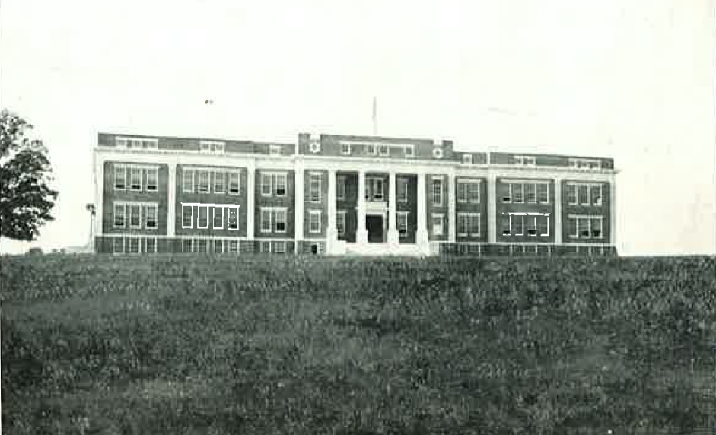
From the Archives of Appalachia (ETSU Sherrod Library)

Slide 19
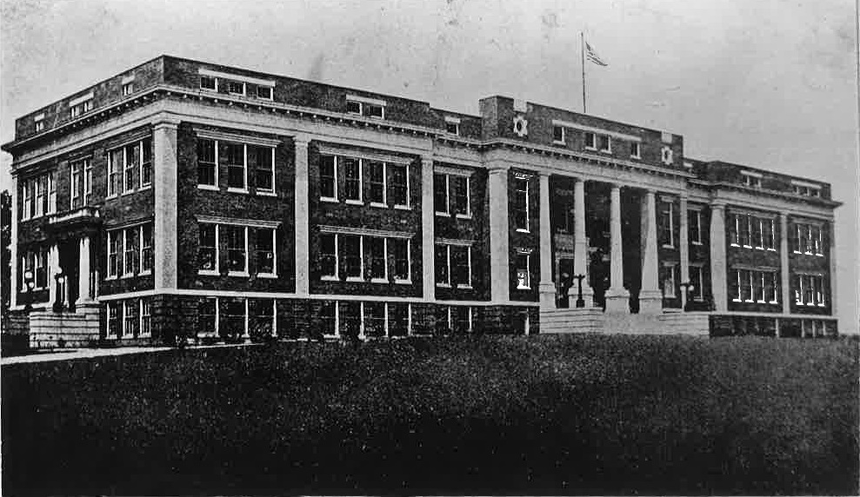
From the Archives of Appalachia (ETSU Sherrod Library)

Slide 20
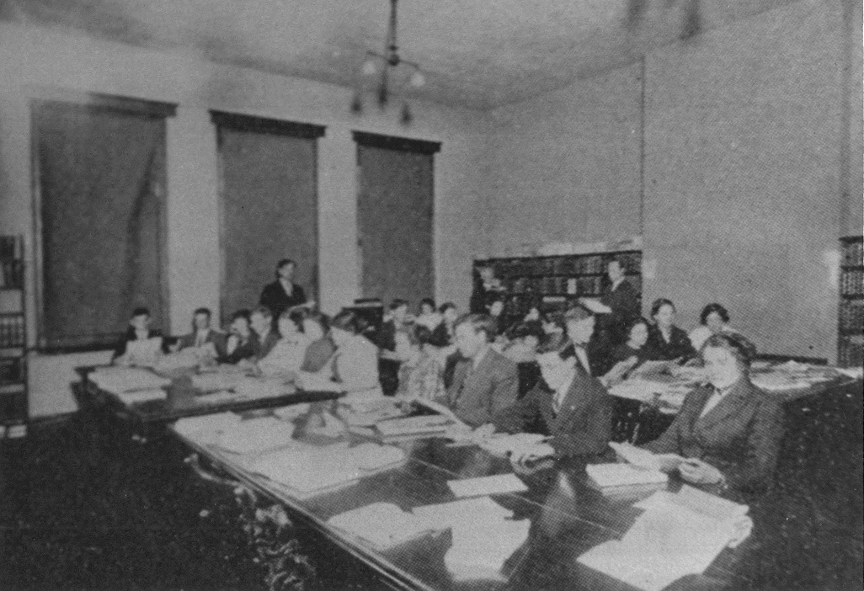
Back of photo: First ETSU “library” was in Administration Building, top Floor, SW corner room.” [Now, Gilbreath room 304] [from Archives of Appalachia]

Slide 21
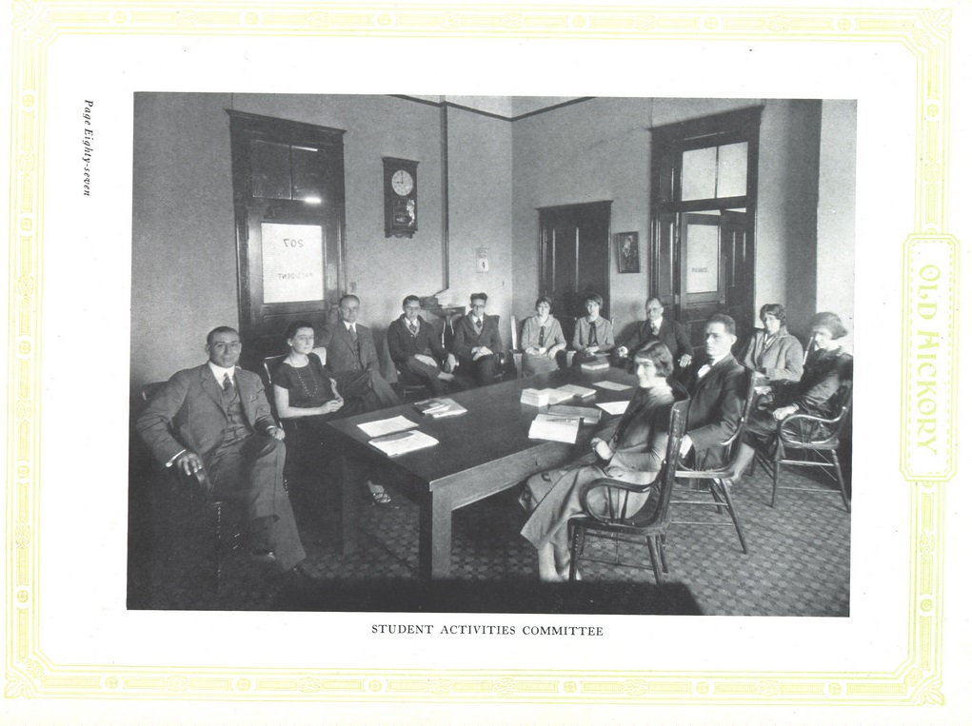
The 1926 Old Hickory with a view of Room 207 of the Administrative Building. The door on the left reads “207 President;” the door on the right reads “Private.”
Notes:
From Flickr, Old Hickory 1926

Slide 22
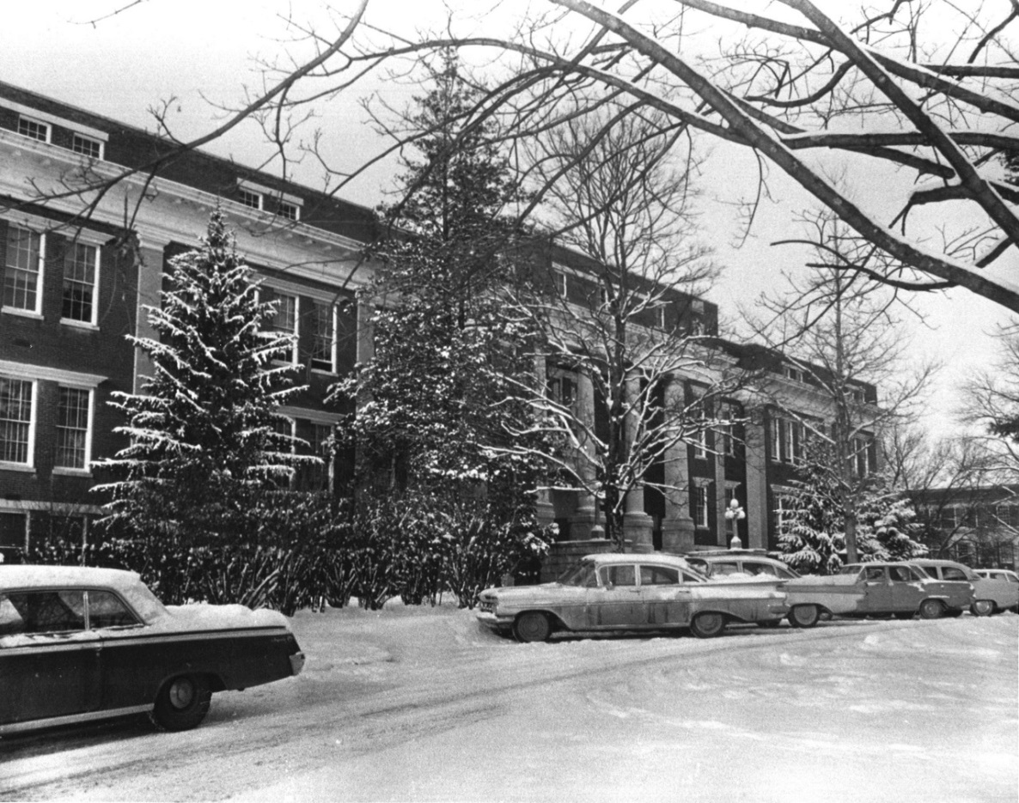
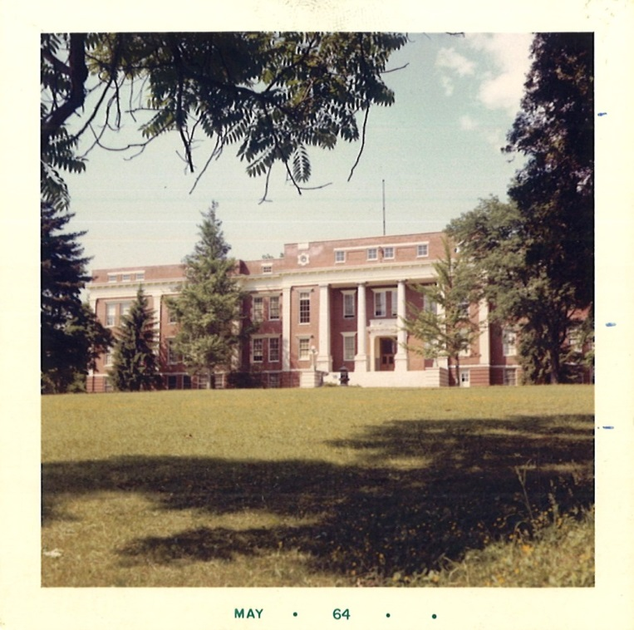
In the `60s
From the Archives of Appalachia (ETSU Sherrod Library)

Slide 23
The Other Original Buildings

Slide 24
An Early Panorama – Carter Hall and the “Administration Building”

Slide 25
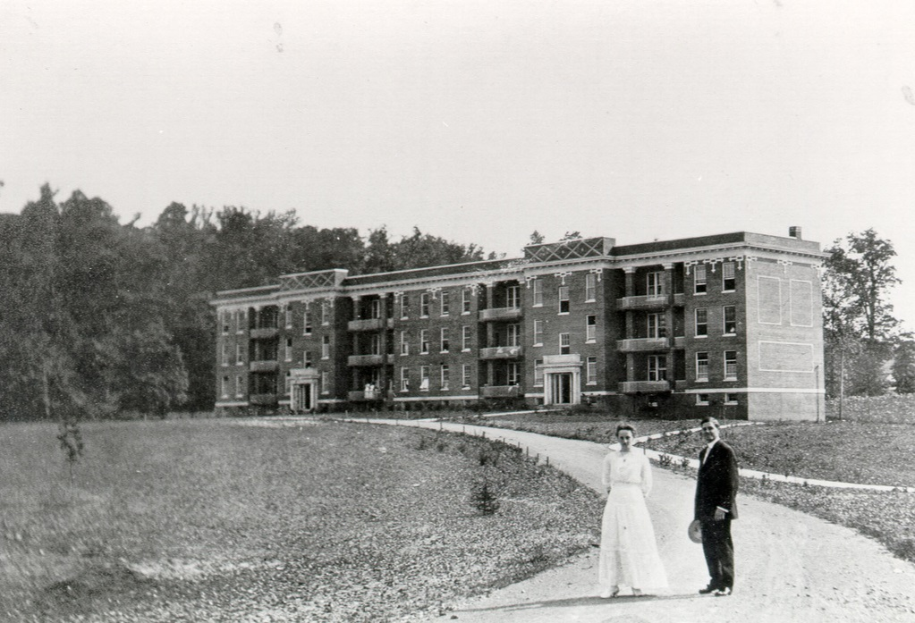
The Women’s Dorm (“Mayetta Carter Hall”)

Slide 26
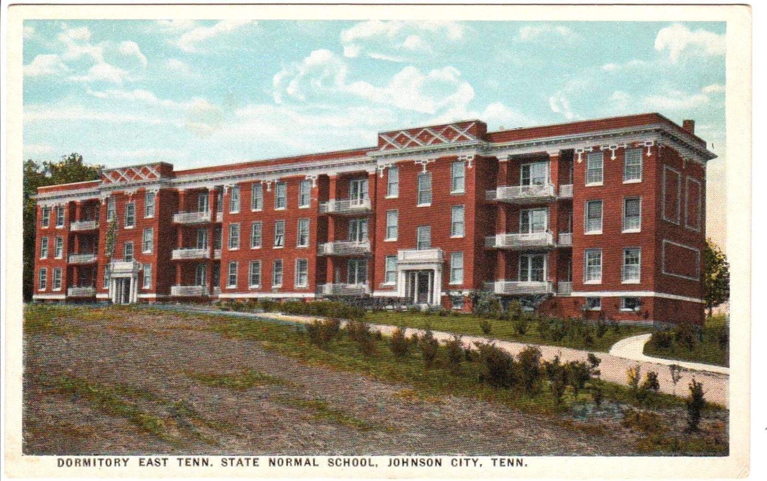
The Women’s Dorm (“Mayetta Carter Hall”)

Slide 27
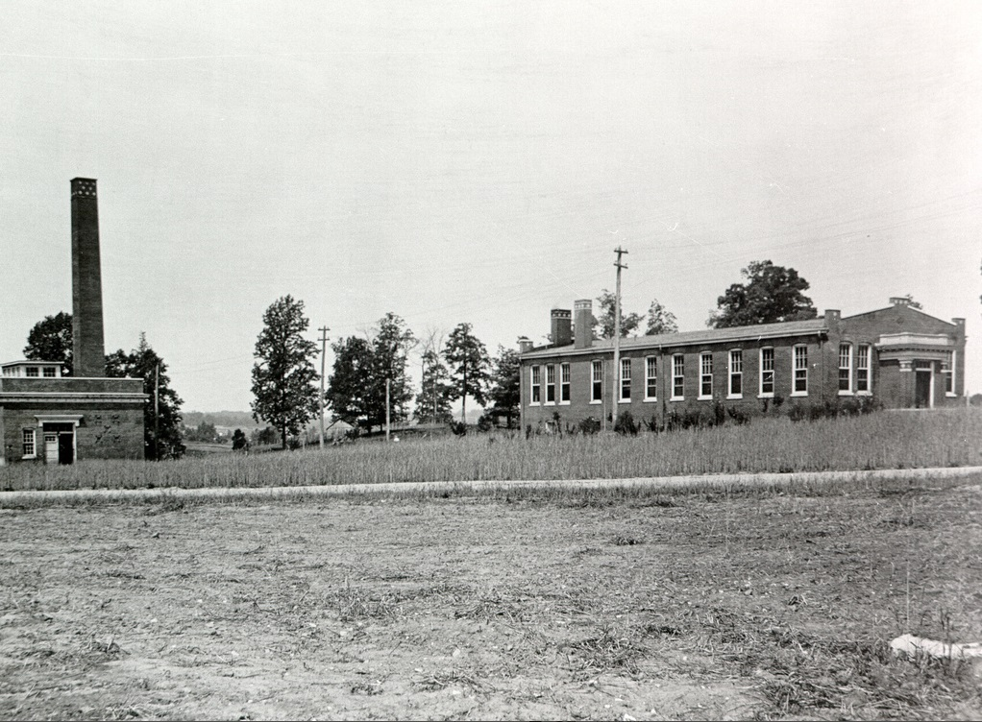
Dining Hall, Heating Plant

Slide 28
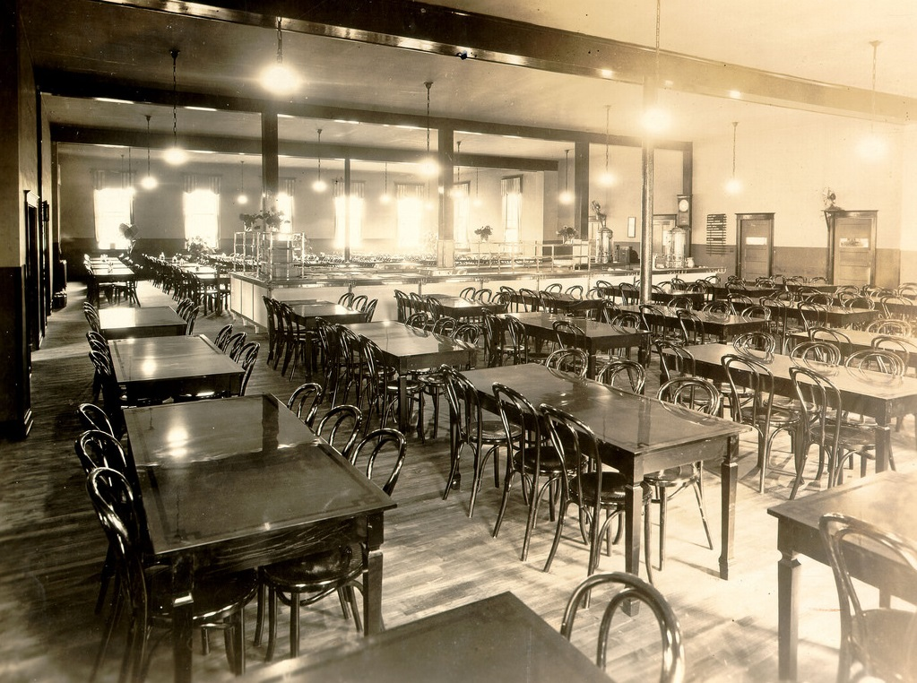
Dining Hall, interior

Slide 29
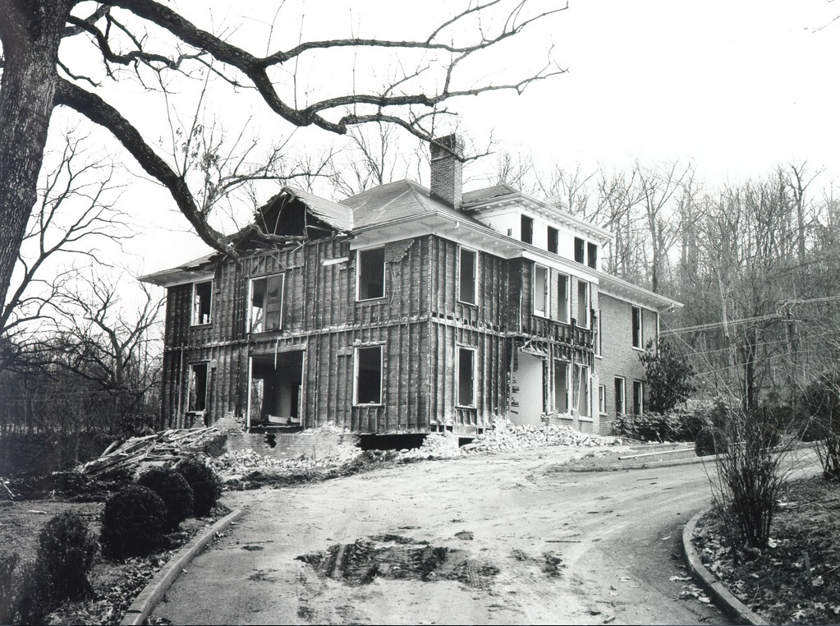
The President’s Home
From the Archives of Appalachia (ETSU Sherrod Library)

Slide 30
The “Second Generation” Buildings

Slide 31
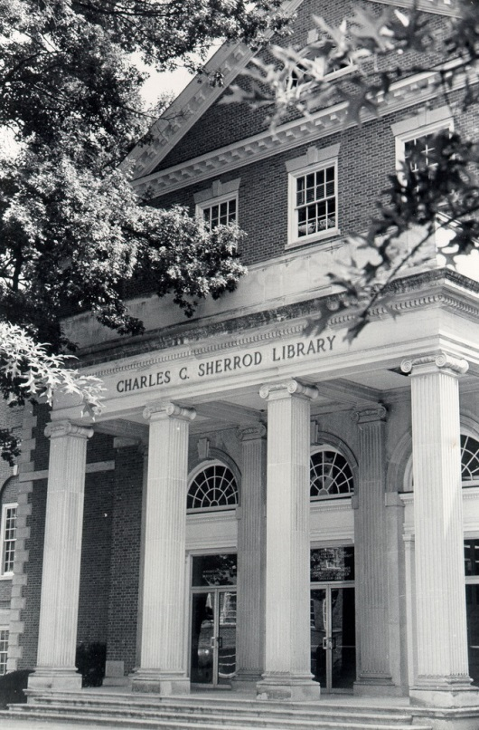
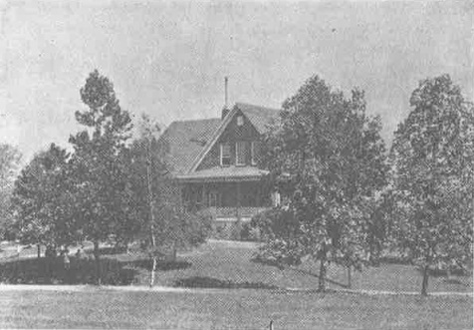
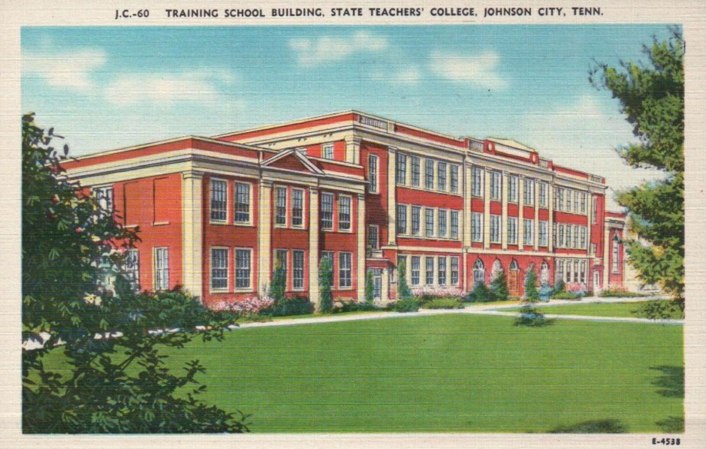
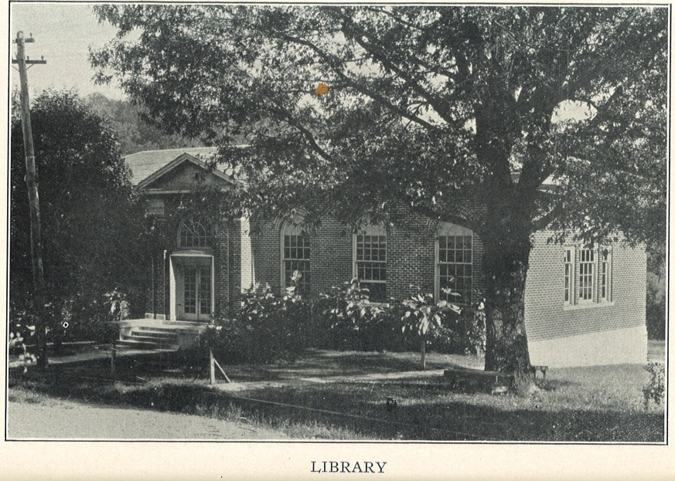
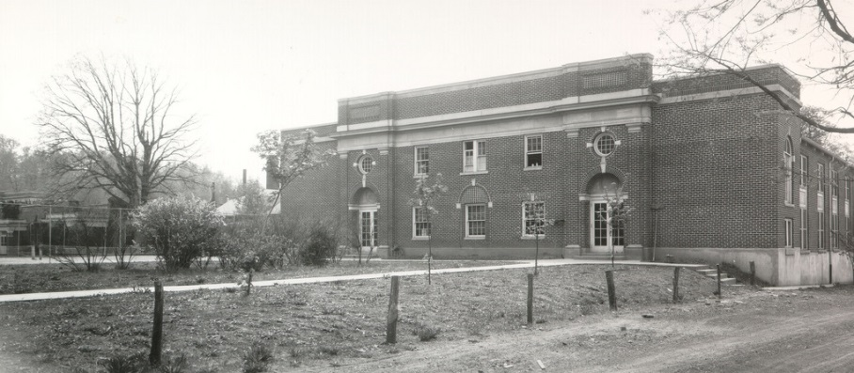
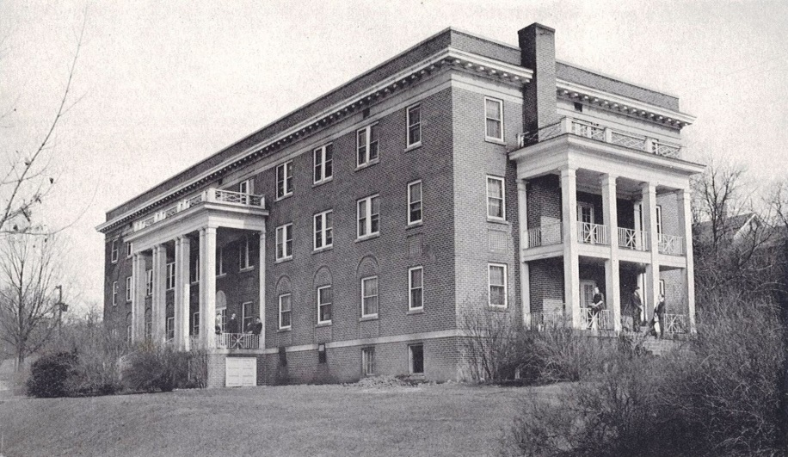
Men’s Dorm (Taylor Hall, 1922)
Sherrod Library (1931)
“Old Library”
(Reece Museum, 1923)
First Gym
(1922)
Model School
(1915)
Training School (Alexander Hall, 1928)
State Teachers College, Johnson City (1935)

Slide 32
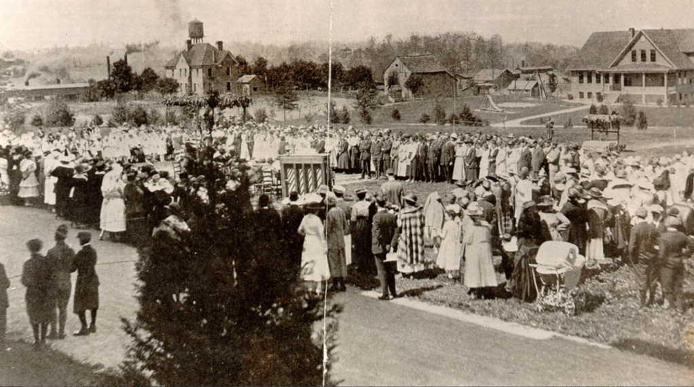
“Community Singing,” from around 1920
From Burleson’s East Tennessee State College

Slide 33
The First Free-Standing Library (the “Reece Museum”)
From the 1926 Bulletin.

Slide 34
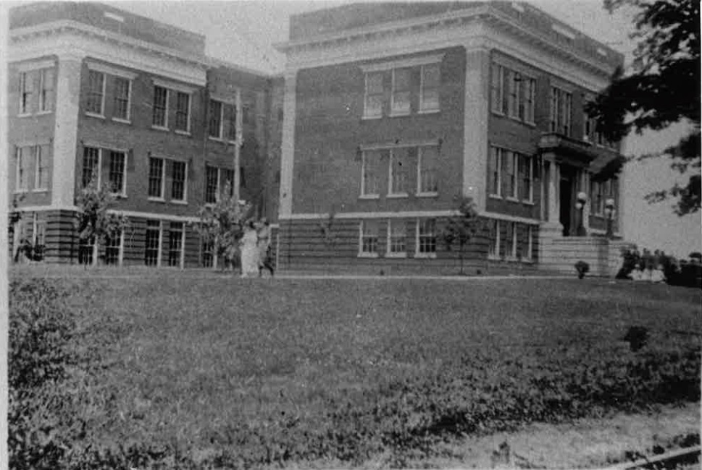
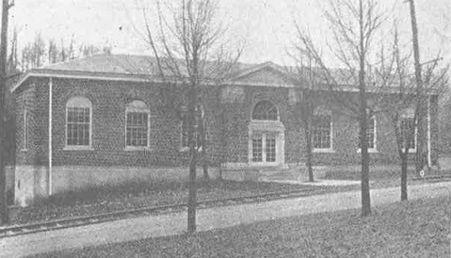
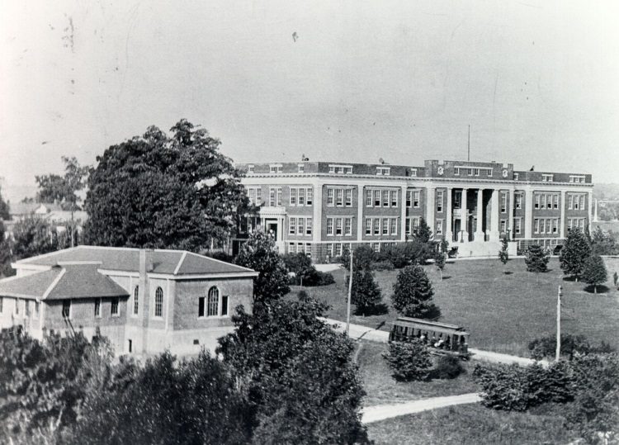
The Trolley System
From Burleson’s East Tennessee State College
The Administrative Building in 1919 (from the Archives of Appalachia)

Slide 35
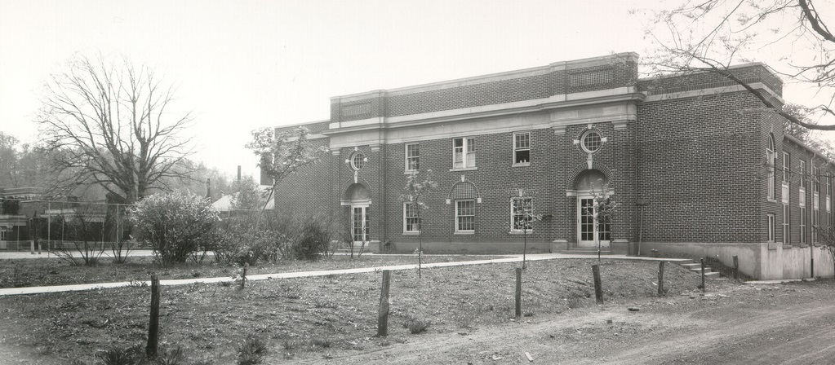
The Old Gymnasium
Notice the chain link fence on the left; this encloses the tennis courts behind the Administration building.
Notes:
Probably the 1920s?

Slide 36
Tennis Courts Behind Gilbreath
This undated photo shows a tennis match on the court that once existed adjacent to the rear of GIlbreath Hall in the background . (Flickr)

Slide 37
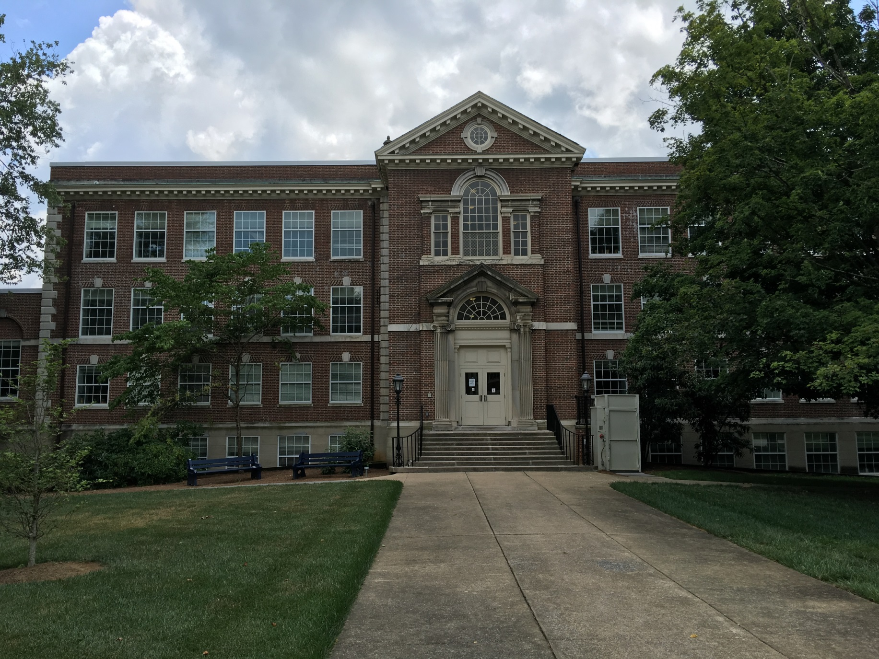
The “New Library” (Nick’s Hall)

Slide 38
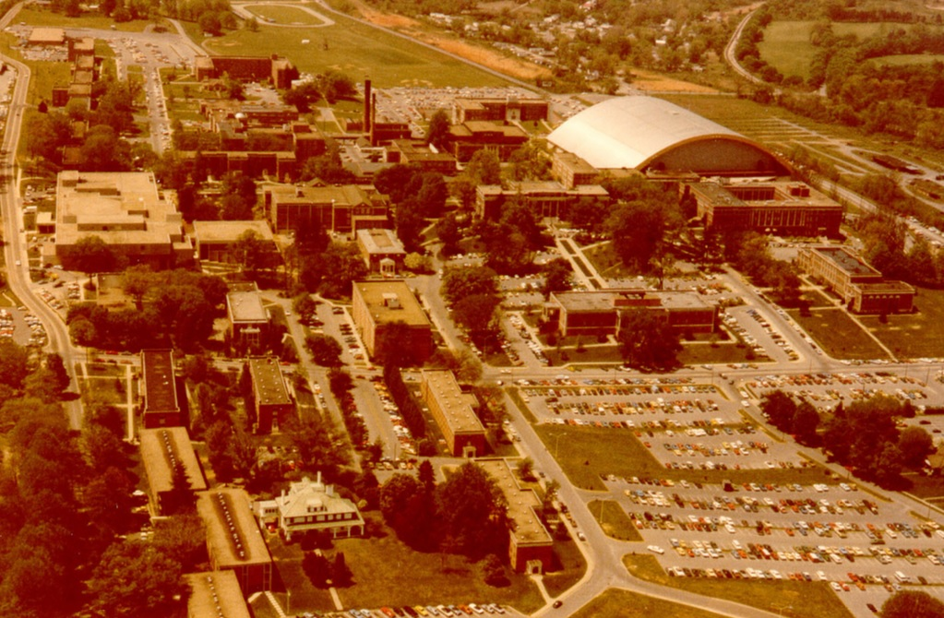
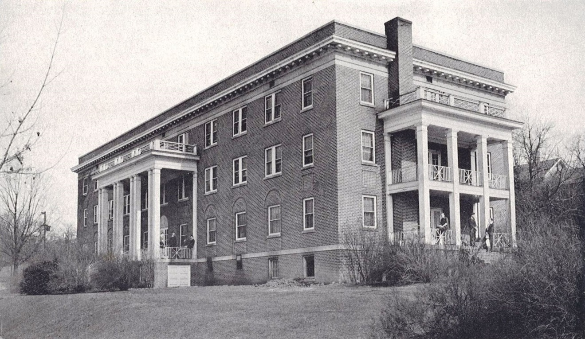
Men’s Dorm
From the 1941 Buccaneer
Circa 1980

Slide 39
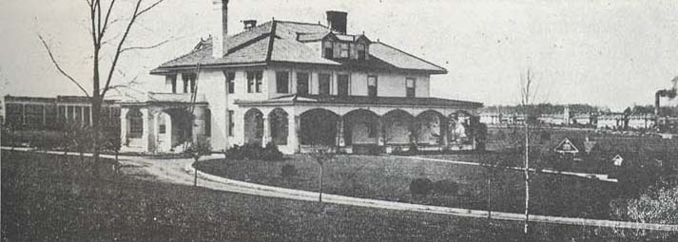
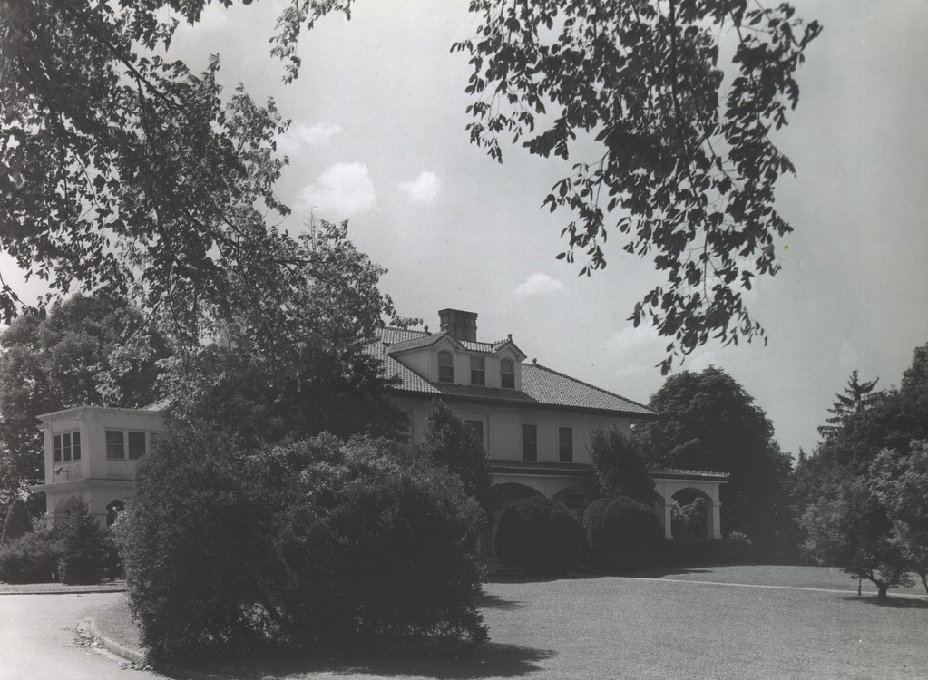
The George L. Carter House
(1909-1984)

Slide 40
The George L. Carter House
(1909-1984)
Nick’s Hall (2nd floor)

Slide 41
Other Buildings up to 1960

Slide 42
Brown Hall (1948)
Cafeteria (Varsity Grill)
East Tennessee State College (1950)
Amphitheater (1941)

Slide 43
From the Archives of Appalachia, circa 1960
Student Center
Brooks Gym (1952)
Carson Hall (1952)

Slide 44
The Structure of the Administrative Building
From the Archives of Appalachia
(ETSU Sherrod Library)

Slide 45
Granite Plaques at Top of Front Steps

Slide 46
Auditorium/Theater
The original theater

Slide 47
Back of photo: This newly designed and reconstructed auditorium, seating 750, was the work of Dr. C. C. Sherrod, after he became president in 1925. The new stage at North end, with new balcony and seats. [Archives of Appalachia]

Slide 48
Homecoming in “auditorium.” Is this the basement? [Flickr, undated]

Slide 49
South End, 1941
The flag pole was dedicated November 11, 1937…

Slide 50
The Stub of the 1937 Flag Pole Today

Slide 51
Name the Administrative Building after Sidney Gilbreath - 1950

Slide 52
Name the Administrative Building after Sidney Gilbreath - 1957
The portrait on the 2nd floor of Gilbreath Hall, by Gordon Westmore (1967)

Slide 53
The 1975 Renovation

Slide 54
The 1975 Renovation
The bronze plaque near the front door

Slide 55
The `08 Complexes

Slide 56
Above the Ceiling Tiles in 308

Slide 57
Gilbreath Hall, Early 1970s?
Second Floor

Slide 58
After the Renovation
Second Floor

Slide 59
A First Floor Entrance on the West Side
Rat Week, 1960 (from Flickr)

Slide 60
Back of Gilbreath, 1961

Slide 63
Before Dossett Hall – Notice the Tile Work

Slide 64
1967-68

Slide 65
Tiles are still present…

Slide 66
The Front Doors

Slide 67
The Front Doors
The first graduating class.

Slide 68
“The Gilbreath Crack”
There is a crack in Gilbreath which runs from the ground to the top of the third floor. It runs through some of the bricks and there are easily visible breaks in the marble under the bricked-in windows.

Slide 69
The Office Space in Gilbreath Hall

Slide 70
Gilbreath Hall, 1st Floor
(Based on the posted fire escape plans .)
Missing Room Numbers: 101, 102, 103, 109, 110, 111, 112
Security was in Gilbreath 114
(1971-72 phone directory)
Theater
104
BR
BR
117
The Post Office was in Gilbreath 117 (1971-72 phone directory)
107
Elec.
105
106
113
114
115
116
Outdoor Wall
Door
BR Bathroom
1955 Buccaneer
Interior Wall (wooden)
Window
Elevator
Interior Wall (stucco)
Column
Steps

Slide 71
Gilbreath Hall, 1st Floor
1959 (Flickr)
(Based on the posted fire escape plans .)
Missing Room Numbers: 101, 102, 103, 109, 110, 111, 112
Where was the bookstore???
Theater
104
BR
BR
117
107
Elec.
105
106
113
114
115
116
1964-65 Phonebook
Outdoor Wall
Door
BR Bathroom
Interior Wall (wooden)
Window
Elevator
Interior Wall (stucco)
Column
Steps

Slide 72
Gilbreath Hall, 1st Floor
(Based on the posted fire escape plans .)
Missing Room Numbers: 101, 102, 103, 109, 110, 111, 112
Theater
104
BR
BR
117
107
Elec.
105
106
113
114
115
116
Outdoor Wall
Door
BR Bathroom
Interior Wall (wooden)
Window
Elevator
Interior Wall (stucco)
Column
Steps

Slide 73
Gilbreath Hall, 2nd Floor
(Based on the posted fire escape plans .)
Missing Room Numbers: 201, 202, 203
President’s Office, 207
Telecommunications, 206 (in 1971)
Theater
204
BR
BR
214
209
207B
210
212
205
206
206
207A
211
213
A
Outdoor Wall
Door
BR Bathroom
Interior Wall (wooden)
Window
Elevator
Interior Wall (stucco)
Column
Steps

Slide 74
ETSU Directory, 1975-76
ETSU Directory, 1976-77
NAME | OFFICE
Bailes, Gordon | Carson, 204C
Carson, Sally | Carson ,205
Faber, Joe | Carson, 103
Ginnings, Gerald | Carson, 204A
Jablonski, Todd | Carson, 101B
Kerley, Lyndell | Carson, 104
Kinloch, John | Carson, 105
Lyle, Ben | Carson, 101B
Lyle, Betty | Carson, 204B
Midyett, Marjorie | Carson, 204B
Pleasant, James | Carson, 105
Sakhare, Vish | Carson, 104
Suh, Tae Il | Carson, 101C
Taylor, Charles | Carson, 106A
Williams, Ed | Carson, 103
Wilson, Charles | Carson, 209
Wiseman, Ken | Carson, 106A
Carson Hall
NAME | OFFICE
Bailes, Gordon | Carson, 204C
Carson, Sally | Carson ,205
Faber, Joe | Carson, 103
Ginnings, Gerald | Carson, 204A
Jablonski, Todd | Carson, 101B
Kerley, Lyndell | Carson, 104
Kinloch, John | Carson, 105
Lyle, Ben | Carson, 101B
Lyle, Betty | Carson, 204B
Midyett, Marjorie | Carson, 204B
Pleasant, James | Carson, 105
Sakhare, Vish | Carson, 104
Slimick, John | Carson, 202A
Suh, Tae Il | Carson, 101C
Taylor, Charles | Carson, 106A
Williams, Ed | Carson, 103
Wilson, Charles | Carson, 209
Wiseman, Ken | Carson, 106A
Lester Hartsell (Chair) Carson 202A
Helen Byrd (Secretary) Carson 202A
Lester Hartsell (Chair) Carson 202A
Helen Byrd (Secretary) Carson 202A

Slide 75
Carson Hall (1952-1990???)

Slide 76
Math Department Rejects Gilbreath Hall!
"...the plan was that... the Math Department would vacate Tom Carson Hall and move into Gilbreath... [Other units planned to return to Gilbreath as soon as construction was complete but] Not so with the Math Department. This summer the faculty of the department petitioned the administration for permission to remain in Carson Hall.
The primary complaint about Gilbreath Hall is the third floor office space. The faculty offices are separated only by partitions with no doors. Dr. Lester Hartsell cited lack of security as one of the major drawbacks of the new building.
With no doors, occupants would be unable to insure safe-keeping of examinations, books, typewriters, calculators and other valuable equipment.
...Betty Lyle of the Math Department was concerned that the limited privacy would hamper student guidance. She fells that students would be unwilling to discuss class or personal problems when they could be overheard.
Hartsell said there is a feeling of department unity in Carson Hall. "We have a building we can call our own," Hartsell said.
...Hartsell said, "All in all the administration has been very nice.“ East Tennessean, 9/26/1975

Slide 77
Gilbreath Hall, 3rd Floor
(Based on the posted fire escape plans .)
Missing Room Numbers: 301, 302, 303
D
E
F
G
H
I
308
C
U
T
S
J
B
P
Q
R
K
304
BR
BR
314
A
O
N
M
L
309
310
311
312C
307B
305-306
307A
312
313
312A
312B
Outdoor Wall
Door
BR Bathroom
Interior Wall (wooden)
Window
Elevator
Interior Wall (stucco)
Column
Steps

Slide 78
Gilbreath Hall, 308 Office Complex 1977-78
Math Department Members 308 Gilbreath, 1977-78
According to the ETSU Telephone Directory
D
E
F
G
H
J. Kinloch
C. Taylor
I
James Pleasant
Ben Lyle
V. Sakhare
G. Ginnings
Tae-Il Suh
Sally Carson
L. Kerley
C
J
U
T
S
K
B
P
Q
R
Joe Faber
Ed Williams
T. Jablonski
C. Wilson
L
A
Betty Lyle
O
N
M
M. Midyett
In the Math Office (311 Gilbreath): Lester Hartsell (chair) and Helen Byrd (secretary).

Slide 79
Gilbreath Hall, 308 Office Complex 1982-83
Math Department Members 308 Gilbreath, 1982-83
According to the ETSU Telephone Directory
D
E
F
G
H
J. Kinloch
C. Taylor
I
James Pleasant
Ben Lyle
V. Sakhare
G. Ginnings
Tae-Il Suh
J
C
L. Hartsell
U
T
S
K
B
P
Q
R
Joe Faber
Ed Williams
Robert
Zeighami
T. Jablonski
C. Wilson
Betty Lyle
L
A
O
N
M
M. Midyett
In the Math Office (311 Gilbreath): William Anderson, Jr. (chair) and Helen Byrd (secretary).

Slide 80
Gilbreath Hall, 308 Office Complex 2016
D
E
F
G
H
I
Norwood
Gardner
Cintron-
Arias
Lewis
Poole
McGill
J
C
Robe
U
Graduate Students
T
S
Davidson
Hicks
K
B
P
Q
R
J. Knisley
Hardin
Hendrick-son
Joyner
L
A
O
N
M
Adjuncts
Beeler
Hosler
Smith
Keaton
Also, Haynes (307A), D. Knisley (307B), Godbole (509A Warf-Pickel Hall), and Marks (314 McCune-Welch Hall, Kingsport).
In the Math Office (312 Gilbreath): Bob Price (chair), Daryl Stephens (assistant chair), and Lisa Erwin (executive aid).

Slide 81
Tae-Il Suh: The First Research Paper?
Nathan Jacobson (1910-1999)
June 1, 1928-July 27, 2009
Photo taken spring 1996 in Gilbreath 308H.
Nederl. Akad. Wetensch. Proc. Ser. A 71 = Indag. Math. 30 (1968) 321–324.
(Lists ETSU as affiliation)

Slide 82
Our Most Recent Departmental Group Photo
(in a familiar setting!)
Spring 2012

Slide 83
Our Most Interesting Neighbor…

Slide 84
The Old Gymnasium, 1947

Slide 85
Campus Map, February 1951
“Fine Arts”

Slide 86
A letter from President Burgin E. Dossett dated August 12, 1964.
“[We moved] a 100’ x 112’ solid brick, with steel frame and reinforcement, in 1953. We picked up the building, moved it west 12 feet, reversed it [i.e., its direction], moved it north 114 feet, raised it 14 feet and added a complete new story under the building and a story on top of the building, changing it from a two-story to a four-story brick, doubling the capacity of the building. It was a superb engineering job executed by the Winn Engineering Company of Nashville.”

Slide 87
The upper plaque reads:
“On March 8, 1960 under the authority of the State Board of Education the Administrative Council in regular session officially named this building The Charles Hodge Mathes Hall in honor of him who as charter member of the faculty served this college from its beginning September 1, 1911, to August 31, 1949.
Master teacher
Dean – 1911-1920”

Slide 88
The Façade of the old Gym is preserved in Mathes Hall
Notes:
Both from Flickr (posted by Archives)

Slide 89
The Windows from the South side of the old Gym are partially preserved in Mathes Hall

Slide 90
The South Facing Windows on Mathes Hall Today (Outside)

Slide 91
The South Facing Arched Window on Mathes Hall Today (Inside)

Slide 92
The North Facing Windows on the Old Gym
?
From 1952 Buccaneer
From the 1941 Buccaneer, page 37.

Slide 93
Burleson Hall
First Floor
Second Floor
Third Floor
Fourth Floor

Slide 94
T. Alan Holmes’ Office
(305 Burleson)
Third Floor

Slide 95
The North Facing Arched Window on Mathes Hall Today (Inside)

Slide 96
When Was It Moved?
From ETSU’s Facts and History website (http://www.etsu.edu/facts/history.aspx):
September 1955: Old gymnasium (built in 1928) moved to become part of Mathes Hall (music and military science).
BUT THIS CAN’T BE CORRECT!!!
ETSC Collegian 9/11/1953
ETSC Collegian 9/22/1954
Notes:
Suspected move date: September 1953?

Slide 97
The Back of Mathes Hall Today

Slide 98
The Front of Mathes Hall Today

Slide 99
YouTube Video: 2012 ETSU Virtual Campus Tour
https://www.youtube.com/watch?v=hMVP3wGCBIY

Slide 100
Some Final Nonsense: Ghosts on Campus
“ETSU’s spooky campus has gained national attention from publications like the Huffington Post for its myriad of ghostly residents.” - East Tennessean, 10/27/2016
George L. Carter’s daughter, Alice, distraught over a lost love who died by taking rat poison! For years, she was said to haunt the old George L. Carter house. However, Carter didn’t have a daughter! See:
http://www.prairieghosts.com/etsu.html
The October 27, 2016 East Tennessean.

Slide 101
A Number of Additional Questions!
Have the room numbers remained the same over the last century?
Where was the bookstore?
What’s up with the attic space? Is it just for storage?
Why are the front stairwell landings in the middle of the windows?
Was the theater originally on the 2nd and 3rd floors?
Did the north and south ends used to have the exterior doors flush with the ends of the building?
Why are so many windows on the west side bricked up?
Is the Gilbreath Crack being monitored?
When was Carson Hall razed?
Is the stained glass in Nick’s Hall backlit?
?

