Slide 1
Magical Math Results
…and Their Explanations
Robert “Dr. Bob” Gardner
September 22, 2017

Slide 2
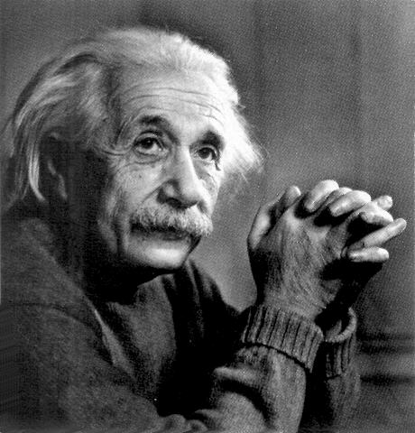
The purpose of mechanics is to describe how bodies change their position in space with “time.” I should load my conscience with grave sins against the sacred spirit of lucidity were I to formulate the aims of mechanics in this way, without serious reflection and detailed explanations.
FROM: Albert Einstein, Relativity (first published in 1916), Chapter 3, “Space and Time in Classical Mechanics.”

Slide 3
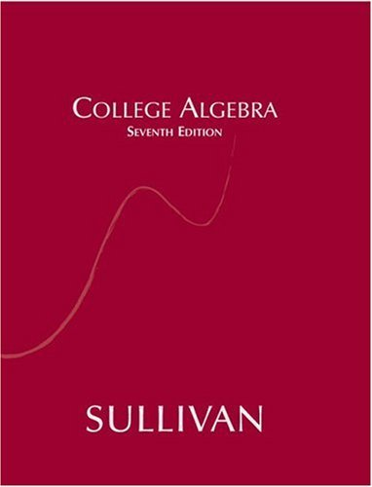
Sloppy Algebra
Pre-Calculus Algebra (MATH 1710)

Slide 4
Proof That $2=1$

Slide 5
Proof That $2=1$
Let $x=y$.
Multiply both sides by $x$: $x^{2}=xy$.
Subtract $y^{2}$ from both sides: $x^{2}−y^{2}={xy−y}^{2}$.
Factor: $\left(x+y\right)\left(x−y\right)=y(x−y)$.
Cancel factor $(x−y)$: $\left(x+y\right)=y$.
DIVISION BY 0!!!
Substitute $x=y$: $2y=y$.
Cancel the factor $y$: $2=1$.
So what’s up?

Slide 6
EXPLANATION
You can’t divide by zero!!!
Note. You can’t divide by zero in algebra, calculus, or analysis. There isn’t an advanced class somewhere out there (in mathematics) where people are dividing by zero.
Note. In the study of meromorphic functions in complex analysis, you can consider a function $f$ with a pole at point $a∈ℂ$ (that is, $\lim_{z→a}{|f\left(z\right)|=∞}$ and some more stuff) for which you define $f\left(a\right)=∞$. You are then dealing with functions from $ℂ$ to the metric space $ℂ∪\{∞\}$, but you are not dividing by 0 and getting $∞$!

Slide 7
Proof That $3=−3$
A Quick Multiple Choice Question: $\sqrt{9}=$ ?
(a) $+3$
(b) $−3$
(c) $±3$
Answer: $+3$
Two True Facts:
(1) $\sqrt{x^{2}}=|x|$ for all $x∈ℝ$,
(2) $\left|x\right|=a$ implies $x=±a$ (where $x∈ℝ$).

Slide 8
Proof That $3=−3$
Let $x=3$.
EXTRANEOUS ROOTS!!!
Square both sides: ${(x)}^{2}={(3)}^{2}$ or $x^{2}=9$.
Take square roots of both sides: $\sqrt{x^{2}}=\sqrt{9}$.
Simplify: $\left|x\right|=3$. So $x=±3.$
So what’s up?

Slide 9
EXPLANATION
SQUARING BOTH SIDES OF AN EQUATION INTRODUCES EXTRANEOUS ROOTS!!!
Note. That is, in an equation with an unknown, the operation of squaring both sides introduces a new equation with values satisfying the new equation which do not satisfy the original equation. This is illustrated for the real numbers, but holds for other algebraic structures as well.
Note. For an extreme example, in the division ring of the quaternions, squaring both sides of the equation $q=i$ to produce $q^{2}=−1$ introduces an infinite number of extraneous roots!

Slide 10
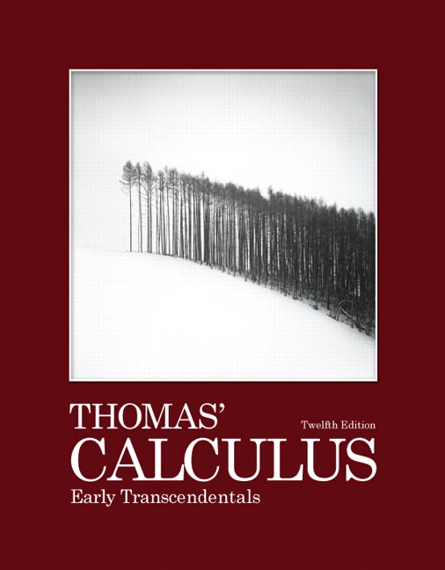
Calculus
Calculus 2 (MATH 1920)

Slide 11
Finite Paint for an Infinite Wall
Note. Consider the graph of $y=1/x$ for $x∈[1,∞)$. Revolve this about the $x$-axis to produce a surface of revolution and a solid of revolution.
1
Note. The resulting object is called “Gabriel’s trumpet.” We will show that it has finite volume and infinite surface area.

Slide 12
Finite Paint for an Infinite Wall
Note. We use the washer method to find the volume. In terms of $dx$-slices we have:
$$V=\int_{1}^{∞}{π{(\text{radius}\text{)}}^{2}(\text{thickness})}=\int_{1}^{∞}{π{\left(\frac{1}{x}\right)}^{2}dx}$$
$$∞$$
$=−π\left(\frac{1}{x}\right) =π$.
$$1$$
Note. Now a $dx$-slice of arclength is:
$$\sqrt{1+{\left(y^{′}\right)}^{2}}dx=\sqrt{1+{\left(\frac{−1}{x^{2}}\right)}^{2}}dx.$$

Slide 13
Finite Paint for an Infinite Wall
Note. So the area of the surface of revolution is:
$$\int_{1}^{∞}{2π(\text{radius})(\text{arclength})= \int_{1}^{∞}{2π\left(\frac{1}{x}\right)}}\sqrt{1+{\left(\frac{−1}{x^{2}}\right)}^{2}}dx$$
$$≥\int_{1}^{∞}{2π\left(\frac{1}{x}\right)dx=2π \text{ln}\left(x\right) =∞}.$$
$$∞$$
$$1$$
Note. So Gabriel’s trumpet has finite volume ($π$ cubic units) and infinite surface area. Here’s the “paradox”: Gabriel’s trumpet can be filled with a finite amount of paint, but it takes an infinite amount of paint to cover the (inner) surface!

Slide 14
EXPLANATION
Note. I explain this to Calculus 2 students as saying that it isn’t “fair” to compare two different dimensional quantities, say surface area (2 dimensional) and volume (3 dimensional); a physical argument could be based on the units by which these are measured. I pose the question: “How much paint does it take to paint an infinite surface?” Well, it depends on how thick you paint the surface… if you paint it 0 thick, then it will take 0 (volume) of paint; not to say that it will take no paint, but that I could start with 1 gallon of paint, paint an infinite surface with a 0-thick coat, and have 1 gallon of paint left over. This foreshadows measure theory and the fact that a measure 0 set can still have a lot of stuff in it!

Slide 15
EXPLANATION
Note. One can observe (with an easy computation) that the area under the curve $y=1/x^{2}$ for $x∈[1,∞)$ is finite (it is an area of 1), yet the perimeter of the region is infinite.
1
Nobody objects to this, but it is the same story as above, just dropped down one dimension (from finite volume to finite area, and from infinite surface are to infinite perimeter). It is the introduction of the paint terminology that makes things suspect in the discussion of Gabriel’s trumpet.

Slide 16
Everything Equals Everything Else
Note. As seen in Calculus 2 (MATH 1920), we see that the Maclaurin series for $\ln{(x+1)}$ is
$\ln{(x+1)}=\sum_{n=1}^{∞}{{(−1)}^{n+1}\frac{x^{n}}{n}}$ for $x∈\left(−1,1\right].$
So $\ln{(2)}=\sum_{n=1}^{∞}{{(−1)}^{n+1}\frac{1^{n}}{n}=1−\frac{1}{2}+\frac{1}{3}−\frac{1}{4}+\frac{1}{5}−…}$
That is, the alternating harmonic series converges to $\ln{2}.$
Note. We notice two properties of the alternating harmonic series $\sum_{n=1}^{∞}{a_{n}}$, where $a_{n}={(−1)}^{n+1}\frac{1}{n}$:
The terms approach 0: $\lim_{n→∞}{a_{n}=0}$, and
The positive terms only and the negative terms only form divergent series:
$\sum_{n=1}^{∞}{\frac{1}{2n−1}=∞}$ and $\sum_{n=1}^{∞}{\frac{−1}{2n}=−∞}$.

Slide 17
Everything Equals Everything Else
Note. Let’s rearrange the alternating harmonic series to get something different… say 1.
Note. We take positive terms until the partial sum is greater than or equal to 1, then take negative terms until the partial sum is less than 1, then take positive terms… This gives process yields:
$$\frac{1}{1}−\frac{1}{2}+\frac{1}{3}+\frac{1}{5}−\frac{1}{4}+\frac{1}{7}+\frac{1}{9}−\frac{1}{6}+\frac{1}{11}+\frac{1}{13}−\frac{1}{8}+\frac{1}{15}+\frac{1}{17}−\frac{1}{10}+\frac{1}{19}+\frac{1}{21}−\frac{1}{12}+\frac{1}{23}+\frac{1}{25}−\frac{1}{14}+\frac{1}{27}−\frac{1}{16}+…$$

Slide 18
Everything Equals Everything Else
Note. Since we have expressed $\ln{2}$ and $1$ as series using the same terms, we conclude that $\ln{2}=1$.
Note. The choice of 1 in the previous argument is arbitrary and could be replaced with any real number. So we conclude that any two real numbers are equal…
Wait! It gets worse! We could rearrange the alternating harmonic series by first using positive terms until the sum is greater than 1, then using a negative term, then using positive terms until the sum is greater than 2, then using a negative term, etc. This will yield a rearrangement of the harmonic series which diverges to $+∞$. Similarly, we can rearrange it to diverge to $−∞$.

Slide 19
EXPLANATION
YOU CAN ONLY REARRANGE ABSOLUTEY CONVERGENT SERIES, WITHOUT AFFECTING THE SUM!!!
Note. This is expressed as “The Rearrangement Theorem for Absolutely Convergent Series”:
If $\sum_{n=1}^{∞}{a_{n}}$ converges absolutely and $b_{1}, b_{2}, …, b_{n},…$ is any rearrangement of the sequence $\{a_{n}\}$ then $\sum_{n=1}^{∞}{b_{n}}$ converges absolutely and $\sum_{n=1}^{∞}{a_{n}}=\sum_{n=1}^{∞}{b_{n}}$.

Slide 20
EXPLANATION
Note. It is not that The Rearrangement Theorem for Absolutely Convergent Series is surprising; one would probably expect any rearrangement of a series to have no effect on the sum of the series. The surprise is how conditionally convergent series behave:
Theorem. A conditionally convergent series can be rearranged to converge to any desired limit (including $+∞$ and $−∞$), or to diverge.

Slide 21
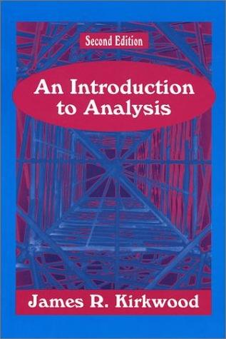
Set Theory
Analysis 1 (MATH 4217/5217)

Slide 22
Bigger Than Infinity
Note. Consider all real numbers between 0 and 1 written as “binary decimals.” Each number in $[0,1]$ has a unique representation in binary by using an infinite number of nonzero decimals. For example we can write $1/2$ base 2 as: $1/2=0.1=0.0111⋯$.
Note. Assume we can “count” the numbers in $[0,1]$ by listing a first number, a second number, etc.:
$$x_{1}=0.d_{11}d_{12}d_{13}d_{14}⋯$$
$$x_{2}=0.d_{21}d_{22}d_{23}d_{24}⋯$$
$$x_{3}=0.d_{31}d_{32}d_{33}d_{44}⋯$$
$$x_{4}=0.d_{41}d_{42}d_{43}d_{44}⋯$$
$$⋮$$

Slide 23
Bigger Than Infinity
Note. We now show that this list cannot be complete by presenting a number in $[0,1]$ that is not in the list.
$$x_{1}=0.d_{11}d_{12}d_{13}d_{14}⋯$$
$$d_{1}=1−d_{11}$$
$$x_{2}=0.d_{21}d_{22}d_{23}d_{24}⋯$$
$$d_{2}=1−d_{22}$$
$$x_{3}=0.d_{31}d_{32}d_{33}d_{44}⋯$$
$$d_{3}=1−d_{33}$$
$$x_{4}=0.d_{41}d_{42}d_{43}d_{44}⋯$$
$$d_{4}=1−d_{44}$$
$$⋮$$
$$⋮$$
Define: $x_{∞}=0.d_{1}d_{2}d_{3}d_{4}⋯$
Then $x_{∞}$ is not in the list!
Note. This is called the “Cantor diagonalization argument.”

Slide 24
Bigger Than Infinity
Note. It is easy to say when two finite sets are the same size; it’s when they both have the same number of elements. But for infinite sets, it is more complicated.
Definition. Two sets $A$ and $B$ are of the same cardinality, denoted $\left|A\right|=\left|B\right|$, if there is a one to one and onto function (i.e., a bijection) from one set to the other.
Note. In the Cantor Diagonalization Argument we have shown that there is not a bijection from the natural numbers $ℕ$ to the interval $[0,1]⊂ℝ$. So these two sets are not of the same cardinality. Since $ℕ⊂ℝ$, we must have $|ℕ|<|ℝ|$. So even though both sets are infinite, one is larger than the other!

Slide 25
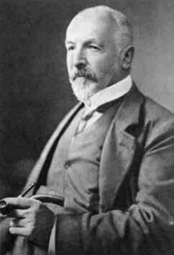
EXPLANATION
Note. These ideas about the cardinalities of sets were introduced by Georg Cantor in 1873.
Note. In particular, he proved that for any set $A$ the power set of $A$ is larger that set $A$: $\left|A\right|<|𝒫\left(A\right)|$.
This implies that there can be no largest set nor a largest infinity!
1845-1918

Slide 26
Neither True Nor False
Note. Given that there are different levels of infinity, Cantor turned his attention to cardinalities of subsets of the real numbers $ℝ$. In the 1890s he tried to prove that there is no set of the real numbers with cardinality strictly greater than that of $ℕ$ and strictly less than that of $ℝ$. He was unable to prove this and it became known as The Continuum Hypothesis (since it involves the cardinality of the continuum $ℝ$).
The Continuum Hypothesis. There does not exist a set $A⊂ℝ$ such that $ℵ_{0}=\left|ℕ\right|<\left|ℝ\right|=c$.
Question: Is The Continuum Hypothesis true or false?

Slide 27
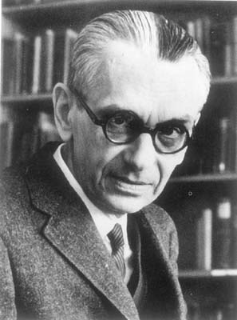
Neither True Nor False
Note. The truth value of The Continuum Hypothesis is a complicated story.
Note. In 1939 Kurt Gödel proved that the Continuum Hypothesis is consistent with the (ZFC) axioms of set theory.
1906-1978

Slide 28
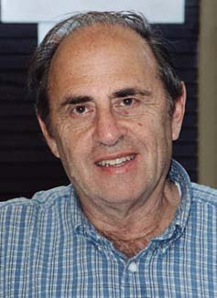
Neither True Nor False
Note. In 1964 Paul Cohen proved that the Continuum Hypothesis is does not follow from the (ZFC) axioms of set theory (it is independent of them).
1934-2007

Slide 29
EXPLANATION
Note. In fact, Kurt Gödel studied the consistency and completeness of axiomatic systems. He showed that in certain axiomatic systems there are meaningful claims
which are neither true nor false; they are “undecidable.”
The Continuum Hypothesis is an example of an undecidable in the ZFC axiomatic system of set theory.
1906-1978

Slide 30
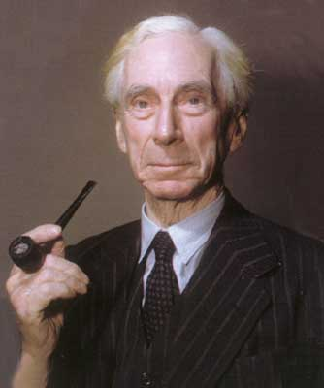
A Set or Not a Set?
Note. In 1903 Bertrand Russell, while working on Principia Mathematica, discovered what became known as Russell’s Paradox.
1872-1970

Slide 31
A Set or Not a Set?
Note. Russell’s Paradox can be informally described in the following story.
Imagine a town with a barber. The barber cuts the hair of all of those who do not cut their own hair (and only those). Who cuts the barber’s hair?
If he does not cut his own hair then he must cut his own hair (since that is his job). If he does cut his own hair, then he cannot cut his own hair since his job is to cut the hair of those who do not cut their own hair.

Slide 32
A Set or Not a Set?
Note. A more set theoretic approach is to consider the set $E$of all sets that are not members of themselves. Is set $E$ a member of itself?
If $E$ is a member of itself, then it cannot be a member of itself since it only consists of such sets. If $E$ is not a member of itself, then it must be a member of itself by its own definition.

Slide 33
EXPLANATION
Note. The lesson from Russell’s Paradox is that we cannot just define a set in any old way! This realization lead to a revision of axiomatic set theory. Existence axioms were introduced and processes of producing new sets from existing sets were established (such as the Axiom of the Power Set which states that for any given set $A$, the power set $𝒫(A)$ exists).
Note. This revision of the axioms of set theory in the very early 1900s set the stage for the later work by Kurt Gödel in the 1920s.

Slide 34
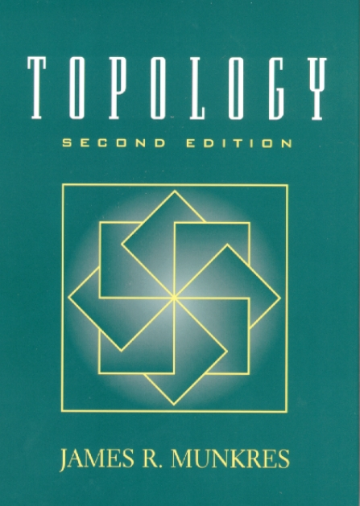
Weird Functions
Introduction to Topology (MATH 4357/5357)

Slide 35
Painting a Plane with a Line
Note. In 1878, Cantor proved that the cardinality of the interval $[0,1]$ is the same as the cardinality of the unit square $\left[0,1\right]×[0,1]$. So there is a one to one and onto function from the interval to the square.
Question. Can we map the interval one to one, onto, and continuously to the square?
Answer. NO! [Netto, 1879]
Question. Can we map the interval continuously onto the square?

Slide 36
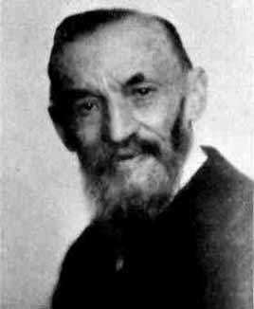
Painting a Plane with a Line
Note. In 1890, Peano constructed a continuous onto mapping from $[0,1]$ to $\left[0,1\right]×[0,1]$. The result image of $[0,1]$ is called a “space-filling curve” (or “Peano curve”) and satisfies the surprising property that the 1-dimensional interval is continuously mapped onto the 2-dimensional square.
Peano’s paper: “Sur une courbe, qui remplit toute une aire plane,” Mathematische Annalen, 36(1), 157–160 (1890).
Guiseppe Peano
1858-1932

Slide 37
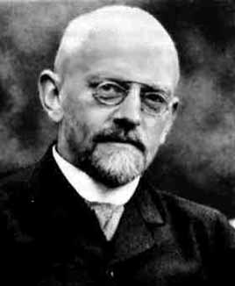
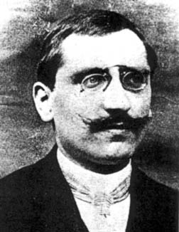
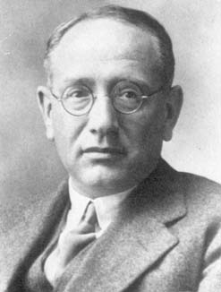
Painting a Plane with a Line
Note. Additional examples were given by David Hilbert (1862–1943), Eliakim H. Moore (1862–1932), Henri Lebesgue (1875–1941),
Wacław Sierpiński (1882–1969), George Pólya (1887–1985) and others.
David Hilbert
Henri Lebesgue
George Pólya

Slide 38
Painting a Plane with a Line
Note. The desired function is given as a limit of a sequence of functions. There is a “fractal nature” to this sequence of functions

Slide 39
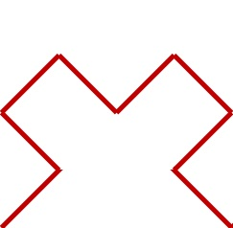
Painting a Plane with a Line

Slide 40
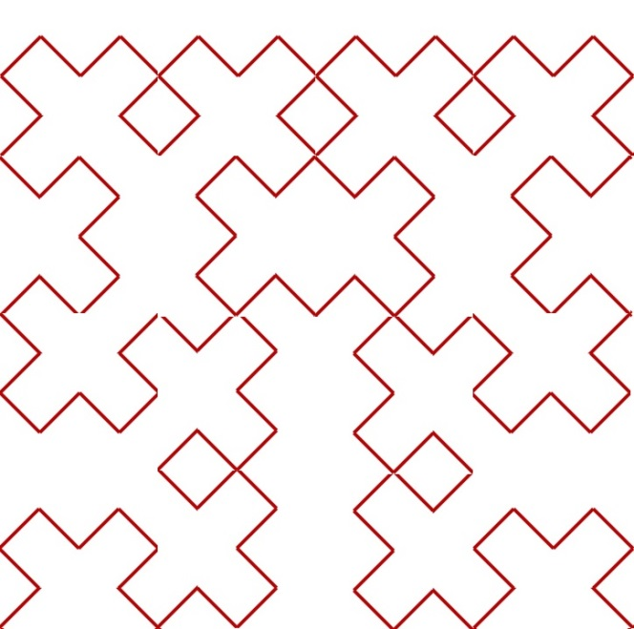
Painting a Plane with a Line

Slide 41
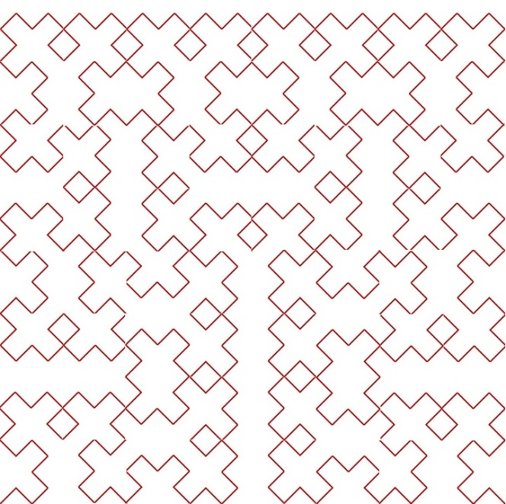
Painting a Plane with a Line

Slide 42
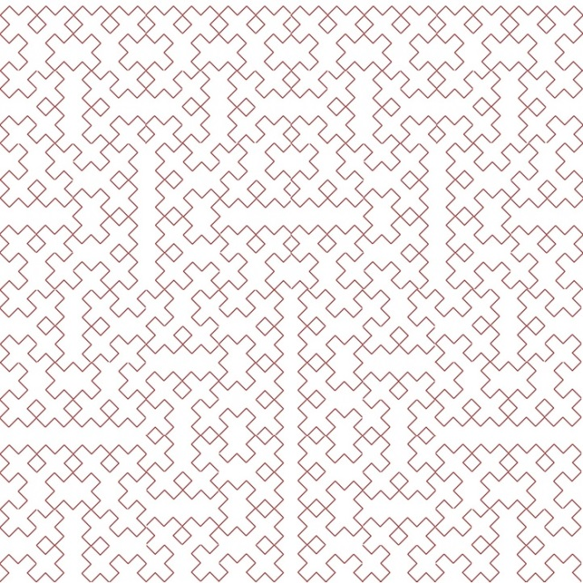
Painting a Plane with a Line

Slide 43
EXPLANATION
Note. The proof that the limit function is continuous is based on showing that the sequence of functions is a Cauchy sequence in the space of continuous functions from $[0,1]$ to $\left[0,1\right]×[0,1]$. This is a complete space and so the sequence converges in the space, and the limit function is therefore continuous.
Note. The proof that the limit function is onto is based on showing that every point in $\left[0,1\right]×[0,1]$ is a limit point of the limit function. Since the limit function is continuous then it maps the compact set $[0,1]$ to a compact set in $\left[0,1\right]×[0,1]$. Since the Heine-Borel Theorem holds, then the image of $[0,1]$ is closed and so includes its limit points. So every point in $\left[0,1\right]×\left[0,1\right]$ is in the range of the limit function and it is onto.

Slide 44
A Very Sharp Function
Note. You know from Calculus 1 that if a function is differentiable at an interior point of its domain then it is continuous at that point. Of course, a function can be continuous at a point yet not differentiable at that point; consider $f\left(x\right)=|x|$ at $x=0$.
Note. So a continuous function can be non-differentiable at one point. How badly non-differentiable can a continuous function be?
$$f\left(x\right)=|x|$$

Slide 45
A Very Sharp Function
Note. On July 18, 1872, Karl Weierstrass presented a paper to the Prussian Academy of Sciences in Berlin. He introduced the Fourier series $f\left(x\right)=\sum_{n=0}^{∞}{a^{n}\cos\left(b^{n}πx\right)}$ where $0<a<1$, $b$ is a positive odd integer, and $ab>1+3π/2$ (these conditions on $a$ and $b$ can be loosened and the conclusion of Weierstrass still holds). Weierstrass showed that function $f$ is continuous on $ℝ$ but is nowhere differentiable!
Note. By the way, notice that each term of $f$ is bounded in absolute value by $a^{n}$ and we see that the Weierstrass M-test shows that the series converges uniformly and so is continuous.

Slide 46
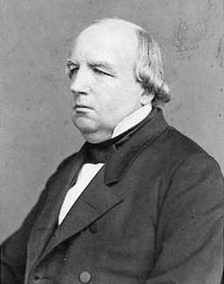
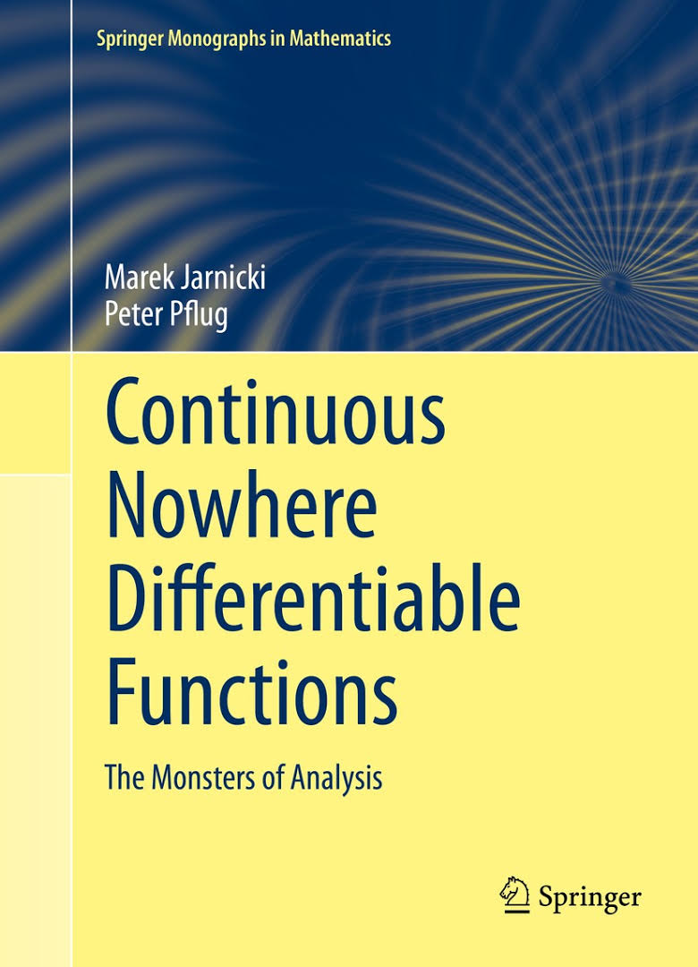
EXPLANATION
Note. Weierstrass’ example was the first of many continuous but nowhere differentiable functions. In fact, there are entire books devoted to the topic.
Karl Weierstrass, 1815-1897

Slide 47
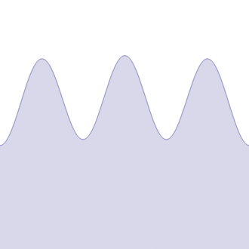
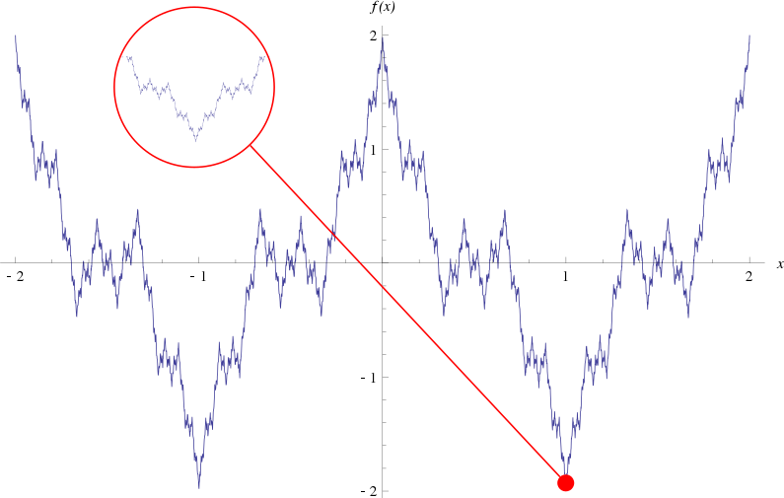
EXPLANATION
Note. The graph of Weierstrass’ function has a fractal nature. The animated picture show the first few partial sums of Weierstrass’ Fourier series.
(The notes for this topic and these two images are from Wikipedia.)

Slide 48
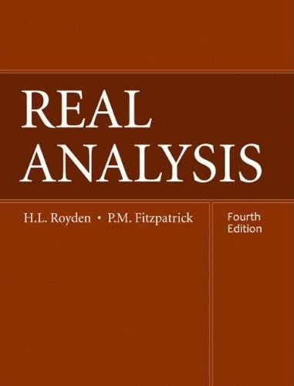
Measure Theory
Real Analysis 1 (MATH 5210)

Slide 49
Volume from Nowhere!
Note. The Banach-Tarski Theorem states: “A solid ball may be separated into a finite number of pieces and reassembled in such a way as to create two solid balls, each identical in shape and volume to the original.”
“The Banach-Tarski Paradox does not hold in the plane; a space of three or more dimensions is required.” We have similar paradoxes for an interval and a disk, but these examples required an infinite number of pieces. [L.M. Wapner, The Pea and the Sun—A Mathematical Paradox. A.K. Peters, Ltd., 2005.]

Slide 50
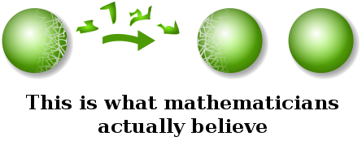
Volume from Nowhere!
Note. Polish mathematician Stefan Banach (1892–1945), of “Banach space” fame, and Alfred Tarski (1902–1983) published “On the Decomposition of Sets of Points in Respectively Congruent Parts” (in French in Fundamenta Mathematicae 6) in 1924. Their work was heavily dependent on earlier work of Vitali and Hausdorff.
From: https://warosu.org/sci/thread/6690359

Slide 51
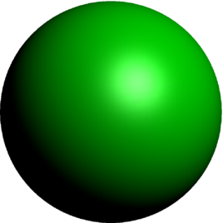
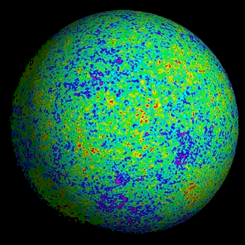
Volume from Nowhere!
Note. In 1947, R.M. Robinson (1911–1995) showed that the construction could be accomplished using only five pieces (and could not be accomplished using fewer pieces). Two of the pieces form one new sphere and the other three create a second sphere (“On the Decomposition of Spheres,” Fundamenta Mathematicae, 34 (1947), 246–260).
Axiom of Choice

Slide 52
EXPLANATION
Note. The Axiom of Choice allows us to show the existence of sets so exotic that we cannot assign to them a volume in a meaningful way. The problem is that the pieces of the sphere are not measurable. So the sum of the measures of the disjoint pieces does not equal the measure of the union of the pieces.
Note. This is addressed in Real Analysis 1 (MATH 5210) when constructing a nonmeasurable subset of the set [0,1]. The Axiom of Choice is used to partition [0,1] into a countable number of disjoint pieces which union to give [0,1]. Each of these pieces has the same measure (if this makes sense), since any one can be rigidly transformed to any other.

Slide 53
EXPLANATION
Note. Denote these pieces as $P_{1},P_{2},P_{3},…$
$$\left[0,1\right]= P_{1}∪P_{2}∪P_{3}∪P_{4}∪⋯∪P_{2n}∪P_{2n+1}∪⋯$$
$$P_{1}$$
$$P_{2}$$
$$⋯$$
$$P_{n+1}$$
$$P_{1}$$
$$P_{2}$$
$$⋯$$
$$P_{n}$$
$$\left[0,1\right]= P_{1}∪P_{2}∪P_{3}∪⋯$$
$$\left[0,1\right]= P_{1}∪P_{2}∪P_{3}∪⋯$$

Slide 54
EXPLANATION
Note. If the pieces $P_{1},P_{2},P_{3},…$ are “measurable” then we have $m\left(P_{i}\right)=m(P_{j})$ for all $i,j∈ℕ$. Measurable sets satisfy “additivity” and we would have
$1=m\left(\left[0,1\right]\right)=m\left(P_{1}\right)+m\left(P_{2}\right)+m\left(P_{3}\right)+⋯$,
$$1=\sum_{i=1}^{∞}{m\left(P_{i}\right).}$$
or
But if each $P_{i}$has measure 0 then the equality cannot hold since the RHS is 0. If each $P_{i}$ has measure $ε>0$, then the equality cannot hold since the RHS is $∞$.
So the $P_{i}$are not measurable!

Slide 55
EXPLANATION
Note. So it is not that volume can be created out of nothing. It is simply that the Axiom of Choice allows us to create sets which have such bizarre shapes that it is meaningless to assign to them a measure (of length, area, volume,…).
Note. Nonmeasurable sets are a standard part of analysis these days. The story about creating two spheres from one is not meant to be taken as a physical possibility, simply that nonmeasurable sets may violate additivity.
The Sacred Spirit of Lucidity!

Slide 56
Thank you!
Questions?

