Slide 1
The Three Stooges, Conic Sections, Trigonometry, and Implicit Differentiation
Robert Davidson and Bob Gardner Department of Mathematics and Statistics East Tennessee State University
April 6, 2012 (The Kickoff of Three Stooges Week)
Online at: http://www.etsu.edu/math/gardner/stooges/Stooges-Trig-2012.ppt

Slide 2
Motivation for the Project
Stooges are a great attention device – it keeps student’s interest.
Trig is very applicable – even in the setting of the Three Stooges.
Watching the Stooges should relieve any form of intellectual anxiety.
Students learn by doing (measurement, unit conversion, scaling factor, trig).

Slide 3
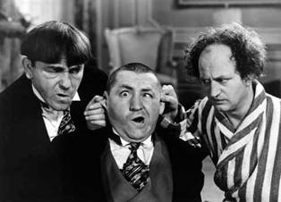
The Three Stooges
Moe Curly Larry

Slide 4
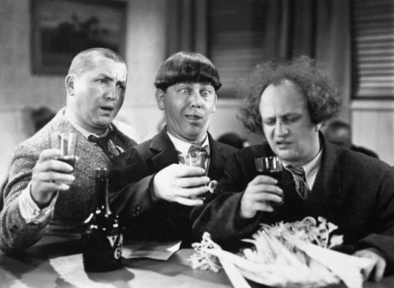
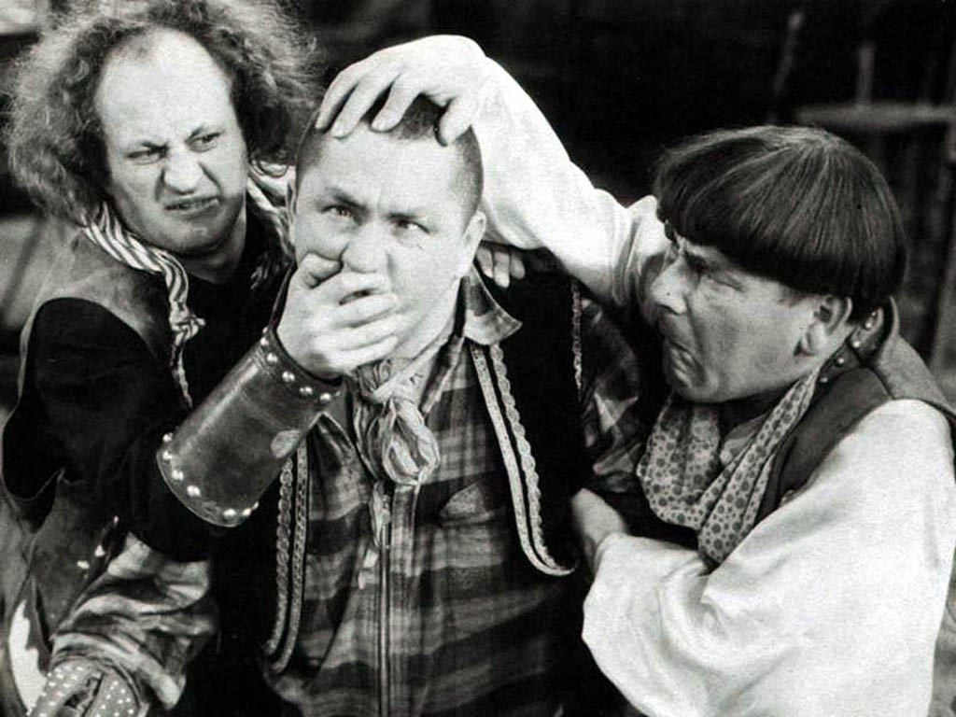
The Three Stooges
As a group, they were in show business for almost 50 years.
Made 190 “shorts” with Columbia Pictures.
Had their third short, Men in Black (1934), nominated for an Academy Award.
Had 4 different people in the role of “the third Stooge.”
Were the first to lampoon Adolph Hitler, in You Nazty Spy (1940).

Slide 5
Are the Three Stooges Still Relevant?

Slide 6
Zogby International conducted a poll of 1,213 American adults by telephone in July 2006.
One question asked for the names of the Three Stooges and another asked for the names of the three branches of government.
Those able to name the Three Stooges: 73%
Those able to name the three branches of government: 42%
Source: http://www.zogby.com/Soundbites/ReadClips.dbm?ID=13498

Slide 7
20th Century Fox will release The Three Stooges movie on April 13, 2012.

Slide 8
A Bird in the Head
The 89th Columbia Pictures Three Stooges film; this was released in 1946. This short is classic Stooges and has the boys wall-papering a room. We watch from 2:35 to 4:28 (1:53 total).

Slide 10
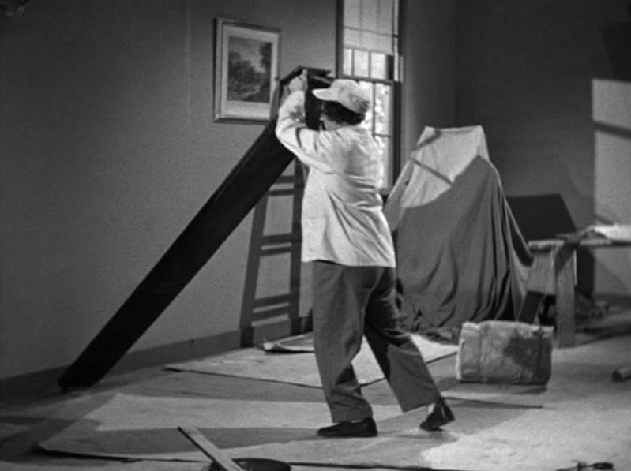

Slide 11
R. Gardner and R. Davidson, “Mathematical Lens: The Three Stooges Meet the Conic Sections,” Mathematics Teacher, February 2012, pp. 414-418.

Slide 13
Stooges Among Us
edited by Lon & Debra Davis
BearManor Media (2008)
“…like Moe, Larry was only five-feet-four-inches tall.” (page 10)

Slide 14
Students Insert Known Data
c
a
= 5’4’’
b

Slide 15
Unit Conversion and Conversion Factor
1 foot = 12 inches, so the conversion factor is
12 inches/1 foot = 12’’/1’
c
So: 5’+4’’ = 5’x12’’/1’+4’’ = 60’’+4’’ = 64’’
a = 5’4’’
= 64’’
b

Slide 16
Students Make Measurements on Worksheet
c
= 10.9 cm
a
= 7.3 cm
b
= 8.1 cm

Slide 17
Students Set Up a Scaling Factor
7.3 cm = 64.0’’
Scaling factor: 64.0 in / 7.3 cm = 8.77 in/cm
Students must be warned to distinguish between a scaling factor (like on a map) and a conversion factor.

Slide 18
Students Scale Their Measurements
c = 95.6’’
a
= 64.0’’
b
= 71.0’’
Board length = 95.6’’

Slide 19
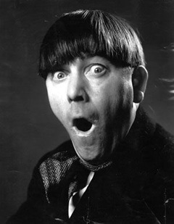
Now we use the scene where the board falls on Moe’s head to introduce angles and trig functions.

Slide 20
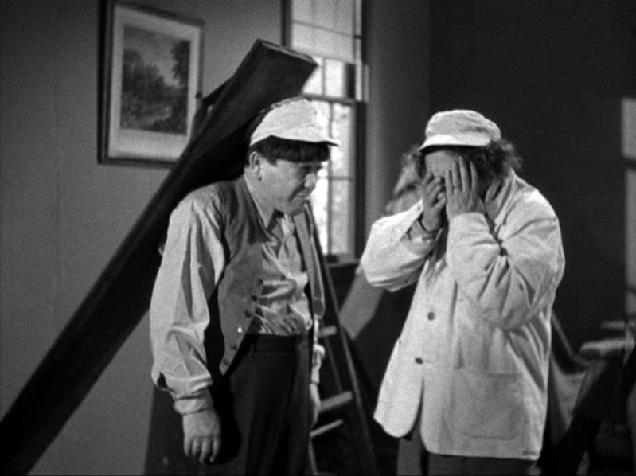
Nice!
Suppose the board hits Moe on the head at a point 6 inches from the end of the board.

Slide 21
A Schematic Diagram
What is the angle, θ, the board makes when it hits Moe on the head?
What are the six trig functions of θ?
θ

Slide 22
Students Use the Pythagorean Theorem
c_{m} = 95.6’’ – 6’’ = 89.6’’
a_{m} = 64’’
θ
b_{m} = 62.7’’
The Pythagorean Theorem

Slide 23
Students Find θ
c_{m} = 89.6’’
a_{m} = 64’’
θ
b_{m} = 62.7’’
Trig Functions and Inverse Trig Functions
θ = 45.6º

Slide 24
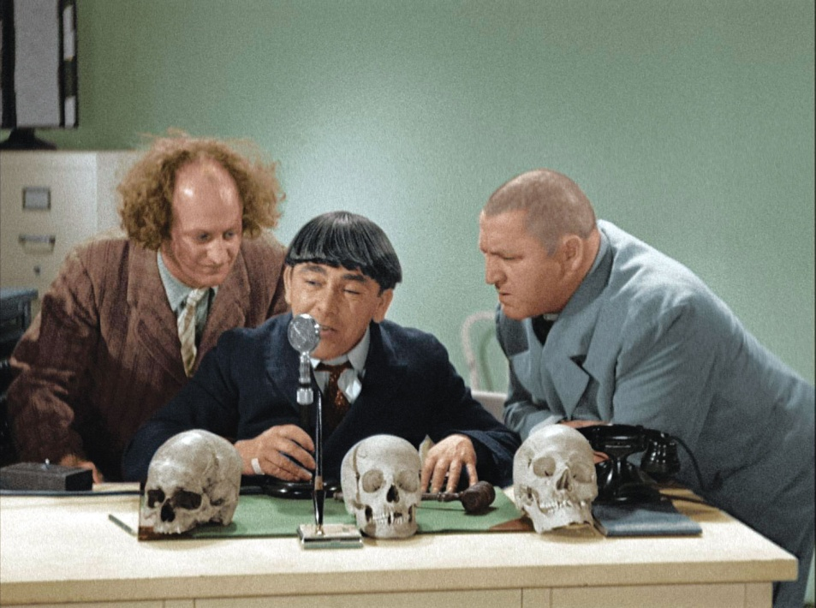
Introduce Coordinate Axes
y
From: http://www.collider.com/ dvd/reviews/article.asp/aid/5899/tcid/3
x

Slide 25
Questions About Coordinates
What are the coordinates of the top end of the board when it is standing vertically?
What are the coordinates of the top of Moe’s head?
What are the coordinates of the end of the board when the board hits Moe on the head?
What is the equation of the circle traced out by the end of the board?

Slide 26
Questions Involving Angles
Convert θ to radians. Use the conversion factor π radians /180º.
Through what angle did the board travel, from when it was vertical to when it hit Moe? Give your answer in radians.
How far did the end of the board travel from when it was vertical to when it hit Moe?
What area did the board sweep out from when it was vertical to when it hit Moe?

Slide 27
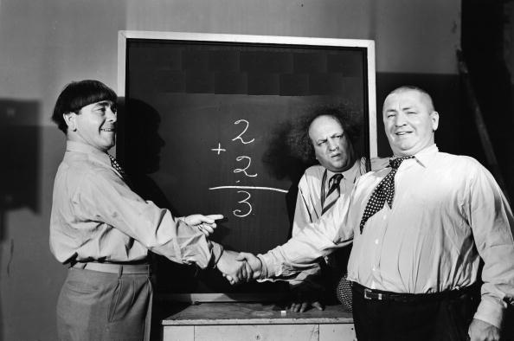
More Online
Online, you can find a copy of this PowerPoint presentation, the PowerPoint presentation we use in class to introduce the worksheet, the worksheet itself, our solutions to the worksheet, and a summary of student impressions of the in-class experience described today: http://faculty.etsu.edu/gardnerr/stooges-trig/stooges-trig-2012.htm

Slide 28
Now a more analytic approach…

Slide 29
R. Gardner and R. Davidson, “Mathematical Lens: The Three Stooges Meet the Conic Sections,” Mathematics Teacher, February 2012, pp. 414-418.

Slide 30
Where does this ellipse come from?

Slide 31
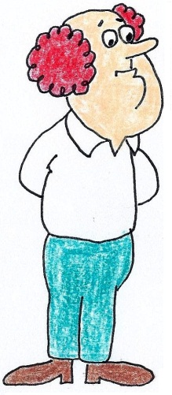
Suppose the camera lens is located a horizontal distance d from Larry's feet and a vertical distance h. We will initially measure such distances in feet, but then convert them to units based on a coordinate system we introduce.
h
d

Slide 32
We project the circle of radius r onto the plane through Larry's left foot and perpendicular to the floor. The radius from Larry's left foot to the point on the circle farthest from the camera projects onto a line segment of length y₁’. The radius from Larry's left foot to the point on the circle closest to the camera projects onto a line segment of length y₂’.
Plane of the Photograph
h
y₁’
d - r
r
r
d
y₂’

Slide 33
Now, we set up relationships between y₁’, y₂’, and other parameters of the ellipse. First, set up a coordinate system in the plane of the photograph with the x’ axis horizontal, the y’ axis vertical, and the origin at Larry's foot. If Larry spins around on his left foot, the end of the board traces out a circle. In the plane of the photograph, this is an ellipse.
y’
x’

Slide 34
The minor axis of the ellipse will then have length y₁’+ y₂’ and the center of the ellipse in the (x’, y’) coordinate system in (x’, y’) = (0, (y₁’- y₂’)/2).
Plane of the Photograph
h
y₁’
d - r
r
r
d
y₂’

Slide 35
Therefore the equation of the ellipse is
$\frac{{\left(x^{′}\right)}^{2}}{a^{2}}$ + $\frac{{\left(y^{′}−{\left(y_{1}^{′}−y_{2}^{′}\right)}/2\right)}^{2}}{b^{2}}$ =1,
y’
y₁’
x’
(y₁’- y₂’)/2
-y₂’

Slide 36
or
where A = 1/a² and B = 1/b².
A${\left(x^{′}\right)}^{2 }$+ B${\left(y^{′}−{\left(y_{1}^{′}−y_{2}^{′}\right)}/2\right)}^{2}$=1,
y’
y₁’
x’
(y₁’- y₂’)/2
-y₂’

Slide 37
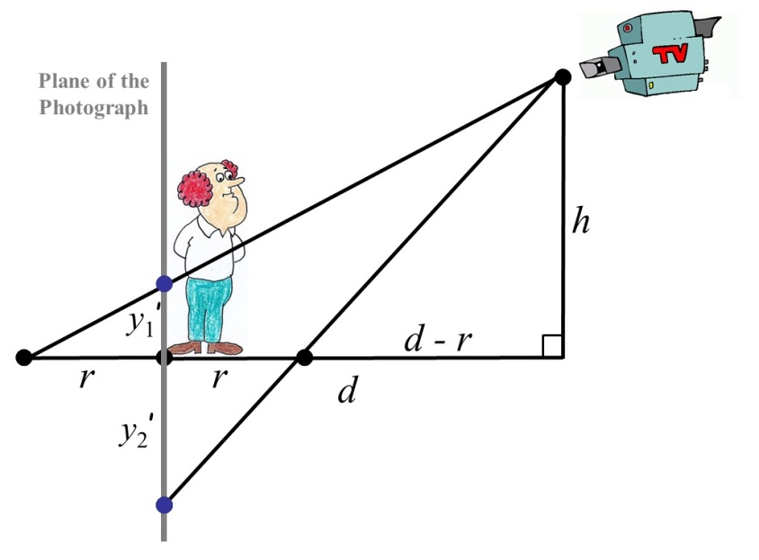
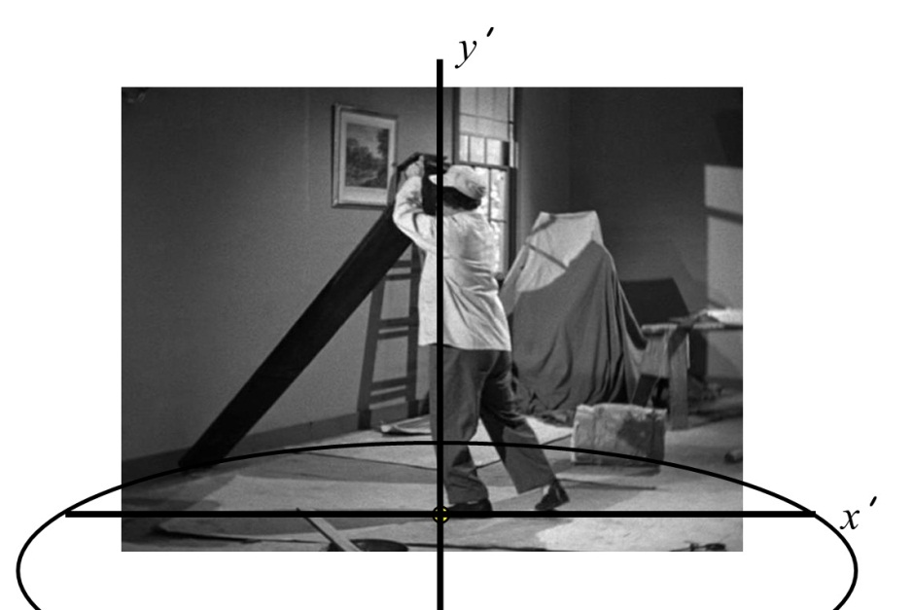
We will measure distances in the studio (such as r, h, and d) in feet. We measure distances in the x’y’-plane in units such that the width of the photograph is 100 units. So we need a scaling factor s to convert r, h, and d into the units used in the x’y’-plane.
s
Distances measured in feet.
Distances measured in units.

Slide 38
In the x’y’-plane, the point (rs,0) lies on the ellipse.
We denote as (x₀ ’, y₀’) the projection of the point at the end of the board when in its initial position as given in the photograph, onto the x’y’-plane.
y’
y₁’
(x₀ ’, y₀’)
x’
rs
(y₁’- y₂’)/2
r
-y₂’

Slide 39
Since the point (rs,0) lies on the ellipse, then
$$A r^{2}s^{2}+B{\left(\frac{y_{1}^{′}−y_{2}^{′}}{2}\right)}^{2}=1.$$
(1)
Since the point (x₀ ’, y₀’) lies on the ellipse, then
$A{\left(x_{0}^{′}\right)}^{2}+B{\left(y_{0}^{′}−\frac{y_{1}^{′}−y_{2}^{′}}{2}\right)}^{2}=1$.
(2)
y’
y₁’
(x₀ ’, y₀’)
x’
rs
(y₁’- y₂’)/2
-y₂’

Slide 40
Denote by m the slope of the x-axis in the x’y’-plane .
Differentiating the equation of the ellipse with respect to x’ gives:
$\frac{d}{dx^{′}}[{A\left(x^{′}\right)}^{2}$ + B${\left(y^{′}−{\left(y_{1}^{′}−y_{2}^{′}\right)}/2\right)}^{2}]$ = $\frac{d}{dx^{′}}$[1],
2A$x^{′}+$2B$\left(y^{′}−{\left(y_{1}^{′}−y_{2}^{′}\right)}/2\right)\frac{dy^{′}}{dx^{′}}$ = 0.
z
y
x

Slide 41
With x’ = x₀ ’ and y’ = y₀’, we have $\frac{dy_{0}^{′}}{dx_{0}^{′}}$ = m and so
2A$x_{0}^{′}+$2B$\left(y_{0}^{′}−{\left(y_{1}^{′}−y_{2}^{′}\right)}/2\right)m=0.$
(3)
We now set up an equation for r using equation (1), (2), (3), and equations relating $y_{1}^{′}$ and $y_{2}^{′}$ to h and d.
z
y
x

Slide 42
Equation (3)
2A$x_{0}^{′}+$2B$\left(y_{0}^{′}−{\left(y_{1}^{′}−y_{2}^{′}\right)}/2\right)m=0$
(3)
rearranges as:
A = $\frac{Bm}{x_{0}^{′}}\left(\frac{y_{1}^{′}−y_{2}^{′}}{2}−y_{0}^{′}\right)$= $\frac{Bm}{{2x}_{0}^{′}}\left(y_{1}^{′}−y_{2}^{′}−{2y}_{0}^{′}\right)$.
Substituting this value of A into (1)
$$A r^{2}s^{2}+B{\left(\frac{y_{1}^{′}−y_{2}^{′}}{2}\right)}^{2}=1$$
(1)
gives:
$$\frac{Bm}{x_{0}^{′}}\left(\frac{y_{1}^{′}−y_{2}^{′}}{2}−y_{0}^{′}\right) r^{2}s^{2}+B{\left(\frac{y_{1}^{′}−y_{2}^{′}}{2}\right)}^{2}=1,$$
This equation can be solved for B and that value of B can be used to determine A:

Slide 43
$$B=\frac{4x_{0}^{′}}{2mr^{2}s^{2}\left(y_{1}^{′}−y_{2}^{′}−2y_{0}^{′}\right)+x_{0}^{′}{\left(y_{1}^{′}−y_{2}^{′}\right)}^{2}}$$
and
$$A=\frac{2m\left(y_{1}^{′}−y_{2}^{′}−2y_{0}^{′}\right)}{2mr^{2}s^{2}\left(y_{1}^{′}−y_{2}^{′}−2y_{0}^{′}\right)+x_{0}^{′}{\left(y_{1}^{′}−y_{2}^{′}\right)}^{2}} .$$
Using these values of A and B in Equation (2)
$$A{\left(x_{0}^{′}\right)}^{2}+B{\left(y_{0}^{′}−\frac{y_{1}^{′}−y_{2}^{′}}{2}\right)}^{2}=1$$
(2)

Slide 44
.
.
.
.
.
gives
$$2m\left(y_{1}^{′}−y_{2}^{′}−2y_{0}^{′}\right){\left(x_{0}^{′}\right)}^{2}+x_{0}^{′}{\left(y_{1}^{′}−y_{2}^{′}−2y_{0}^{′}\right)}^{2}=2mr^{2}s^{2}\left(y_{1}^{′}−y_{2}^{′}−2y_{0}^{′}\right)+x_{0}^{′}{\left(y_{1}^{′}−y_{2}^{′}\right)}^{2}.$$
(4)
Next, by similar triangles:
$$\frac{h}{d+r}=\frac{y_{1}^{′}}{r}$$
$$\frac{h}{d−r}=\frac{y_{2}^{′}}{r} ,$$
and
or
$$y_{1}^{′}=\frac{hr}{d+r}$$
$$y_{2}^{′}=\frac{hr}{d−r}.$$
and
Therefore
$$y_{1}^{′}−y_{2}^{′}=\frac{hr}{d+r}−\frac{hr}{d−r}=\frac{2hr^{2}}{r^{2}−d^{2}}.$$

Slide 45
However, these relationships give the values of y₁’ and y₂’ in the same units as r, d, and h. We will adopt common units of feet and so need to convert them to the “units” used in the x’ y’-plane.
s
Distances measured in feet.
Distances measured in units.

Slide 46
55.0 units
100 “units”
In this plane, Larry measures as 55.0 units tall and we know that he is 5.33 feet tall. So we need to scale the values of y₁’ and y₂’ by an amount s = 55.0/5.33 units/foot = 10.32 units/foot. So in the units of the x’ y’-plane, we have
$$y_{1}^{′}=\frac{hrs}{d+r} ,$$
$$y_{2}^{′}=\frac{hrs}{d−r},$$
$$y_{1}^{′}−y_{2}^{′}=\frac{2hr^{2}s}{r^{2}−d^{2}} .$$
and

Slide 47
Eliminating y₁’ and y₂’ in equation (4) gives
$$2m{\left(x_{0}^{′}\right)}^{2}\left(\frac{hr^{2}s}{r^{2}−d^{2}}−2y_{0}^{′}\right)+x_{0}^{′}{\left(\frac{2hr^{2}s}{r^{2}−d^{2}}−2y_{0}^{′}\right)}^{2}=2mr^{2}\left(\frac{2hr^{2}s}{r^{2}−d^{2}}−2y_{0}^{′}\right)−{\left(\frac{2hr^{2}s}{r^{2}−d^{2}}\right)}^{2}$$
which, assuming $r^{2}≠d^{2}$, rearranges to the quadratic
$$R^{2}\left[ms^{2}\left(hs−y_{0}^{′}\right)\right]+R\left[\left(hs−y_{0}^{′}\right)\left(x_{0}^{′}y_{0}^{′}−m{\left(x_{0}^{′}\right)}^{2}\right)+y_{0}^{′}s\left(md^{2}s+hx_{0}^{′}\right)\right]+\left[x_{0}^{′}y_{0}^{′}d^{2}\left(y_{0}^{′}−mx_{0}^{′}\right)\right]=0$$
where we set $R=r^{2}.$

Slide 48
From measurements in the photo, we have m = 0.22, x₀ ’ = -38.3 units, and y₀’ = 8.7 units. From above, s = 10.32 units/foot.
The height of the camera (using the point at infinity) is roughly h = 4.5 ft.
$$∞$$
Height of Camera

Slide 49
The distance of the camera from Larry we estimate as d = 15 ft. With these parameters, the quadratic yields R = r² = -41.43 ft² and R = r² = 35.06 ft², and so $r=\sqrt{35.06}$. Finally, by the Pythagorean Theorem, the length of the board is
l = $\sqrt{r^{2}+{5.33}^{2}}$ ft = 7.97 ft = 95.60 in.
l
5.33 ft
r

Slide 50
So how’d we do?
Presumably, we are dealing with a standard-length 8 foot = 96 inch board. If so, this means that our percentage error is:
$$\frac{0.4 in}{96 in}×100\%=0.42\%.$$

Slide 51
Not bad… for a couple of Knuckleheads!

Slide 52
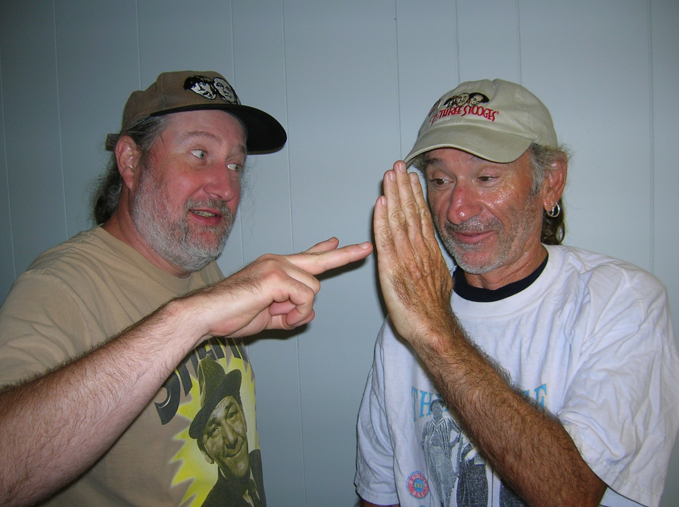
Any Questions?

Slide 53
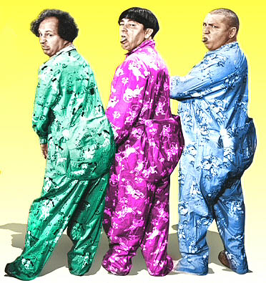
Thank You!
From: http://www.lunkhead.net/

